Slide 1
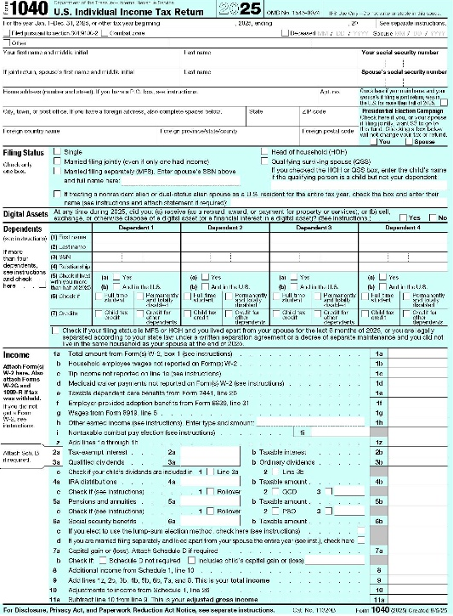
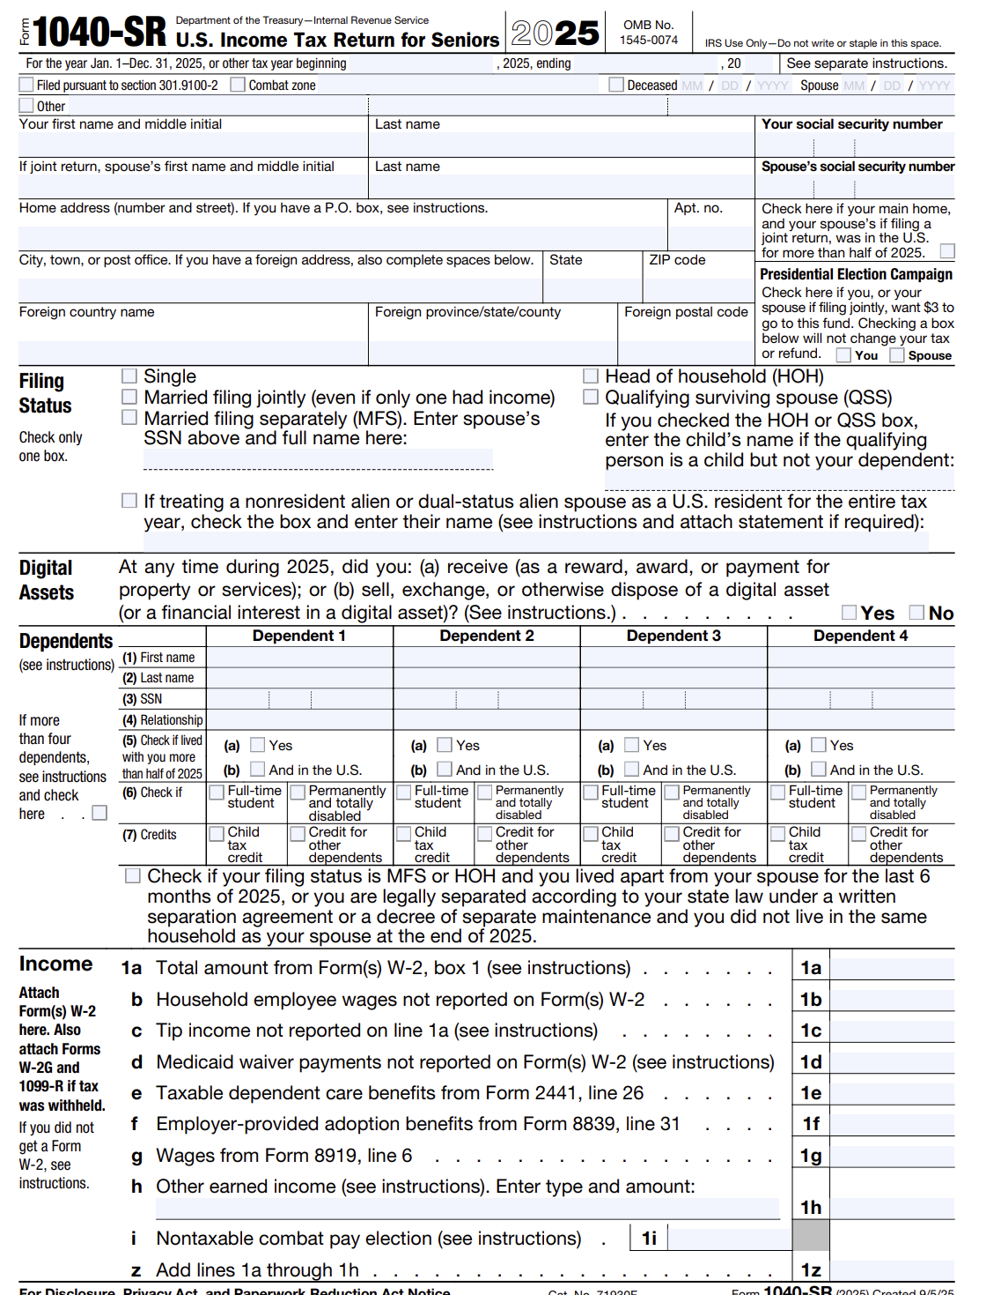
2025 INDIVIDUAL INCOME TAX WORKSHOP
John B. Goldhamer, is essentially a Retired Tax Lawyer and Authored Tax Law Expert, reviews the 2025 U.S. Individual Income Tax Forms published by the Internal Revenue Service (IRS) and makes suggestions.
He humorously says,
"I can Hammer out any Problem!"

Slide 2
2025 INDIVIDUAL INCOME TAX WORKSHOP
TABLE OF CONTENTS
Slide Topic Slide
Why Should You Listen To John B. Goldhamer? ……………………………………………..... 5
John B. Goldhamer’s Job Seeker Tips, Topics & Tools ………………………………………. 6
John B. Goldhamer’s Website: www.JohnGoldhamer.com ………………………………. 7
JohnGoldhamer.com: Individual Income Tax Workshops & Unemployment Benefits 8
Tax Envelope To Keep Tax Information ……………………………………………………………… 9
Tax Software ………………………………………………………………………………………………….. 10
Paycheck Stub Matched to W-2 …..…………………………………………………………………. 11
Two Types of Worker Income Statements ………………………………………………………. 12
There are 20 Different Types of IRS Form 1099 ………………………………………………. 13
2025 Form 1040 Is Two Pages ………………………………….…...…………..………………….. 14
2025 Form 1040 Page 2 …………………………………………………….…………………………… 15
2025 Form 1040-SR if born before January 2, 1961 …………………...…….……………. 16
Schedule B: Interest and Ordinary Dividends ………………………………………………….. 17

Slide 3
2025 INDIVIDUAL INCOME TAX WORKSHOP
TABLE OF CONTENTS
Slide Topic Slide
Schedule D: Capital Gains and Losses ………………………………………..………………….. 18
Schedule D: Capital Gains and Losses- Suggestions ………………………………………. 19
Schedule D: Selling Your Home at a Gain (Profit) …………..………………………………. 20
Standard Deduction Amounts- Most Taxpayers will not be Itemizing .............. 21
Personal Exemptions Suspended ……………………………………………………………..……. 22
2025 Three Schedules ......................................................................................... 23
Schedule 1: Additional Income and Adjustments to Income- Income ……..……… 24
Schedule 2: Additional Taxes ............................................................................... 25
Schedule 3: Additional Credits and Payments ..................................................... 26
Form 2441: Child And Dependent Care Expenses ..…………………………………………. 27
Schedule A: Itemized Deductions- Has 6 Sections .............................................. 28
Schedule A: Medical and Dental Expenses ……………………………………………………… 29
Schedule A: Taxes You Paid …………………………………………………………………………….. 30
Schedule A: Taxes You Paid – Suggestions …………………….………………………………… 31
Schedule A: Interest You Paid – Mortgage Interest Caped …..……………………..…… 32
Schedule A: Charitable Contributions ………………………..………………….…................ 33
Schedule A: And Form 4684: Casualty and Thefts ……….………………………………….. 34

Slide 4
2025 INDIVIDUAL INCOME TAX WORKSHOP
TABLE OF CONTENTS
Slide Topic Slide
Schedule A: Other Itemized Deductions ………..………………….……………………………. 35
Schedule A: Other Itemized Deductions ……………………………………………..………….. 36
Form 2106: Employee Business Expenses ........................................................... 37
Schedule A: Suggestions ………………………………….……………………………………………... 38
2025 Tax Brackets And Filing Status ..................................................................... 39
2025 Tax Brackets Percentages ............................................................................ 40
Alternative Minimum Tax (AMT) Form 6251 ....................................................... 41
Alternative Minimum Tax Income (AMTI) ............................................................ 42
Schedule C: Profit Or Loss From Business- Sole Proprietorship …….…………………. 43
Pass-through Entities Deduction ………………………………………………………………........ 44
Form W-4: Withholding Tax ……………………………………………………………………………. 45
Flexible Spending Account (FSA) …………………………………………………………………….. 46
Flexible Spending Account (FSA) - Qualified Medical Expenses ………………………. 47
Flexible Spending Account (FSA) Plans - Use It Or Lose It Policy ……………………… 48
Why Are Unemployment Benefit Payments Taxable? …………………………………….. 49
Unemployment Benefits For 501(C)(3) (Non-Profit) Employees ……………………... 50
401(k) Financial Questions ……………………………………………………………………………... 51
Conclusion ……………………………………………………………………………………………………... 52

Slide 5

2025 INDIVIDUAL INCOME TAX WORKSHOP
Why should you listen to John B. Goldhamer?
WHY SHOULD YOU LISTEN TO JOHN B. GOLDHAMER?
John B. Goldhamer is essentially a Retired Tax Lawyer and an Authored Tax Law Expert with Education and Experience in all Business Disciplines, including:
J.D. - Juris Doctorate Equivalent Legal Education, Finance, Marketing, MBA, Accounting, and Information Systems.
For years, he has helped many organizations for numerous years—researching, composing, and presenting—Impact Statements on new law, Position Papers on current law, and Tax Appeals to Administrators, Jurisdictions, and Management.
John compiled “Thirty Tax Tools” to assist with Business, Legal, and Tax Research, which are on his website.

Slide 6

2025 INDIVIDUAL INCOME TAX WORKSHOP
John B. Goldhamer
www.LinkedIn.com/in/JohnGoldhamer
www.JohnGoldhamer.com
JOB SEEKER TIPS, TOPICS & TOOLS
John B. Goldhamer is the author of Job Seeker Tips, Topics & Tools, which has Everything a Job Seeker Needs to Get a Job from Beginning to End!
It contains Comprehensive Documents that assist Job Seekers with Composing: Cover Letters, Resumes, Marketing Plans, Researching Companies and People, as well as Presenting an Image and More!
At one time, John taught classes on LinkedIn, Résumé Writing, and Researching the Internet at Employment Transition Centers and Network Groups. He is also on the speaker circuit to organizations and small groups.

Slide 7
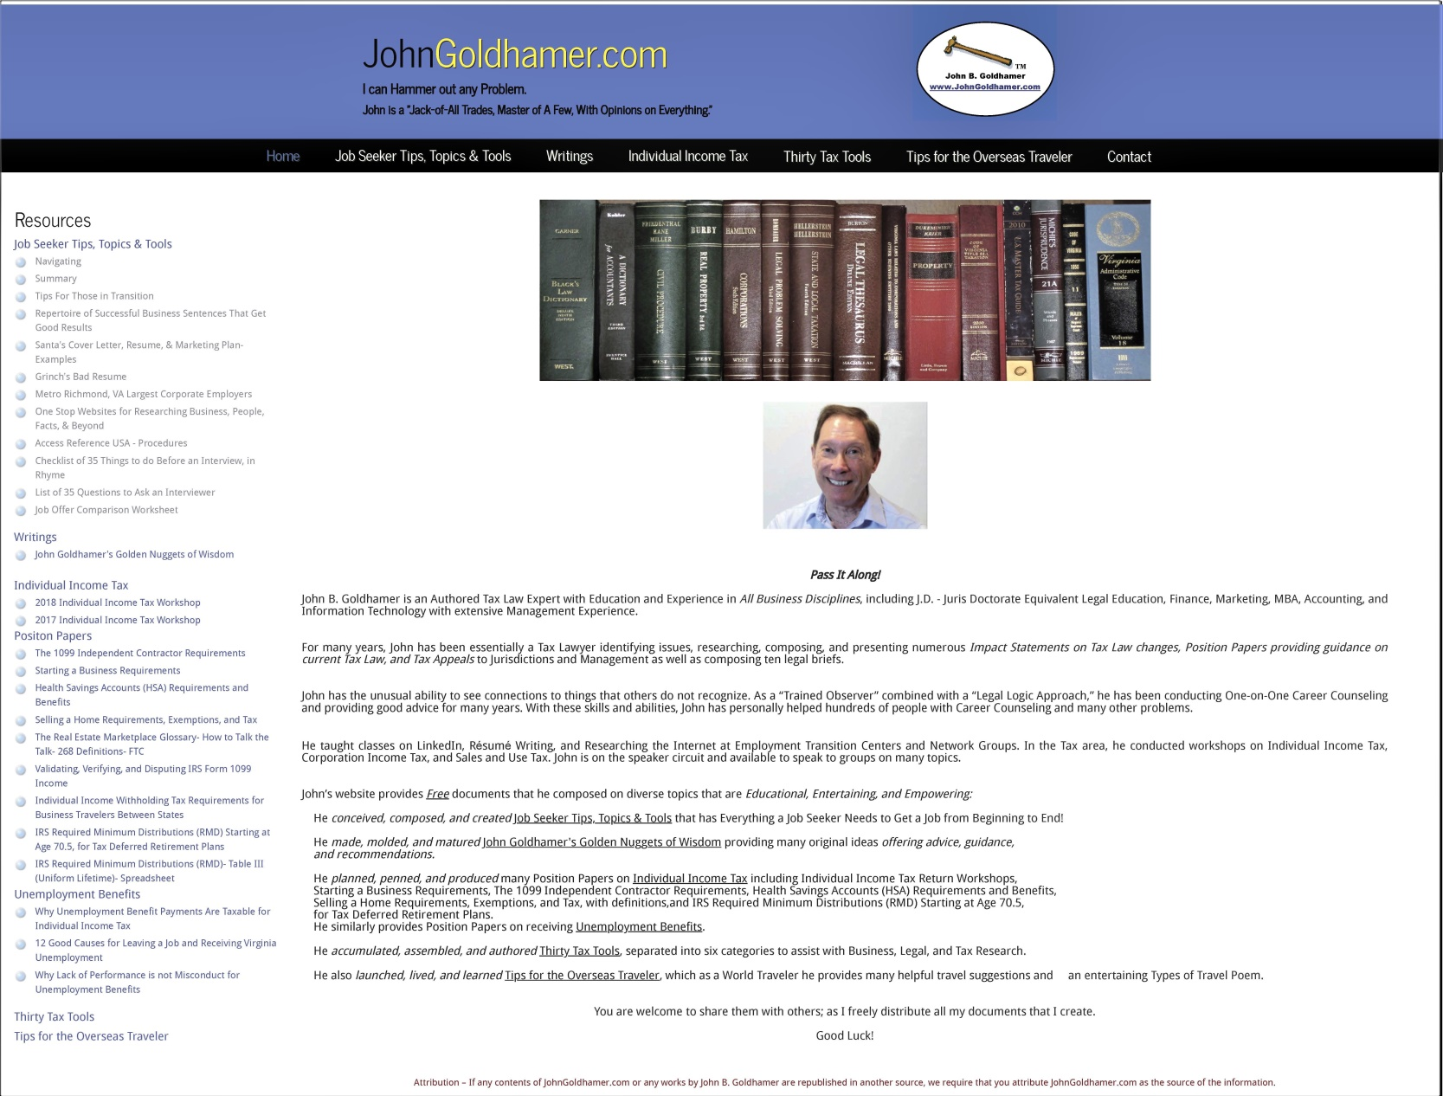
2025 INDIVIDUAL INCOME TAX WORKSHOP
JOHN B. GOLDHAMER’S WEBSITE: www.JohnGoldhamer.com

Slide 8
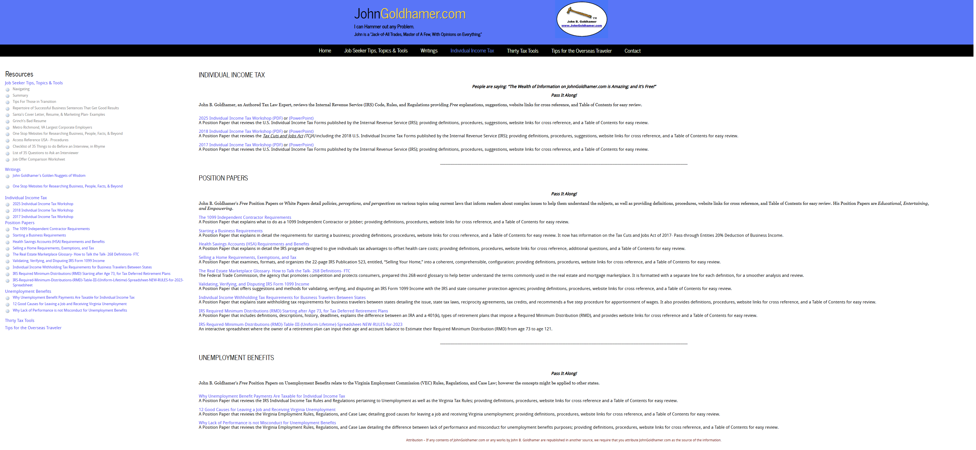
2025 INDIVIDUAL INCOME TAX WORKSHOP
JohnGoldhamer.com: INDIVIDUAL INCOME TAX WORKSHOPS & UNEMPLOYMENT BENEFITS

Slide 9
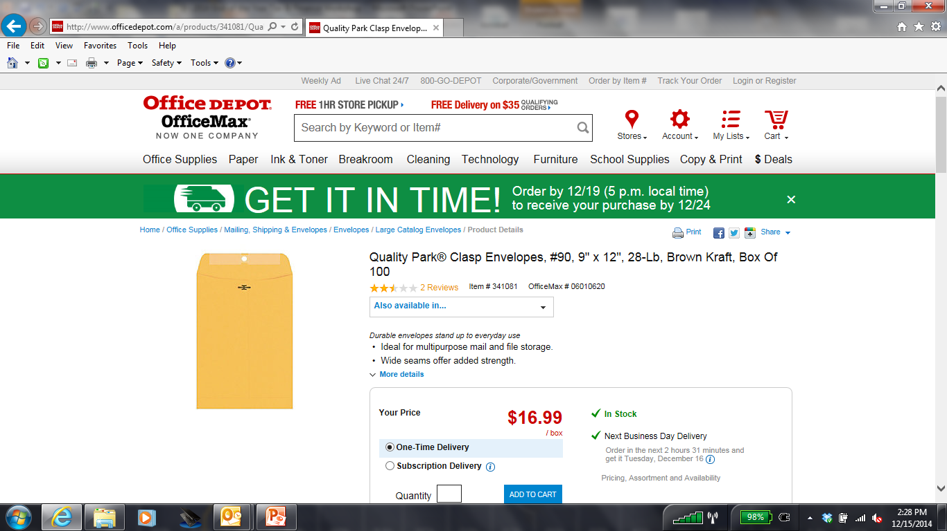
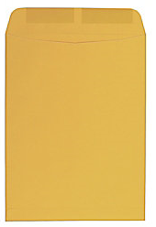
2025 INDIVIDUAL INCOME TAX WORKSHOP
TAX ENVELOPE TO KEEP TAX INFORMATION Large Open-End Kraft (Brown) 9" x 12“ Envelope
Suggestions:
In the beginning of each year get a Large Open-End Kraft (Brown) 9" x 12“ Envelope.
Mark it in large letters with the Tax Year, such as 2025.
During the year, as you receive Income Information such as W-2, 1099, Bank Statements, place these Important Tax information in the Envelope.
Keep the Envelope some place where you can always find it.
When W-2’s, 1099’s, and other important Tax Documents come in the mail around the end of January, put those items in the Envelope too.
Then everything is in one place ready for you to file your Tax Returns.
95% of U.S. Taxpayers file a Standard Deduction then there is no need to keep expense documents.

Slide 10
2025 INDIVIDUAL INCOME TAX WORKSHOP
TAX SOFTWARE
Personally, I always recommend using Turbo Tax or another Tax Software for complicated returns, which will stay up to date and know more specific rules than a Tax Attorney or CPA, who also use Tax Softwares to file their client’s returns.
Since 2017, with the Tax Cuts and Jobs Act which nearly doubled the standard deduction, Most Taxpayers File a Standard Deduction and Do Not Itemizing, so many Taxpayers might not need to purchase Tax Software or pay for a Tax Service.
For 2025, the Standard Deduction increased due to inflation.
The IRS has Free File Fillable Forms for filing 2025 Individual Income Tax Returns.
https://www.irs.gov/e-file-providers/free-file-fillable-forms
Some State Individual Income Tax Returns are also free to file when completed online using the state’s website.
Virginia has certain criteria: https://www.tax.virginia.gov/free-file

Slide 11
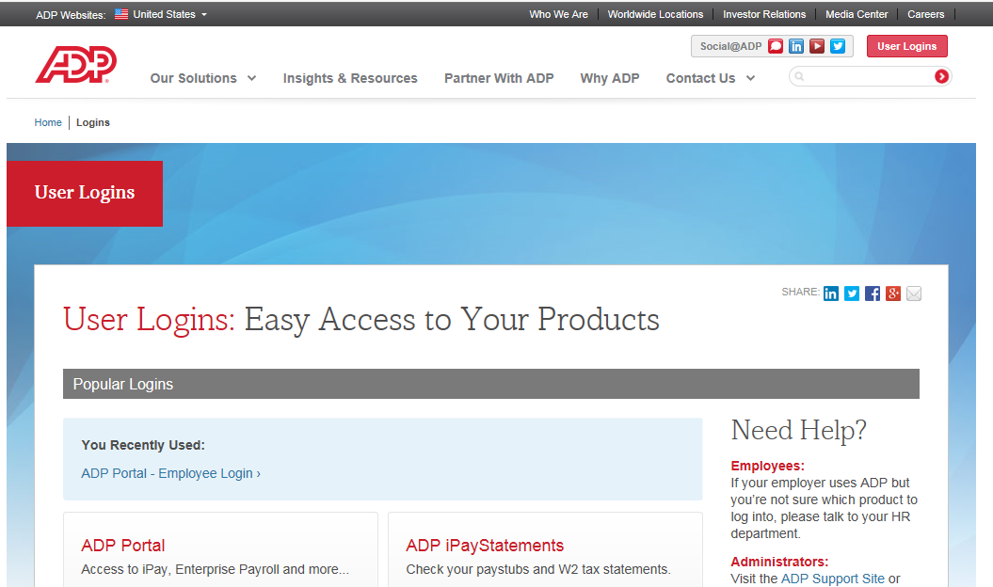
2025 INDIVIDUAL INCOME TAX WORKSHOP
PAYCHECK STUB MATCHED TO W-2
Suggestion:
At the end of the year, printout and save your last Paycheck Stub listing your entire year’s Income, Deductions and Taxes. When you receive your W-2 after the end of January, make sure the numbers match.

Slide 12
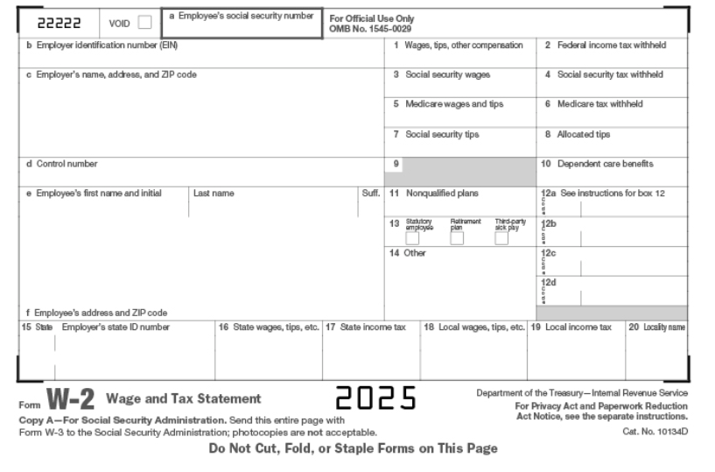
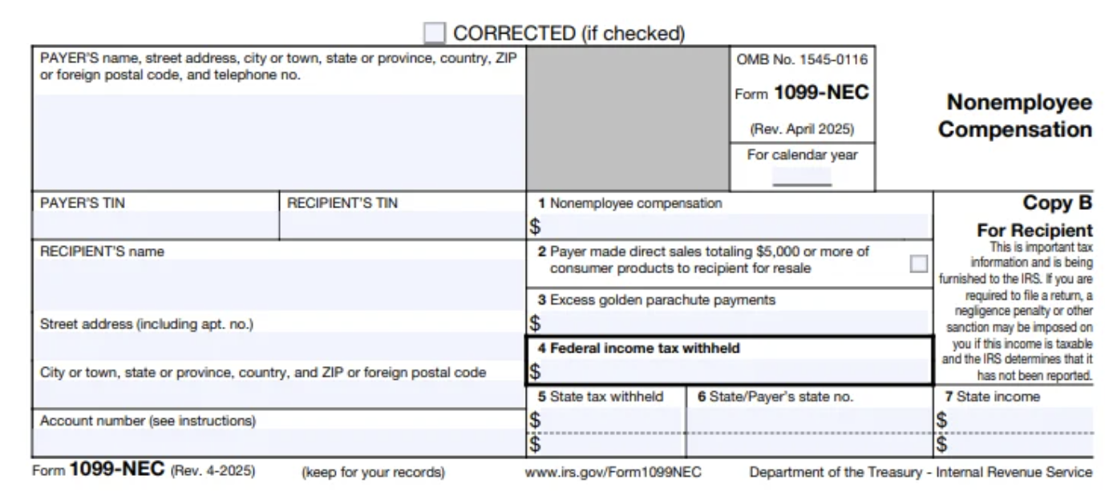
2025 INDIVIDUAL INCOME TAX WORKSHOP
TWO TYPES OF WORKER INCOME STATEMENTS
Employee (W-2) or Independent Contractor (1099-NEC)
JohnGoldhamer.com

Slide 13
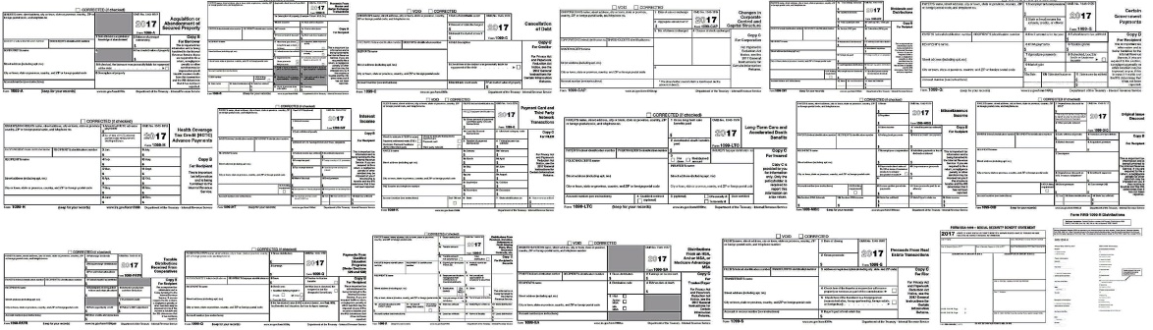
2025 INDIVIDUAL INCOME TAX WORKSHOP
THERE ARE 20 DIFFERENT TYPES OF IRS FORM 1099
Form 1099 is one of several IRS tax forms used in the U.S. to prepare and file an information return to report various types of income other than wages, salaries, and tips. The form is used to report to the IRS payments to independent contractors, rental property income, interest and dividend income, sales proceeds and miscellaneous income. Wikipedia
Form Description
1099-A Acquisition or Abandonment of Secured Property
1099-B Proceeds From Broker and Barter Exchange Transactions
1099-C Cancelation of Debt
1099-CAP Changes in Corporate Control and Capital Structure
1099-DIV Dividends and Distributions
1099-G Certain Government Payments
1099-H Health Coverage Tax Credit (HCTC) Advance Payments
1099-INT Interest Income
1099-K Payment Card & Third-Party Transactions ((PayPal) IRS threshold to issue- sales over $20,000/year
1099-LTC Long-Term Care and Accelerated Death Benefits
1099-MISC Miscellaneous Income
1099-NEC Nonemployee Compensation (for independent contractors)
1099-OID Original Issue Discount
1099-PATR Taxable Distributions Received From Cooperatives
1099-Q Payments From Qualified Education Programs (Under Sections 529 and 530)
1099-R Distributions From Pensions, Annuities, Retirement or Profit-Sharing Plans, IRAs, Insurance Contracts
1099-S Proceeds From Real Estate Transactions
1099-SA Distributions From an HSA, Archer MSA, or Medicare Advantage MSA
RRB-1099 Railroad Retirement Board Statement
SSA- 1099 Social Security Benefit Statement JohnGoldhamer.com

Slide 14
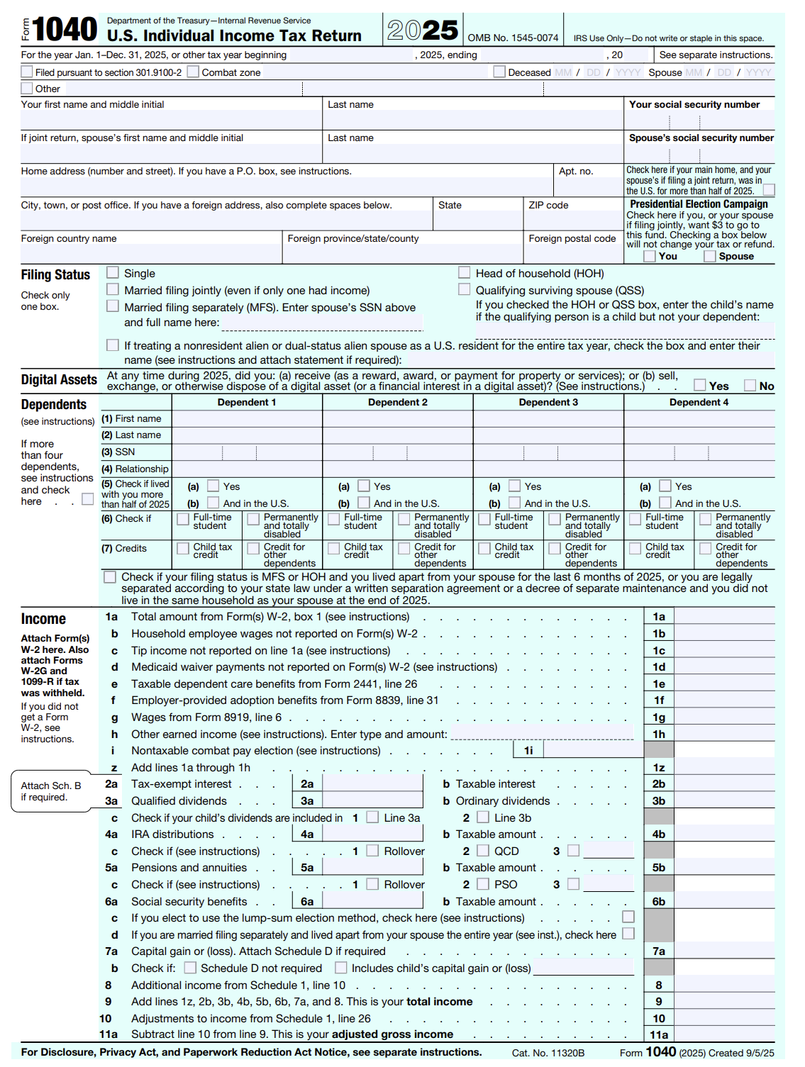
2025 INDIVIDUAL INCOME TAX WORKSHOP
2025 FORM 1040 IS TWO PAGES

Slide 15
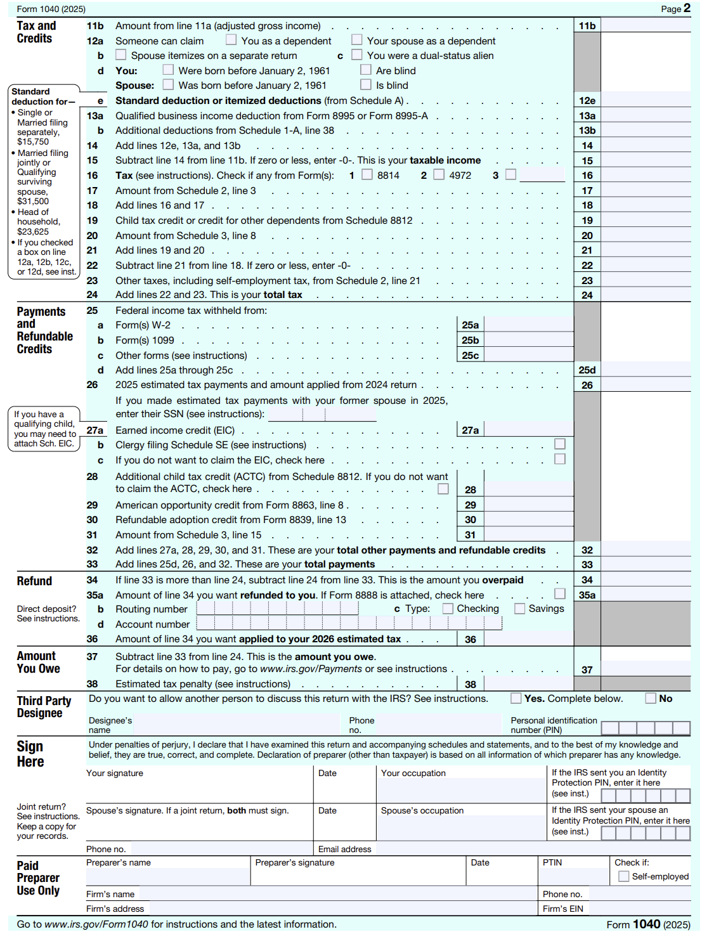
2025 INDIVIDUAL INCOME TAX WORKSHOP
2025 FORM 1040 PAGE 2

Slide 16
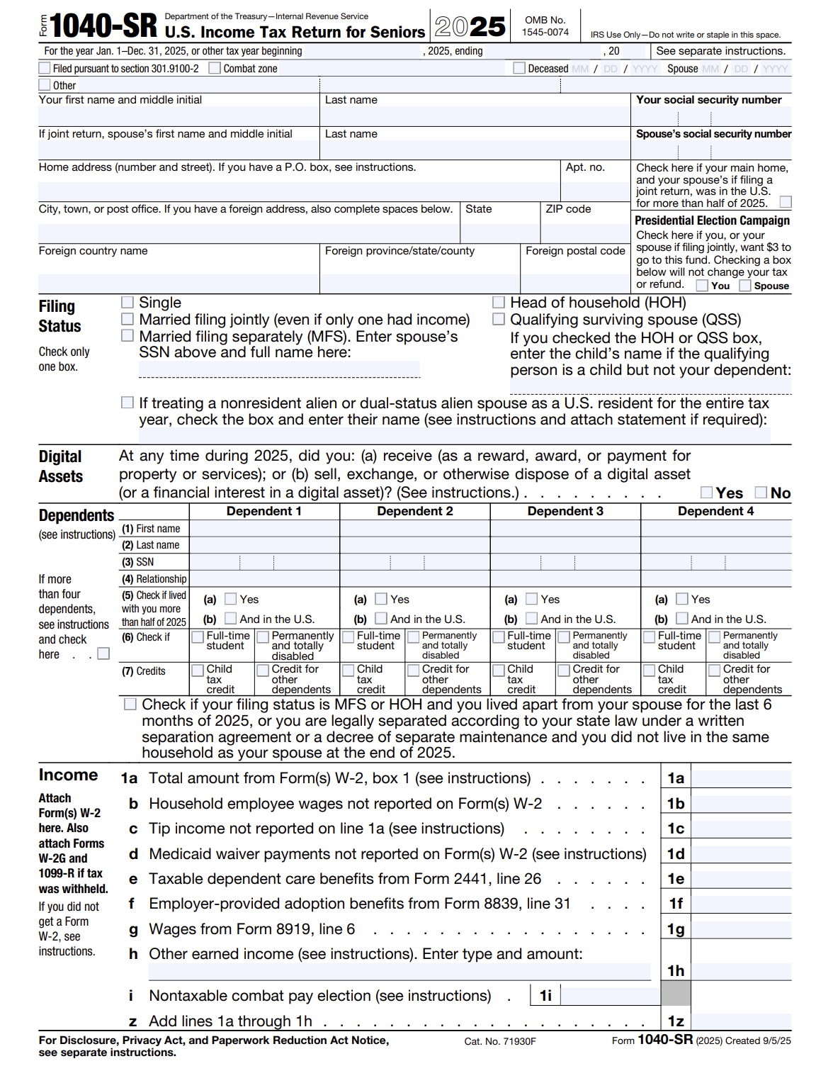
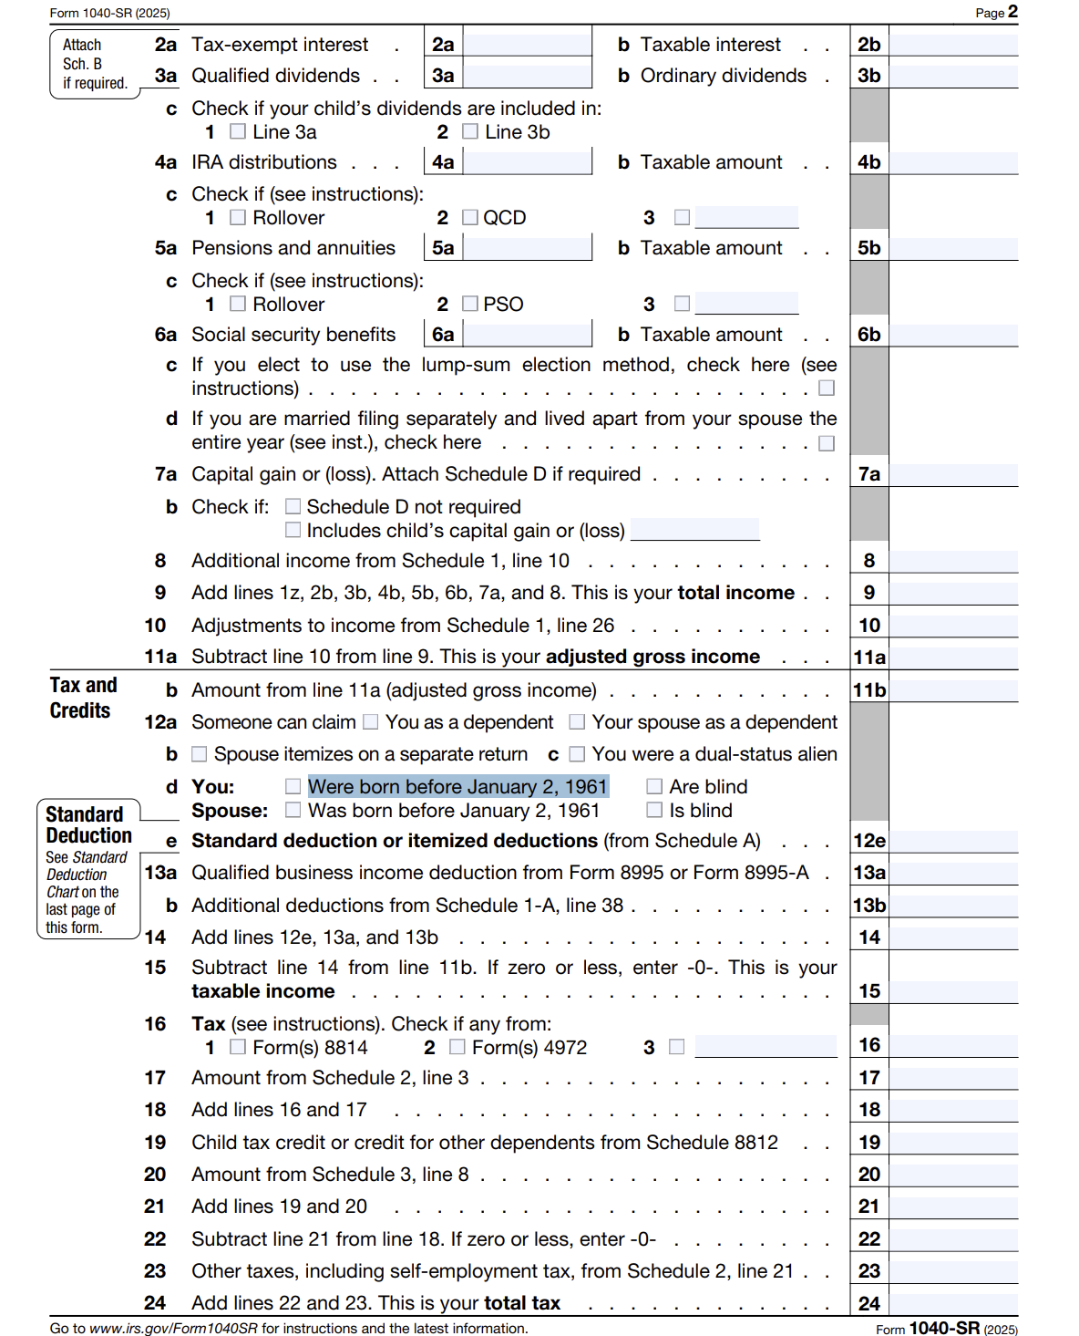
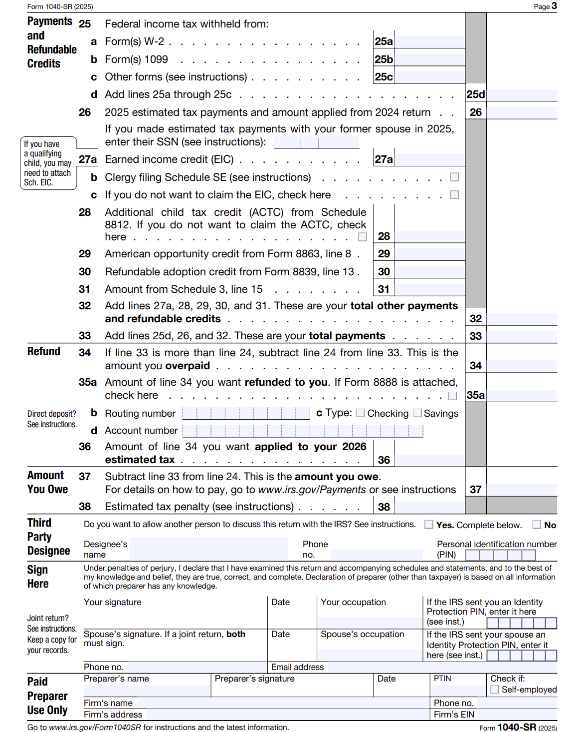
2025 INDIVIDUAL INCOME TAX WORKSHOP
For 2025, Form 1040-SR is available to you if you were born before January 2, 1961. It offers taxpayers aged 65 or older a simplified, easier-to-read, large-print format designed to help identify senior-specific tax benefits, such as higher standard deductions.

Slide 17
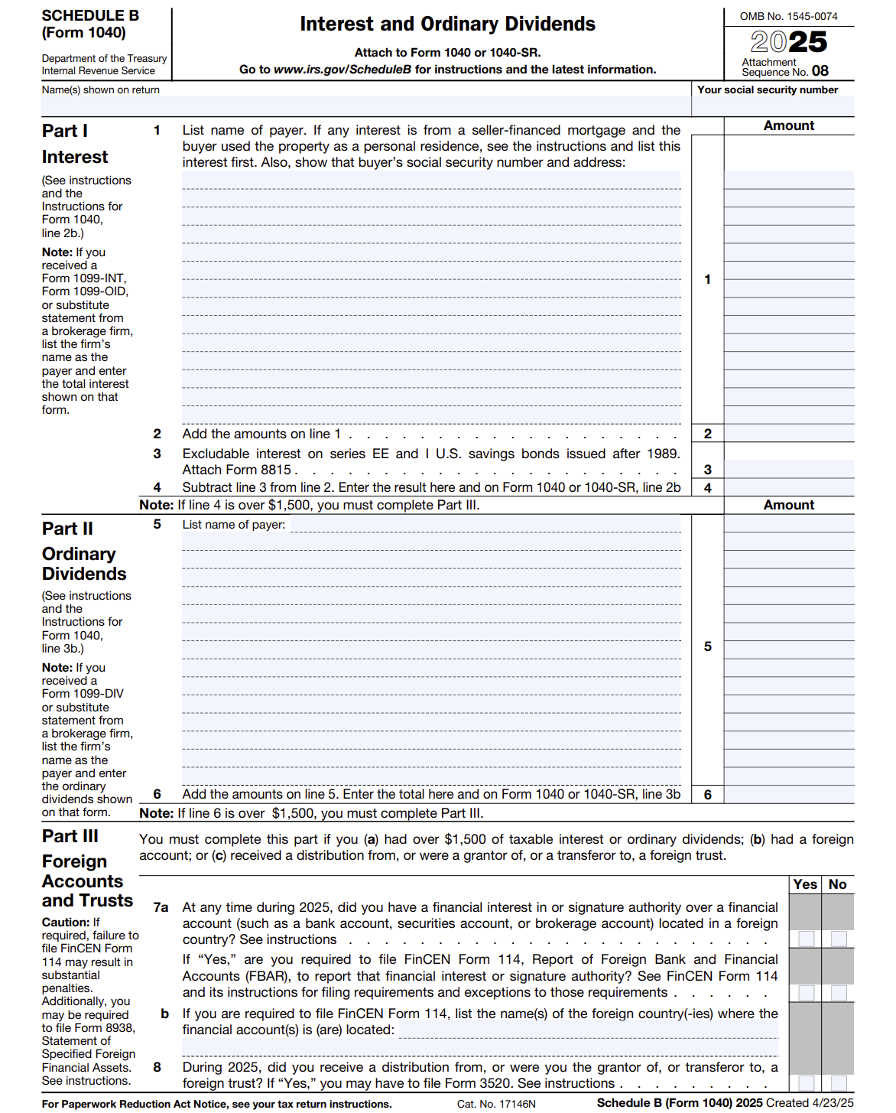
2025 INDIVIDUAL INCOME TAX WORKSHOP
SCHEDULE B: INTEREST AND ORDINARY DIVIDENDS

Slide 18
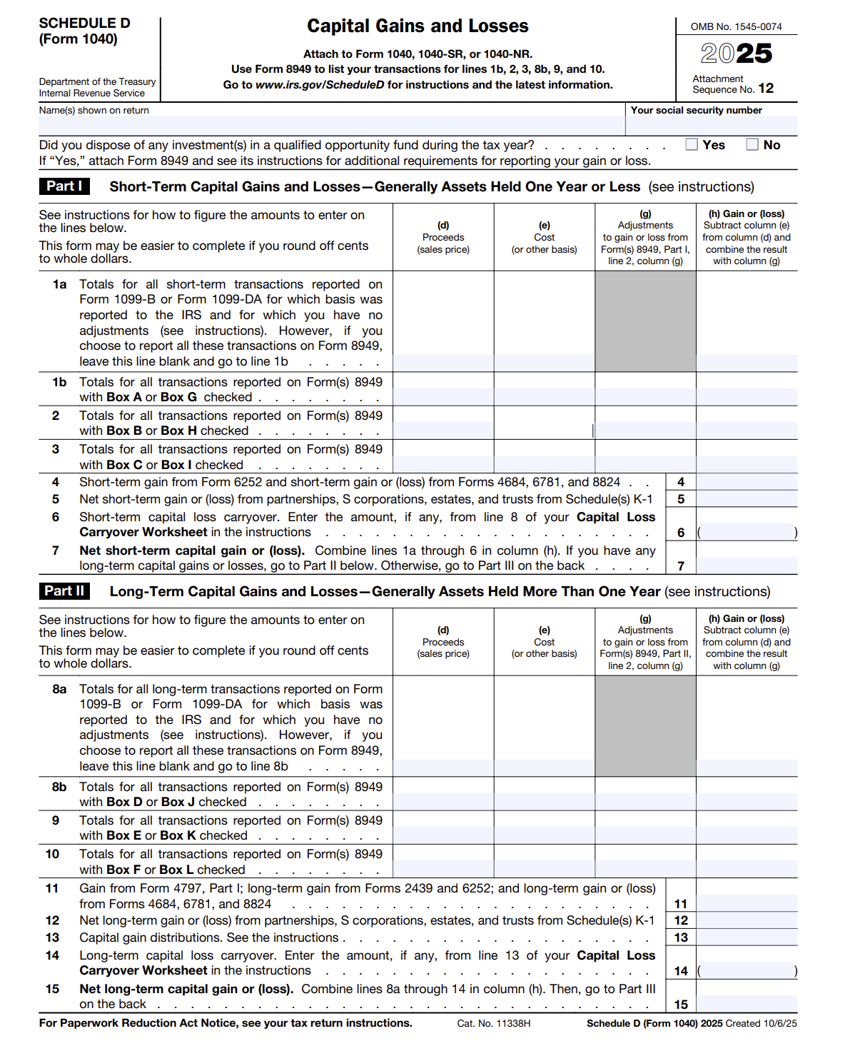
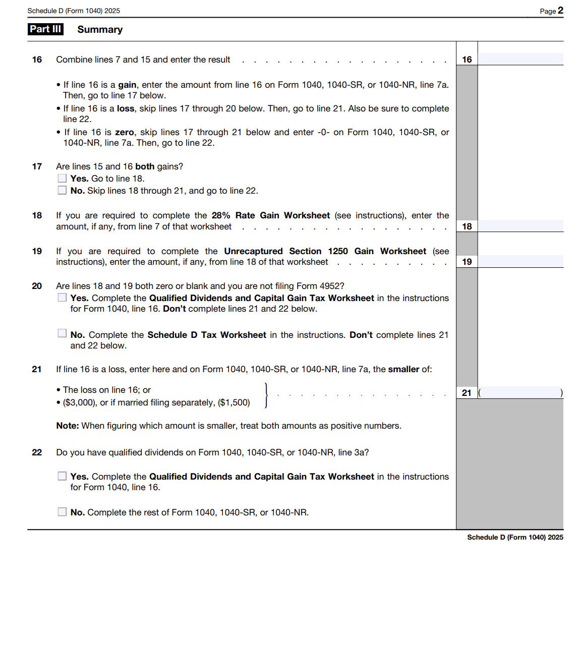
2025 INDIVIDUAL INCOME TAX WORKSHOP
SCHEDULE D: CAPITAL GAINS AND LOSSES

Slide 19
2025 INDIVIDUAL INCOME TAX WORKSHOP
SCHEDULE D: CAPITAL GAINS AND LOSSES
For 2025, you can deduct capital losses up to the amount of your capital gains plus $3,000 ($1,500 if married filing separately). You may be able to use capital losses that exceed this limit in future years.
Suggestions:
If you already have “Taxable Capital Gains” from selling stock or investment real estate, see if you have some unrealized “Capital losses” in other assets that you can sell before year-end to offset those gains and reduce your tax liability.
If you’re thinking of selling stock, consider postponing the gain until after January to avoid the tax in the current year.

Slide 20
2025 INDIVIDUAL INCOME TAX WORKSHOP
SCHEDULE D, CAPITAL GAINS AND LOSSES
SELLING YOUR HOME AT A GAIN (PROFIT)
Proceeds (Sale) less Basis (Costs) = Gain (Profit)
For 2025, and few previous years, generally, if you sell your home at a gain (profit), some of the gain could be taxable, but in most cases, if the home you sold counts as your main home, there are exemptions:
Exemptions
Single – The first $250,000 of Gain is Exempt
Married and Filing Jointly – The first $500,000 of Gain is Exempt
Since 1997 the former rule to “Roll Over" home profits by reinvesting in a new home was removed.
You should receive Federal Form 1099-S, titled, Proceeds From Real Estate Transactions, which is issued by the person responsible for closing the real estate transaction.
Basis Adjustments - Details and Exceptions
Basis are the costs associated with Purchasing and making Improvements to the property. Costs for repairs or maintenance that are necessary to keeping the home in good condition, but do not add to its value or prolong its life are not included. For more information on basis, see Pub. 551, Basis of Assets.
2024 IRS Publication 523, “Selling Your Home”
https://www.irs.gov/pub/irs-pdf/p523.pdf
IRS Publication 523, titled “Selling Your Home” is a 27-page document filled with answers that explains the tax rules that apply when you sell (or otherwise give up ownership of) a home. It also shows you how to do the calculations you'll need to do.
JohnGoldhamer.com, Individual Income Tax page has a positon paper,:
Selling a Home Requirements, Exemptions, and Tax

Slide 21
2025 INDIVIDUAL INCOME TAX WORKSHOP
2025 STANDARD DEDUCTION AMOUNTS
For 2025, the Standard Deduction for one dependent is as follows:
Filing Status Standard Over 65 / Blind
Single $15,750 $17,750
Married Filing Separately $15,750 $17,350
Head of Household $23,625 $25,625
Married Filing Jointly or Surviving Spouse $31,500 $33,100
For 2025, Most Taxpayers will File a Standard Deduction and Not Itemize
When the Standard Deduction is used,
there are not any additional Deductions such as Charities.
From 1982 to 1986 and again in 2020, Form 1040 provided a
Form 1040 Line-Item Charitable Contribution Deduction.
2026 has a 1040 $1,000 deduction ($2,000 for joint filers) for Charitable cash gifts
Many Taxpayers May Owe More State Tax Than Previous Years
Most states are Conformity States, which means they follow the IRS return as their starting point for their tax returns. When a Standard Deduction is filed with the IRS the State Individual Income Tax Return must conform with the IRS and only the Standard Deduction is allowed on the State Tax Return.

Slide 22
2025 INDIVIDUAL INCOME TAX WORKSHOP
PERSONAL EXEMPTIONS SUSPENDED
For the 2025 tax year there is No Personal Exemption, but the standard deduction is increased.
The 2018 Tax Cuts and Jobs Act (TCJA) suspended the Personal Exemption for yourself, your spouse, and all your dependents.

Slide 23
2025 INDIVIDUAL INCOME TAX WORKSHOP
2025 THREE SCHEDULES
For 2025 Form 1040 is Two Pages.
There are now Three Schedules that might be attached to the 2025 Federal Form 1040 as follows:
Schedule 1 – Additional Income and Adjustments to Income
Schedule 2 – Additional Taxes
Schedule 3 – Additional Credits and Payments
Former Schedules 4, 5, and 6 have been consolidated into other forms to simplify the filing process.

Slide 24
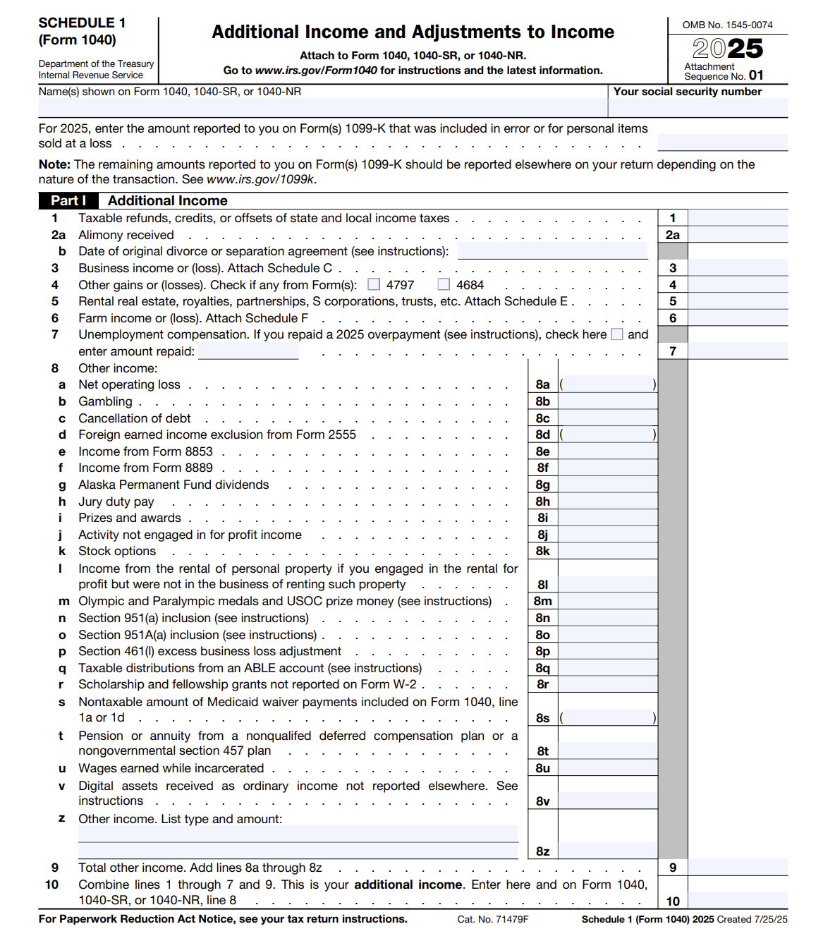
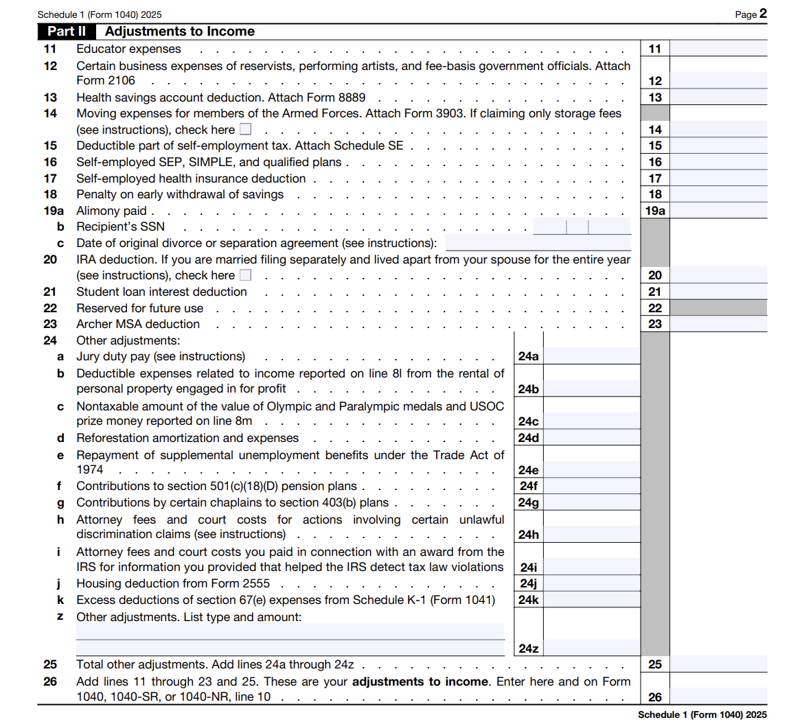
2025 INDIVIDUAL INCOME TAX WORKSHOP
2025 THREE SCHEDULES
Schedule 1: Additional Income and Adjustments to Income
Examples of Adjustments to Income: Educator Expenses, Certain Business Expenses, Health Savings Account Deduction, Moving Expenses (Only Armed Forces Members), Deductible Part of Self-Employment Tax, Self-Employed SEP, SIMPLE, and Qualified Plans, Self-Employed Health Insurance Deduction, Penalty on Early Withdrawal of Savings, Alimony Paid, IRA Deduction, Student Loan Interest Deduction.

Slide 25
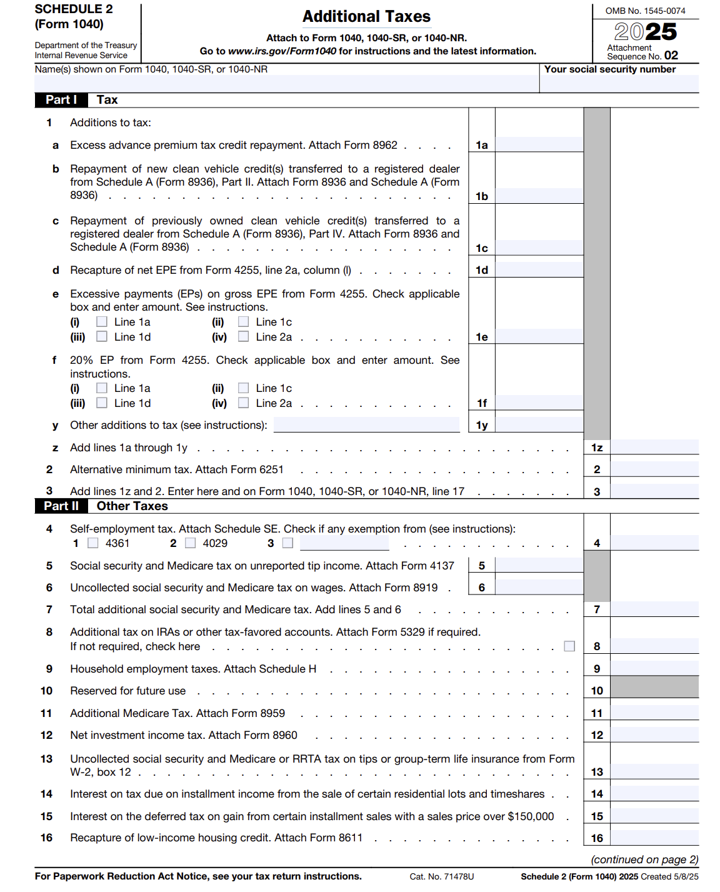
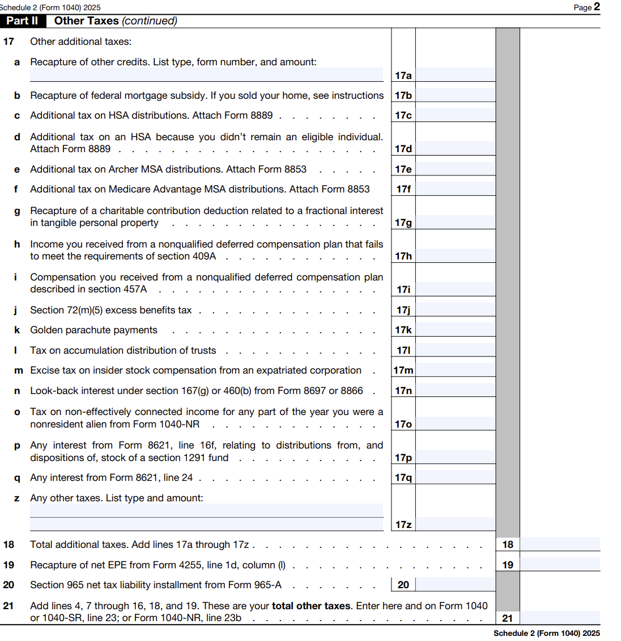
2025 INDIVIDUAL INCOME TAX WORKSHOP
THE THREE SCHEDULES
Schedule 2: Additional Taxes

Slide 26
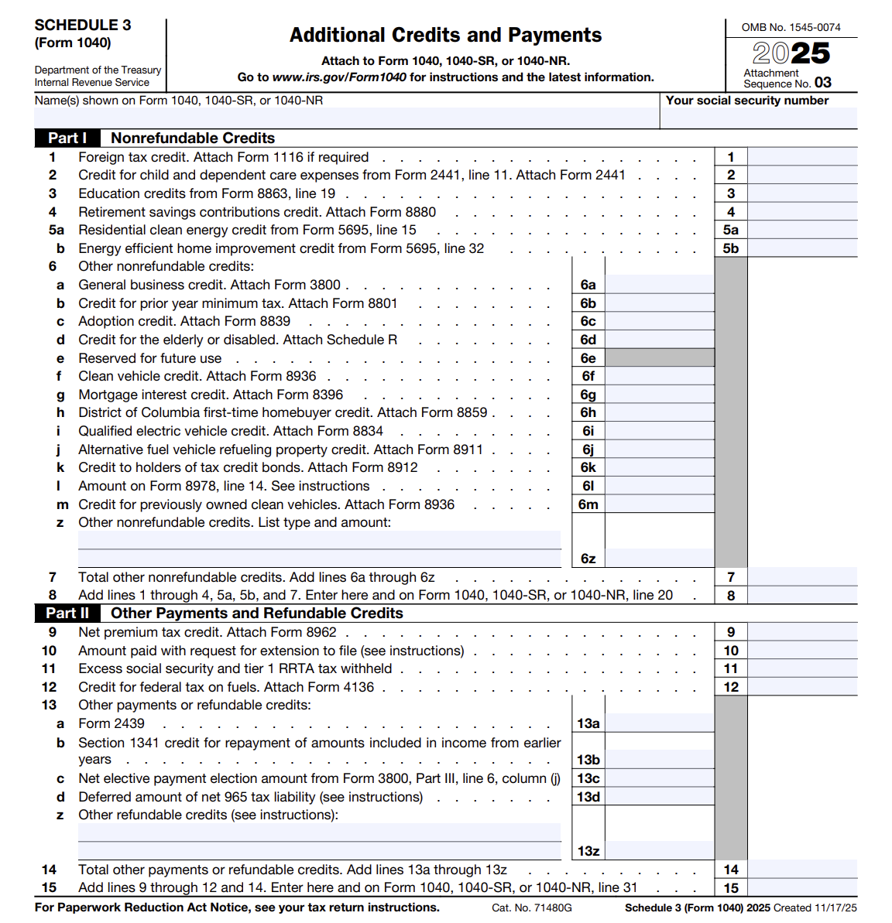
2025 INDIVIDUAL INCOME TAX WORKSHOP
THE THREE SCHEDULES
Schedule 3: Additional Credits and Payments
Examples of Additional Credits and Payments:
Foreign Tax Credit
Credit For Child and Dependent Care Expenses, attach Form 2441
Retirement savings contributions credit. Attach Form 8880
Education Credits

Slide 27
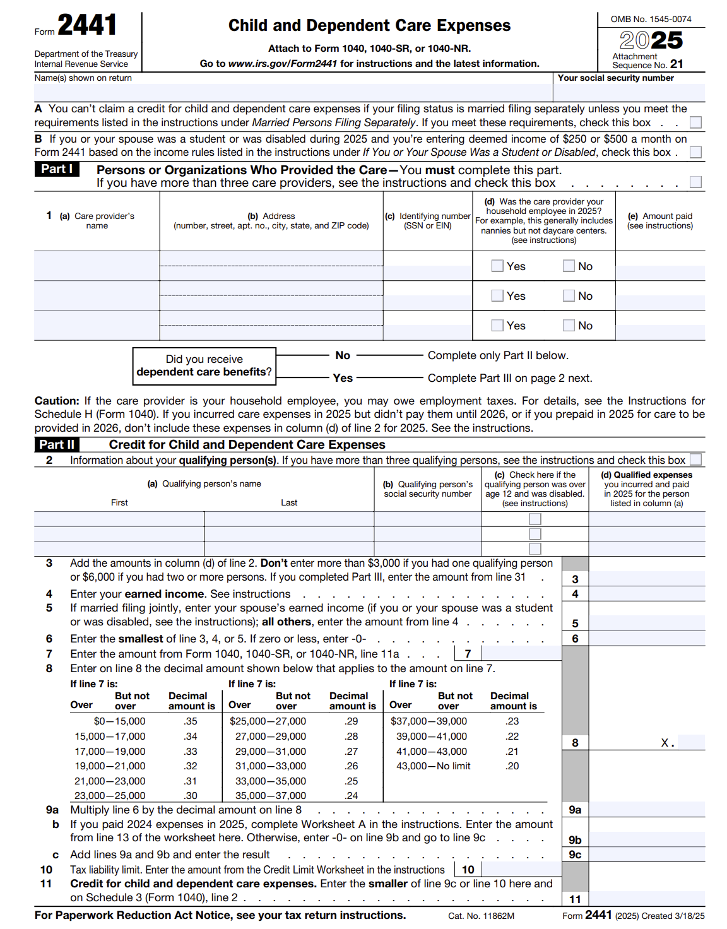
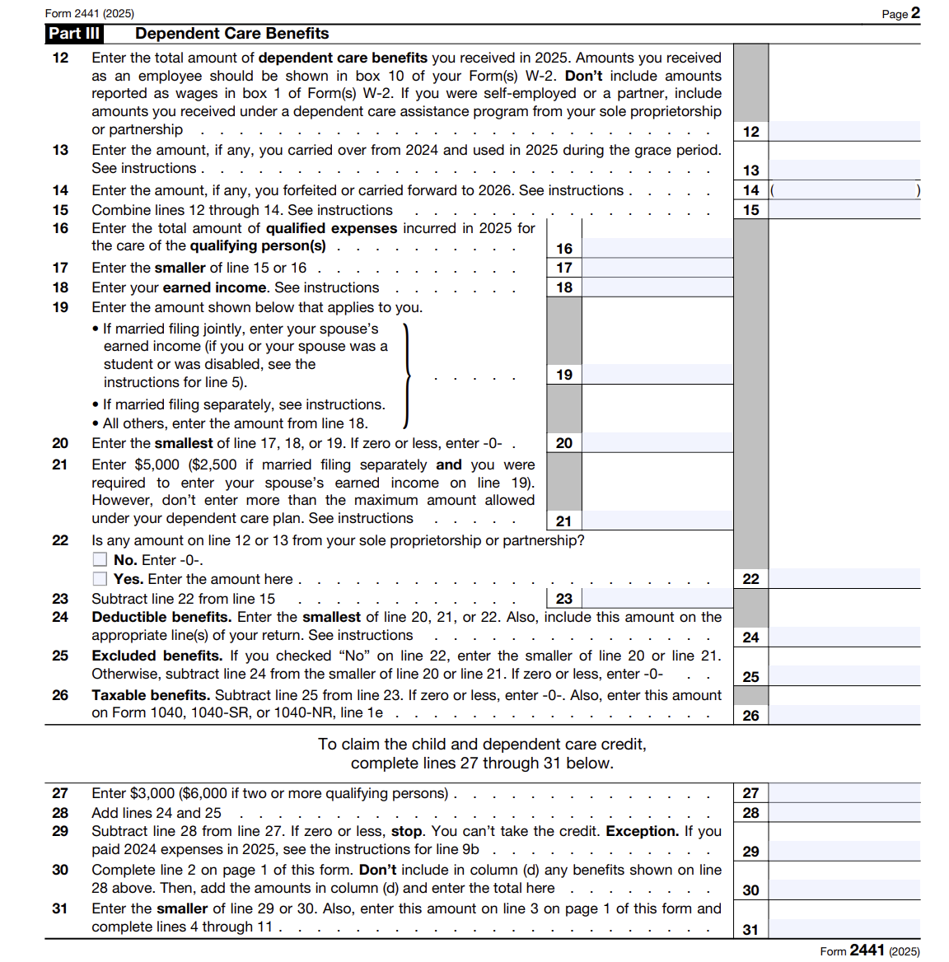
2025 INDIVIDUAL INCOME TAX WORKSHOP
FORM 2441: CHILD AND DEPENDENT CARE EXPENSES
For the 2025, the Child Tax Credit (CTC) is up to $2,200 per qualifying child under age 17, with a maximum refundable portion of $1,700.

Slide 28
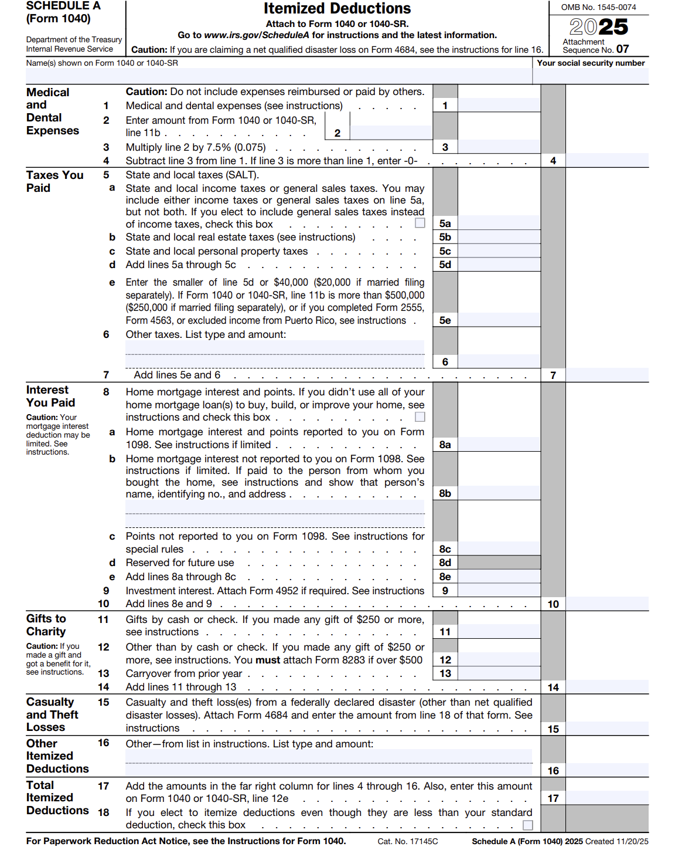
2025 INDIVIDUAL INCOME TAX WORKSHOP
SCHEDULE A: ITEMIZED DEDUCTIONS HAS 6 SECTIONS Since 95% Taxpayers will file the Standard Deduction, only 5% will file Schedule A: Itemized Deductions

Slide 29
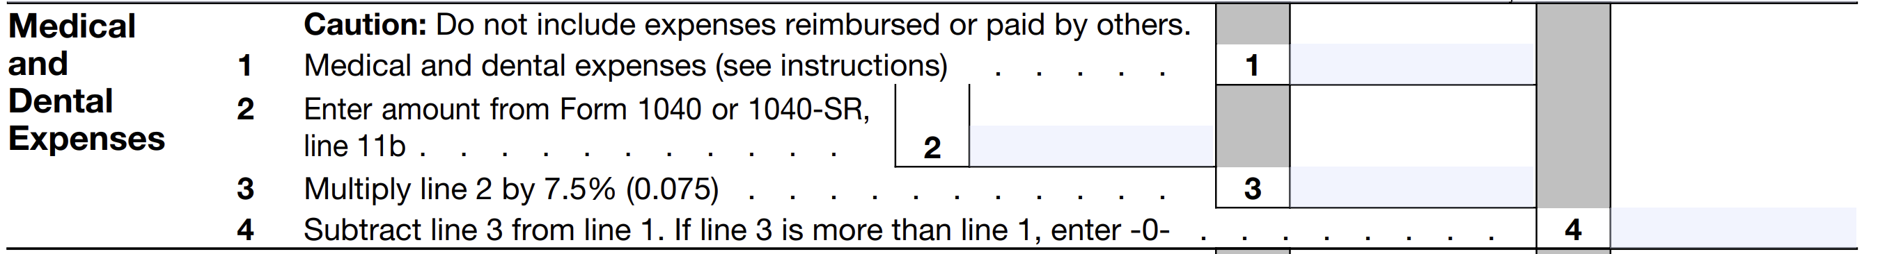
2025 INDIVIDUAL INCOME TAX WORKSHOP
SCHEDULE A: MEDICAL AND DENTAL EXPENSES
Since 95% Taxpayers will file the Standard Deduction, only 5% will file Schedule A: Itemized Deductions
Medical and Dental Deductions are Out of Pocket expenses ‘That you paid’ for medical insurance, products, and services such as; COBRA, Medical, Dental, and Vision Insurance Premiums, Prescriptions and Co-payments, Deductibles, Contacts Lens, Glasses, Approved Medical Devices, etc. are deductible.
Generally, medical expenses for cosmetic surgery; specific procedures with the intention to enhance your appearance are not deductible.
For 2025, for Scheule A Itemized Deductions Taxpayers are limited to amounts above 7.5% of your “Adjusted Gross Income.”
Medical Transportation Costs are also deductible provided they are primarily for and essential to medical care. Deductible Transportations are bus, train, taxi, plane fares or ambulance services as well as Medical Mileage, for driving to and from medical appointments. For 2025, Vehicle Medical Mileage is deducted at 21 cents per mile.
Suggestions:
Before the end of the year, ask your Insurer and Pharmacist to print all Medical visits and Prescriptions to determine if you are above 7.5% of your “Adjusted Gross Income.”
If you are close to or over, consider seeing your Doctor, Dentist, or fill prescriptions before the end of the year so that you can deduct the expense.

Slide 30
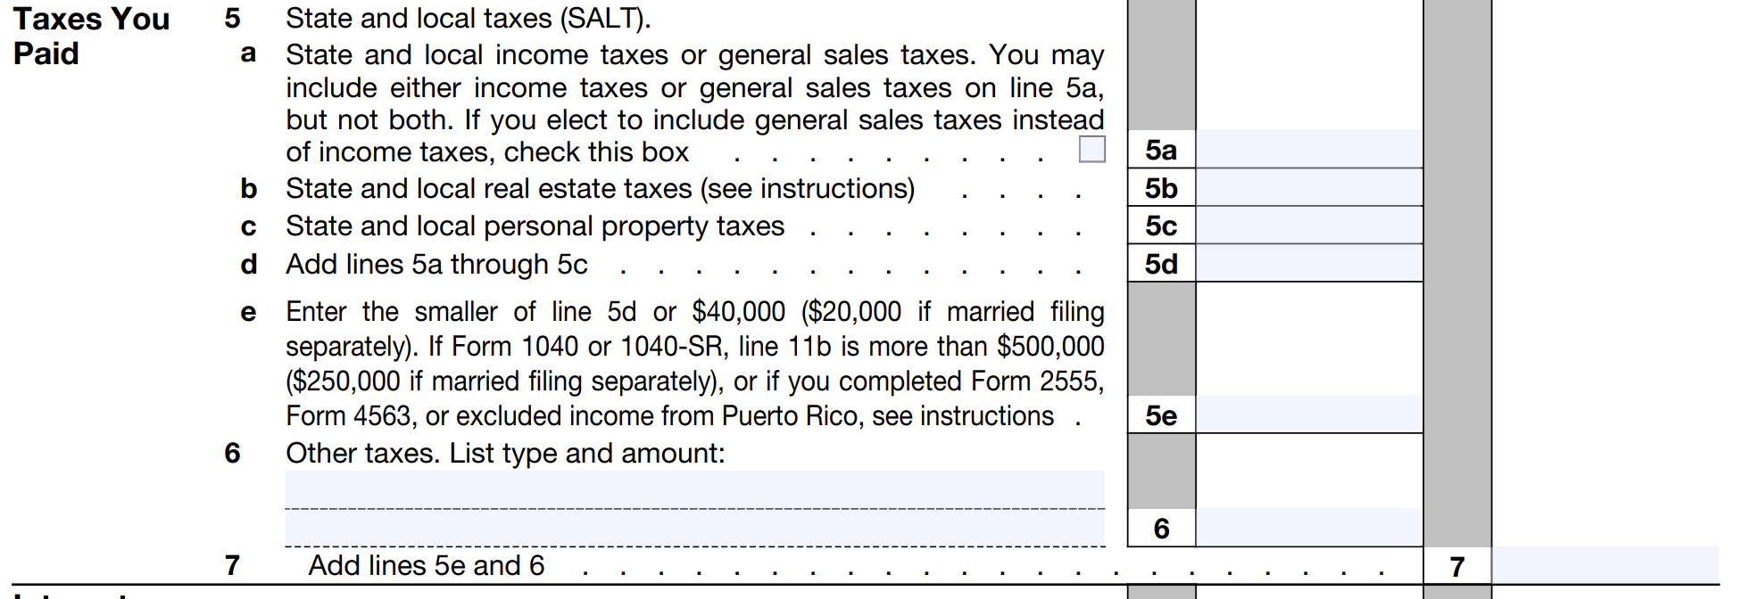
2025 INDIVIDUAL INCOME TAX WORKSHOP
SCHEDULE A: TAXES YOU PAID
Since 95% Taxpayers will file the Standard Deduction, only 5% will file
Schedule A: Itemized Deductions
For 2025, Itemized Deductions for Taxes Paid for State and Local Taxes(SALT) or general sales taxes, limits the deduction to $40,000, which includes all State and Local and Foreign Taxes:
Income Tax
Real Estate Tax
Personal Property Tax
Sales and Use Taxes
Income Tax paid to Foreign Jurisdictions *
*(Taking a Foreign Tax Credit may be more beneficial)

Slide 31
2025 INDIVIDUAL INCOME TAX WORKSHOP
SCHEDULE A: TAXES YOU PAID
Since 95% Taxpayers will file the Standard Deduction, only 5% will file
Schedule A: Itemized Deductions
Suggestions:
Generally, your State Income Taxes will be listed on your W-2, or 1099 but do not forget to include any voluntary Quarterly State Tax Payments.
You may deduct either state income taxes or general sales taxes, but not both.
If you filed your State Income Taxes and you paid additional taxes in the current year, your Total State Income Taxes paid is that additional State Taxes you paid when you filed your State Tax return, plus State Income Taxes listed on your W-2, which may be deducted on your Federal 1040, Schedule A, Itemized Deductions. For example, if you filed your 2024 Virginia Income Tax Return in 2025, paying an additional $200 Income Tax, then your total State Income Taxes paid would be the additional $200 State Income Tax paid, plus $10,000 State Income Taxes listed on your W-2 for a total of $10,200. Interest and penalty are not included.
If you itemized your deductions the previous year, which included a deduction for State Income Taxes and received a State Refund, do not forget to add the refund amount from the State Dept. of Revenue or Tax, Form 1099-G, on Schedule 1, Line 10. If in 2024, you did not receive a State Refund, did not Itemize, and did not receive Form 1099-G; there is nothing to list.
For Virginia and some other states, Vehicle Personal Property Tax Paid, are deductible.

Slide 32
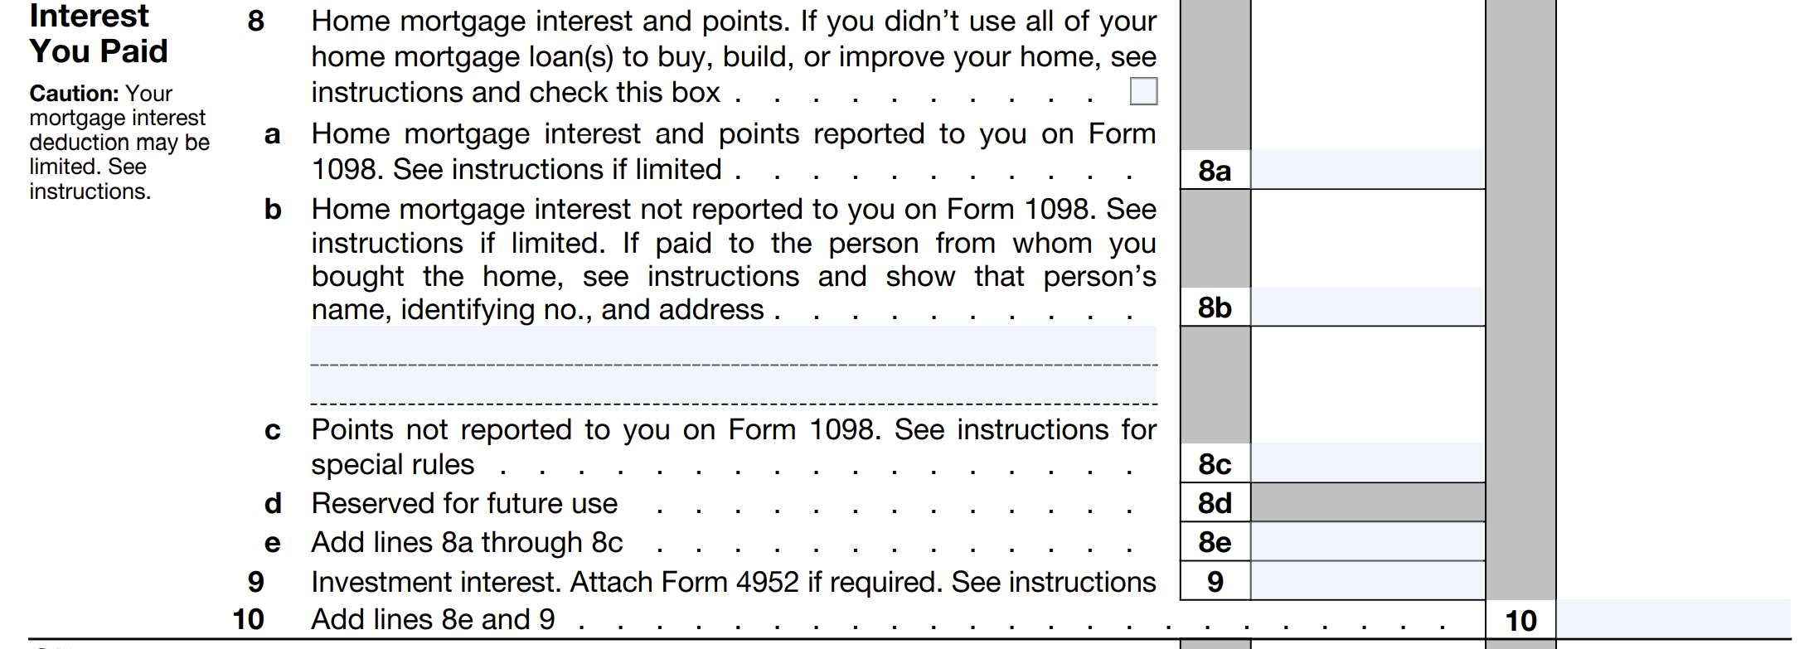
2025 INDIVIDUAL INCOME TAX WORKSHOP
SCHEDULE A: INTEREST YOU PAID
Since 95% Taxpayers will file the Standard Deduction, only 5% will file
Schedule A: Itemized Deductions
Only Home Mortgage and Home Equity Line Interest and Points are Deductible.
Personal Interest paid to Credit Cards are not Deductible.
Home Mortgages- For 2025, the home mortgage interest deduction is capped. For mortgages taken out after December 15, 2017, you can only deduct interest on the first $750,000 of debt ($375,000 for married filing separately). This $750,000 limit applies to the combined total of your primary and secondary residence.
Home Equity Lines– For 2025, interest on Home Equity Lines of Credit (HELOCs) and home equity loans is deductible only if the funds are used to buy, build, or substantially improve the home that secures the loan. Interest on funds used for personal expenses (debt consolidation, cars) is not deductible.

Slide 33
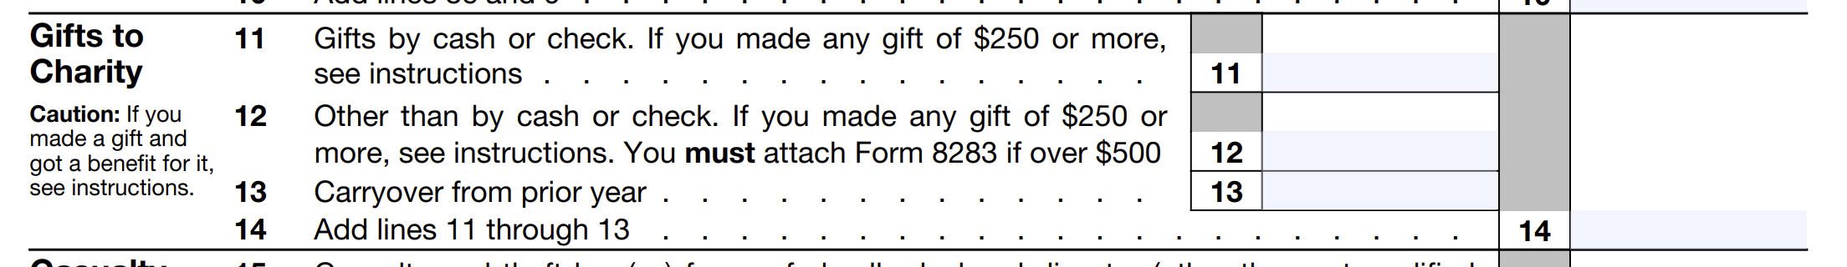
2025 INDIVIDUAL INCOME TAX WORKSHOP
SCHEDULE A: CHARITABLE CONTRIBUTIONS
Since 95% Taxpayers will file the Standard Deduction, only 5% will file
Schedule A: Itemized Deductions
Generally, a deduction is valid only if given to a Charitable Organization that is Tax-exempt by 26 U.S.C. § 501(c) of the Internal Revenue Code (IRC), whereby it is exempt from federal income tax if its activities have the basic purpose for the Betterment of Humans: charitable, religious, educational, scientific, literary, public safety, testing, fostering amateur sports etc.
Verify 501(c) Tax Exempt Organization Search: https://apps.irs.gov/app/eos/
Suggestions:
If you have a “Some Extra Funds,” consider making an extra payment to your Church, Synagogue, Mosque or other charity before the end of the year to increase your Deduction. For 2025, using your Vehicle for a Charity is deductible at 14 cents per mile.
Donations to Charities other than cash, such as Computers, Clothing, Housewares, TV’s, etc. are also deductible.
The question is their value. The Salvation Army provides a great “Donation Value Guide” https://satruck.org/Home/DonationValueGuide that provides 4 pages of items with high and low values.
For an Automobile or Truck, the deduction is restricted to the lower of the Fair Market Value or the amount the charity sold the vehicle. If the Automobile or Truck Value is $1,000, but if only sold for $500, then only $500 is deductible.

Slide 34
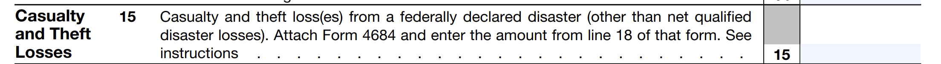
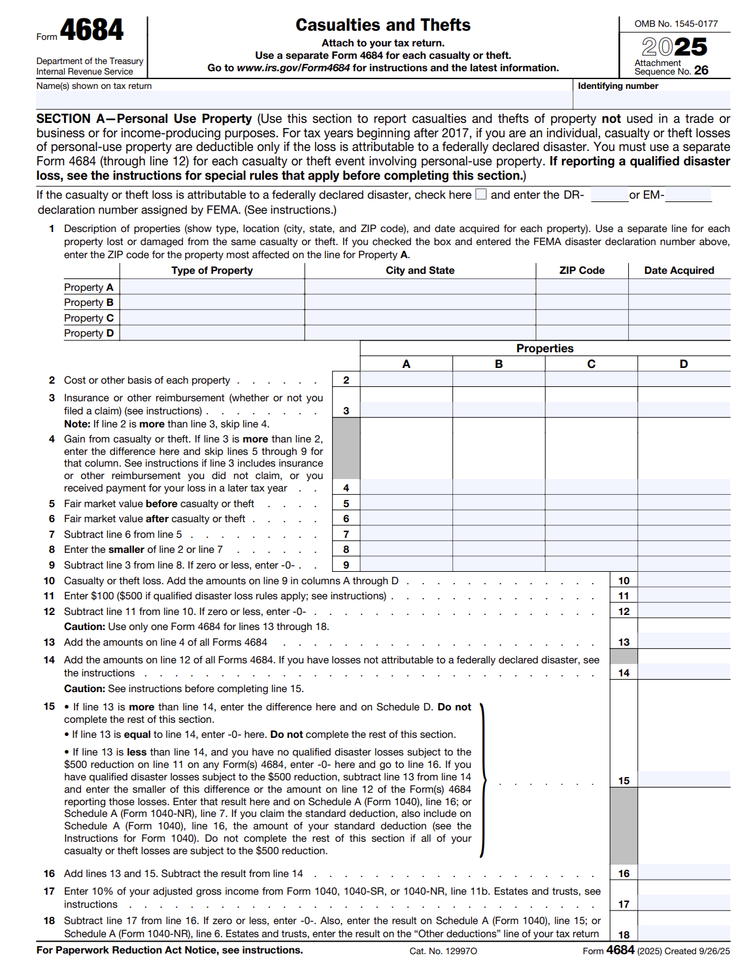
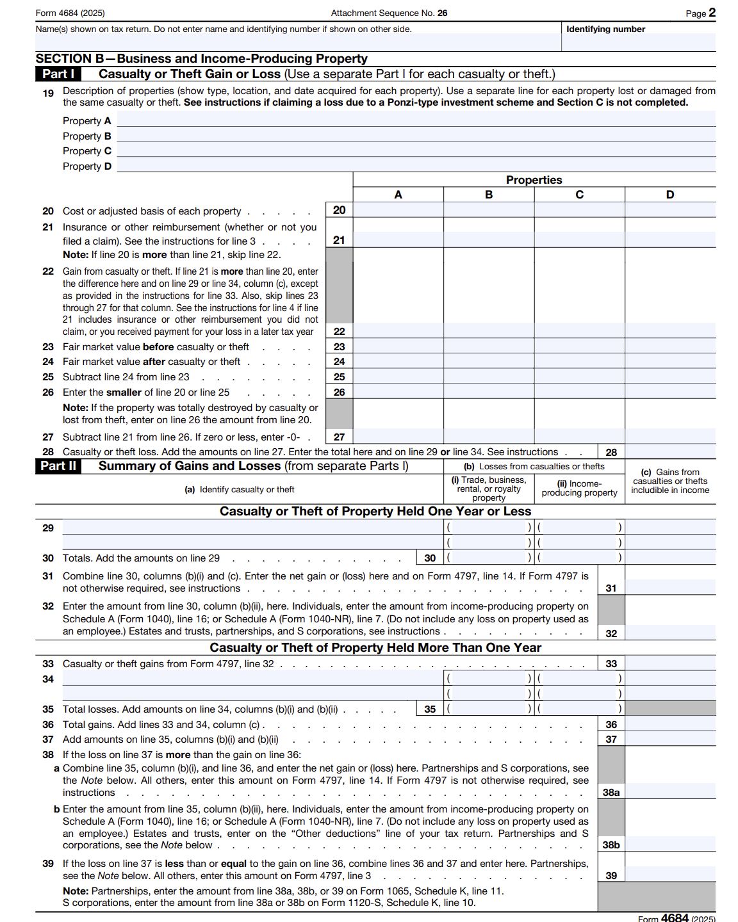
2025 INDIVIDUAL INCOME TAX WORKSHOP
SCHEDULE A: AND FORM 4684: CASUALTY AND THEFTS
Since 95% Taxpayers will file the Standard Deduction, only 5% will file
Schedule A: Itemized Deductions
For 2025, the Casualty and Thefts deduction is only if they occurred in a Federally Declared Disaster Area with a FEMA Disaster Declaration Number. Federal Form 4684 Casualty and Thefts, Limits the Deduction to any amount over 10% of “Adjusted Gross Income.”
Non-disaster Personal Theft/Casualty Losses are generally not deductible.

Slide 35
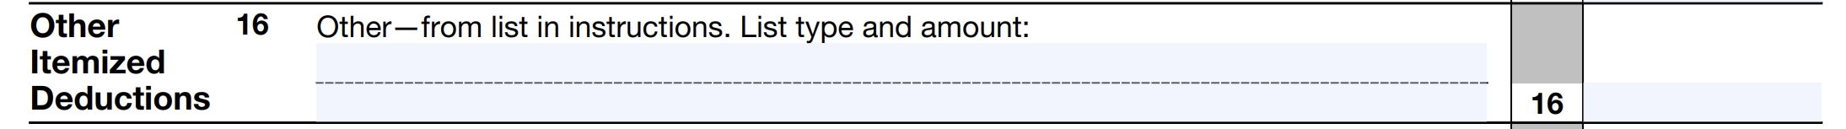
2025 INDIVIDUAL INCOME TAX WORKSHOP
SCHEDULE A: OTHER ITEMIZED DEDUCTIONS
Since 95% Taxpayers will file the Standard Deduction, only 5% will file
Schedule A: Itemized Deductions
If you had a Net Qualified Disaster Loss and you can elect to
Increase your Standard Deduction
For 2025, if you have “Net Qualified Disaster Losses” on Form 4684: Casualties and Thefts line 15, you can claim an increased standard deduction even if you do not itemize. Report the loss amount on Schedule A (Form 1040) next to line 16, adding it to your standard deduction, and note “Standard Deduction Claimed With Qualified Disaster Loss.”
For more information on how to determine your increased standard deduction, see Pub. 976.
2025 Form Schedule A: Itemized Deductions - Instructions
https://www.irs.gov/pub/irs-pdf/i1040sca.pdf

Slide 36
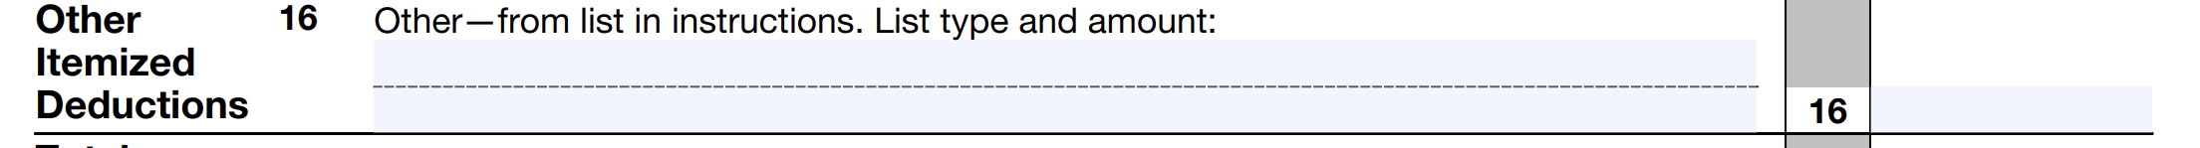
2025 INDIVIDUAL INCOME TAX WORKSHOP
SCHEDULE A: OTHER ITEMIZED DEDUCTIONS
Since 95% Taxpayers will file the Standard Deduction, only 5% will file
Schedule A: Itemized Deductions
Only the following expenses can be deducted for Other Itemized Deductions on line 16:
Gambling losses (gambling losses include, but aren't limited to, the cost of nonwinning bingo, lottery, and raffle tickets) but only to the extent of gambling winnings reported on Schedule 1 (Form 1040), line 8b.
Casualty and theft losses of income-producing property (including losses from financial scams) from Form 4684, lines 32 and 38b, or Form 4797, line 18a.
Federal estate tax on income in respect of a decedent.
A deduction for amortizable bond premium (for example, a deduction allowed for a bond premium carryforward or a deduction for amortizable bond premium on bonds acquired before October 23, 1986).
An ordinary loss attributable to a contingent payment debt instrument or an inflation-indexed debt instrument (for example, a Treasury Inflation-Protected Security).
Deduction for repayment of amounts under a claim of right if over $3,000. See Pub. 525 for details.
Certain unrecovered investment in a pension.
Impairment-related work expenses of a disabled person.
Moving Expenses are no longer be deductible, except for members of the Armed Forces
who move due to a military order.

Slide 37
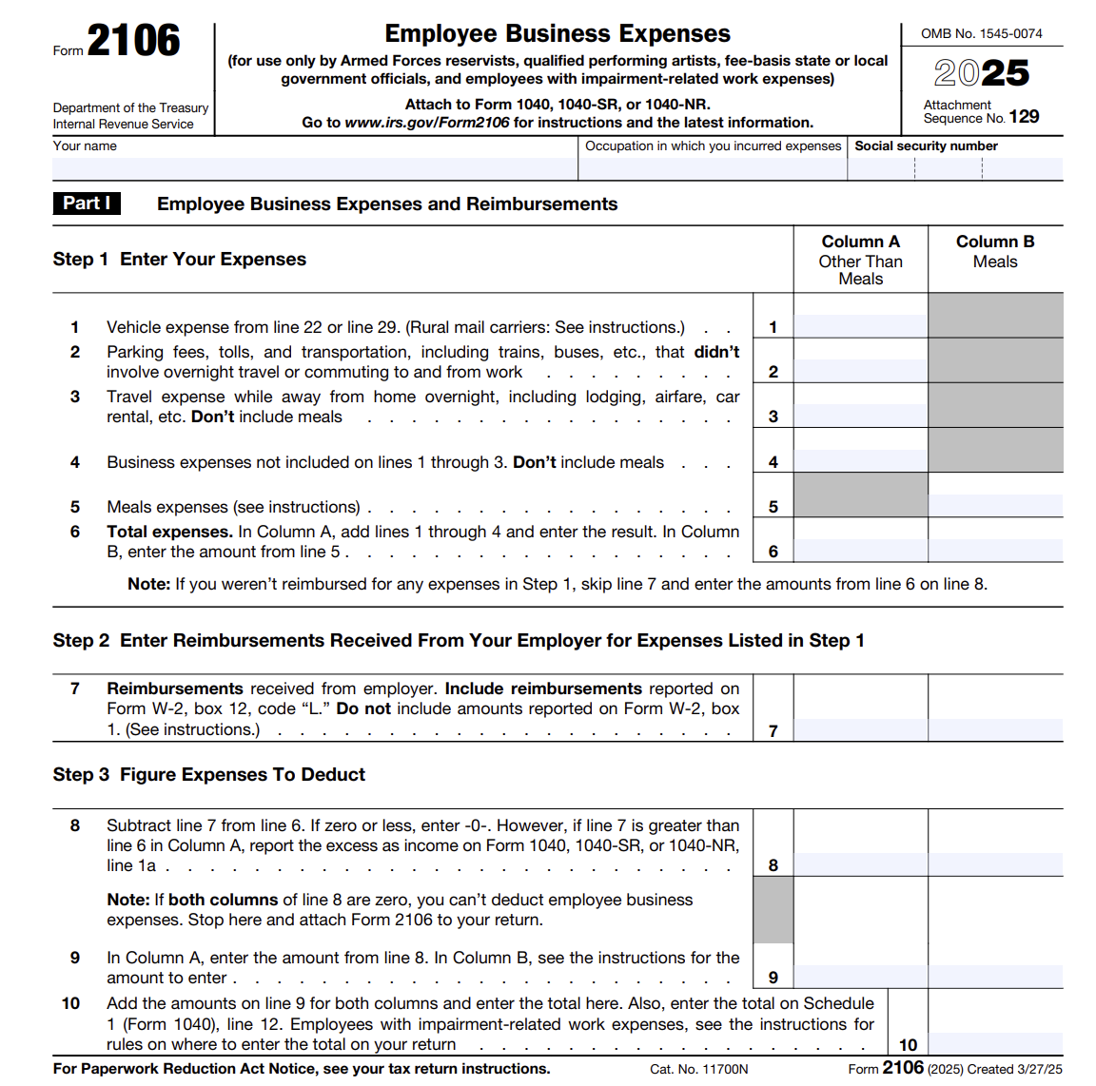
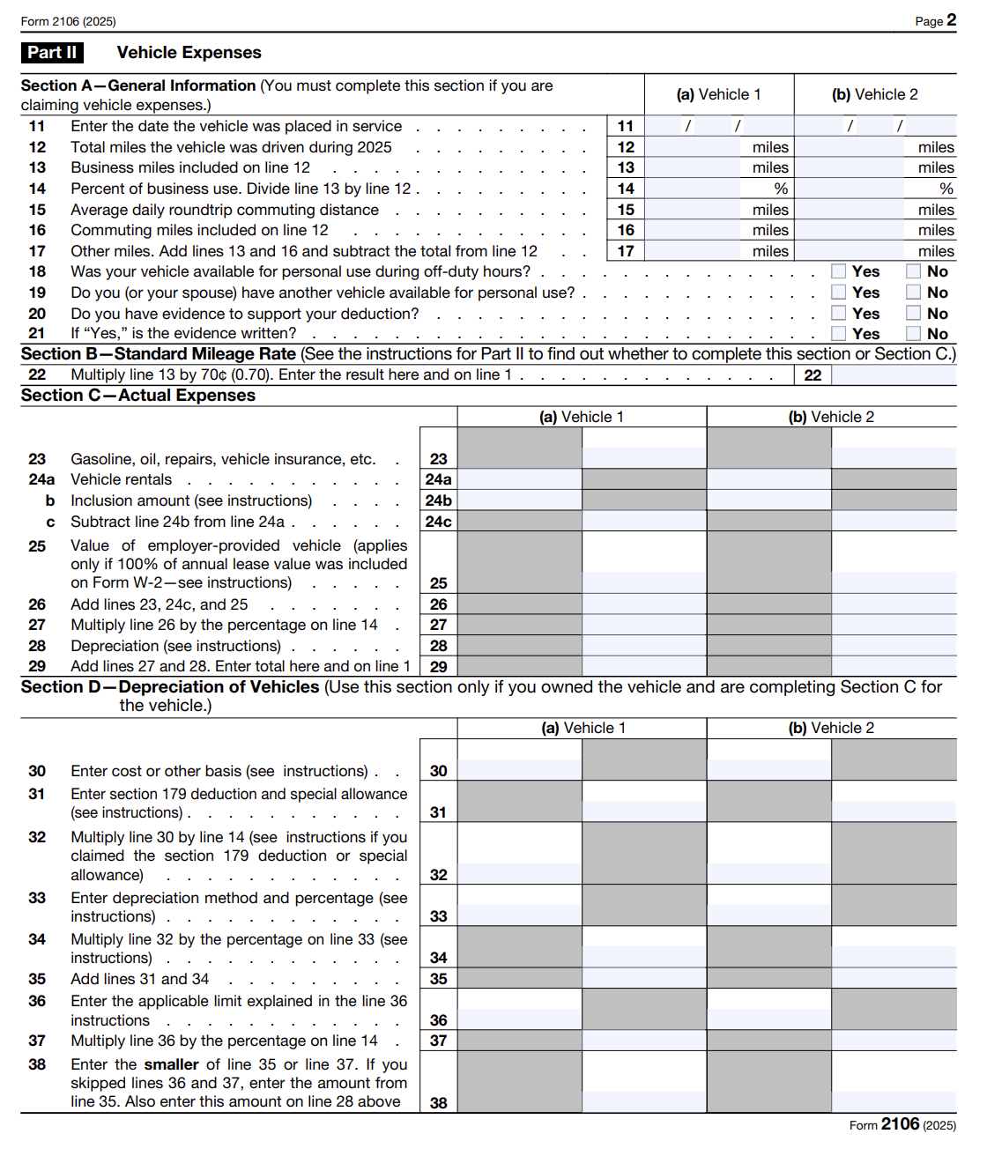
2025 INDIVIDUAL INCOME TAX WORKSHOP
FORM 2106: EMPLOYEE BUSINESS EXPENSES
For 2025, Form 2106 Employee Business Expenses is Limited only if filed by:
Armed Forces reservists
Qualified performing artists,
Fee-basis state or local government officials,
Employees with impairment-related work expenses

Slide 38
2025 INDIVIDUAL INCOME TAX WORKSHOP
SCHEDULE A: SUGGESTIONS
Question:
If I take the Standard Deduction in 2025, can I pay for some things in 2026 and then take Itemized Deductions?
Answer:
For 2025, since 95% Taxpayers will file the Standard Deduction, only 5% will file Schedule A: Itemized Deductions.
Most likely, in 2026, you will still take a Standard Deduction.
When you take the Standard Deduction because you do not have enough expenses to itemize in 2025, you can “Defer” or “Put off” paying some things to 2026, as long as the Bank does not charge any additional penalties or interest.
If your Mortgage is better than up to date, perhaps you could put off making that extra payment until the following year. This will eventually lower your Mortgage Principal.
If your current Itemized Deductions are close to the Standard Deduction amount, and if you have just a “Little Extra Funds,” think about making an extra payment on your Mortgage before the end of the year to increase your Mortgage Interest Deduction.
If you have a “Larger Amount of Extra Funds,” consider making a payment on your Mortgage “To Principle Only,” which will eventually decrease the total Interest, the number of Mortgage payments, and you will pay off your Mortgage earlier.

Slide 39
2025 INDIVIDUAL INCOME TAX WORKSHOP
2025 TAX BRACKETS AND FILING STATUS
The Federal Income Tax owed depends on Income Level and Filing Status
2025 Federal Income Tax Brackets
10%: $0–$11,925 (Single/MFS); $0–$23,850 (Married Joint/Surviving Spouse).
12%: $11,926–$48,475 (Single/MFS); $23,851–$96,950 (Married Joint/Surviving Spouse).
22%: $48,476–$103,350 (Single/MFS); $96,951–$206,700 (Married Joint/Surviving Spouse).
24%: $103,351–$197,300 (Single/MFS); $206,701–$394,600 (Married Joint/Surviving Spouse).
32%: $197,301–$250,525 (Single/MFS); $394,601–$501,050 (Married Joint/Surviving Spouse).
35%: $250,526–$626,350 (Single); $250,526–$375,800 (MFS); $501,051–$751,600 (Married Joint/Surviving Spouse).
37%: Over $626,350 (Single); Over $375,800 (MFS); Over $751,600 (Married Joint/Surviving Spouse).
Common Filing Statuses
Single: Unmarried or divorced.
Married Filing Jointly: Combined income, usually lower tax rate.
Married Filing Separately (MFS): Separate tax liability.
Head of Household: Unmarried with qualifying dependents.
Qualifying Surviving Spouse: Widowed with dependent child.

Slide 40
2025 INDIVIDUAL INCOME TAX WORKSHOP
2025 TAX BRACKETS PERCENTAGES
For the 2024, the federal income tax system consists of seven tax brackets:
10%, 12%, 22%, 24%, 32%, 35%, and 37%.
For the 2025, the federal income tax system consists of seven tax brackets that are are the same:
10%, 12%, 22%, 24%, 32%, 35%, and 37%.

Slide 41
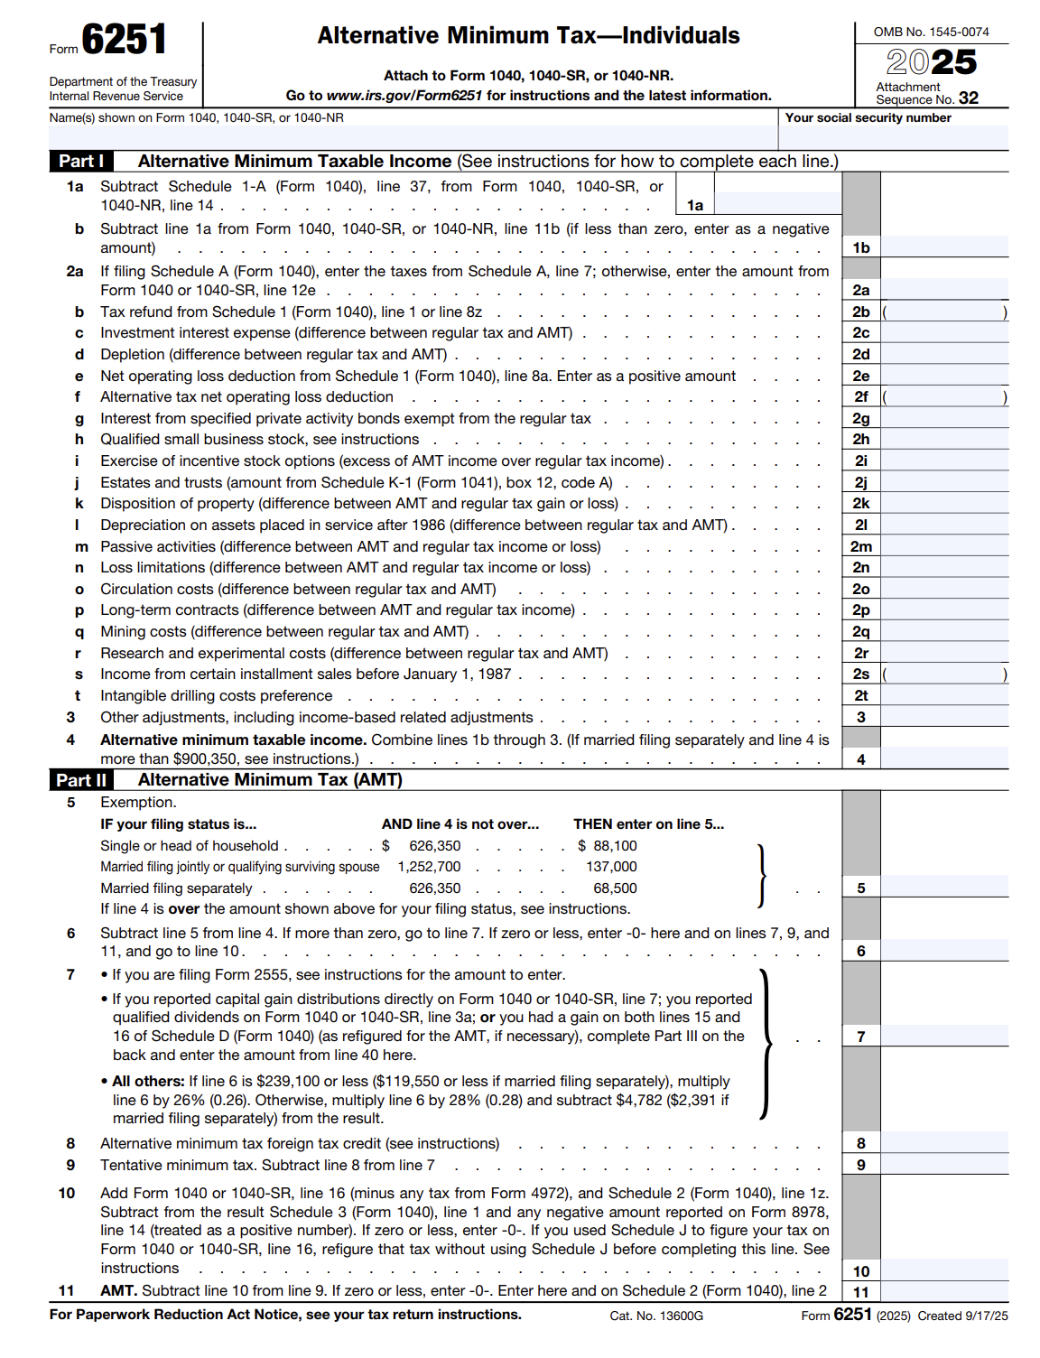
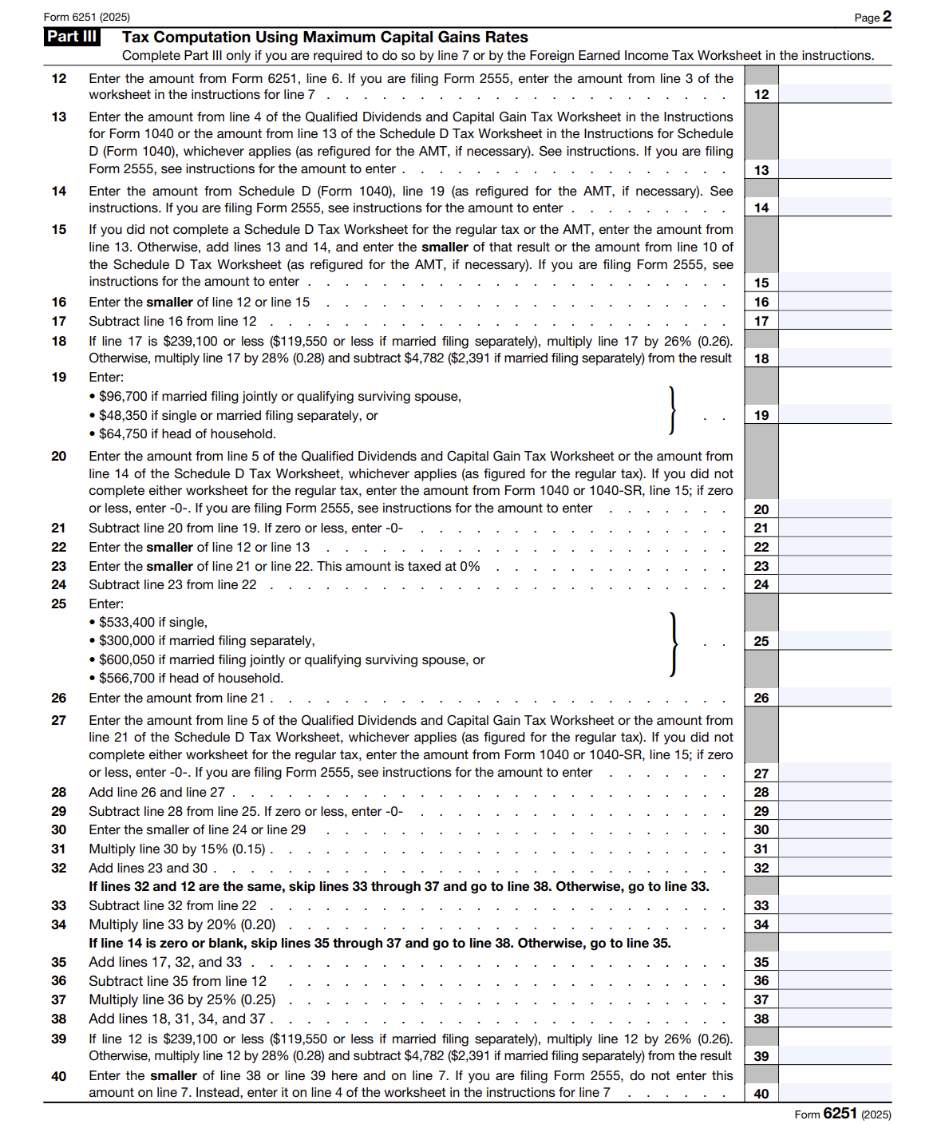
2025 INDIVIDUAL INCOME TAX WORKSHOP
ALTERNATIVE MINIMUM TAX (AMT) FORM 6251
Alternative Minimum Tax (AMT)- is Designed for High Income Earners and a Few middle-income filers to pay more Individual Income Tax by generally limiting deductions claimed.
Taxpayer’s must pay the higher of the Regular Tax Calculation or the AMT Calculation

Slide 42
2025 INDIVIDUAL INCOME TAX WORKSHOP
ALTERNATIVE MINIMUM TAX INCOME (AMTI)
The starting point is Form 1040, Line 10 Taxable Income, which is calculated by adding Line 7, Adjusted Gross Income, less Line 8, Standard or Itemized Deduction and less Line 9, Qualified Business Income Deductions. Next, certain Tax Exclusions and Deferrals are added back.
2025 AMT Exemptions
Filing Status . . . . . . . . . . . . . . . . . .EXEMPTION
Single or head of household . . . . . .$88,100
Married filing jointly or
Qualifying widow(er) . . . . . . . . . . . .$137,000
Married filing separately. . . . . . . . . . $68,500 00
2025 Alternative Minimum Tax Income (AMTI) Brackets
The Standard Income Tax Calculation Method has seven tax brackets, but the Alternative Minimum Tax has only one: 26%.
Filing Status AMT Tax Rate
Noncorporate Taxpayers 26% first $239,100
Married filing separately 26% first $119,550

Slide 43
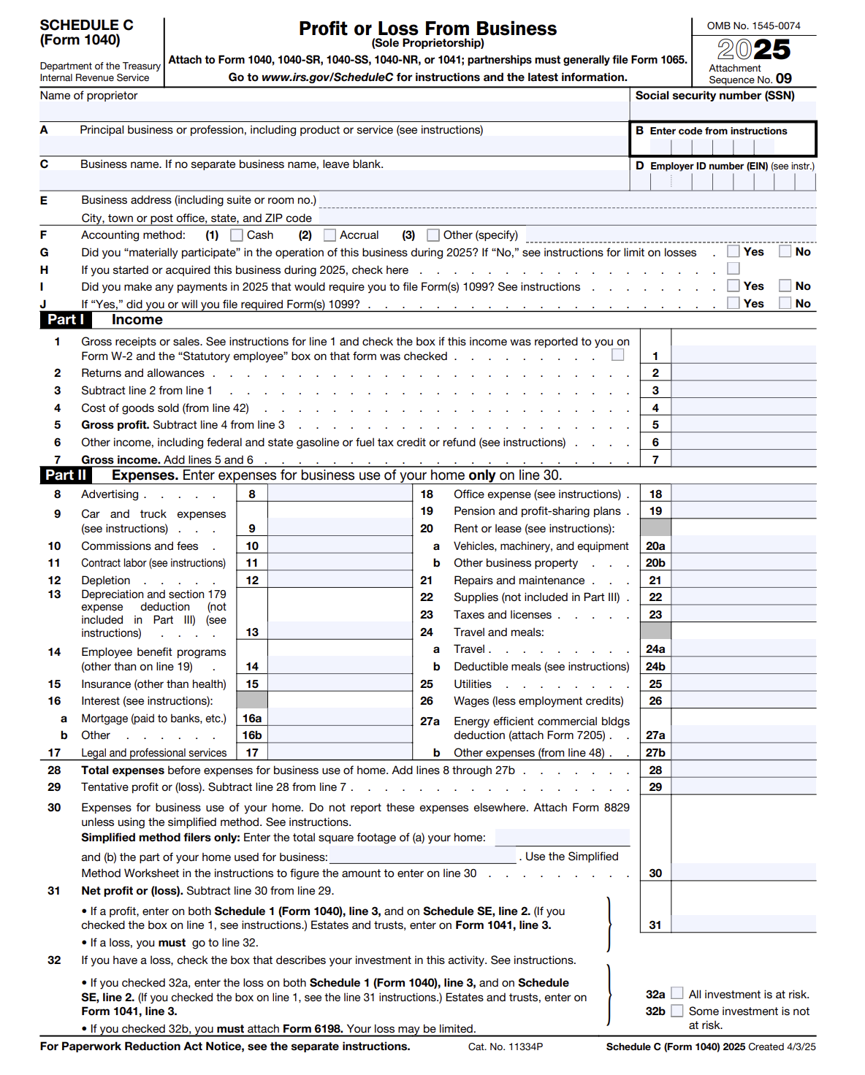
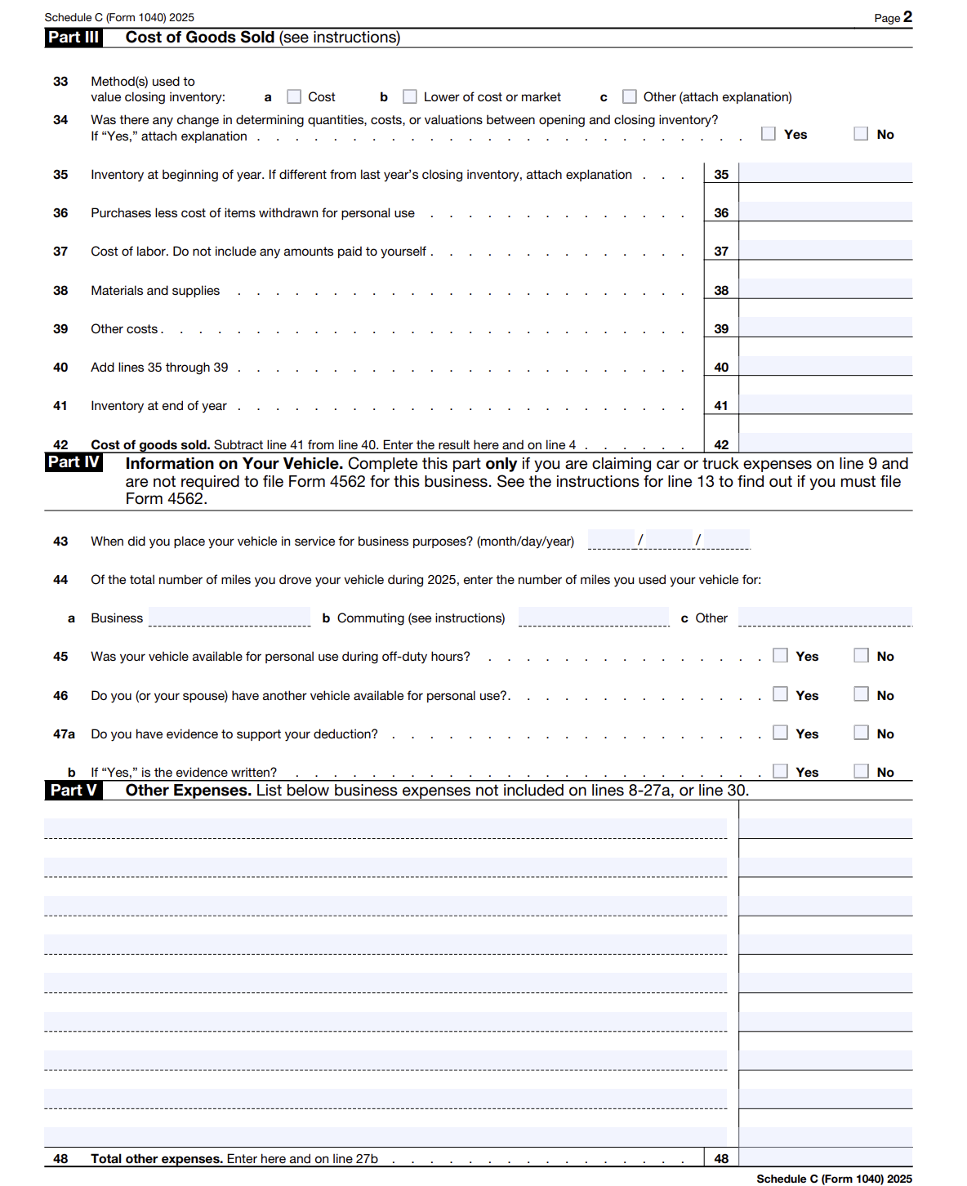
2025 INDIVIDUAL INCOME TAX WORKSHOP
SCHEDULE C: PROFIT OR LOSS FROM BUSINESS- SOLE PROPRIETORSHIP

Slide 44
2025 INDIVIDUAL INCOME TAX WORKSHOP
PASS-THROUGH ENTITIES DEDUCTION
A Pass-through Entity is a domestic business operated as a Sole Proprietorship or Through a Partnership, S Corporation, Trust or Estate and recognized as a separate entity for federal income tax purposes.
For 2025, The Sec. 199A pass-through entity deduction, or Qualified Business Income (QBI) deduction, allows eligible sole proprietors, partnerships, and S corporations to deduct up to 20% of their qualified business income from federal income taxes. Qualified REIT Dividends or Qualified PTP Income may qualify for the deduction.
Eligible taxpayers may be entitled to a deduction of up to 20% of Qualified Business Income (QBI) from a domestic business operated as:
Sole Proprietorship (Form Schedule C) Partnership, S-Corporation, Trust or Estate
For 2025, the 20% deduction for Qualified Business Income (QBI) from pass-through entities is phased out and unavailable for Specified Service Trades or Businesses (SSTBs) when Taxable Income exceeds $247,300 for single filers or $494,600 for married filing jointly
Specified Service Trade or Business (SSTBs) is defined as a business where the Principal Asset is a key staff member with significant decision-making, supervisory, or policy-making authority and the reputation or skill of the one or more employees or owners, often covers the fields:
Health, Law, Accounting, Actuarial Science, Performing Arts, Consulting, Athletics, Financial Services, Investing and Investment Management
SSTBs are excluded from the full Qualified Business Income (QBI) deduction.

Slide 45
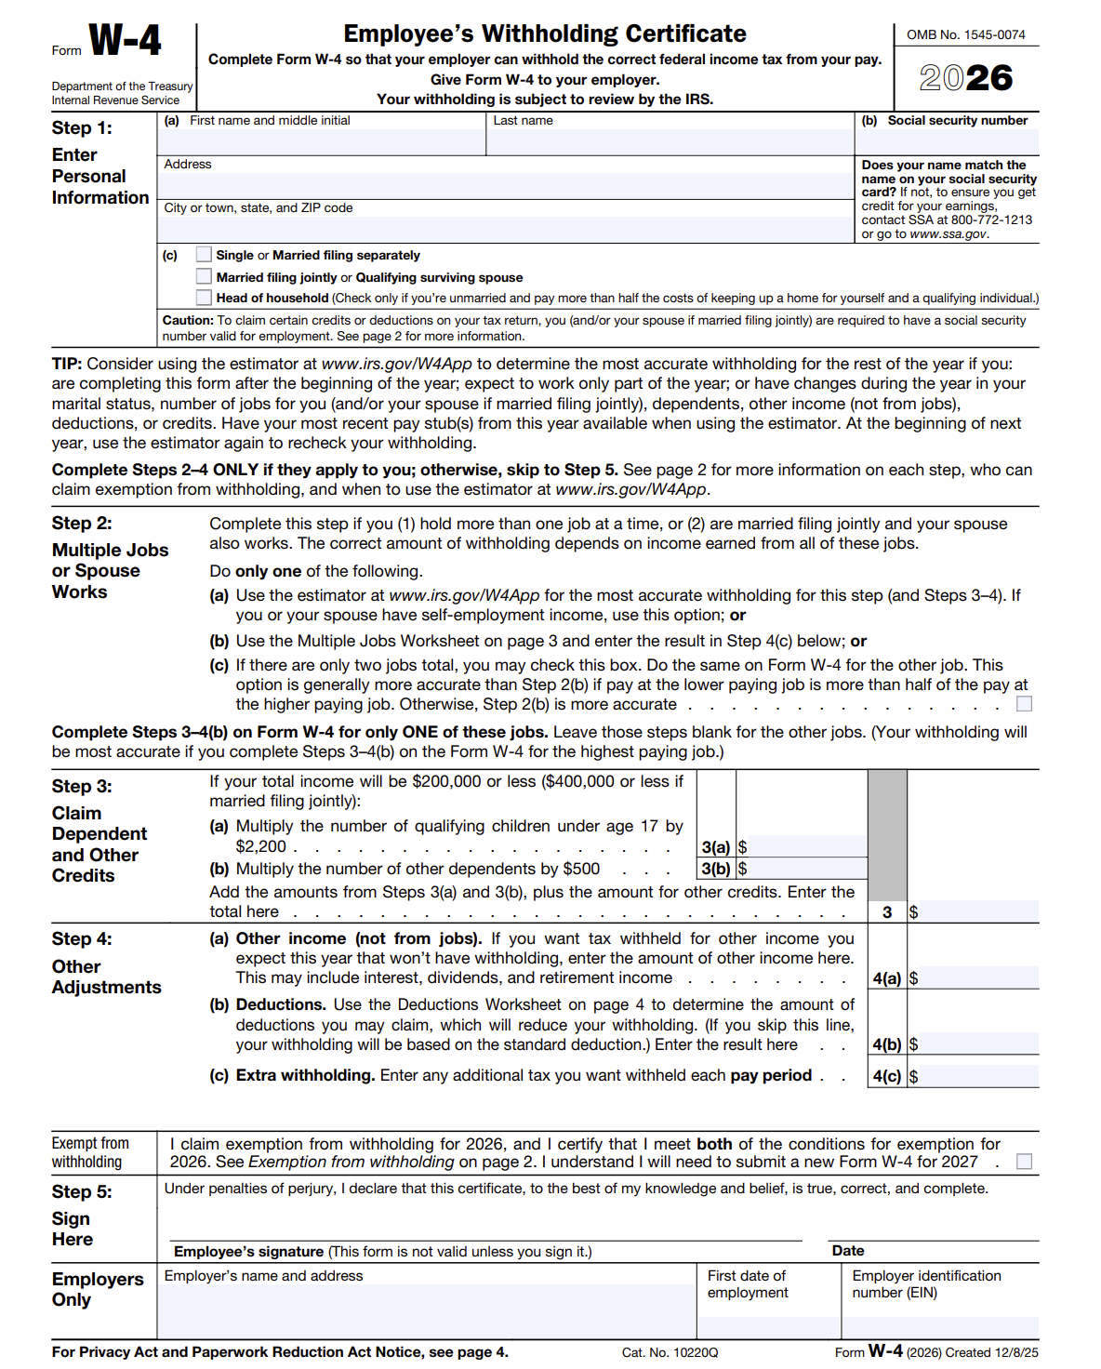
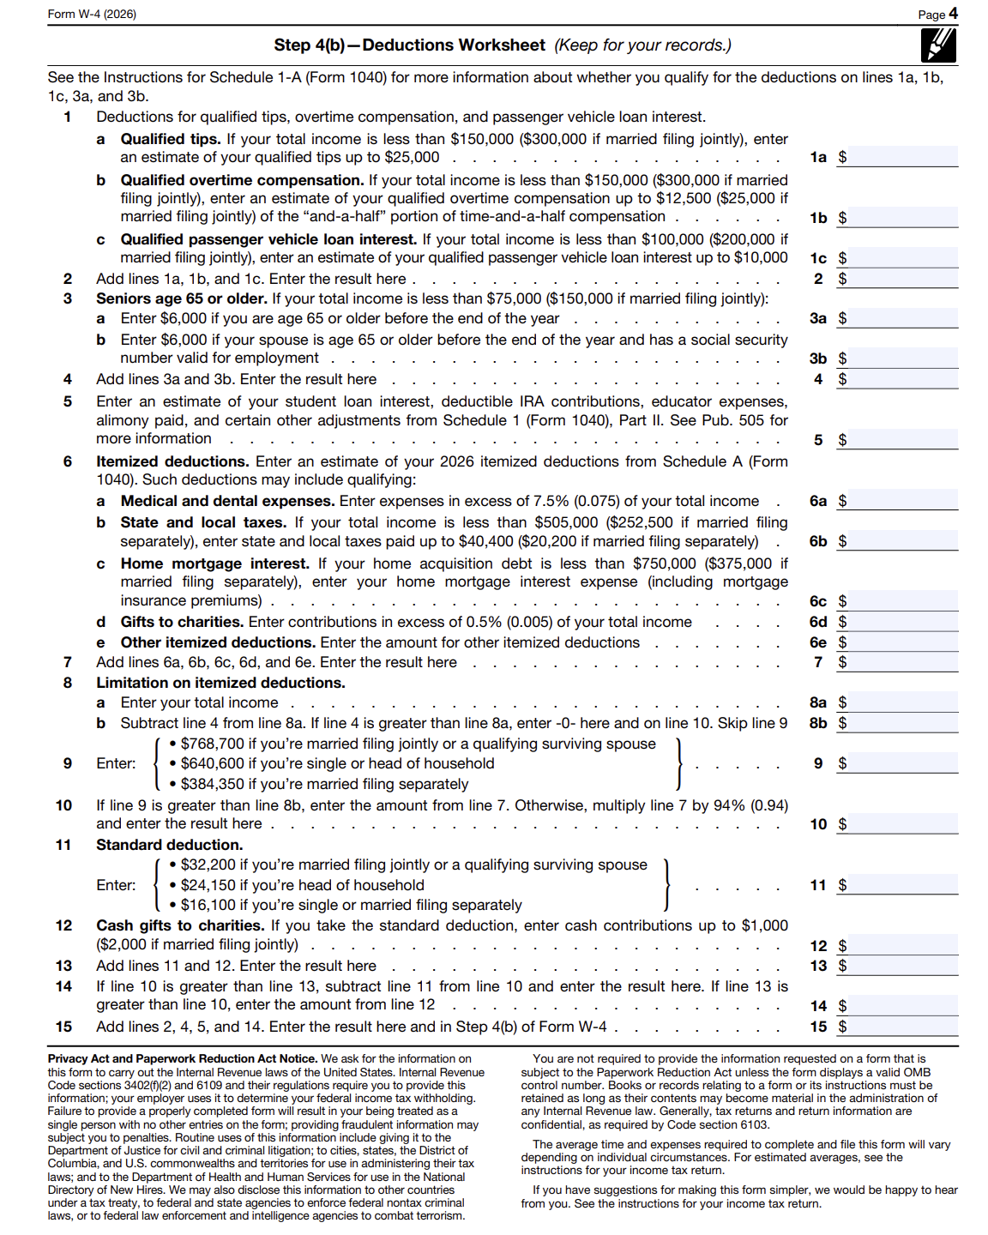
2025 INDIVIDUAL INCOME TAX WORKSHOP
FORM W-4: WITHHOLDING TAX
Complete Form W-4 for hiring or life changes (marriage, child, new job) to ensure accurate federal income tax withholding, preventing large tax bills or unnecessary refunds. For the IRS Withholding Calculator go to www.irs.gov/W4App

Slide 46
2025 INDIVIDUAL INCOME TAX WORKSHOP
FLEXIBLE SPENDING ACCOUNT (FSA)
A Flexible Spending Account (FSA) is an employer-sponsored benefit allowing employees to contribute pre-tax dollars from their paychecks into a special account for qualified health or dependent care expenses. By reducing taxable income, participants save on taxes but must generally "Use It Or Lose It" within the plan year.
The 2025 contribution limit for health FSAs is $3,300.
Money deducted from an employee's pay into an FSA is not subject to payroll taxes, resulting in substantial payroll tax savings.
Generally, by paying qualified health or dependent care expenses with “Pre-Tax money” or “Tax-free money,” then if your Tax rate is 25% you are saving 25%—just like getting a discount! Deductions are easy, they are taken out of your paycheck by your employer.

Slide 47
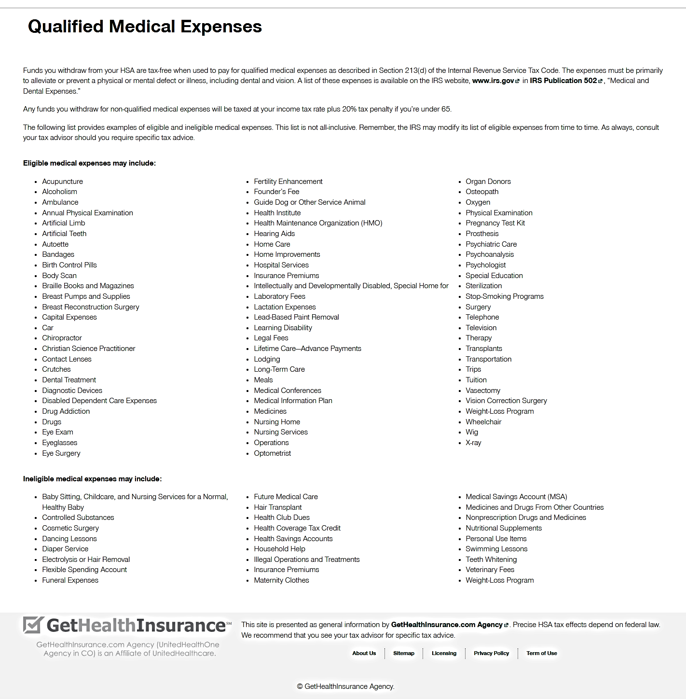
2025 INDIVIDUAL INCOME TAX WORKSHOP
FLEXIBLE SPENDING ACCOUNT (FSA)
QUALIFIED MEDICAL EXPENSES
The IRS is very strict what are considered “Qualified Medical Expenses.” http://www.hsacenter.com/what-is-an-hsa/qualified-medical-expenses

Slide 48
2025 INDIVIDUAL INCOME TAX WORKSHOP
FLEXIBLE SPENDING ACCOUNT (FSA) PLANS
USE IT OR LOSE IT POLICY
Generally, some Flexible Spending Account Plans (FSA) have a “Use It or Lose It Policy.” This means that amounts in the account at the end of the plan year cannot be carried over to the next year. If your plan follows this rule, you should make sure to use all of your funds by the end of the plan year, which generally is the end of the calendar year.
Flexible Spending Account Plans may permit an employee to carry over up to $500 into the following year without losing the funds, but it is not required.
Suggestions:
Because of some FSA plans have the “Use It or Lose It Policy, ” if you do not spend everything in your account, legally the company is not responsible to pay you the balance. Before the end of the year, spend your FSA on Qualified Medical Expenses to maximize your tax savings.
FSA Store https://fsastore.com offers only FSA-Eligible Products for sale.
Flexible Spending Accounts allows “Pre-funding,” which means you can spend the money in the account before it’s actually deposited. If you left a company where your Flexible Spending Account paid all the Medical Expenses during the year, but your Payroll Deductions were less, then you are not responsible to pay the company the difference. Although, the company may take it out of your final paycheck.

Slide 49
2025 INDIVIDUAL INCOME TAX WORKSHOP`
WHY ARE UNEMPLOYMENT BENEFIT PAYMENTS TAXABLE?
Similar to Medical Insurance Benefits, Unemployment Benefits are just another “Employee Benefit.”
When you file for Unemployment Benefits, the state pays you from a State Trust Fund, which has State Unemployment Taxes plus Federal Unemployment Taxes; both paid by organizations.
Starting with the Tax Reform Act of 1986, unemployment insurance benefits became taxable as a “Substitute for Wages.”
According to The Tax Foundation, of the states that tax wage income, fifteen states completely exempt unemployment benefits from tax:
Alabama, Alaska, California, Florida, Montana, Nevada, New Hampshire, New Jersey, Pennsylvania, South Dakota, Tennessee, Texas, Virginia,
Washington, and Wyoming.
Nine states do not have an Income Tax:
Texas, Florida, Washington, Nevada, South Dakota, Tennessee, Wyoming, Alaska, and Washington
After the end of the year, the Unemployment Benefits Beneficiary should receive Federal Form 1099-G, Certain Government Payments listing the Unemployment Compensation, Federal Income Tax Withheld, and any State Income Tax Withheld. Generally, Severance and Vacation Pay will be allocated to the employees last week of work and is included in the W-2 issued.

Slide 50
2025 INDIVIDUAL INCOME TAX WORKSHOP
UNEMPLOYMENT BENEFITS FOR 501(C)(3) (NON-PROFIT) EMPLOYEES
An organization that is exempt from income tax under Section 501(c)(3) (Non-profit) of the Internal Revenue Code is also exempt from Federal Unemployment Taxes (FUTA).
https://www.irs.gov/charities-non-profits/exempt-organizations-what-are-employment-taxes
The Federal Unemployment Tax Act, Section 3309 enables 501(c)(3) (Non-profit) organizations to opt out of the tax system and to reimburse the state for unemployment claims the state has paid out to the non-profits' former employees.
http://www.501ctrust.org/unemployment-tax-exemption-for-501c3s-explained
In some states, non-profit reimbursing claims is voluntary.
VA Code Ann §60.2-213 (B)(1) only exempts organizations operating primarily for religious purposes from reimbursing claims to the state. Generally, since these groups are not required to reimburse the state, then their employees are not eligible for Unemployment.
https://law.lis.virginia.gov/vacode/title60.2/chapter2/section60.2-213

Slide 51
2025 INDIVIDUAL INCOME TAX WORKSHOP
401(k) FINANCIAL QUESTIONS
Question:
When I left my company, did the company stop matching funds paid into my 401(k)?
Answer:
Yes, generally you are not eligible to receive additional Company Matching Contributions in a 401(k) plan 30 days after the Separation Date, but what was paid is yours and remains in the account.
Generally, you are also not eligible to Contribute additional amounts to the 401(k) plan 30 days after the Separation Date.
Question:
Since I left my company, will my 401(k) investment fees be higher?
Answer:
No, all plans must charge each investor the same fees for the same investments.
Question:
If I leave my 401(k) with the company, will it still earn investment income?
Answer:
Yes, if you leave your 401(k) with the company, it will still earn investment income.

Slide 52
2025 INDIVIDUAL INCOME TAX WORKSHOP
CONCLUSION
“The hardest thing in the world to understand is the income tax.”
Albert Einstein
https://thestoryexchange.org/25-funny-one-liners-about-taxes
Please let me know if you have any questions.
John B. Goldhamer
John.Goldhamer@gmail.com www.LinkedIn.com/in/JohnGoldhamer www.JohnGoldhamer.com
I can Hammer out any Problem!

