Slide 1
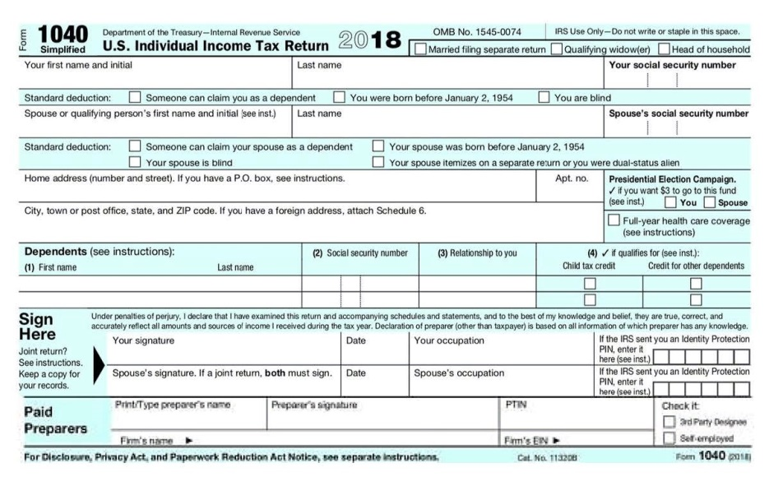
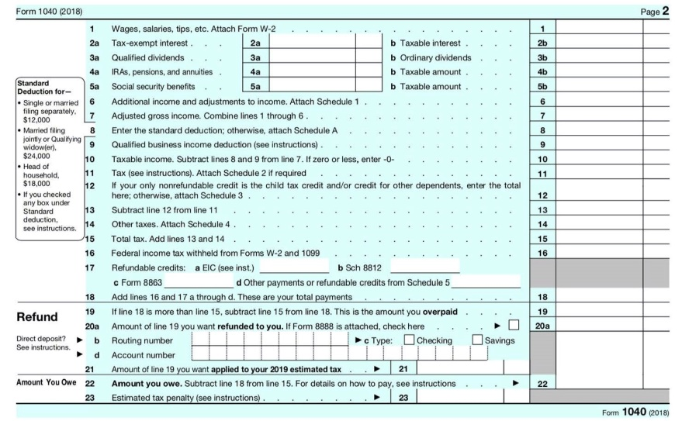
2018 INDIVIDUAL INCOME TAX WORKSHOP
John B. Goldhamer, an Authored Tax Law Expert, reviews the Tax Cuts and Jobs Act (TCJA) including the 2018 U.S. Individual Income Tax Forms published by the Internal Revenue Service (IRS) and makes suggestions.
He humorously says,
"I can Hammer out any Tax Problem!"

Slide 2
2018 INDIVIDUAL INCOME TAX WORKSHOP
TABLE OF CONTENTS
Slide Topic Slide
Why Should You Listen To John B. Goldhamer? ……………………………………………..... 5
John B. Goldhamer’s Job Seeker Tips, Topics & Tools ………………………………………. 6
John B. Goldhamer’s Website: www.JohnGoldhamer.com ………………………………. 7
JohnGoldhamer.com: Individual Income Tax Workshops & Unemployment …….. 8
Tax Envelope To Keep Tax Information ……………………………………………………………… 9
Tax Software ………………………………………………………………………………………………….. 10
Paycheck Stub Matched With W-2 …………………………………………………………………. 11
There are 19 Different Types of IRS Form 1099 ………………………………………………. 12
Caveat - Early Release of IRS Tax Forms ………………………………………………………….. 13
Simplified Form 1040, only one 1040- Front Page ………………………………………….. 14
Simplified Form 1040, only one 1040- Back Page …………………………………………… 15
Schedule B, Interest And Ordinary Dividends …………………………………………………. 16
Schedule D, Capital Gains and Losses …………………………………………………………….. 17
Schedule D, Capital Gains and Losses- Suggestions ………………………………………. 18
Selling Your Home at a Gain (Profit) ………………………………………………………………. 19

Slide 3
2018 INDIVIDUAL INCOME TAX WORKSHOP
TABLE OF CONTENTS
Slide Topic Slide
Standard Deduction Amounts- Most Taxpayers will not be Itemizing ............... 20
Personal Exemption- Suspended ......................................................................... 21
The New Six Schedules ........................................................................................ 22
Schedule 1 – Additional Income and Adjustments to Income- Income …………… 23
Schedule 1 – Additional Income and Adjustments to Income- Adjustments …… 24
Schedule 2 – Tax .................................................................................................. 25
Schedule 3 – Nonrefundable Credits .................................................................. 26
Schedule 4 – Other Taxes .................................................................................... 27
Schedule 5 – Other Payments and Refundable Credits ...................................... 28
Schedule 6 – Foreign Address and Third Party Designee ................................... 29
Child Tax Credits ……………………………………………………………………………………………. 30
Itemized Deductions, Schedule A. Now Has 6 Sections ...................................... 31
Medical and Dental Expenses ………………………………………………………………………… 32
State Income Tax Personal Property Tax & Real Estate Tax- Limited Deduction . 33
State Income Tax Personal Property Tax & Real Estate Tax- $10,000 Limit ………. 34
Interest on Home Mortgage, Equity Line-Deduct Home & Home Improvements.35
Charitable Contributions …………………………………………………………………................ 36
Casualty and Theft Losses of Property-Only Federally Declared Disaster Area .. 37
Other Miscellaneous Deductions ..…………………………………………………………………. 38

Slide 4
2018 INDIVIDUAL INCOME TAX WORKSHOP
TABLE OF CONTENTS
Slide Topic Slide
Miscellaneous Itemized Deductions- Eliminated, No Job Expenses ……………….. 39
Employee Business Expenses - Form 2106 .......................................................... 40
Suggestions- Standard Deduction Now, Defer Expenses to Itemize Next Year ... 41
Tax Brackets and Filing Status .............................................................................. 42
Tax Rates .............................................................................................................. 43
Alternative Minimum Tax (AMT) Form 6251 ....................................................... 44
Alternative Minimum Tax (AMT) Information ..................................................... 45
Schedule C, Profit Or Loss From Business- Sole Proprietorship ………………………. 46
Pass-through Entities - Deduction Up To 20% of Qualified Business Income ..... 47
Tax Year 2019, Withholding Tax - Form W-4 ……………………………………………………. 48
Affordable Care Act- Healthcare Coverage- No Individual Mandate Penalty …… 49
Important Dates For 2018 Affordable Care Act Enrollment ................................ 50
Special Enrollment Period (Sep) ……………………………………………………………………… 51
Flexible Spending Account (FSA) - Definition ………………………………………………….. 52
Flexible Spending Account (FSA) - Qualified Medical Expenses ………………………. 53
Flexible Spending Account (FSA) Plans - Use It Or Lose It Policy ……………………… 54
Why Are Unemployment Benefit Payments Taxable? …………………………………….. 55
Unemployment Benefits For 501(C)(3) (Non-Profit) Employees ……………………... 56
401(k) Financial Questions ……………………………………………………………………………... 57
Conclusion ……………………………………………………………………………………………………... 58

Slide 5

2018 INDIVIDUAL INCOME TAX WORKSHOP
Why should you listen to John B. Goldhamer?
Why should you listen to John B. Goldhamer?
John B. Goldhamer is an Authored Tax Law Expert with Education and Experience in all Business Disciplines, including:
J.D. - Juris Doctorate Equivalent Legal Education, Finance, Marketing, MBA, Accounting, and Information Systems.
He has been essentially a Tax Attorney for organizations for numerous years; researching, composing, and presenting Impact Statements on new law, Position Papers on current law, and Tax Appeals to Administrators, Jurisdictions, and Management.
John compiled “Thirty Tax Tools” to assist with Business, Legal, and Tax Research, which are on his website.

Slide 6

2018 INDIVIDUAL INCOME TAX WORKSHOP
John B. Goldhamer
www.LinkedIn.com/in/JohnGoldhamer
www.JohnGoldhamer.com
JOB SEEKER TIPS, TOPICS & TOOLS
John B. Goldhamer is the author of Job Seeker Tips, Topics & Tools, which has Everything a Job Seeker Needs to Get a Job from Beginning to End!
It contains Comprehensive Documents that assist Job Seekers with Composing: Cover Letters, Resumes, Marketing Plans, Researching Companies and People, as well as Presenting an Image and More!
At one time, John taught classes on LinkedIn, Résumé Writing, and Researching the Internet at Employment Transition Centers and Network Groups. He is also on the speaker circuit to organizations and small groups.

Slide 7
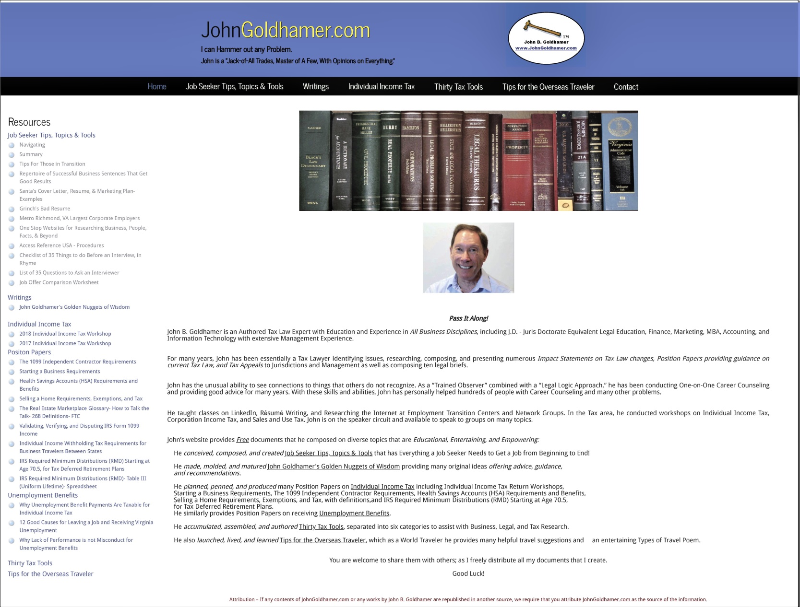
2018 INDIVIDUAL INCOME TAX WORKSHOP
John B. Goldhamer’s Website: www.JohnGoldhamer.com

Slide 8
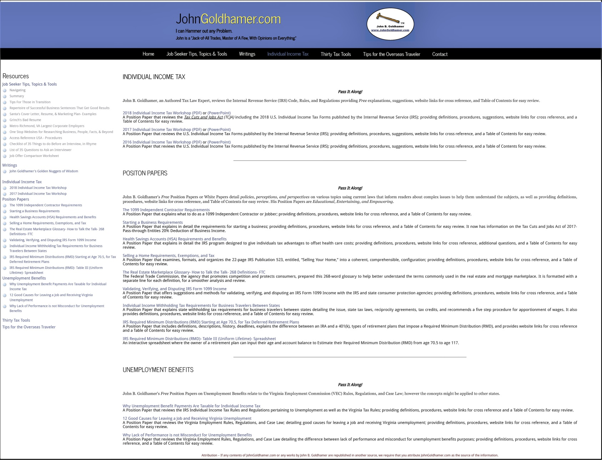
2018 INDIVIDUAL INCOME TAX WORKSHOP
JohnGoldhamer.com: Individual Income Tax Workshops & Unemployment Benefits

Slide 9
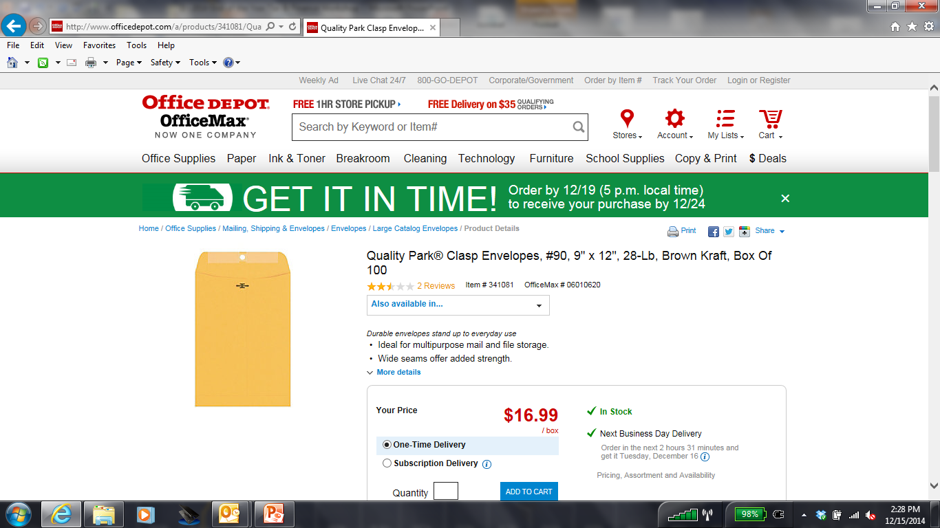
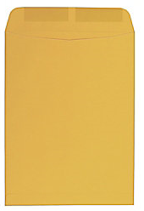
2018 INDIVIDUAL INCOME TAX WORKSHOP
TAX ENVELOPE TO KEEP TAX INFORMATION
Large Open-End Kraft (Brown) 9" x 12“ Envelope
Suggestions:
In the beginning of each year get a Large Open-End Kraft (Brown) 9" x 12“ Envelope.
Mark it in large letters the Tax Year, such as 2018.
During the year, as you receive Deductible Expenses like Donations, Summary of Medical Expenses, Real Estate Taxes, Personal Property Tax, and Income Information; W-2, 1099, Bank Statements, place all of these Important Tax information in the Envelope.
Keep the Envelope some place where you can always find it.
When W-2’s, 1099’s, and other important Tax Documents come in the mail around the end of January, put those items in the Envelope too.
Then everything is in one place ready for you to file your Tax Returns.

Slide 10
2018 INDIVIDUAL INCOME TAX WORKSHOP
TAX SOFTWARE
Personally, I always recommend using Turbo Tax or another Tax Software for complicated returns, which will stay up to date and know more specific rules than a Tax Attorney or CPA, who also use Tax Softwares to file their client’s returns.
For 2018, since Most Taxpayers will be Filing a Standard Deduction and Not Itemizing, many might not need to purchase Tax Software or pay for a Tax Service.
The IRS has Free File Fillable Forms for filing 2018 Individual Income Tax Returns.
https://www.irs.gov/filing/free-file-do-your-federal-taxes-for-free
Some State Individual Income Tax Returns are also free to file when completed online using the state’s website.

Slide 11
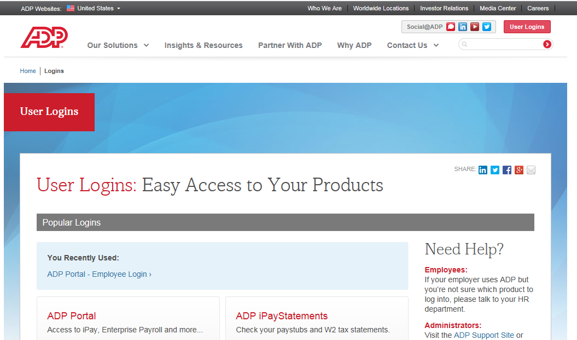
2018 INDIVIDUAL INCOME TAX WORKSHOP
PAYCHECK STUB MATCHED WITH W-2
Suggestion:
At the end of the year, printout and save your last Paycheck Stub listing your entire year’s Income, Deductions and Taxes. When you receive your W-2 around the end of January, make sure the numbers match.

Slide 12
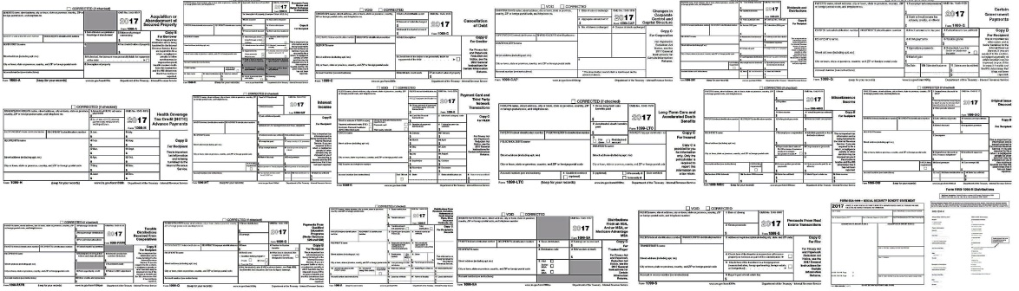
2018 INDIVIDUAL INCOME TAX WORKSHOP
THERE ARE 19 DIFFERENT TYPES OF IRS FORM 1099
Form 1099 is one of several IRS tax forms used in the U.S. to prepare and file an information return to report various types of income other than wages, salaries, and tips. The form is used to report to the IRS payments to independent contractors, rental property income, interest and dividend income, sales proceeds and miscellaneous income. Wikipedia
Form Description
1099-A Acquisition or Abandonment of Secured Property
1099-B Proceeds From Broker and Barter Exchange Transactions
1099-C Cancelation of Debt
1099-CAP Changes in Corporate Control and Capital Structure
1099-DIV Dividends and Distributions
1099-G Certain Government Payments
1099-H Health Coverage Tax Credit (HCTC) Advance Payments
1099-INT Interest Income
1099-K Merchant Card & Third Party Network Payments (PayPal) IRS threshold to issue- sales over $20,000/year
1099-LTC Long-Term Care and Accelerated Death Benefits
1099-MISC Miscellaneous Income
1099-OID Original Issue Discount
1099-PATR Taxable Distributions Received From Cooperatives
1099-Q Payments From Qualified Education Programs (Under Sections 529 and 530)
1099-R Distributions From Pensions, Annuities, Retirement or Profit-Sharing Plans, IRAs, Insurance Contracts
1099-S Proceeds From Real Estate Transactions
1099-SA Distributions From an HSA, Archer MSA, or Medicare Advantage MSA
RRB-1099 Railroad Retirement Board Statement SSA- 1099 Social Security Benefit Statement JohnGoldhamer.com

Slide 13
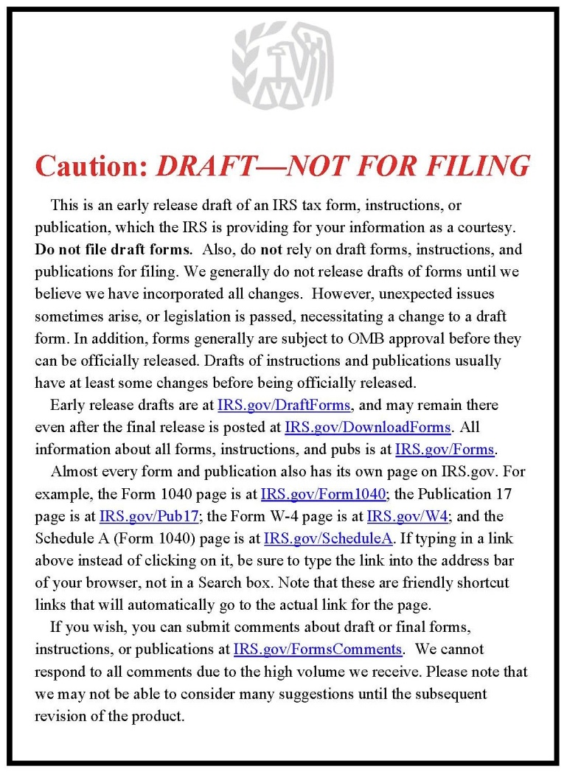
2018 INDIVIDUAL INCOME TAX WORKSHOP
CAVEAT: DRAFT – NOT FOR FILING
Generally, the 115th Congress has until December 15, 2018 to pass changes. The IRS released Draft copies of the 2018 Tax Forms in June 2018.
The IRS accepts electronic and paper tax returns starting January 29, 2019.

Slide 14
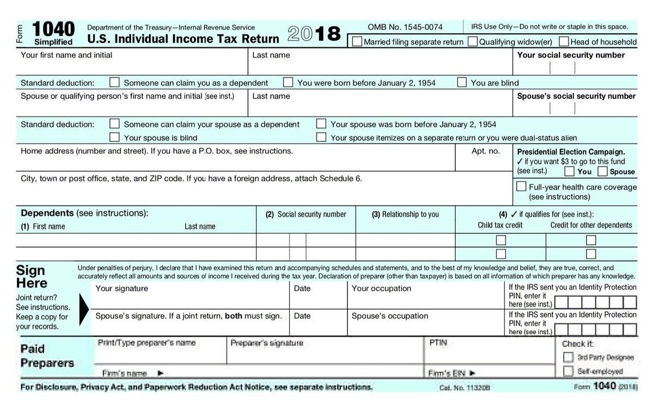
2018 INDIVIDUAL INCOME TAX WORKSHOP
SIMPLIFIED FORM 1040, ONLY ONE 1040 - FRONT PAGE
For 2018, the Tax Cuts and Jobs Act (TCJA) created only one Federal Form 1040, referred to as the Simplified Form1040, which was renumbered and replaces:
1040EZ (Easy), 1040 A (Short Form) and 1040 (Long Form)
https://www.irs.gov/pub/irs-utl/tax_forms_and_publications_imf_bmf.pdf

Slide 15

2018 INDIVIDUAL INCOME TAX WORKSHOP
SIMPLIFIED FORM 1040, ONLY ONE 1040 - BACK PAGE
For 2018, the Tax Cuts and Jobs Act (TCJA) created only one Federal Form

Slide 16
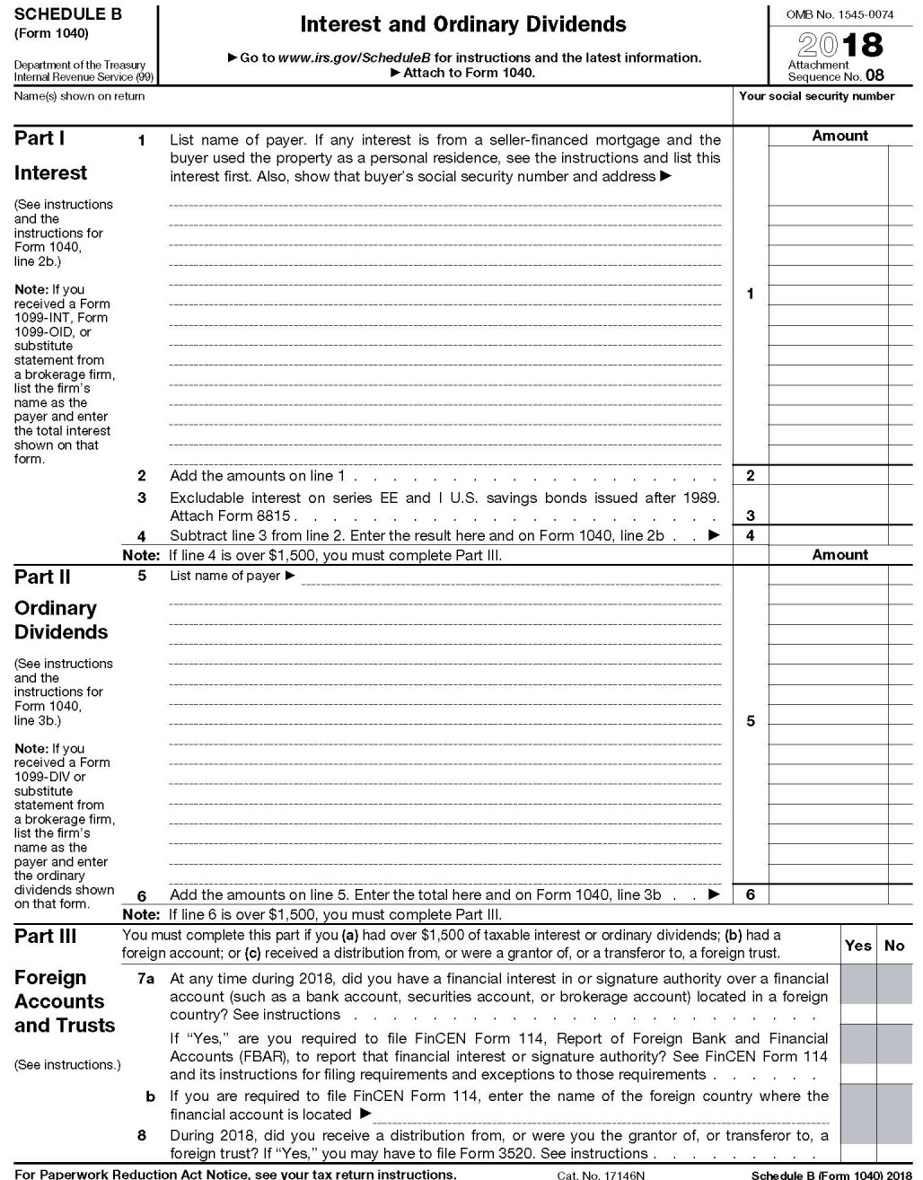
2018 INDIVIDUAL INCOME TAX WORKSHOP
SCHEDULE B, INTEREST AND ORDINARY DIVIDENDS

Slide 17
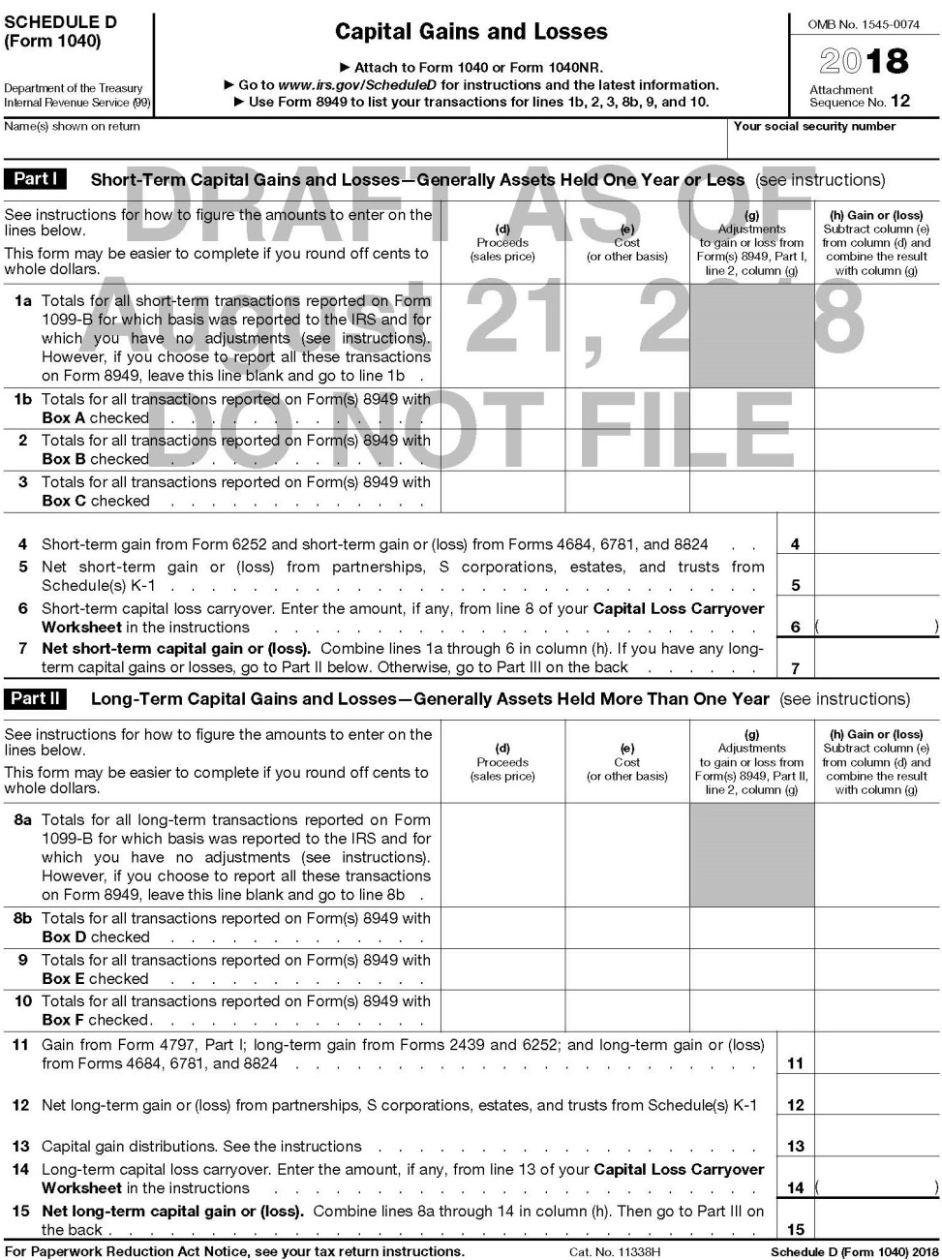
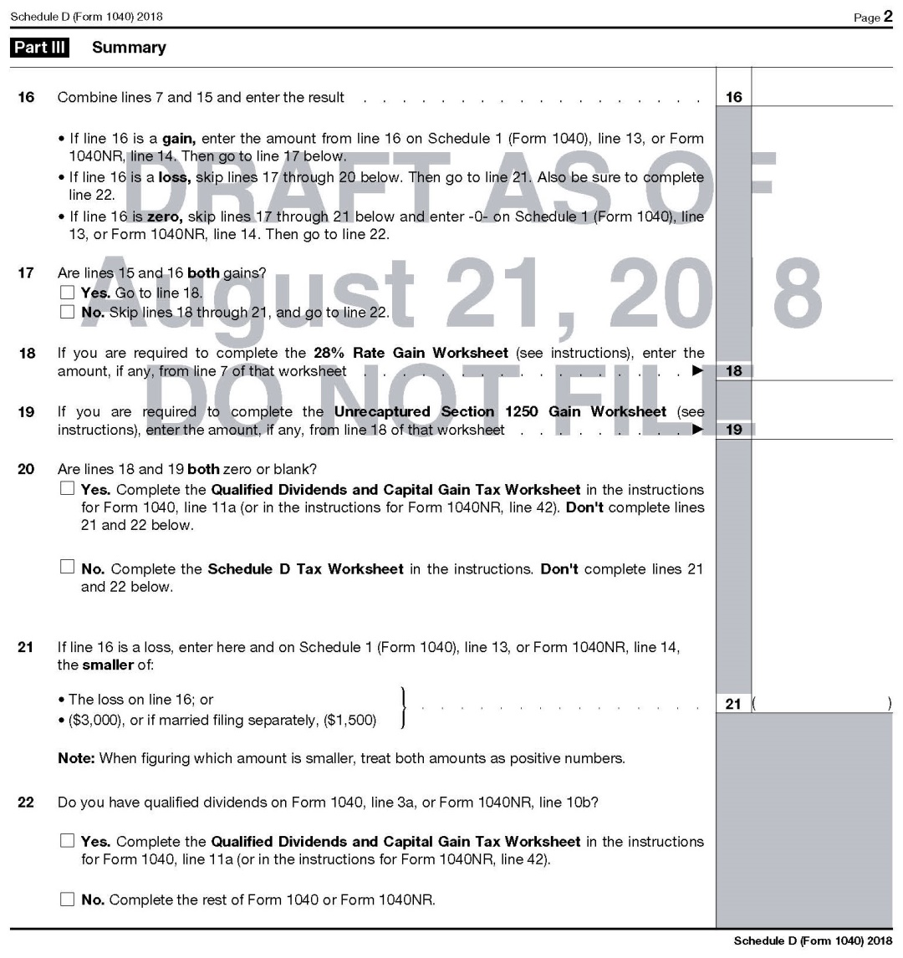
2018 INDIVIDUAL INCOME TAX WORKSHOP
SCHEDULE D, CAPITAL GAINS AND LOSSES

Slide 18
2018 INDIVIDUAL INCOME TAX WORKSHOP
SCHEDULE D, CAPITAL GAINS AND LOSSES
Originally, the Tax Cuts and Jobs Act (TCJA) required taxpayers to determine the cost basis of any security sold on a First-in, First-out basis, also known as the FIFO rule, but it was removed so that Investors can now determine which investments to sell.
Taxpayers can deduct up to $3,000 in “Capital Losses each year,” but if there are more losses, they can be carried forward” to the next year.
Suggestions:
If you already have “Taxable Capital Gains” from selling stock or investment real estate, see if you have some unrealized “Capital losses” in other assets that you can sell before year-end to offset those gains and reduce your tax liability.
If you’re thinking of selling stock, consider postponing the gain until after January to avoid the tax in the current year.

Slide 19
2018 INDIVIDUAL INCOME TAX WORKSHOP
SCHEDULE D, CAPITAL GAINS AND LOSSES
SELLING YOUR HOME AT A GAIN (PROFIT)
Proceeds (Sale) less Basis (Costs) = Gain (Profit)
For 2018, and few previous years, generally, if you sell your home at a gain (profit), some of the gain could be taxable, but in most cases, if the home you sold counts as your main home, there are exemptions:
Exemptions
        Single – The first $250,000 of Gain is Exempt
        Married and Filing Jointly – The first $500,000 of Gain is Exempt
The former rule for reinvesting in another home has been removed.
You should receive Federal Form 1099-S, titled, Proceeds From Real Estate Transactions, which is issued by the person responsible for closing the real estate transaction.
Basis Adjustments - Details and Exceptions
Basis are the costs associated with Purchasing and making Improvements to the property. Costs for repairs or maintenance that are necessary to keeping the home in good condition, but do not add to its value or prolong its life are not included. For more information on basis, see Pub. 551, Basis of Assets.
IRS Publication 523, “Selling Your Home”
https://www.irs.gov/pub/irs-pdf/p523.pdf
IRS Publication 523, titled “Selling Your Home” is a 22 page document filled with answers that explains the tax rules that apply when you sell (or otherwise give up ownership of) a home. It also shows you how to do the calculations you'll need to do.
JohnGoldhamer.com, Individual Income Tax page has a positon paper,:
Selling a Home Requirements, Exemptions, and Tax

Slide 20
2018 INDIVIDUAL INCOME TAX WORKSHOP
STANDARD DEDUCTION AMOUNTS
For 2018, the Standard Deduction doubled as follows:
Filing Status Standard Over 65 / Blind
Single $12,000 $13,300
Married Filing Separately $12,000 $13,300
Head of Household $18,000 $19,300
Married Filing Jointly or Surviving Spouse $24,000 $25,300
For 2018, Most Taxpayers will be Filing a Standard Deduction and Not Itemizing
When the Standard Deduction is used,
there are not any additional Deductions such as Charities.
From 1982 to 1986, Form 1040 provided a
Non-itemizer Line Item Charitable Contribution Deduction.
Perhaps a future Congress will pass similar legislation.
Many Taxpayers May Owe More State Tax Than Previous Years
Most states are Conformity States, which means they follow the IRS return as their starting point for their tax returns. When a Standard Deduction is filed with the IRS the State Individual Income Tax Return must conform with the IRS and only the Standard Deduction is allowed on the State Tax Return.

Slide 21
2018 INDIVIDUAL INCOME TAX WORKSHOP
PERSONAL EXEMPTIONS
For 2018, the Tax Cuts and Jobs Act (TCJA) suspended the Personal Exemption for yourself, your spouse, and all of your dependents.
For the previous year, the Personal Exemption was $4,050 per dependent, if adjusted gross income was $156,900 or less.

Slide 22
2018 INDIVIDUAL INCOME TAX WORKSHOP
THE NEW SIX SCHEDULES
Starting 2018, The Tax Cuts and Jobs Act (TCJA) created the New Federal Simplified Form 1040, which is two half-pages in length, replaces three different 1040’s, eliminates more than 50 lines, and moves many items from the face of the 1040 to various new schedules. The New Six Schedules that may be attached to the New Federal Simplified Form 1040 are as follows:
Schedule 1 – Additional Income and Adjustments to Income
Schedule 2 – Tax
Schedule 3 – Nonrefundable Credits
Schedule 4 – Other Taxes
Schedule 5 – Other Payments and Refundable Credits
Schedule 6 – Foreign Address and Third Party Designee

Slide 23
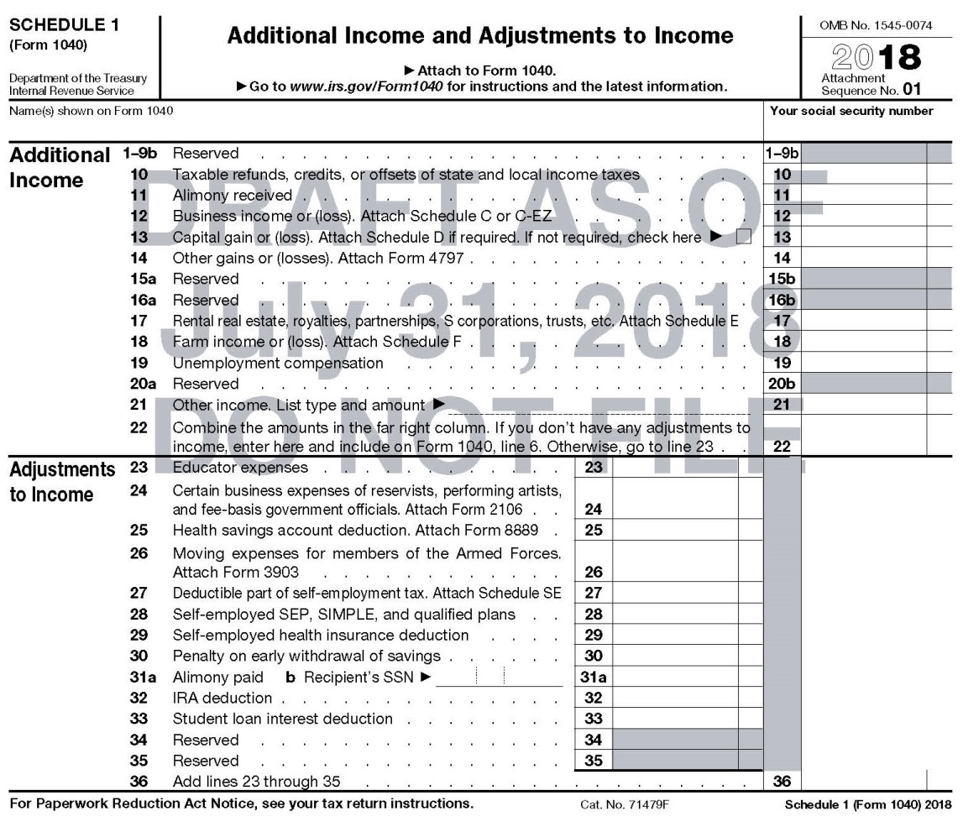
2018 INDIVIDUAL INCOME TAX WORKSHOP
THE NEW SIX SCHEDULES
Schedule 1 – Additional Income and Adjustments to Income
Additional Income - Taxable Refunds, Credits, or Offsets of State and Local Income Taxes, Alimony Received, Business Income or (Loss), Capital Gain or (Loss), Other Gains or (Losses), Rental Real Estate, Royalties, Partnerships, S Corporations, Trusts, Etc., Farm Income or (Loss), Unemployment Compensation.

Slide 24
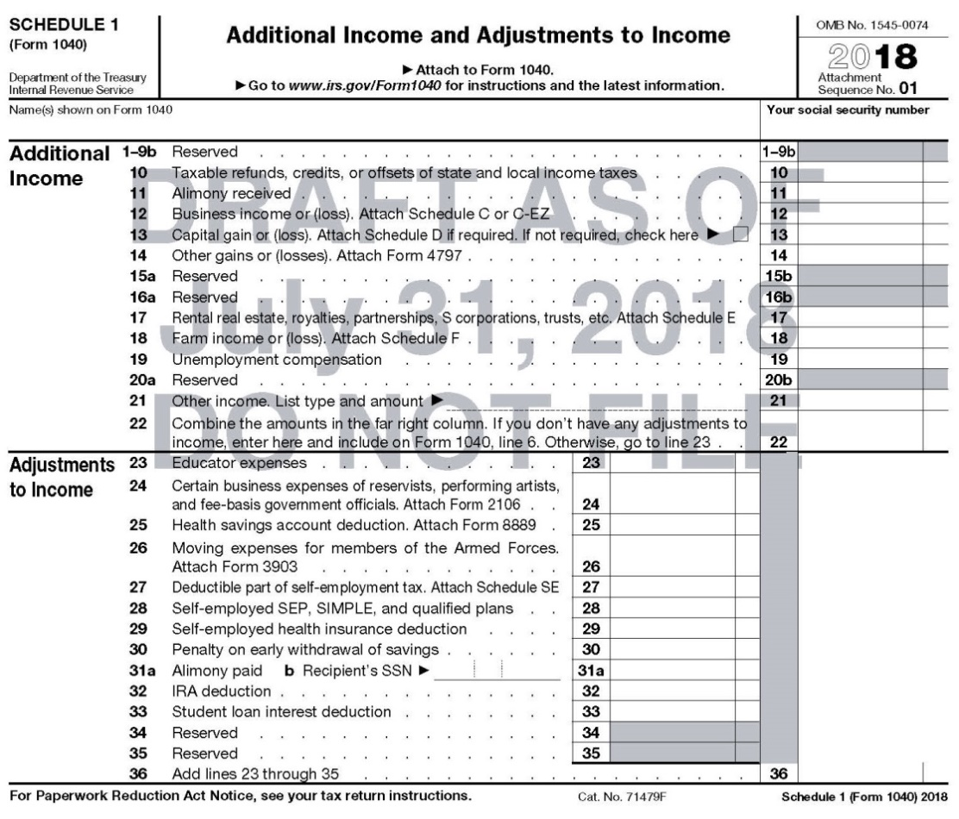
2018 INDIVIDUAL INCOME TAX WORKSHOP
THE NEW SIX SCHEDULES
Schedule 1 – Additional Income and Adjustments to Income
Adjustments to Income - Educator Expenses, Certain Business Expenses, Health Savings Account Deduction, Moving Expenses (Only Armed Forces Members), Deductible Part of Self-Employment Tax, Self-Employed SEP, SIMPLE, and Qualified Plans, Self-Employed Health Insurance Deduction, Penalty on Early Withdrawal of Savings, Alimony Paid, IRA Deduction, Student Loan Interest Deduction.

Slide 25
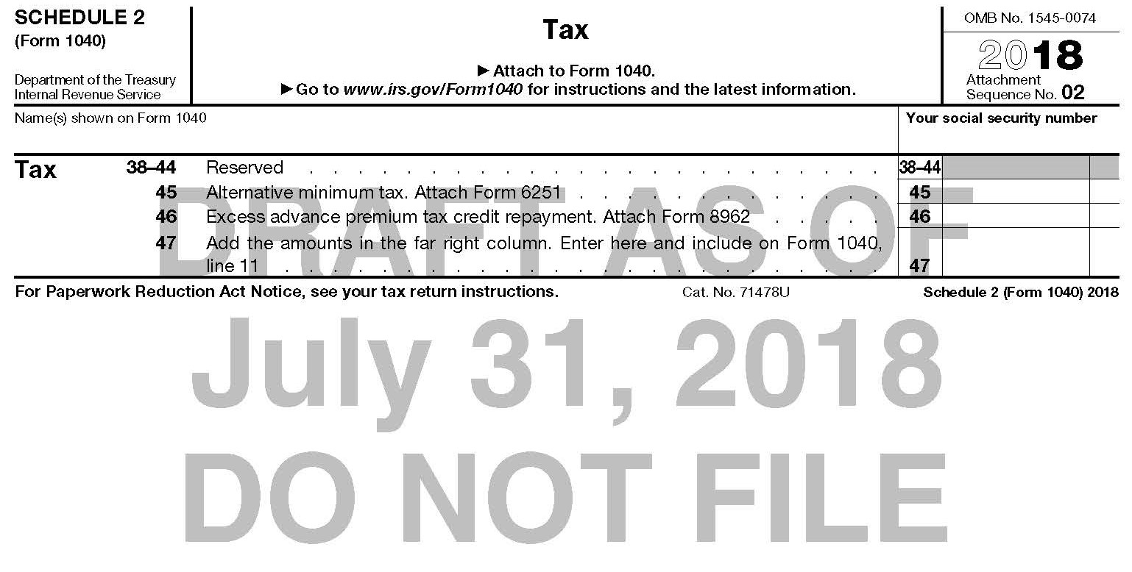
2018 INDIVIDUAL INCOME TAX WORKSHOP
THE NEW SIX SCHEDULES
Schedule 2 – Tax
Alternative Minimum Tax
Excess Advance Premium Tax Credit Repayment

Slide 26
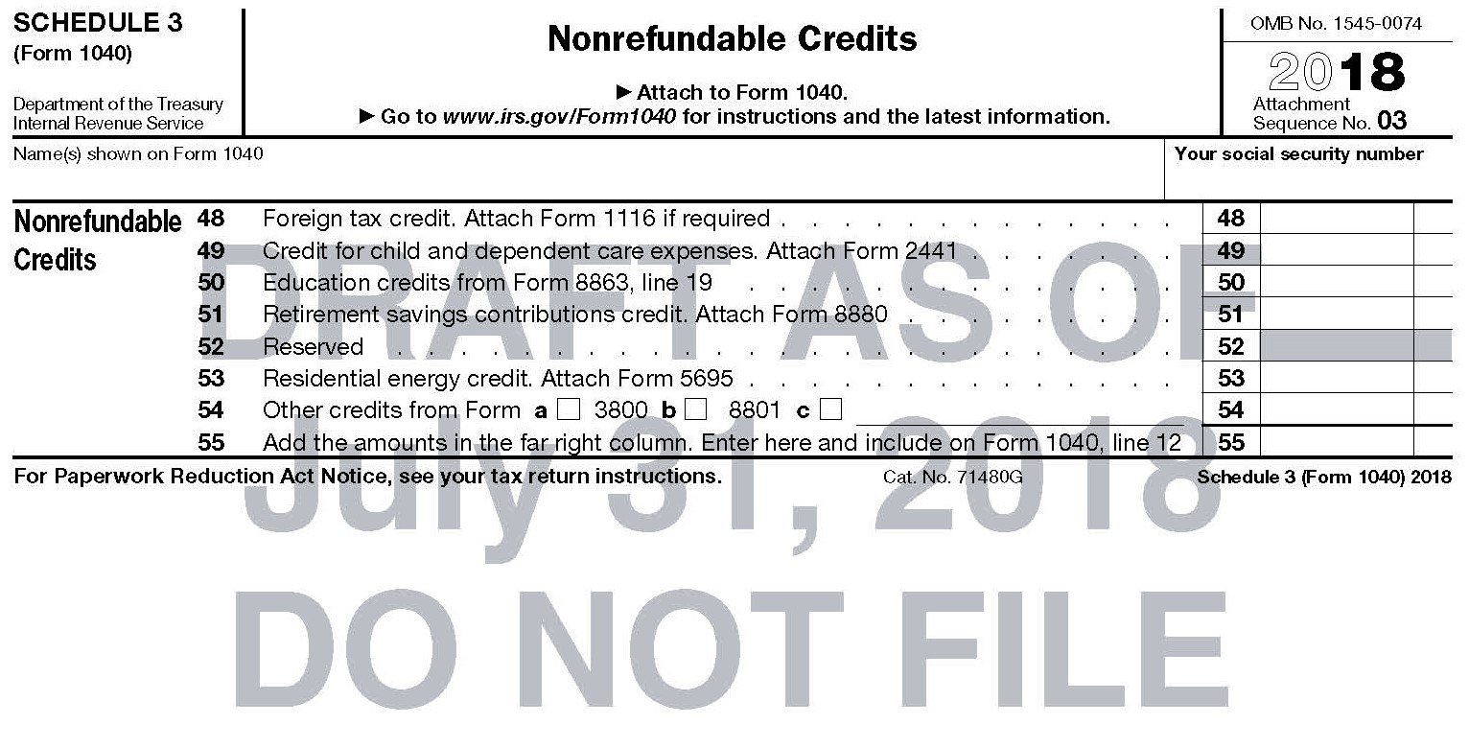
2018 INDIVIDUAL INCOME TAX WORKSHOP
THE NEW SIX SCHEDULES
Schedule 3 – Nonrefundable Credits
Foreign Tax Credit
Credit For Child and Dependent Care Expenses, attach Form 2441
Education Credits
Residential Energy Credit

Slide 27
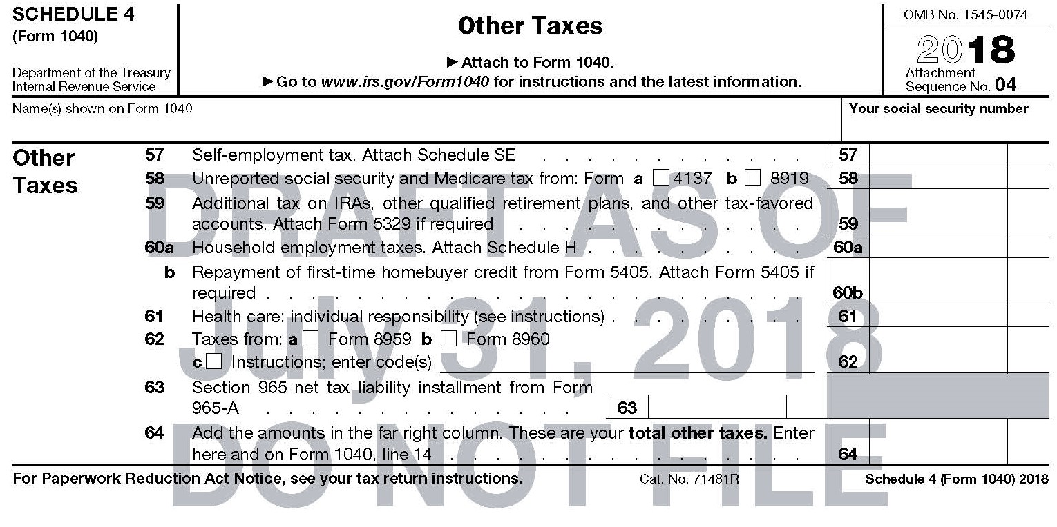
2018 INDIVIDUAL INCOME TAX WORKSHOP
THE NEW SIX SCHEDULES
Schedule 4 – Other Taxes
Self-Employment Tax
Unreported Social Security and Medicare Tax From Form 4137 Or 8919
Additional Tax On IRAS, Other Qualified Retirement Plans, Other Tax-Favored Accounts.
Household Employment Taxes
Repayment of First-Time Homebuyer Credit From Form 5405
Health Care Individual Responsibility
Taxes from Form 8959 or Form 8860
Section 965 Net Tax Liability Installment from Form 965-A

Slide 28
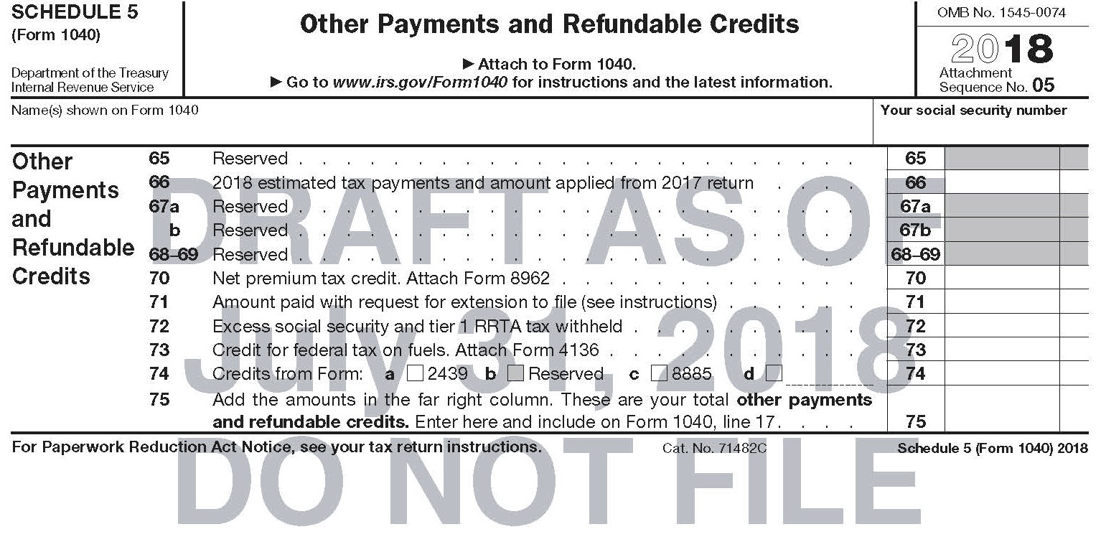
2018 INDIVIDUAL INCOME TAX WORKSHOP
THE NEW SIX SCHEDULES
Schedule 5 – Other Payments and Refundable Credits
2018 Estimated Tax Payments and Amount Applied from 2017 Return
Net Premium Tax Credit
Amount Paid With Request for Extension to File
Excess Social Security and Tier 1 TTYA Tax Withheld
Credit for Federal Tax on Fuels
Credits from Form 2439, or Form 8885

Slide 29
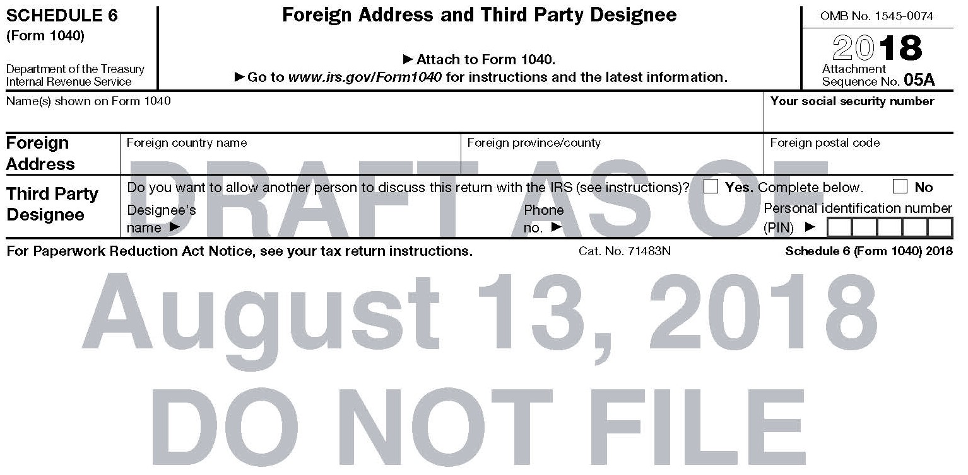
2018 INDIVIDUAL INCOME TAX WORKSHOP
THE NEW SIX SCHEDULES
Schedule 6 – Foreign Address and Third Party Designee
Foreign Address:
Foreign Country Name, Foreign Province/County, Foreign Postal Code
Third Party Designee
Do You Want To Allow Another Person To Discuss This Return With The IRS?
Name, Phone, Personal Identification Number

Slide 30
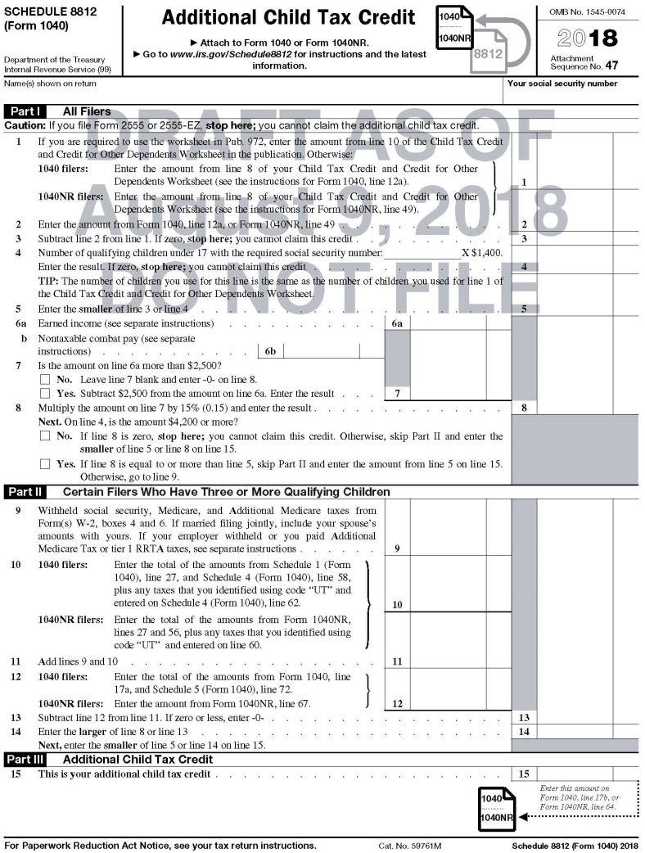
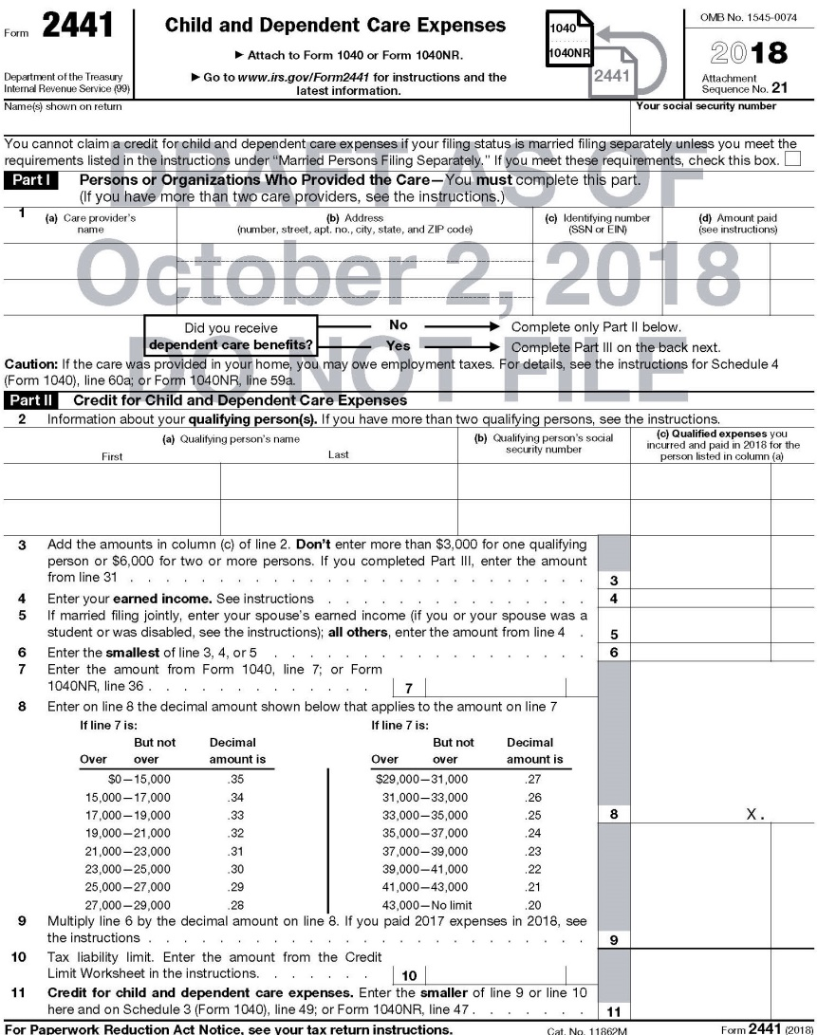
2018 INDIVIDUAL INCOME TAX WORKSHOP
CHILD TAX CREDITS
Starting 2018, The Tax Cuts and Jobs Act (TCJA) increased the Child Tax Credit (CTC) for Form 2441 from $1,000 to up to $2,000 per child under 17 at the end of the tax year and the Additional Child Tax Credit (ACTC) for Schedule 8812 the alternative refundable credit is limited to $1,400 per child.

Slide 31
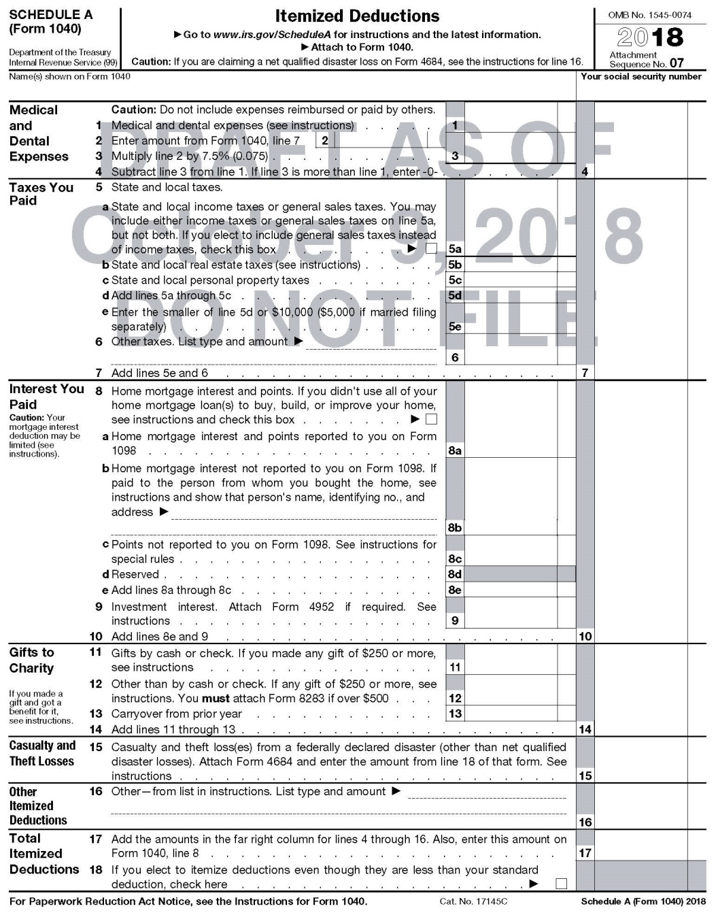
2018 INDIVIDUAL INCOME TAX WORKSHOP
ITEMIZED DEDUCTIONS, SCHEDULE A. NOW HAS 6 SECTIONS

Slide 32
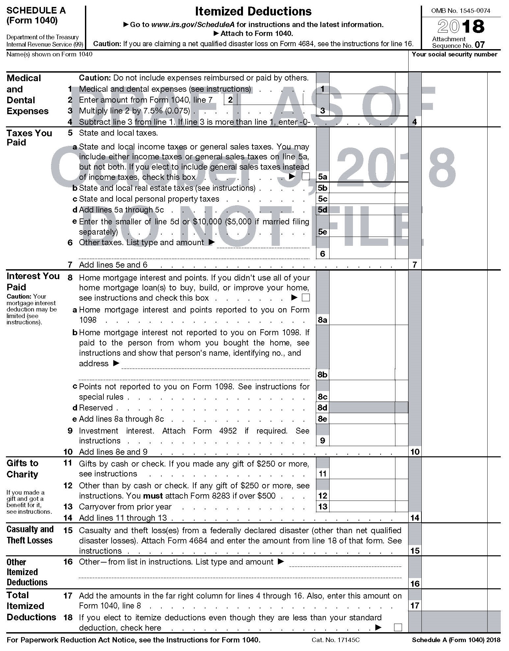
2018 INDIVIDUAL INCOME TAX WORKSHOP
MEDICAL AND DENTAL EXPENSES
Medical and Dental Deductions are Out of Pocket expenses ‘That you paid’ for medical insurance, products, and services such as; COBRA, Medical, Dental, and Vision Insurance Premiums, Prescriptions and Co-payments, Deductibles, Contacts Lens, Glasses, Approved Medical Devices, etc. are deductible.
Generally, medical expenses for cosmetic surgery; specific procedures with the intention to enhance your appearance are not deductible.
For 2018, for All Taxpayers, the deduction is limited to amounts above 7.5% of your “Adjusted Gross Income.” The lower limitation for Seniors 65 or older, was eliminated.
Medical Transportation Costs are also deductible provided they are primarily for and essential to medical care. Deductible Transportations are bus, train, taxi, plane fares or ambulance services as well as Medical Mileage, for driving to and from medical appointments. For 2018, Vehicle Medical Mileage is deducted at 18 cents per mile.
Suggestions:
Before the end of the year, ask your Insurer and Pharmacist to print out all Medical visits and Prescriptions to determine if you are close to or are above 7.5% of your “Adjusted Gross Income.”
If you are close to or over, consider seeing your Doctor, Dentist, or fill prescriptions before the end of the year so that you can deduct the expense.

Slide 33
2018 INDIVIDUAL INCOME TAX WORKSHOP
STATE INCOME TAX, PERSONAL PROPERTY TAX, & REAL ESTATE TAX - LIMITED DEDUCTION
Suggestions:
Generally, your State Income Taxes will be listed on your W-2, but do not forget to include any voluntary Quarterly State Tax Payments.
If you filed your State Income Taxes and you paid additional taxes in the current year, your Total State Income Taxes paid is that additional State Taxes you paid when you filed your State Tax return, plus State Income Taxes listed on your W-2, which may be deducted on your Federal 1040, Schedule A, Itemized Deductions. For example, if you filed your 2017 Virginia Income Tax Return in 2018, paying an additional $200 Income Tax, then your total State Income Taxes paid would be the additional $200 State Income Tax paid, plus $10,000 State Income Taxes listed on your W-2 for a total of $10,200. Interest and penalty are not included.
If you itemized your deductions the previous year, which included a deduction for State Income Taxes and received a State Refund, do not forget to add the refund amount from the State Dept. of Revenue or Tax, Form 1099-G, on Schedule 1, Line 10. If in 2017, you did not receive a State Refund, did not Itemize, and did not receive Form 1099-G; there is nothing to list.
For Virginia and some other states, include Vehicles Personal Property Tax Paid, plus the Personal Property Tax Vehicle Registration, which was called the “Sticker.”

Slide 34
2018 INDIVIDUAL INCOME TAX WORKSHOP
STATE INCOME TAX, PERSONAL PROPERTY TAX, & REAL ESTATE TAX - LIMITED DEDUCTION
Starting in 2018, the Tax Cuts and Jobs Act (TCJA) limits the Itemized Deductions, Taxes Paid for ALL state and local taxes individual taxpayers can deduct in a calendar year to only $10,000, which includes all State and Local as well as Foreign:
          Income Tax
          Real Estate Tax
          Personal Property Tax
          Sales and Use Taxes
          Income Tax paid to Foreign Jurisdictions *
          *(Taking a Foreign Tax Credit may be more beneficial)

Slide 35
2018 INDIVIDUAL INCOME TAX WORKSHOP
INTEREST ON HOME MORTGAGES AND EQUITY LINES
Only Home Mortgage and Equity Line Interest are Deductible.
Personal Interest paid to Credit Cards are not Deductible.
Home Mortgages - Beginning in 2018, the Tax Cuts and Jobs Act (TCJA) modified the deduction so that taxpayers may only deduct interest up to $750,000 of qualified residence loans. The limit is $375,000 for a married taxpayer filing a separate return. The limits apply to the combined amount of loans used to buy, build or substantially improve the taxpayer’s main home and second home. These new limits are lower than the prior limits of $1 million, or $500,000 for a married taxpayer filing a separate return.
Equity Lines – Starting 2018, they are only deductible if used to buy, build or substantially improve the taxpayer’s home that secures the loan.

Slide 36
2018 INDIVIDUAL INCOME TAX WORKSHOP
CHARITABLE CONTRIBUTIONS
Generally, a deduction is valid only if given to a Charitable Organization that is Tax-exempt by 26 U.S.C. § 501(c) of the Internal Revenue Code (IRC), whereby it is exempt from federal income tax if its activities have the basic purpose for the Betterment of Humans: charitable, religious, educational, scientific, literary, testing for public safety, fostering amateur sports, etc.
https://www.irs.gov/Charities-&-Non-Profits/Charitable-Organizations/Exempt-Purposes-Internal-Revenue-Code-Section-501(c)(3)
Verify 501(c) Tax-exempt status at: https://apps.irs.gov/app/eos/mainSearch.do?mainSearchChoice=pub78&dispatchMethod=selectSearch
Suggestions:
If you have a “Some Extra Funds,” consider making an extra payment to your Church, Synagogue, Mosque or other charity before the end of the year to increase your Deduction. For 2018, using your Vehicle for a Charity is deductible at 14 cents per mile.
Donations to Charities other than cash, such as Computers, Clothing, Housewares, TV’s, etc. are also deductible.
The question is their value. The Salvation Army provides a great “Donation Value Guide” https://satruck.org/Home/DonationValueGuide that provides 4 pages of items with high and low values.
For an Automobile or Truck, the deduction is restricted to the lower of the Fair Market Value or the amount the charity actually sold the vehicle. If the Automobile or Truck Value is $1,000, but if only sold for $500, then only $500 is deductible.

Slide 37
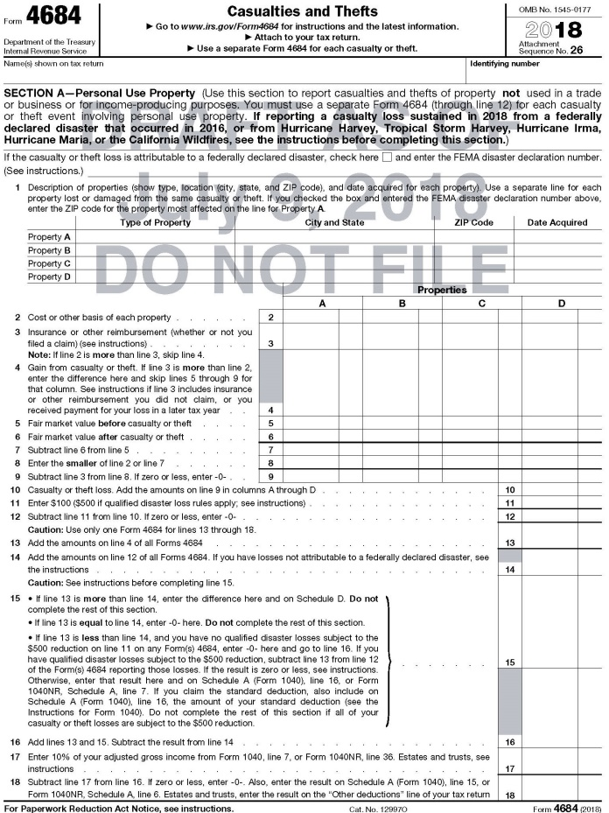
2018 INDIVIDUAL INCOME TAX WORKSHOP
CASUALTY AND THEFT LOSSES OF PROPERTY, NOT USED IN A TRADE OR BUSINESS
Beginning in 2018, the Tax Cuts and Jobs Act (TCJA) modified the Casualty and Thefts deduction only if they occur in a Federally Declared Disaster Area with a FEMA Disaster Declaration Number. For 2018, Federal Form 4684 Casualty and Thefts, will continue to Limit the Deduction to any amount over 10% of “Adjusted Gross Income.”

Slide 38
2018 INDIVIDUAL INCOME TAX WORKSHOP
OTHER MISCELLANEOUS DEDUCTIONS
If you had a Net Qualified Disaster Loss and you can elect to increase your Standard Deduction
For 2018, if you have “Net Qualified Disaster Losses” on Form 4684, Casualties and Thefts, line 15, and you are not itemizing your deductions, you can claim an increased standard deduction using Schedule A by doing the following:
List the amount from Form 4684, line 15, on Schedule A, line 16 “Other,” on the first dotted line, type "Net Qualified Disaster Loss," and attach Form 4684.
List your standard deduction amount on Schedule A, line 16 “Other” on the second dotted line next to line 16 as "Standard Deduction Claimed With Qualified Disaster Loss."
Combine the two amounts on line 16 and enter on Form 1040, line 8.
Do not enter an amount on any other line of Schedule A.
For more information on how to determine your increased standard deduction, see Pub. 976.
2018 Form Schedule A, Itemized Deductions - Instructions
https://www.irs.gov/pub/irs-dft/i1040sca--dft.pdf

Slide 39
2018 INDIVIDUAL INCOME TAX WORKSHOP
MISCELLANEOUS ITEMIZED DEDUCTIONS
Starting 2018, The Tax Cuts and Jobs Act (TCJA) Suspended most Itemized Deductions, Schedule A., Miscellaneous Itemized Deductions such as:
Deductions for employee business expenses
Tax preparation fees
Investment expenses, including investment management fees
Employment related educational expenses
Job search expenses
Hobby losses
Safe deposit box fees
Investment expenses from pass-through entities
Personal Casualty and Theft Loss Deduction are suspended, unless incurred in Federally-declared Disaster Area with a FEMA Number.
Moving Expenses are no longer be deductible, except for members of the Armed Forces who move due to a military order.

Slide 40
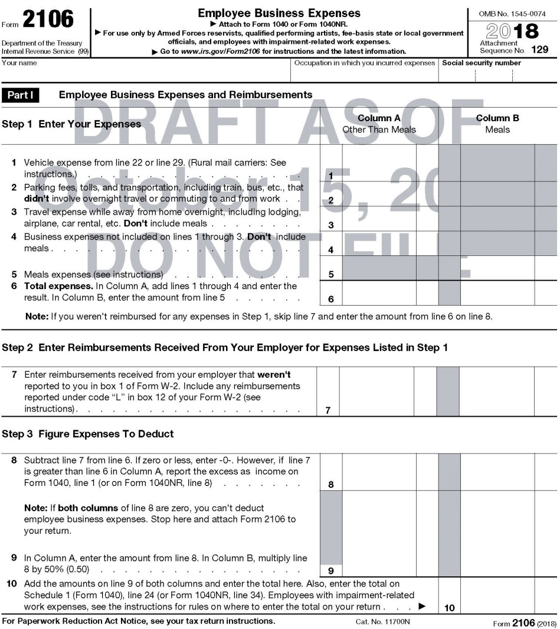
2018 INDIVIDUAL INCOME TAX WORKSHOP
EMPLOYEE BUSINESS EXPENSES - FORM 2106
Starting 2018, The Tax Cuts and Jobs Act (TCJA) Suspended Itemized Deductions, Schedule A., Miscellaneous Itemized Deductions - Employee Business Expenses and Form 2106 is Limited to be only be filed by:
• Armed Forces Reservists,
• Employees with impairment-related work expenses,
• Employees who received employer reimbursements,
• Qualified performing artists, and
• Fee-basis state or local government officials

Slide 41
2018 INDIVIDUAL INCOME TAX WORKSHOP
SUGGESTIONS
Question:
If I take the Standard Deduction this year, can I pay for some things the next year?
Answer:
For 2018 and many following years, because of the Tax Cuts and Jobs Act (TCJA) Standard Deduction increases, Most Taxpayers will be Filing a Standard Deduction and Not Itemizing.
When you have to take the Standard Deduction because you do not have enough expenses to itemize in 2018, you can “Defer” or “Put off” paying some things to 2018; as long as the Bank does not charge any additional penalties or interest.
If your Mortgage is better than up to date, perhaps you could put off making that extra payment until the following year.
If your current Itemized Deductions are close to the Standard Deduction amount, if you have just a “Little Extra Funds,” think about making an extra payment on your Mortgage before the end of the year to increase your Mortgage Interest Deduction.
If you have a “Larger Amount of Extra Funds,” consider making a payment on your Mortgage “To Principle Only,” which will eventually decrease the total Interest, the number of Mortgage payments, and you will pay off your Mortgage earlier.

Slide 42
2018 INDIVIDUAL INCOME TAX WORKSHOP
TAX BRACKETS AND FILING STATUS
The Federal Income Tax owed depends on Income Level and Filing Status.
              0-$9,525
              $9,526 - $38,700
              $38,701 - $82,500
              $82,501 - $157,500
              $157,501 - $200,000
              $200,001 - $500,000
              $500,001 +
Filing Status is based on marital status and family situation.
There are Five Possible Filing Status Categories:
            Single.
            Married filing jointly.
            Married filing separately.
            Head of household.
            Qualifying widow(er) with dependent child.

Slide 43
2018 INDIVIDUAL INCOME TAX WORKSHOP
TAX RATES
For 2017 , the tax rates in seven (7) Tax Brackets was:
10%, 15%, 25%, 28%, 33%, 35%, and 39.6%.
For 2018, the Tax Cuts and Jobs Act (TCJA) the seven (7) Tax Brackets remained, but the Tax Rates were lowered:
The new Tax Rates are:
10%, 12%, 22%, 24%, 32%, 35%, and 37%

Slide 44
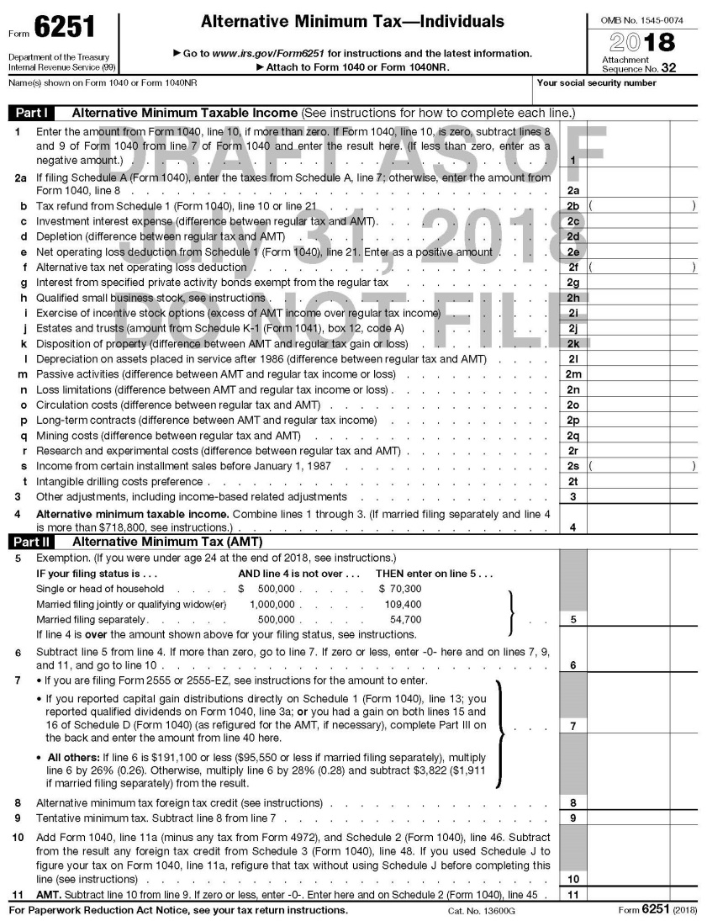
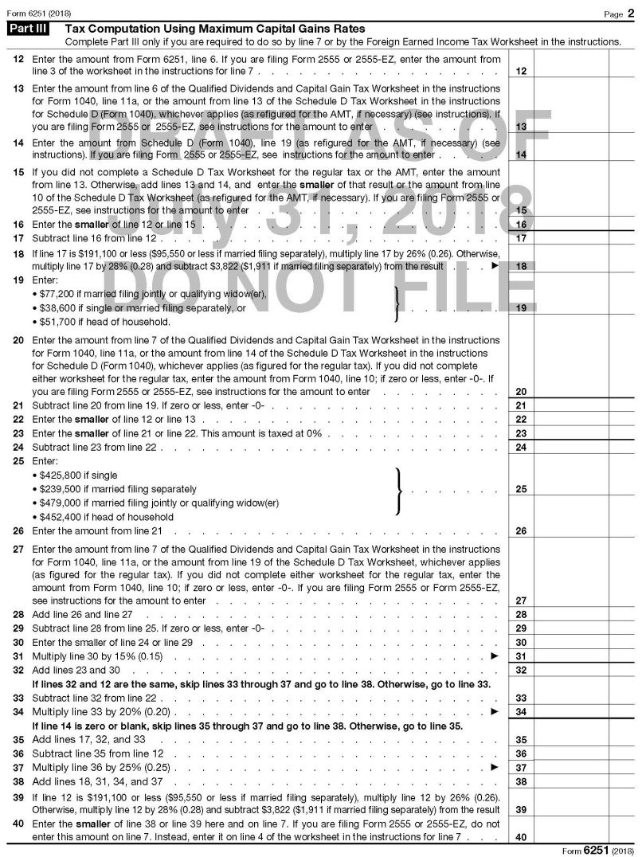
2018 INDIVIDUAL INCOME TAX WORKSHOP
ALTERNATIVE MINIMUM TAX (AMT)- FORM 6251
IRS TIP- If you owe AMT, you may be able to lower your total tax (regular tax plus AMT) by claiming Itemized Deductions on Form 1040, even if your total Itemized Deductions are less than the Standard Deduction. This is because the Standard Deduction is not allowed for AMT and, if you claim the Standard Deduction on Form 1040, you can not claim Itemized Deductions for AMT.

Slide 45
2018 INDIVIDUAL INCOME TAX WORKSHOP
ALTERNATIVE MINIMUM TAX (AMT)- INFORMATION
Alternative Minimum Tax (AMT)- Designed for High Income Earners and a Few middle-income filers to pay more Individual Income Tax by generally limiting deductions claimed.
Taxpayer’s must pay the higher of the Regular Tax Calculation or the AMT Calculation
Tax Cuts and Jobs Act - Permanently Adjusts Individual AMT limits for inflation.
Permanently Abolished Corporate AMT.
Alternative Minimum Tax Income (AMTI) - The starting point is Form 1040, Line 10 Taxable Income, which is calculated by adding Line 7, Adjusted Gross Income, less Line 8, Standard or Itemized Deduction and less Line 9, Qualified Business Income Deductions. Next, certain Tax Exclusions and Deferrals are added back.
AMT Exemptions Amounts
IF Filing Status is . . . . . . . . . . . . . AND AMTI is not over . . . THEN Exemption Amount
Single or head of household . . . . $500,000 . . . . . . . . . . . . . . $70,300
Married filing jointly or
Qualifying widow(er) . . . . . . . . $1,000,000 . . . . . . . . . . . . . . . $109,400
Married filing separately. . . . . . . . $500,000 . . . . . . . . . . . . . . . $54,700
2018, Alternative Minimum Tax Income (AMTI) Brackets
While there are seven tax brackets in the Standard Income Tax Calculation Method, the AMT has only two: 26% and 28%.
Filing Status 26% AMT Tax Rate 28% AMT Tax Rate
Married filing separately AMTI up to $95,750 AMTI above $95,750
All other filers AMTI up to $191,500 AMTI above 191,500

Slide 46
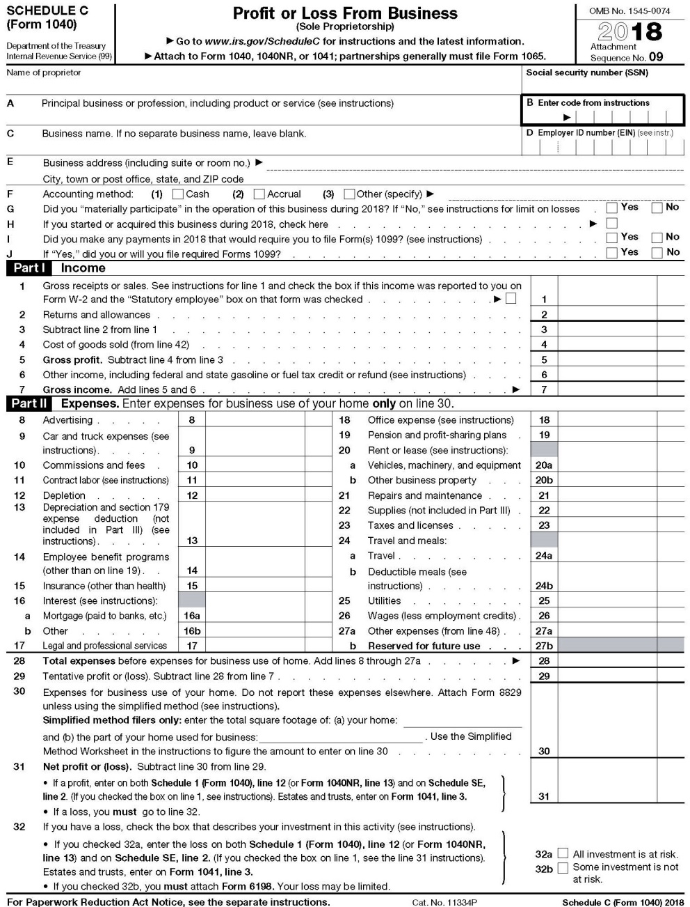
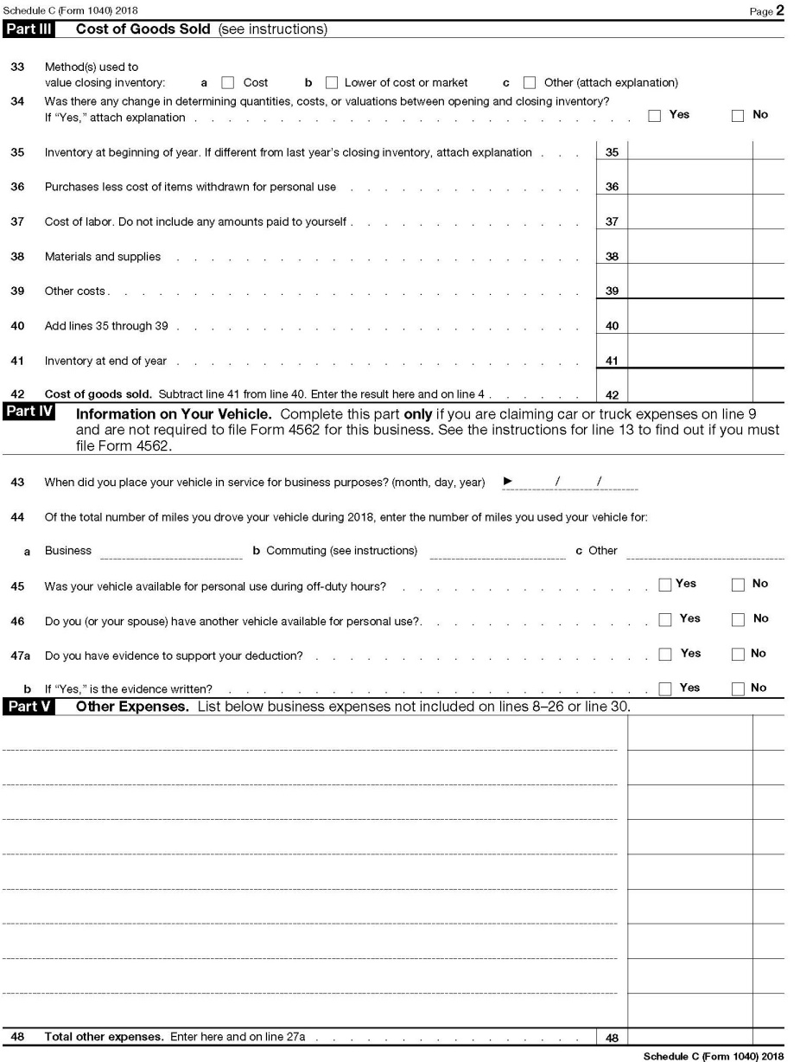
2018 INDIVIDUAL INCOME TAX WORKSHOP
SCHEDULE C, PROFIT OR LOSS FROM BUSINESS- SOLE PROPRIETORSHIP

Slide 47
2018 INDIVIDUAL INCOME TAX WORKSHOP
PASS-THROUGH ENTITIES - DEDUCTION UP TO 20% OF QUALIFIED BUSINESS INCOME
https://www.irs.gov/newsroom/tax-cuts-and-jobs-act-provision-11011-section-199a-qualified-business-income-deduction-faqs
A Pass-through Entity is a domestic business operated as a Sole Proprietorship or Through a Partnership, S Corporation, Trust or Estate and recognized as a separate entity for federal income tax purposes.
Starting 2018, The Tax Cuts and Jobs Act (TCJA) created a Sec. 199A Deduction for up to 20% of Qualified Business Income (QBI) for entities where income is “Passed through.” Individuals, trusts and estates with Qualified Business Income (QBI), Qualified REIT Dividends or Qualified PTP Income may qualify for the deduction.
Eligible taxpayers may be entitled to a deduction of up to 20 % of Qualified Business Income (QBI) from a domestic business operated as:
Sole Proprietorship (Form Schedule C) Partnership, S-Corporation, Trust or Estate
The deduction is not available if a taxpayer’s taxable income exceeds $315,000 for a married couple filing a joint return, or $157,500 for all other taxpayers for Specified Service Trade or Business (SSTB), which includes a trade or business involving the performance of services in the fields of:
Health, Law, Accounting, Actuarial Science, Performing Arts, Consulting, Athletics, Financial Services, Investing and Investment Management
Trading, dealing in certain assets or any trade or business where the principal asset is the reputation or skill of one or more of its employees.
1040 Instructions page 37, Qualified Business Income Deduction-Simplified Worksheet Line 15. Qualified Business Income Deduction, enter amount on Form 1040, line 9.

Slide 48
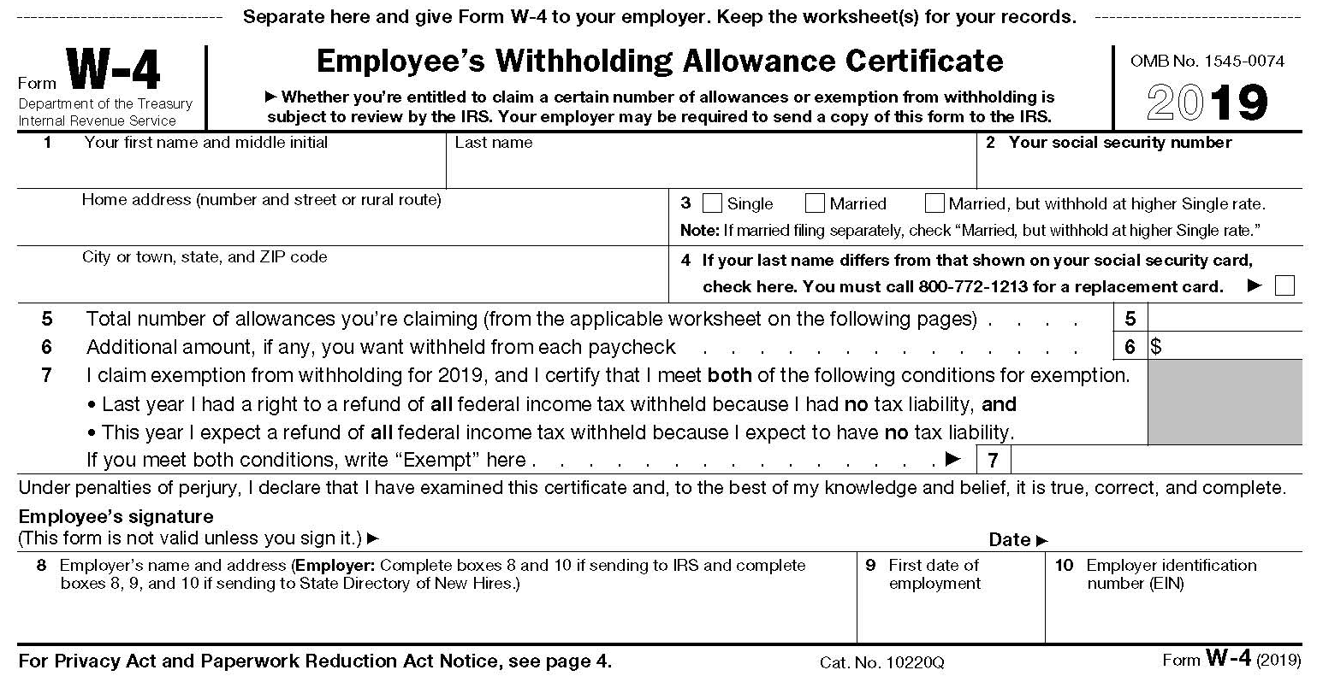
2018 INDIVIDUAL INCOME TAX WORKSHOP
Tax Year 2019, Withholding Tax - Form W-4
For the IRS Withholding Calculator go to www.irs.gov/W4App
Although starting in 2018, the Tax Cuts and Jobs Act (TCJA) suspended the Personal Exemption (People) for Individual Income Tax Returns, but left the Personal Allowance (People) for Withholding Tax Calculations, which is $4,200 per Person. The Act also lowered the Employee Withholding Tax Tables so that employees received more in their paychecks, but it results in Smaller Tax Refunds when Individual Income Tax Returns are filed.

Slide 49
2018 INDIVIDUAL INCOME TAX WORKSHOP
AFFORDABLE CARE ACT (ACA) – HEALTHCARE COVERAGE
Starting 2018, The Tax Cuts and Jobs Act (TCJA) Eliminated the Affordable Care Act (ACA) Individual Mandate Penalty, which required all U.S. Citizens to have Health Care Coverage.
Currently, in the U.S. there are five types of Healthcare Insurance:
Private, Through an Employer, Medicare, Medicaid,
Obamacare, and VA (Veterans Administration)
If all five Healthcare Insurers merged into one National Healthcare policy, then since there would be a greater number of insurers in the “Insurance Pool” to adsorb the risks, the premiums should be less, and yet provide better coverage.

Slide 50
2018 INDIVIDUAL INCOME TAX WORKSHOP
IMPORTANT DATES FOR 2018 AFFORDABLE CARE ACT ENROLLMENT
https://www.healthcare.gov/quick-guide/dates-and-deadlines
If you don’t have health insurance through a Job, Medicare, Medicaid, the Children’s Health Insurance Program (CHIP), or another source that provides qualifying coverage, the Health Insurance Marketplace can provide you with coverage.
For 2018, the Open Enrollment Period was reduced to run from November 1, 2018 to December 15, 2018.
If you did not enroll in a health insurance plan for 2018 you may qualify for a Special Enrollment Period.
Current Dates, Unless Congress Changes the Laws:
November 1, 2018: Open Enrollment started — first day to enroll, re-enroll, or change a 2019 insurance plan through the Health Insurance Marketplace.
December 15, 2018: Last day to enroll in or change plans for coverage to start January 1, 2019.
January 1, 2019: 2019 coverage starts for those who enrolled or changed plans by December 15.
January 29, 2019 to April 15, 2019: IRS Tax Season for filing 2018 Individual Income Tax Return, unless extension is filed, then due October 15, 2019.

Slide 51
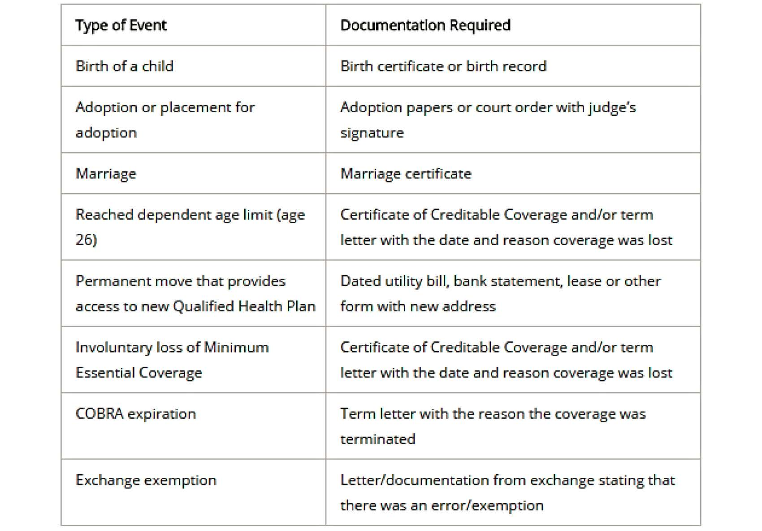
2018 INDIVIDUAL INCOME TAX WORKSHOP
SPECIAL ENROLLMENT PERIOD (SEP)
Special Enrollment Period is a time outside the yearly Open Enrollment Period when you can sign up for health insurance. You qualify for a Special Enrollment Period if you’ve had certain Life Events, including losing health coverage, moving, getting married, having a baby, or adopting a child. https://www.healthcare.gov/glossary/special-enrollment-period
Generally, Special Enrollment Periods apply to all health insurance plans through a Job, Medicare, Medicaid, the Children’s Health Insurance Program (CHIP), or another source that provides qualifying coverage, but paying too much for health care does not qualify for the enrollment.
The following are Life Events or Qualifying Events that would trigger a Special Enrollment Period, and the documentation needed for each:
https://www.healthcare.gov/coverage-outside-open-enrollment/special-enrollment-period

Slide 52
2018 INDIVIDUAL INCOME TAX WORKSHOP
FLEXIBLE SPENDING ACCOUNT (FSA) - DEFINITION
A Flexible Spending Account allows an employee to set aside a portion of earnings to pay for qualified expenses as established in the cafeteria plan, most commonly for medical expenses, but often for dependent care or other expenses. Money deducted from an employee's pay into an FSA is not subject to payroll taxes, resulting in substantial payroll tax savings.
Under the Affordable Care Act, a plan may permit an employee to carry over up to $500 into the following year without losing the funds.
https://en.wikipedia.org/wiki/Flexible_spending_account
A Flexible Spending Account (FSA) is simply a savings account offered by an employer to help employees put away “Tax-free money” for “Qualified Medical Expenses.”
Generally, by paying medical expenses with “Pre-Tax money” or “Tax-free money,” then if your Tax rate is 25% you are saving 25%; just like getting a discount! Deductions are easy, they are taken out of your paycheck by your employer.

Slide 53
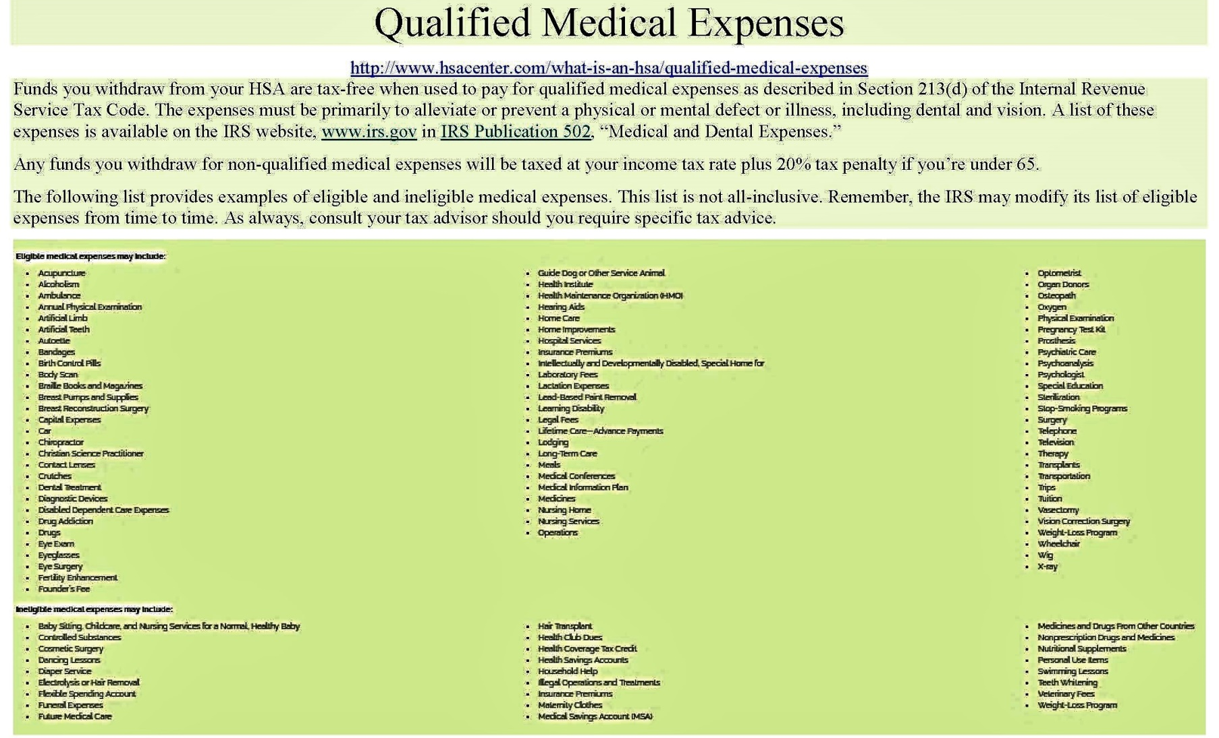
2018 INDIVIDUAL INCOME TAX WORKSHOP
FLEXIBLE SPENDING ACCOUNT (FSA) - QUALIFIED MEDICAL EXPENSES
The IRS is very strict what are considered “Qualified Medical Expenses.” http://www.hsacenter.com/what-is-an-hsa/qualified-medical-expenses

Slide 54
2018 INDIVIDUAL INCOME TAX WORKSHOP
FLEXIBLE SPENDING ACCOUNT (FSA) PLANS
Use It or Lose It Policy
Generally, some Flexible Spending Account Plans (FSA) still have a “Use It or Lose It Policy.” This means that amounts in the account at the end of the plan year cannot be carried over to the next year. If your plan follows this rule, you should make sure to use all of your funds by the end of the plan year, which generally is the end of the calendar year.
As part of the Affordable Care Act, the IRS has changed the rules so that Flexible Spending Account Plans may permit an employee to carry over up to $500 into the following year without losing the funds, but it is not required.
Suggestions:
Because of some FSA plans have the “Use It or Lose It Policy, ” if you do not spend everything in your account, legally the company is not responsible to pay you the balance. Before the end of the year, spend your FSA on Qualified Medical Expenses to maximize your tax savings.
FSA Store https://fsastore.com offers only FSA-Eligible Products for sale.
Flexible Spending Accounts allows “Pre-funding,” which means you can spend the money in the account before it’s actually deposited. If you left a company where your Flexible Spending Account paid all the Medical Expenses during the year, but your Payroll Deductions were less, then you are not responsible to pay the company the difference. Although, the company may take it out of your final paycheck.

Slide 55
2018 INDIVIDUAL INCOME TAX WORKSHOP
WHY ARE UNEMPLOYMENT BENEFIT PAYMENTS TAXABLE?
Similar to Medical Insurance Benefits, Unemployment Benefits are just another “Employee Benefit.”
When you file for Unemployment Benefits, the state pays you from a State Trust Fund, which has State Unemployment Taxes plus Federal Unemployment Taxes; both paid by organizations.
Generally, most insurance proceeds or payments are not taxable. Although unemployment is an insurance paid by employers, to protect salaries, starting with the Tax Reform Act of 1986, unemployment insurance benefits became taxable as a “Substitute for Wages.”
According to The Tax Foundation, of the 41 states that tax wage income, 5 states completely exempt unemployment benefits from tax (California, New Jersey, Oregon, Pennsylvania, and Virginia). Two states (Indiana and Wisconsin) partially exempt a fixed dollar amount of unemployment benefits from state income tax but tax the rest, following federal practice from 1982 to 1986. The remaining states fully tax unemployment benefits.
After the end of the year, the Unemployment Benefits Beneficiary should receive Federal Form 1099-G, Certain Government Payments listing the Unemployment Compensation, Federal Income Tax Withheld, and any State Income Tax Withheld. Generally, Severance and Vacation Pay will be allocated to the employees last week at the organization and should be included in the W-2 issued by that organization.

Slide 56
2018 INDIVIDUAL INCOME TAX WORKSHOP
UNEMPLOYMENT BENEFITS FOR 501(C)(3) (NON-PROFIT) EMPLOYEES
An organization that is exempt from income tax under Section 501(c)(3) (Non-profit) of the Internal Revenue Code is also exempt from Federal Unemployment Taxes (FUTA).
https://www.irs.gov/charities-non-profits/exempt-organizations-what-are-employment-taxes
The Federal Unemployment Tax Act, Section 3309 enables 501(c)(3) (Non-profit) organizations to opt out of the tax system and to reimburse the state for unemployment claims the state has paid out to the non-profits' former employees.
http://www.501ctrust.org/unemployment-tax-exemption-for-501c3s-explained
In some states, non-profit reimbursing claims is voluntary.
VA Code Ann §60.2-213 (B)(1) only exempts organizations operating primarily for religious purposes from reimbursing claims to the state. Generally, since these groups are not required to reimburse the state, then their employees are not eligible for Unemployment.
https://law.lis.virginia.gov/vacode/title60.2/chapter2/section60.2-213

Slide 57
2018 INDIVIDUAL INCOME TAX WORKSHOP
401(k) FINANCIAL QUESTIONS
Question:
When I left my company, did the company stop matching funds paid into my 401(k)?
Answer:
Yes, generally you are not eligible to receive additional Company Matching Contributions in a 401(k) plan 30 days after the Separation Date, but what was paid is yours and remains in the account.
Generally, you are also not eligible to Contribute additional amounts to the 401(k) plan 30 days after the Separation Date.
Question:
Since I left my company, will my 401(k) investment fees be higher?
Answer:
No, all plans must charge each investor the same fees for the same investments.
Question:
If I leave my 401(k) with the company, will it still earn investment income?
Answer:
Yes, if you leave your 401(k) with the company, it will still earn investment income.

Slide 58
2018 INDIVIDUAL INCOME TAX WORKSHOP
CONCLUSION
“The hardest thing in the world to understand is the income tax.”
Albert Einstein, Physicist
https://www.irs.gov/uac/Tax-Quotes
Please let me know if you have any questions.
John B. Goldhamer
John.Goldhamer@gmail.com
www.LinkedIn.com/in/JohnGoldhamer
www.JohnGoldhamer.com
I can Hammer out any Tax Problem!

