Slide 1
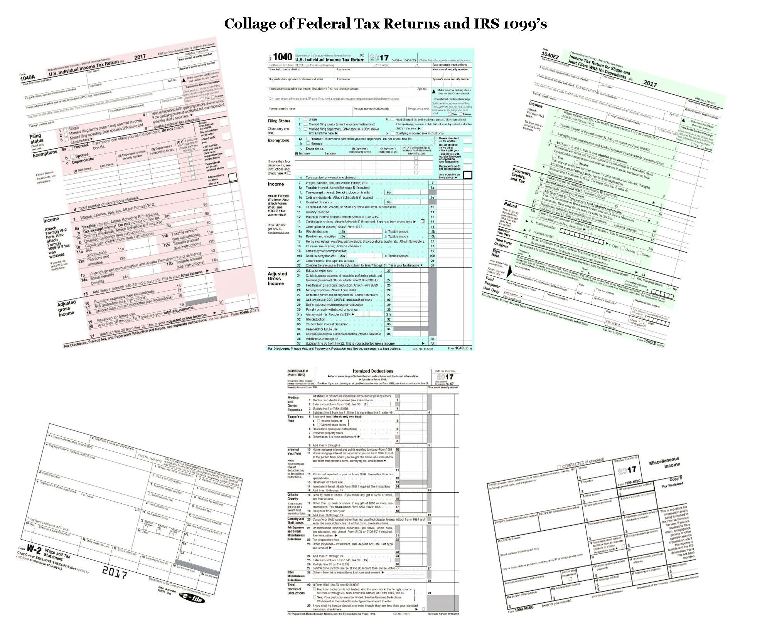
2017 INDIVIDUAL INCOME TAX WORKSHOP
John B. Goldhamer, an Authored Tax Law Expert, reviews the 2017 U.S. Individual Income Tax Forms published by the Internal Revenue Service (IRS) and makes suggestions; including explaining the “Affordable Care Act” requirements. He humorously says,
"I can Hammer out any Tax Problem!"

Slide 2
2017 INDIVIDUAL INCOME TAX WORKSHOP
TABLE OF CONTENTS
Slide Topic Slide
Why Should You Listen To John B. Goldhamer? …………………………………………….... 4
John B. Goldhamer’s Job Seeker Tips, Topics & Tools ………………………………………. 5
John B. Goldhamer’s Website: www.JohnGoldhamer.Com ……………………………… 6
JohnGoldhamer.Com: Individual Income Tax Workshops & Unemployment ……. 7
Tax Envelope To Keep Tax Information ……………………………………………………………. 8
Paycheck Stub Matched With W-2 …………………………………………………………………. 9
There are 19 Different Types of IRS Form 1099 ……………………………………………… 10
Three Types of U.S. Individual Income Tax Returns ……………………………………….. 11
What's the Right Form 1040 for Me? 1040EZ, 1040A, or 1040 ……………………... 12
Caveat - Early Release of IRS Tax Forms …………………………………………………………. 13
1040EZ (Easy) U.S. Individual Income Tax Return …………………………………………… 14
1040A (Short Form) U.S. Individual Income Tax Return …………………………………. 15
1040 (Long Form) U.S. Individual Income Tax Return …………………………………….. 16
Standard Deduction Amounts ............................................................................ 17
Itemized Deductions, Schedule A. Has 7 Sections ………………………………………….. 18
Medical and Dental Expenses ………………………………………………………………………… 19
State Income Tax, Personal Property Tax, & Real Estate Taxes- All Deductible .. 20
Interest On Home Mortgages and Equity Lines ……………………………………………... 21
Charitable Contributions …………………………………………………………………................ 22
Casualty and Theft Losses of Property …………………………………………………………… 23
Job Expenses and Certain Miscellaneous Deductions ……………………………………. 24
Other Miscellaneous Deductions …………………………………………………………………… 25

Slide 3
2017 INDIVIDUAL INCOME TAX WORKSHOP
TABLE OF CONTENTS
Slide Topic Slide
Standard Deduction This Year, But What About Next Year? ……………………………. 26
Affordable Care Act (ACA) Requires Health Care Coverage …………..................... 27
ACA- Official Shared Responsibility Payment …………………………………………………. 28
ACA- Official Shared Responsibility Payment Worksheet A. …………………………… 29
ACA- Official Shared Responsibility Payment Worksheet B. …………………………… 30
Official Shared Responsibility Payment Enter On 1040ez, 1040a, 1040 …………. 31
1095-C, Employer-Provided Health Insurance Offer and Coverage ……………….. 32
1095-B, Health Coverage ………………………………………………………………………………. 33
1095-A, Health Insurance Marketplace Statement ……………………………………….. 34
8962, Premium Tax Credit (PTC) ……………………………………………………………………. 35
8965, Health Coverage Exemptions ………………………………………………………………. 36
Types of Coverage Exemptions (16) and Codes ……………………………………………… 37
Important Dates For 2017 Affordable Care Act Enrollment …………………………... 38
Special Enrollment Period (Sep) ……………………………………………………………………. 39
Capital Gains and Losses ………………………………………………………………………………. 40
Flexible Spending Account (FSA) - Definition ………………………………………………… 41
Flexible Spending Account (FSA) - Qualified Medical Expenses …………………….. 42
Flexible Spending Account (FSA) Plans - Use It Or Lose It Policy ……………………. 43
Why Are Unemployment Benefit Payments Taxable? ……………………………......... 44
Unemployment Benefits For 501(C)(3) (Non-Profit) Employees ……………………. 45
401(k) Financial Questions ……………………………………………………………………………. 46
Conclusion …………………………………………………………………………………………………..… 47

Slide 4

2017 INDIVIDUAL INCOME TAX WORKSHOP
Why should you listen to John B. Goldhamer?
Why should you listen to John B. Goldhamer?
John B. Goldhamer is an Authored Tax Law Expert with Education and Experience in all Business Disciplines, including:
J.D. Equivalent Legal Education, Finance, Marketing, MBA, Accounting, and Information Systems.
He has been essentially a Tax Attorney for organizations for numerous years; researching, composing and presenting over 400-pages of Impact Statements, Position Papers, and Tax Appeals to Jurisdictions and Management.
John compiled “Thirty Tax Tools” to assist with Business, Legal, and Tax Research, which are on his website.

Slide 5

2017 INDIVIDUAL INCOME TAX WORKSHOP
John B. Goldhamer
www.LinkedIn.com/in/JohnGoldhamer
www.JohnGoldhamer.com
JOB SEEKER TIPS, TOPICS & TOOLS
John B. Goldhamer is the author of Job Seeker Tips, Topics & Tools, which has Everything a Job Seeker Needs to Get a Job from Beginning to End!
It contains Comprehensive Documents that assist Job Seekers with Composing: Cover Letters, Resumes, Marketing Plans, Researching Companies and People, as well as Presenting an Image and More!
At one time, John taught classes on LinkedIn, Résumé Writing, and Researching the Internet at Employment Transition Centers and Network Groups. He is also on the speaker circuit to organizations and small groups.

Slide 6

2017 INDIVIDUAL INCOME TAX WORKSHOP
John B. Goldhamer’s Website: www.JohnGoldhamer.com

Slide 7
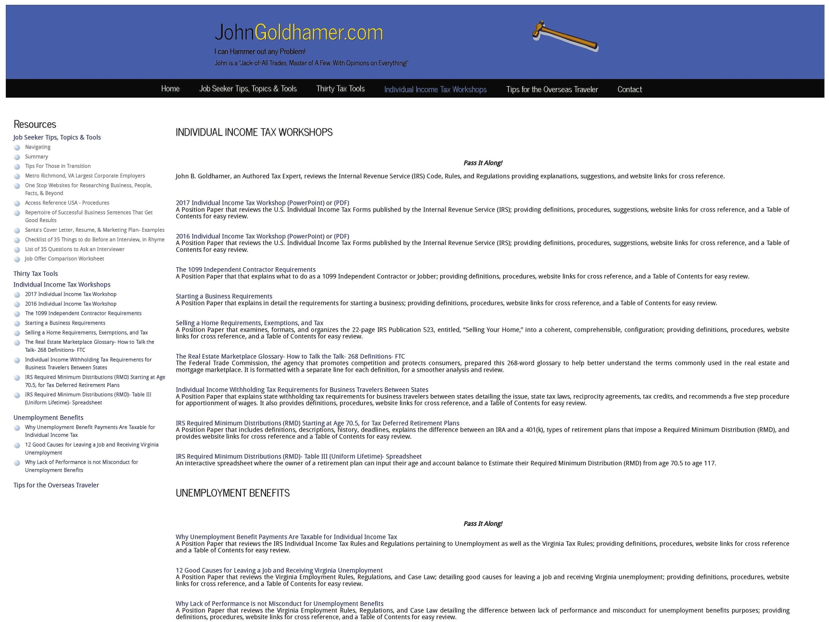
2017 INDIVIDUAL INCOME TAX WORKSHOP
JohnGoldhamer.com: Individual Income Tax Workshops & Unemployment Benefits

Slide 8
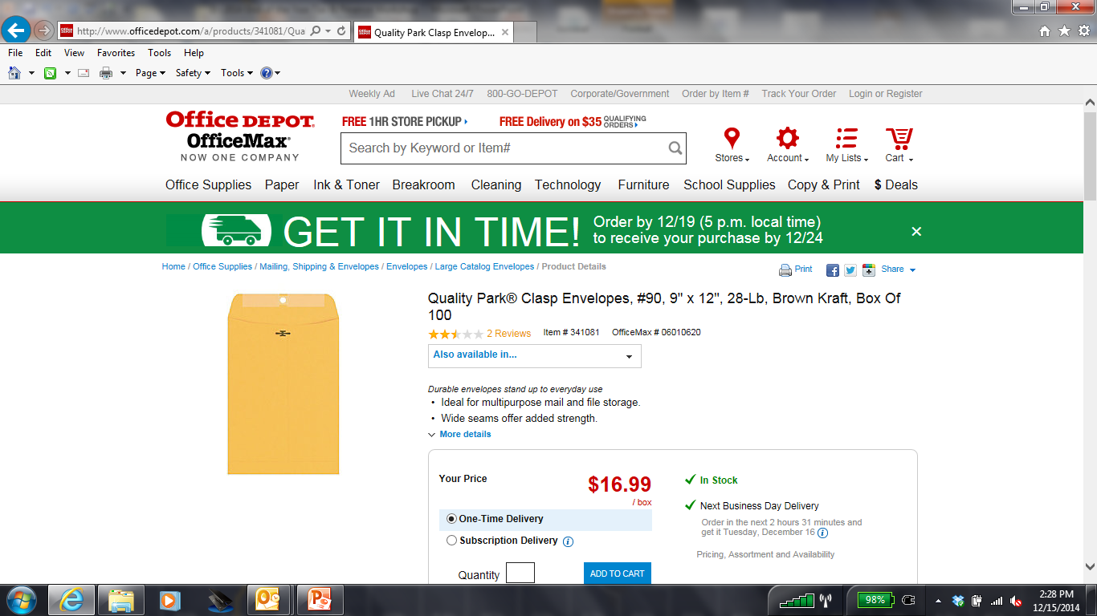
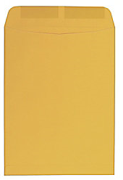
2017 INDIVIDUAL INCOME TAX WORKSHOP
TAX ENVELOPE TO KEEP TAX INFORMATION
Large Open-End Kraft (Brown) 9" x 12“ Envelope
Suggestions:
In the beginning of each year get a Large Open-End Kraft (Brown) 9" x 12“ Envelope.
Mark it in large letters the Tax Year, such as 2017.
During the year, as you receive Deductible Expenses like Donations, Summary of Medical Expenses, Real Estate Taxes, Personal Property Tax, and Income Information; W-2, 1099, Bank Statements, place all of these Important Tax information in the Envelope.
Keep the Envelope some place where you can always find it.
When W-2’s, 1099’s, and other important Tax Documents come in the mail around the end of January, put those items in the Envelope too.
Then everything is in one place ready for you to file your Tax Returns.

Slide 9
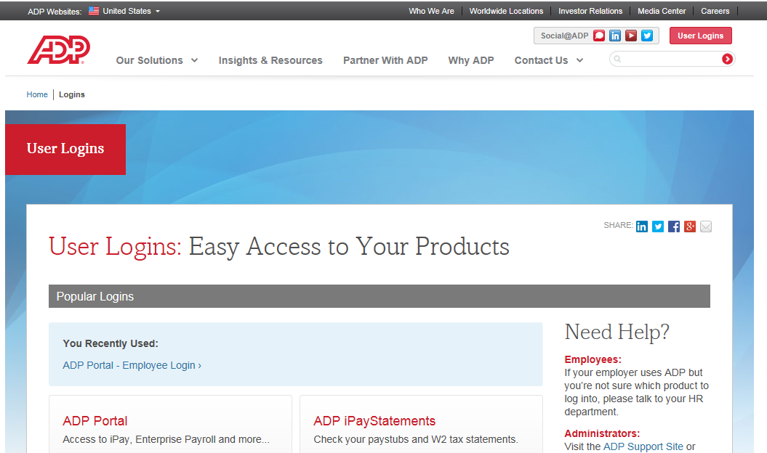
2017 INDIVIDUAL INCOME TAX WORKSHOP
PAYCHECK STUB MATCHED WITH W-2
Suggestion:
At the end of the year, printout and save your last Paycheck Stub listing your entire year’s Income, Deductions and Taxes. When you receive your W-2 around the end of January, make sure the numbers match.

Slide 10
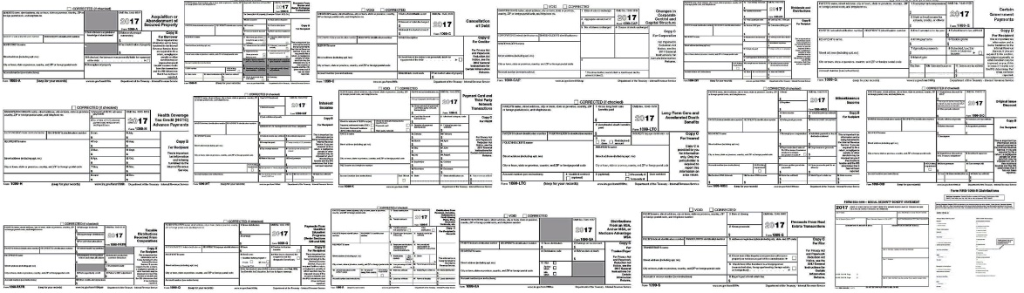
2017 INDIVIDUAL INCOME TAX WORKSHOP
THERE ARE 19 DIFFERENT TYPES OF IRS FORM 1099
Form 1099 is one of several IRS tax forms used in the U.S. to prepare and file an information return to report various types of income other than wages, salaries, and tips. The form is used to report to the IRS payments to independent contractors, rental property income, interest and dividend income, sales proceeds and miscellaneous income. Wikipedia
Form Description
1099-A Acquisition or Abandonment of Secured Property
1099-B Proceeds From Broker and Barter Exchange Transactions
1099-C Cancelation of Debt
1099-CAP Changes in Corporate Control and Capital Structure
1099-DIV Dividends and Distributions
1099-G Certain Government Payments
1099-H Health Coverage Tax Credit (HCTC) Advance Payments
1099-INT Interest Income
1099-K Merchant Card & Third Party Network Payments (PayPal) IRS threshold to issue- sales over $20,000/year
1099-LTC Long-Term Care and Accelerated Death Benefits
1099-MISC Miscellaneous Income
1099-OID Original Issue Discount
1099-PATR Taxable Distributions Received From Cooperatives
1099-Q Payments From Qualified Education Programs (Under Sections 529 and 530)
1099-R Distributions From Pensions, Annuities, Retirement or Profit-Sharing Plans, IRAs, Insurance Contracts
1099-S Proceeds From Real Estate Transactions
1099-SA Distributions From an HSA, Archer MSA, or Medicare Advantage MSA
RRB-1099 Railroad Retirement Board Statement SSA- 1099 Social Security Benefit Statement JohnGoldhamer.com

Slide 11
2017 INDIVIDUAL INCOME TAX WORKSHOP
THREE TYPES OF U.S. INDIVIDUAL INCOME TAX RETURNS
1040EZ (Easy), 1040 A (Short Form), or 1040 (Long Form)?
The IRS (Internal Revenue Service) provides a choice of three Individual Income Tax Returns to file your federal income tax; 1040EZ, 1040A, or 1040.
1040EZ (Easy) – Use if you are filing a “Less complicated” Tax Return such as no dependents, under 65-years-old, and want to take the Standard Deduction.
1040A (Short Form) – Use if you are filing a “A little more complicated” Tax Return with dependents, over 65-years-old, Capital Gains, and want to take the Standard Deduction.
1040 (Long Form) – Use if you are filing a “More complicated” Tax Return and want to Itemized Deductions on Schedule A, have Capital Gains from the Sale of Property, or Self Employment.
For the 1040EZ (Easy) and 1040A (Short Form) you do not need to purchase Tax Software. Free Software may be helpful, but make sure that it will print a copy for your records.
Personally, I always recommend using Turbo Tax or another Tax Software, which will stay up to date and know more specific rules than a Tax Attorney or CPA, who also uses Tax Software to file their client’s returns.

Slide 12
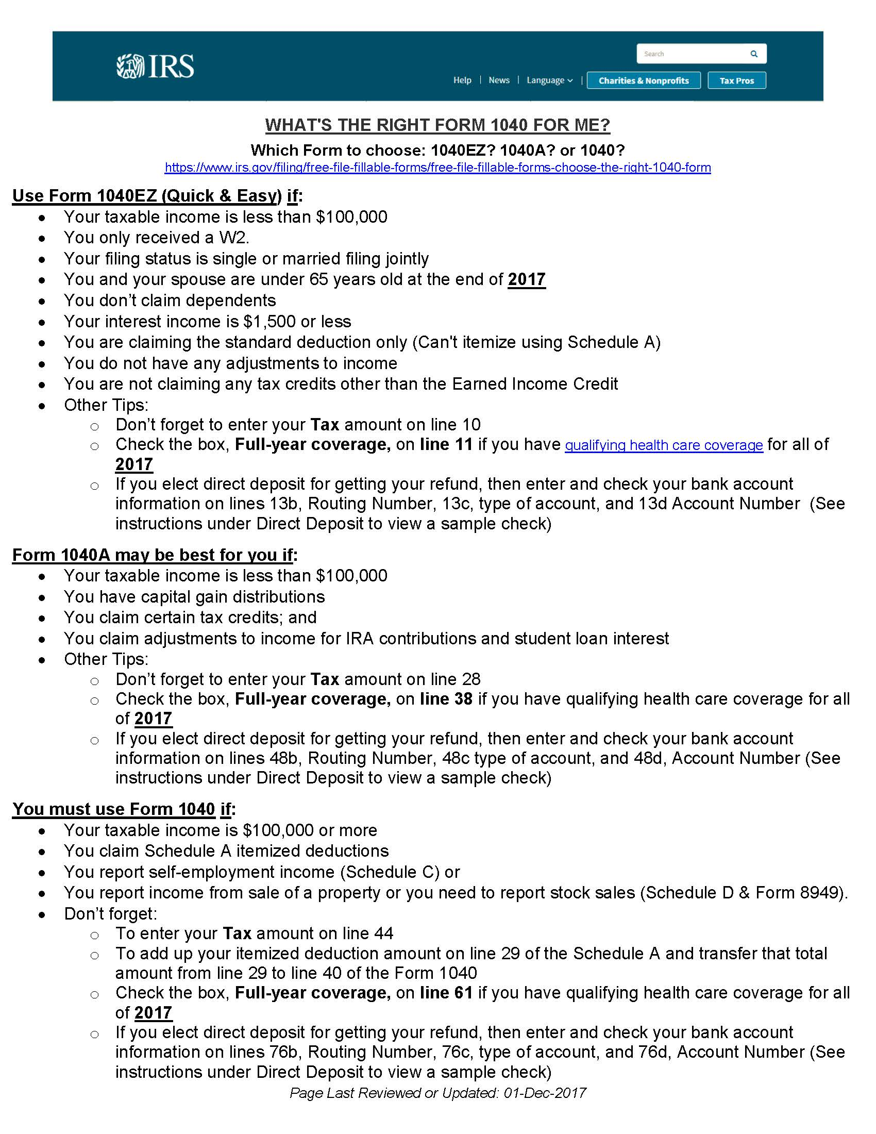
2017 INDIVIDUAL INCOME TAX WORKSHOP
What's the Right Form 1040 for Me? 1040EZ, 1040A, or 1040?
https://www.irs.gov/filing/free-file-fillable-forms/free-file-fillable-forms-choose-the-right-1040-form

Slide 13
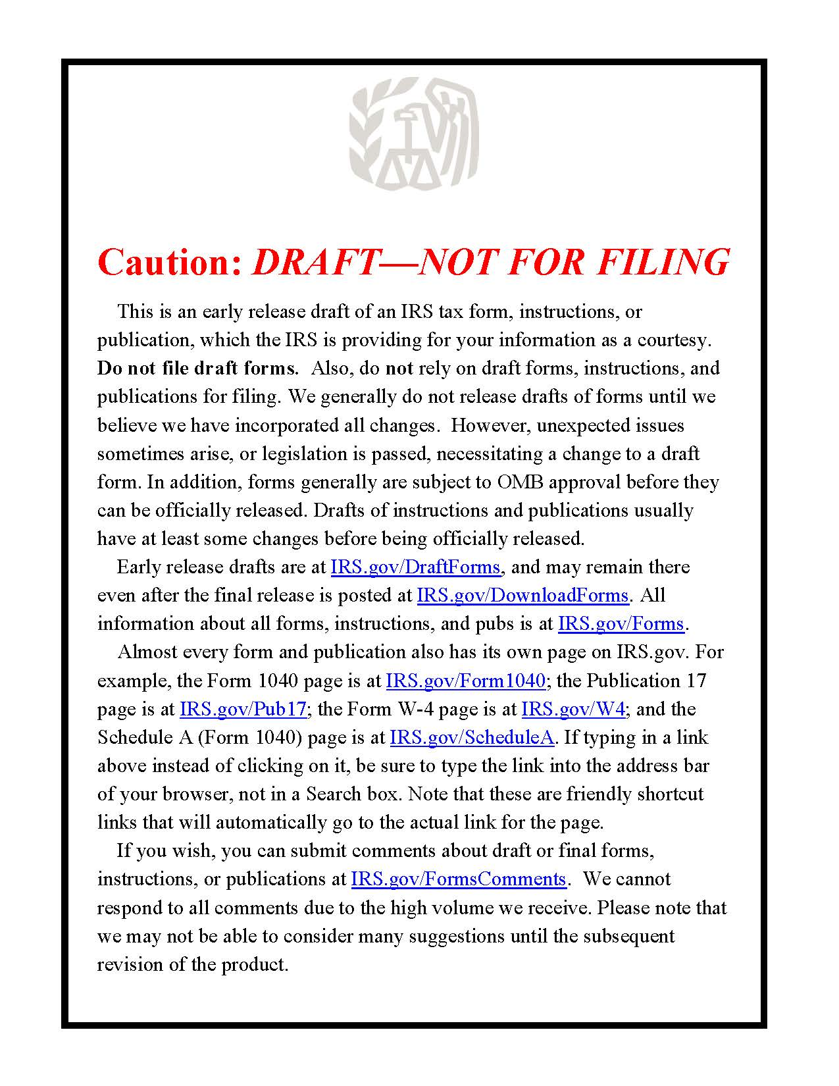
2017 INDIVIDUAL INCOME TAX WORKSHOP
CAVEAT – EARLY RELEASE OF IRS TAX FORMS
Generally, the 115th Congress had until December 15, 2017 to pass Changes. Because of the Tax Cuts and Jobs Act (2017 Trump Tax Act) modified the
2017 tax laws the IRS did not release all 2017 Tax Forms until 1/22/18.
IRS accepts both electronic and paper tax returns on January 29, 2018

Slide 14
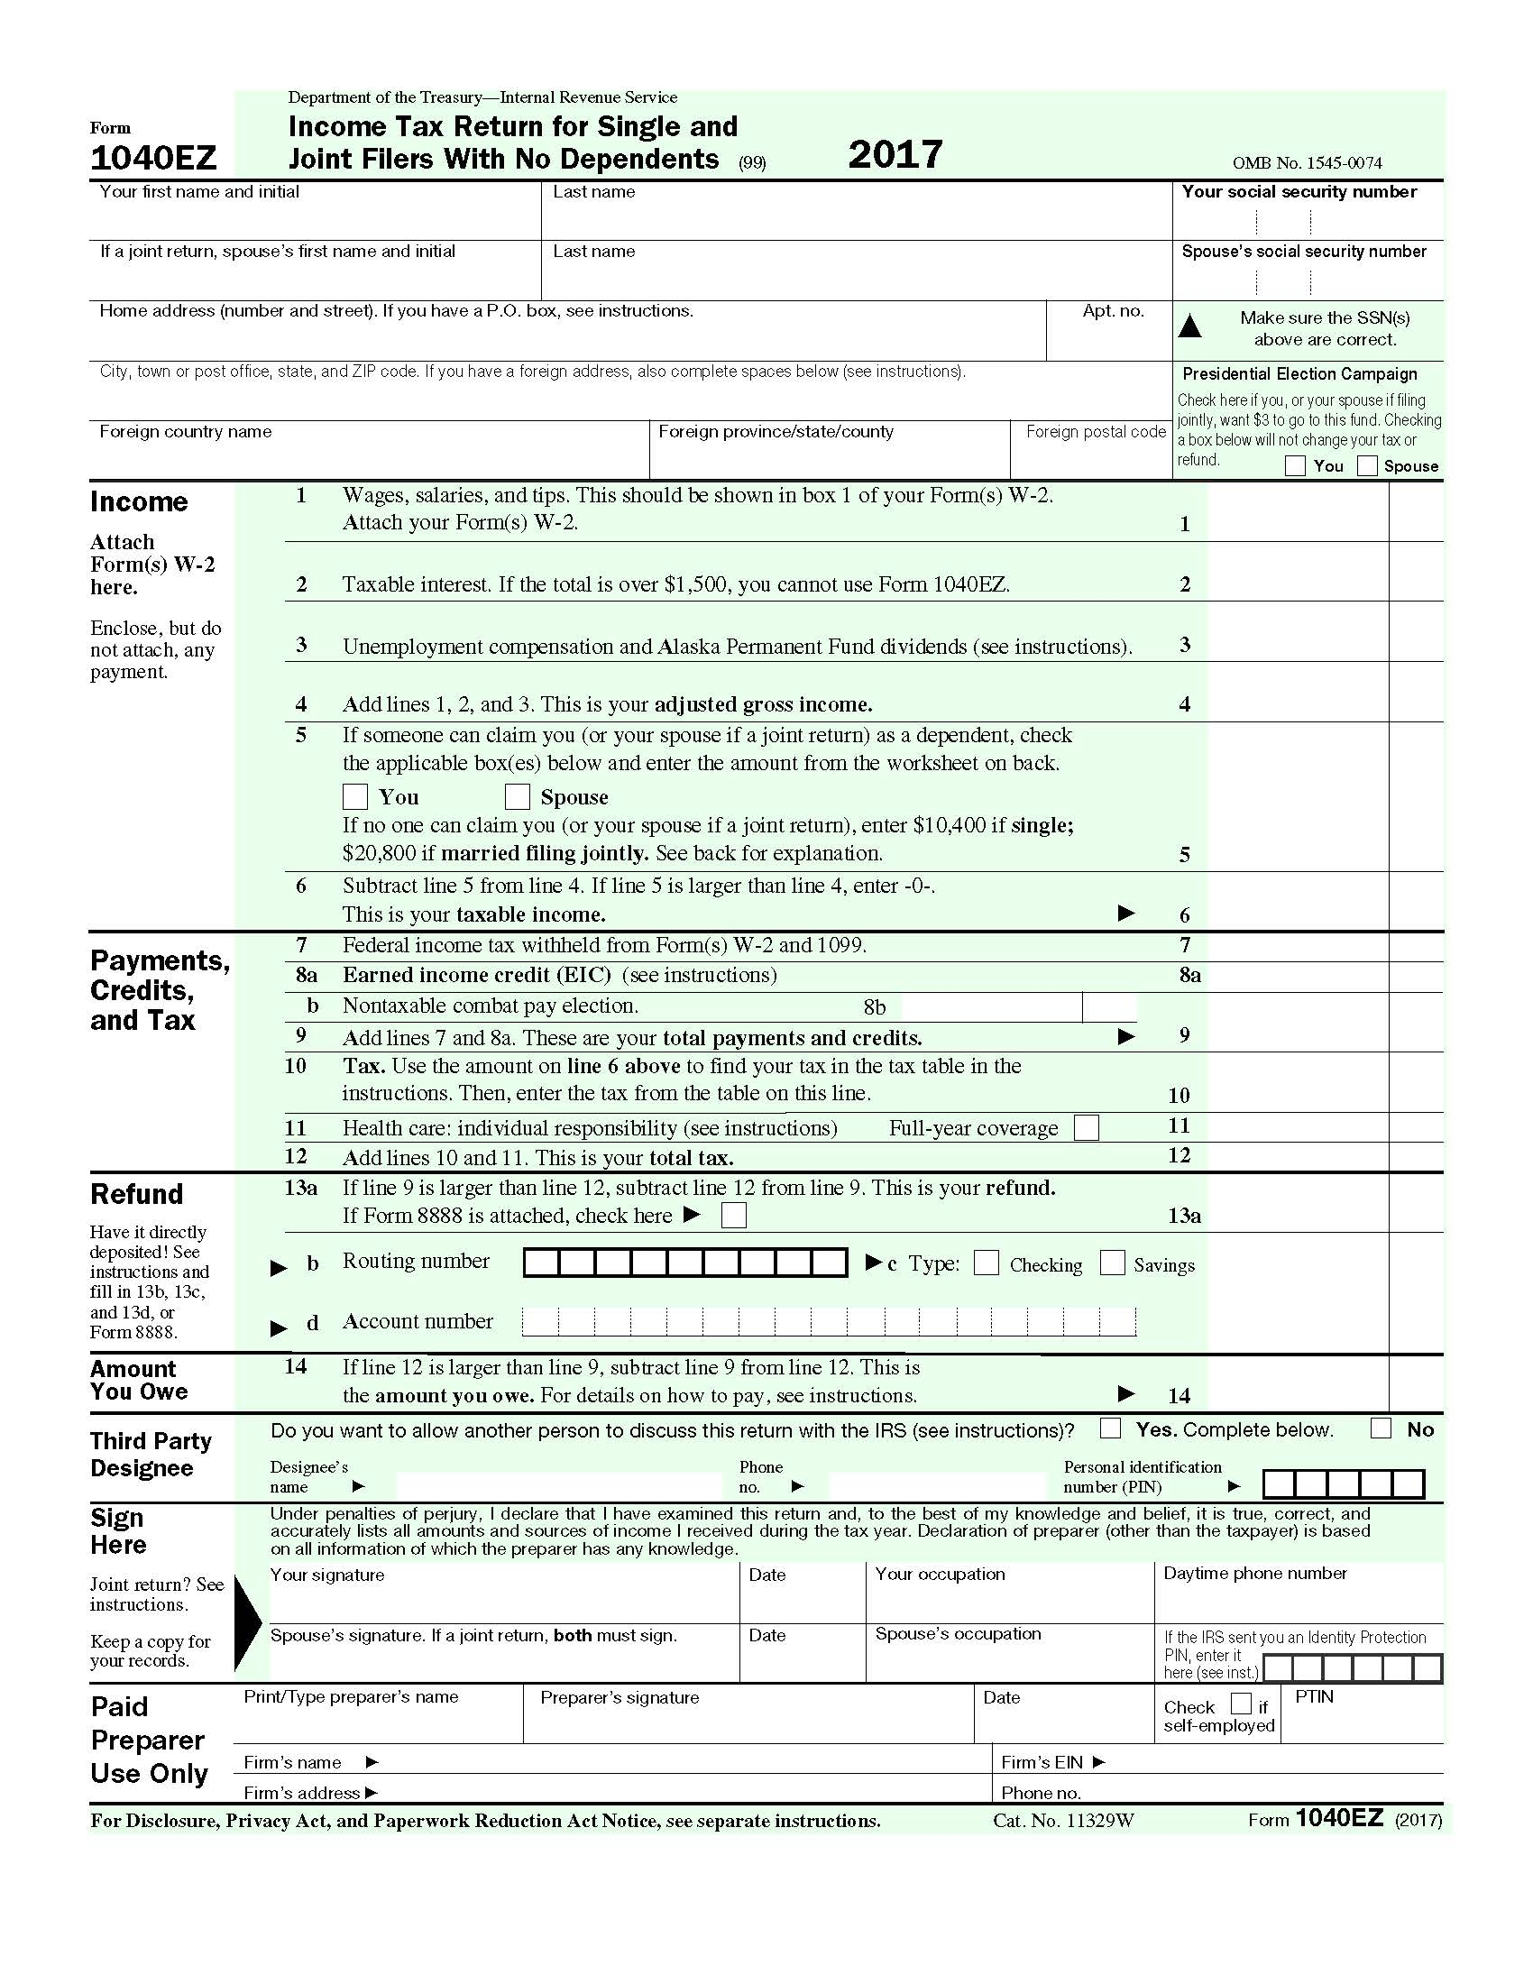
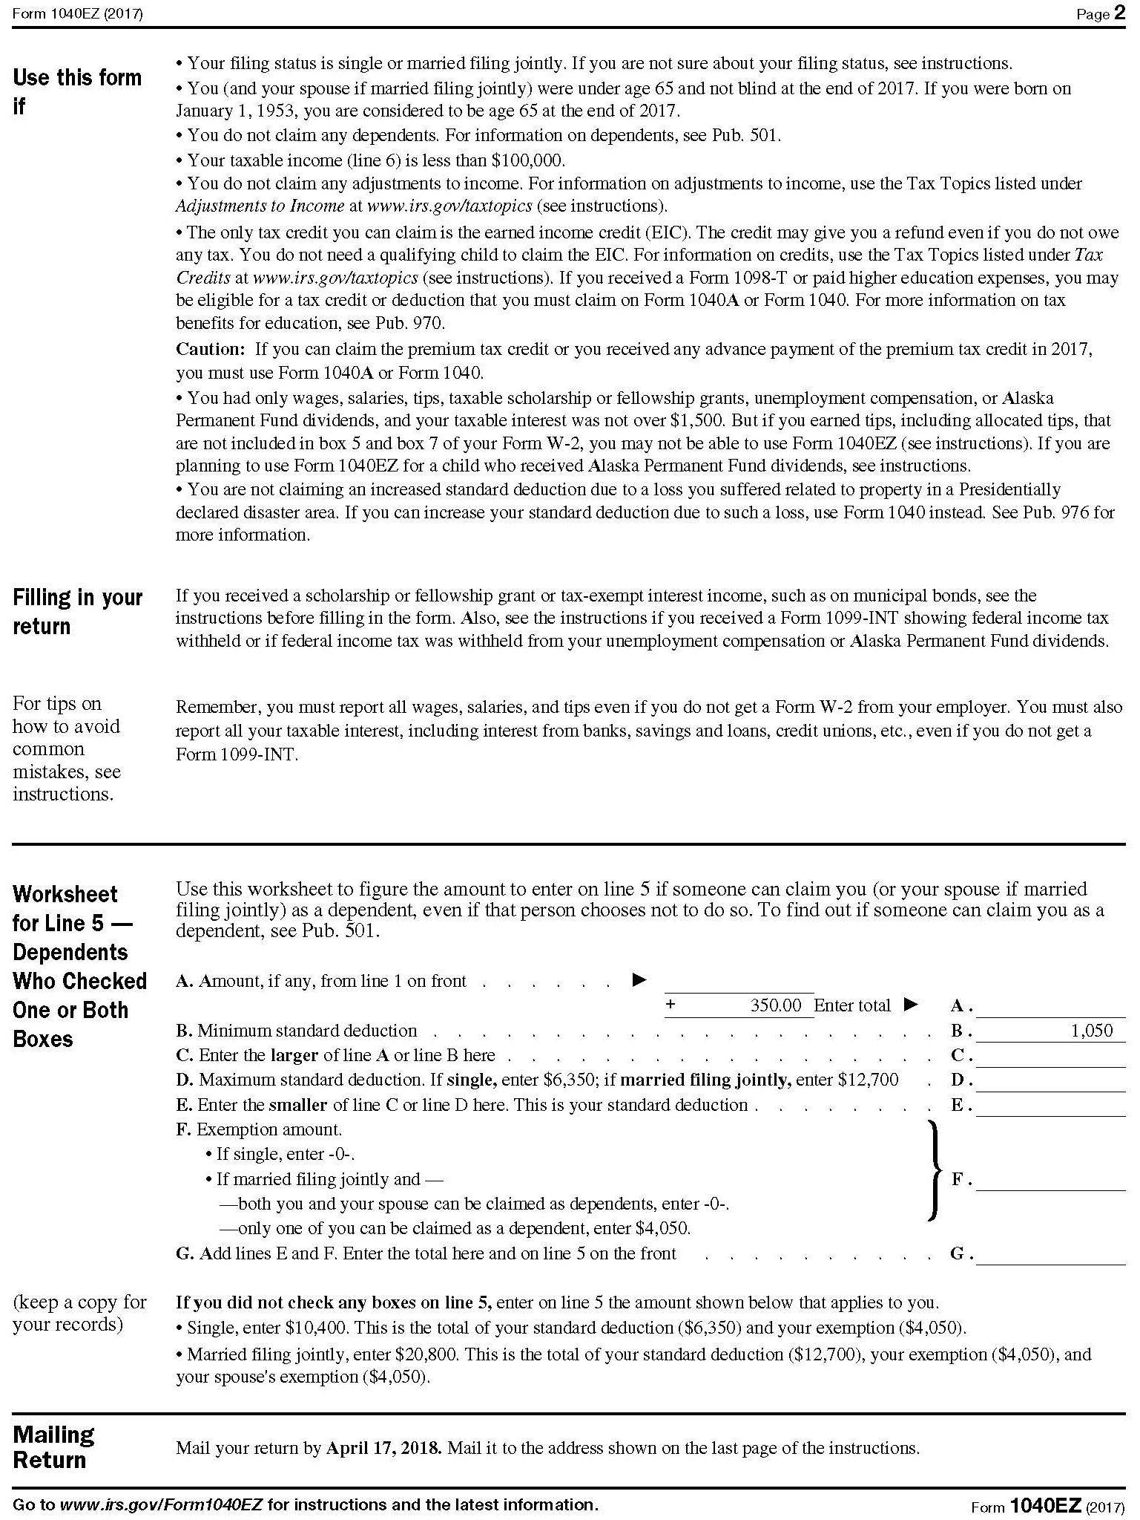
2017 INDIVIDUAL INCOME TAX WORKSHOP
1040EZ (Easy) U.S. Individual Income Tax Return

Slide 15
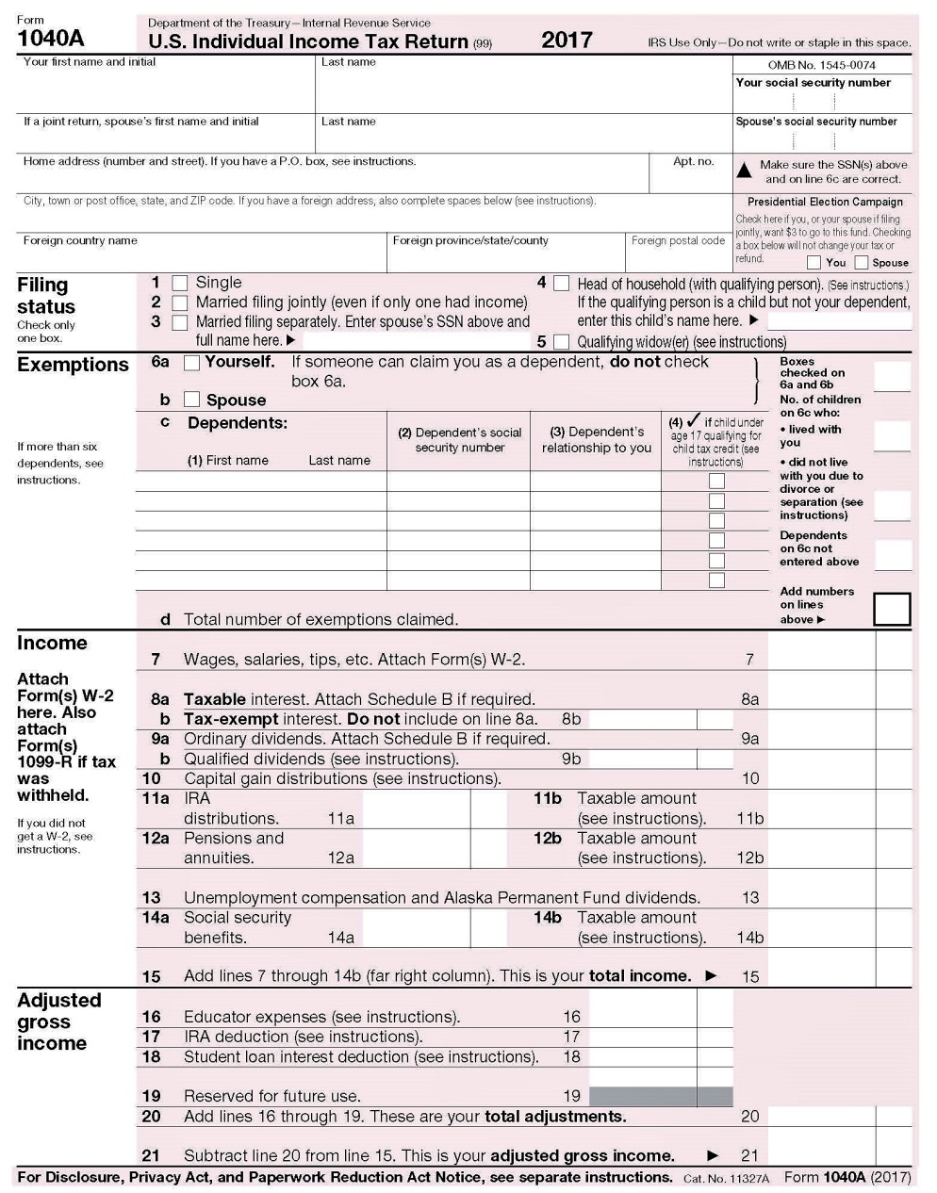
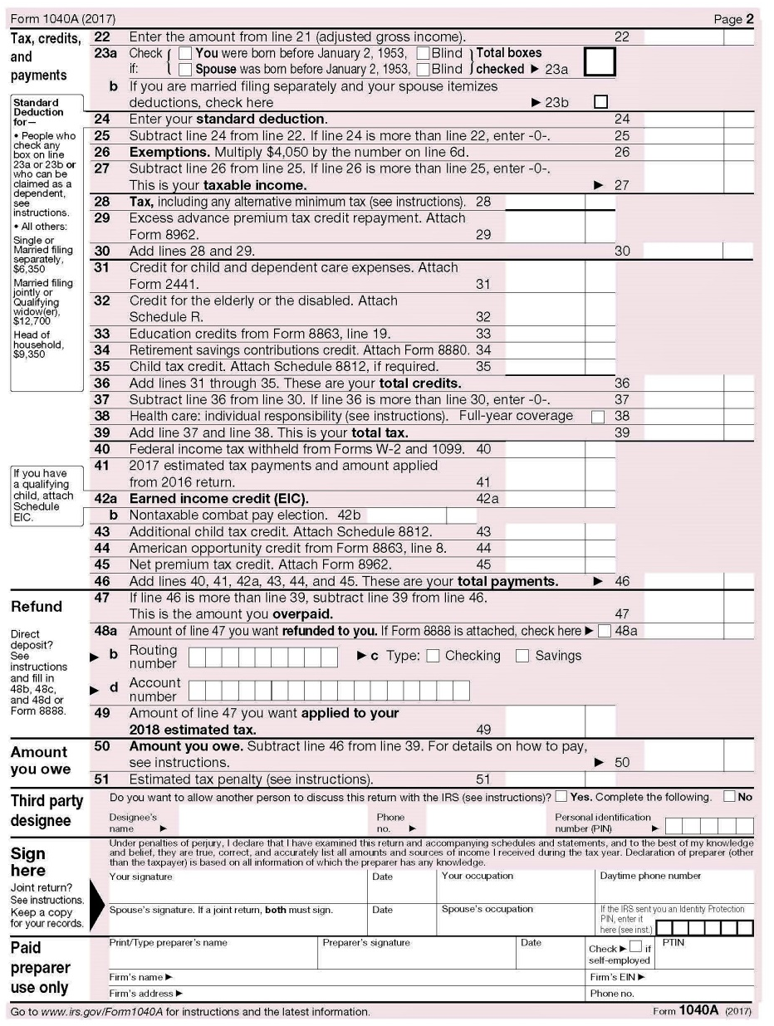
2017 INDIVIDUAL INCOME TAX WORKSHOP
1040A (Short Form) U.S. Individual Income Tax Return

Slide 16
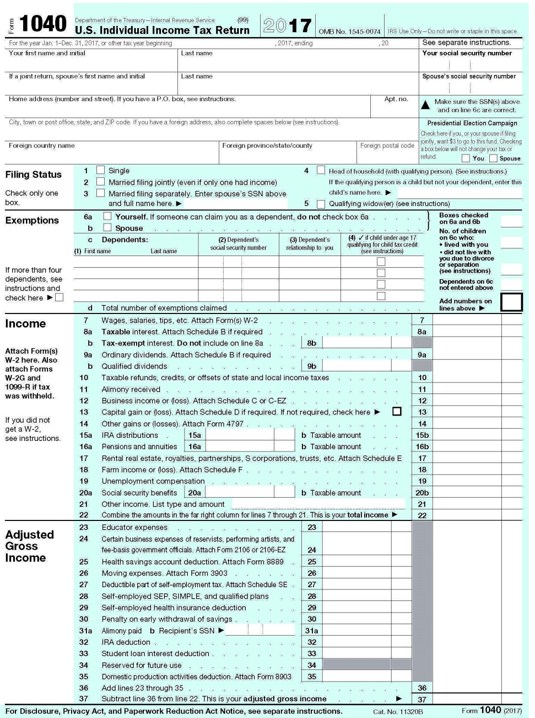
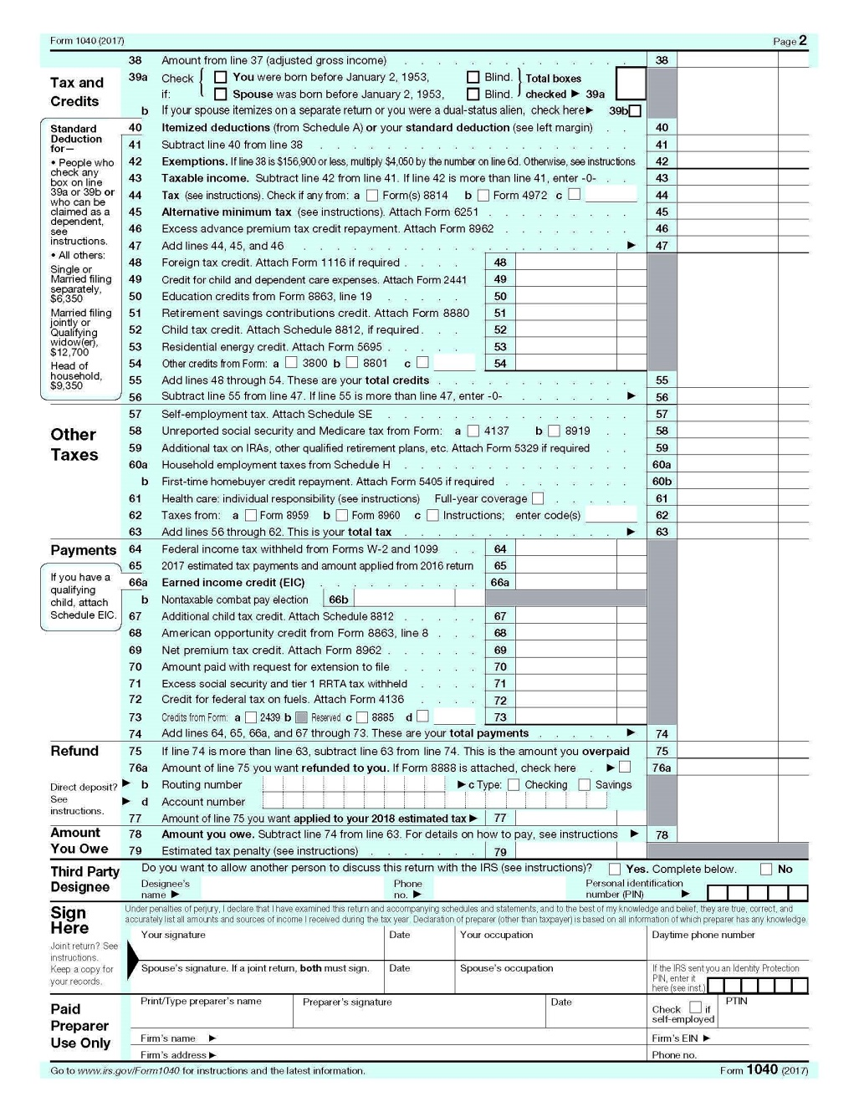
2017 INDIVIDUAL INCOME TAX WORKSHOP
1040 (Long Form) U.S. Individual Income Tax Return

Slide 17
2017 INDIVIDUAL INCOME TAX WORKSHOP
Standard Deduction Amounts
For 2017, the Standard Deduction is as follows:
Filing Status Standard Over 65 / Blind
Single $6,350 $7,900
Married Filing Separately $6,350 $7,900
Head of Household $9,350 $10,900
Married Filing Jointly or Surviving Spouse $12,700 $13,950
https://www.westernsouthernlife.com/education/publications_multimedia/tax/standarddeductionsexemptions.asp
For 2017, you may increase your Standard Deduction, even if you do not itemize, if you have a loss to property in a Presidentially Declared Disaster Area, such as Hurricanes Harvey, Irma, Maria or any Qualified Disaster by using Form 4684 Casualties and Thefts and posting it on line 28, Schedule A, Itemized Deductions.
(See Schedule A, Other Miscellaneous Deductions)
When the Standard Deduction is used,
there are not any additional Deductions such as Charities.
From 1982 to 1986, Form 1040 provided a
Non-itemizer Line Item Charitable Contribution Deduction.
Perhaps the next Congress will pass similar legislation.

Slide 18
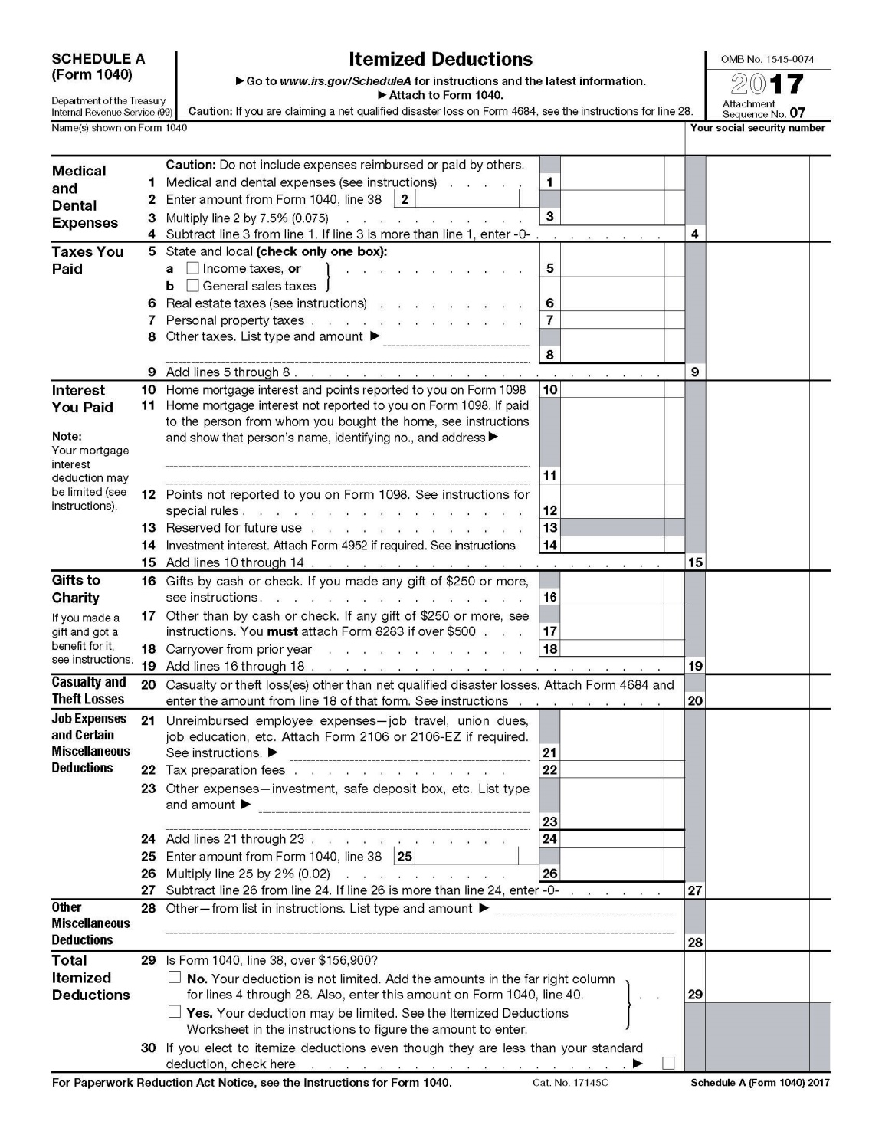
2017 INDIVIDUAL INCOME TAX WORKSHOP
Itemized Deductions, Schedule A. has 7 Sections

Slide 19
2017 INDIVIDUAL INCOME TAX WORKSHOP
Medical and Dental Expenses
Medical and Dental Deductions are Out of Pocket expenses ‘That you paid’ for medical insurance, products, and services such as; COBRA, Medical, Dental, and Vision Insurance Premiums, Prescriptions and Co-payments, Deductibles, Contacts Lens, Glasses, Approved Medical Devices, etc. are deductible.
Generally, medical expenses for cosmetic surgery; specifically procedures with the intention to enhance your appearance are not deductible.
For 2017, for All Taxpayers, the deduction is limited to amounts above 7.5% of your “Adjusted Gross Income.” The lower limitation for Seniors 65 or older, was eliminated.
Medical Transportation Costs are also deductible provided they are primarily for and essential to medical care. Deductible Transportations are Bus, train, taxi, plane fares or ambulance services as well as Medical Mileage, for driving to and from medical appointments which is deducted at 17 cents per mile.
Suggestions:
Before the end of the year, ask your Insurer and Pharmacist to print out all Medical visits and Prescriptions to determine if you are close to or are above 10% of your “Adjusted Gross Income.”
If you are close to or over, consider seeing your Doctor, Dentist, or fill prescriptions before the end of the year so that you can deduct the expense.

Slide 20
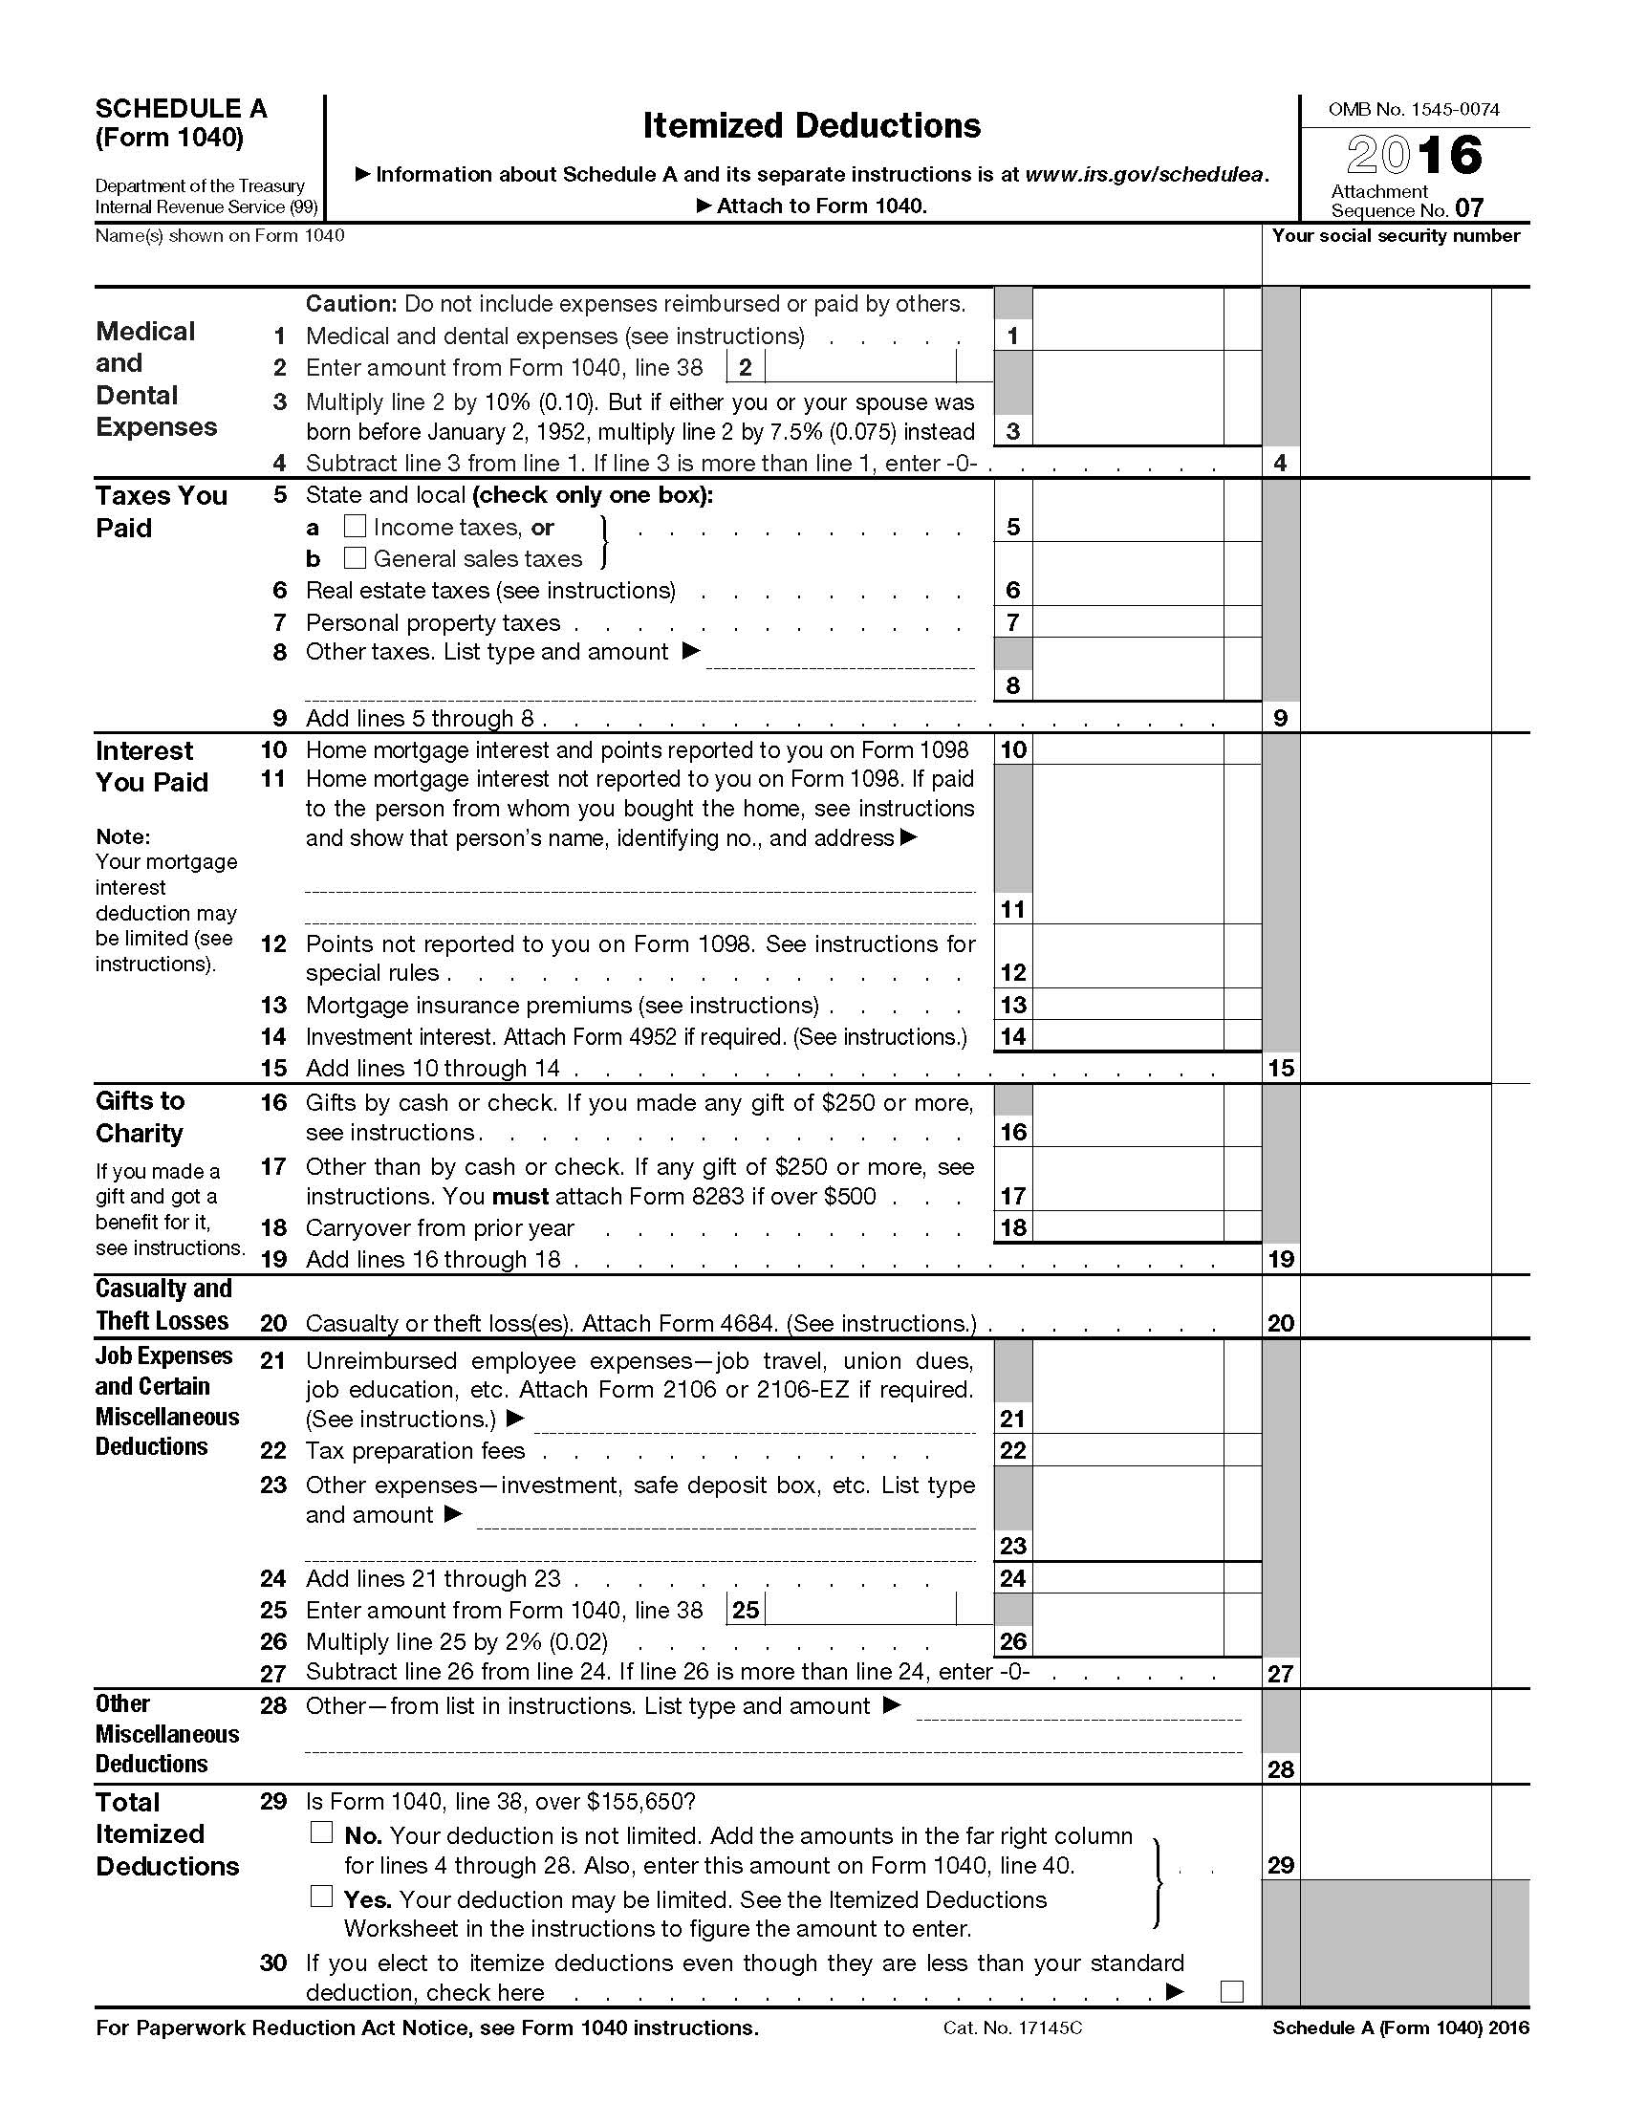
2017 INDIVIDUAL INCOME TAX WORKSHOP
STATE INCOME TAX, PERSONAL PROPERTY TAX, & REAL ESTATE TAXES ARE ALL DEDUCTIBLE
Suggestions:
Generally, your State Income Taxes will be listed on your W-2, but do not forget to include any voluntary Quarterly State Tax Payments.
If when you filed your State Income Taxes you paid additional taxes in the current year, your Total State Income Taxes paid is that additional State Taxes you paid when you filed your State Tax return, plus State Income Taxes listed on your W-2, which may be deducted on your Federal 1040, Schedule A, Itemized Deductions. For example, if when you filed your 2016 Virginia Income Tax Return in 2017, paying an additional $200 Income Tax, then your total State Income Taxes paid would be the additional $200 State Income Tax paid, plus $10,000 State Income Taxes listed on your W-2 for a total of $10,200. Interest and penalty are not included.
If you itemized your deductions the previous year and included a deduction for State Income Taxes, but received a State Refund, do not forget to add the refund amount listed on the card from the Virginia Department of Taxation on Line 10 of the Federal 1040. If your did not receive a State Refund, there is nothing to list.
For Virginia and some other states, include Vehicles Personal Property Tax Paid, plus the Personal Property Tax Vehicle Registration, which was called the “Sticker.”

Slide 21
2017 INDIVIDUAL INCOME TAX WORKSHOP
Interest on Home Mortgages and Equity Lines
Only Mortgage or Equity Line Interest are Deductible.
Personal Interest paid to Credit Cards are not Deductible.
Suggestions:
If you have a “Little Extra Funds,” think about making an extra payment on your Mortgage before the end of the year to increase your Mortgage Interest Deduction.
If you have a “Larger Amount of Extra Funds,” consider making a payment on your Mortgage “To Principle Only,” which will eventually decrease the total Interest, the number of Mortgage payments, and you will pay off your Mortgage earlier.

Slide 22
2017 INDIVIDUAL INCOME TAX WORKSHOP
Charitable Contributions
Generally, a deduction is valid if it is made to a Charitable Organization that is Tax-exempt by 26 U.S.C. § 501(c) of the Internal Revenue Code (IRC), whereby the organization is exempt from federal income tax if its activities have the purposes: charitable, religious, educational, scientific, literary, testing for public safety, fostering amateur sports, etc.
https://www.irs.gov/Charities-&-Non-Profits/Charitable-Organizations/Exempt-Purposes-Internal-Revenue-Code-Section-501(c)(3)
Verify 501(c) Tax-exempt status at: https://apps.irs.gov/app/eos/mainSearch.do?mainSearchChoice=pub78&dispatchMethod=selectSearch
Suggestions:
If you have a “Some Extra Funds,” consider making an extra payment to your Church, Synagogue, Mosque or other charity before the end of the year to increase your Deduction. For 2017, using your Vehicle for a Charity is deductible at 14 cents per mile.
Donations to Charities other than cash, such as Computers, Clothing, Housewares, TV’s, etc. are also deductible.
The question is their value. The Salvation Army provides a great “Donation Value Guide” https://satruck.org/Home/DonationValueGuide that provides 4 pages of items with high and low values.
For an Automobile or Truck, the deduction is restricted to the lower of the Fair Market Value or the amount the charity actually sold the vehicle. If the Automobile or Truck Value is $1000, but it sold for only $500, then only $500 is deductible.

Slide 23
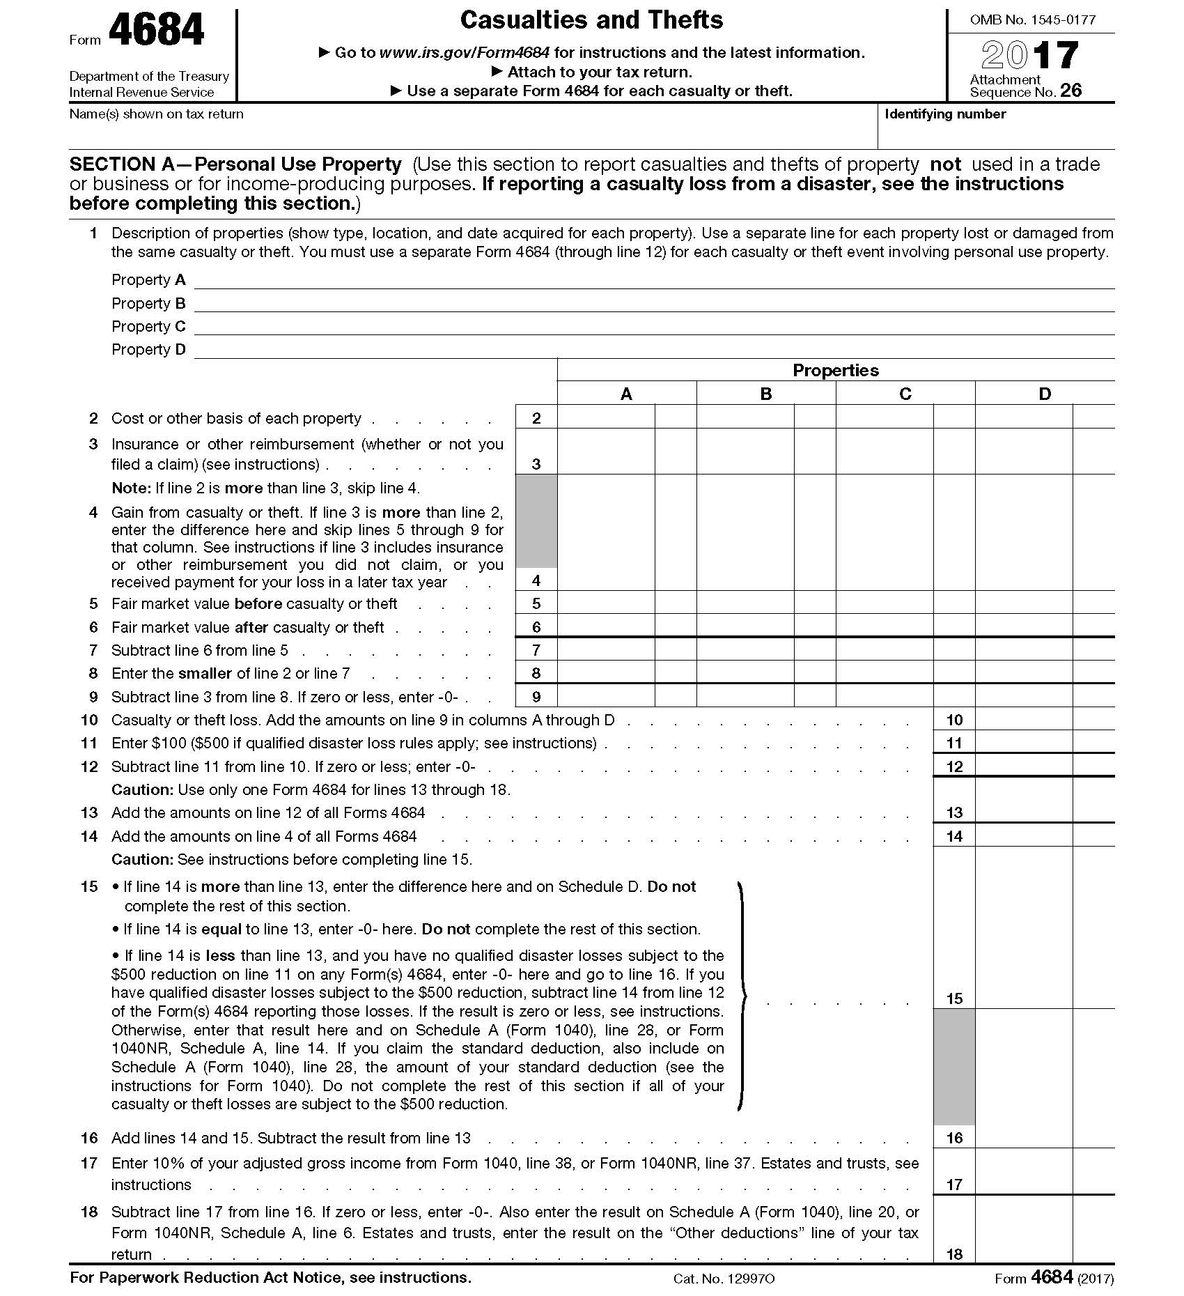
2017 INDIVIDUAL INCOME TAX WORKSHOP
Casualty and Theft Losses of Property, Not Used in a Trade or Business
Federal Form 4684 Casualty and Thefts, Limits the Deduction to any amount over 10% of “Adjusted Gross Income.”
Losses You Can Deduct - You can deduct losses of property from fire, storm, shipwreck, or other casualty, or theft (for example, larceny, embezzlement, robbery, and Ponzi-type investment schemes). See Pub. 547, Casualties, Disasters, and Thefts, for more examples.

Slide 24
2017 INDIVIDUAL INCOME TAX WORKSHOP
Job Expenses and Certain Miscellaneous Deductions
LIMITED TO AMOUNTS OVER 2% OF “ADJUSTED GROSS INCOME.”
(If $50,000 “Adjusted Gross Income” then only amounts over $1,000 are deductible)
For Job Search Expenses to qualify for a deduction, the expenses must be spent on a job search in your current occupation (Not your Job, but your Field, or Profession), but not expenses incurred while looking for a job in a new occupation.
For example, a Plumber may deduct expenses looking for a new job as a Plumber, but not to make a career change to a Wedding Planner.
JOB SEARCH DEDUCTIBLE EXPENSES:
1. Employment and Outplacement Agency Fees paid while looking for a job in your present occupation.
2. Preparing and Mailing copies of your Cover Letter, Résumé, Marketing Plan, and Business Cards to give to prospective employers in your present occupation, as well as the costs for creating and maintaining Websites.
3. Round Trip Travel to look for a new job in your present occupation, in the city you want to work. For 2017, using a vehicle for Business or Job Search the Mileage Rate is 53.5 cents.
Similar to Employment and Outplacement Agency Fees, mileage for travel to and from Career Prospector, JAM, and Accountable Group Meetings may be deductible as long as you are being “Educated on how to get a job” in your current occupation and you must keep a “Log.”
Example 1000 miles x $.53.5 per mile= $530 + $200 Résumés & Business Cards Printing = $730.

Slide 25
2017 INDIVIDUAL INCOME TAX WORKSHOP
Other Miscellaneous Deductions
For 2017, if you have “Net Qualified Disaster Losses” on Form 4684, Casualties and Thefts, line 15, and you are not itemizing your deductions, you can claim an increased standard deduction using Schedule A by doing the following:
Complete Form 4684, from line 15, list the amount on the dotted line next to Schedule A line 28 as “Net Qualified Disaster Loss,” and attach Form 4684.
List your Standard Deduction Amount on Schedule A at the second dotted line next to line 28 as “Standard Deduction Claimed With Qualified Disaster Loss.”
Combine the two amounts on line 28 and enter on Form 1040, line 40.
Do not enter an amount on any other line of Schedule A.
For more information on how to determine your increased standard deduction, see Pub. 976.
2017 Form Schedule A, Itemized Deductions - Instructions
https://www.irs.gov/pub/irs-pdf/i1040sca.pdf

Slide 26
2017 INDIVIDUAL INCOME TAX WORKSHOP
Standard Deduction this Year, but What About Next Year?
Question:
If I have to take the Standard Deduction this year, can I pay for some things the next year?
Suggestions:
Yes, when you have to take the Standard Deduction because you do not have enough expenses to itemize in 2017, you can “Defer” or “Put off” paying some things to 2018; as long as the Bank does not charge any additional penalties or interest.
For example, if your Mortgage is better than up to date, perhaps you could put off making that extra payment until the following year.

Slide 27
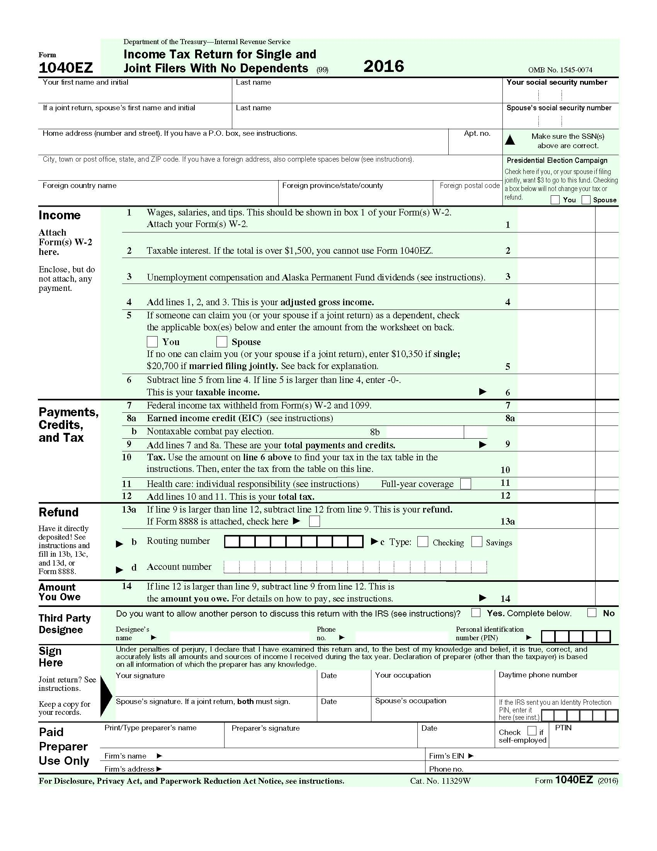
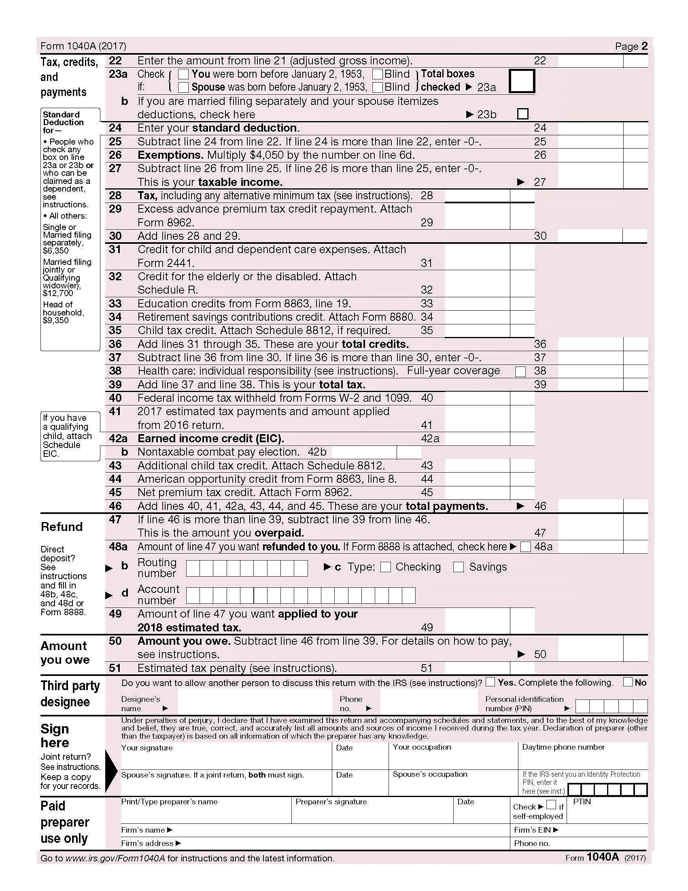
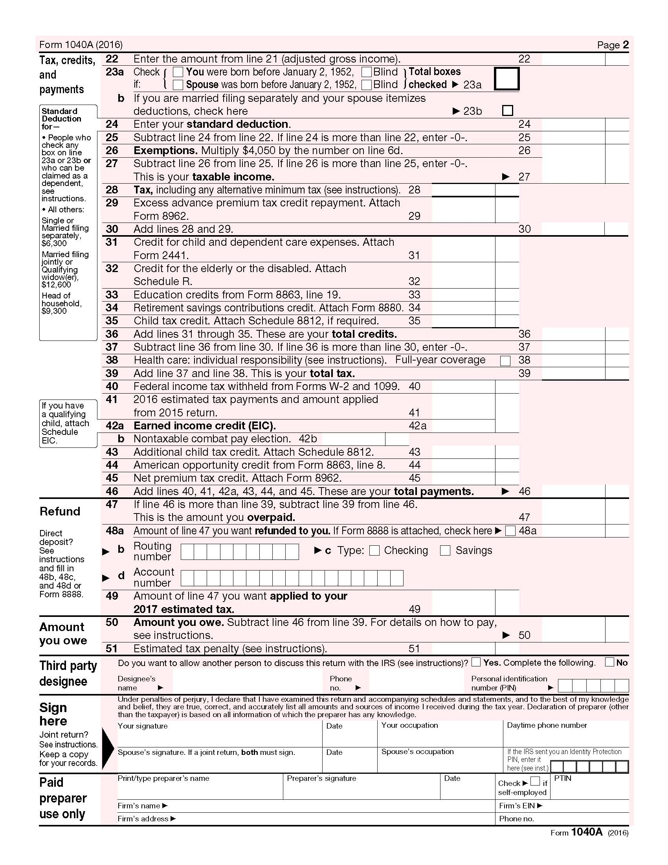

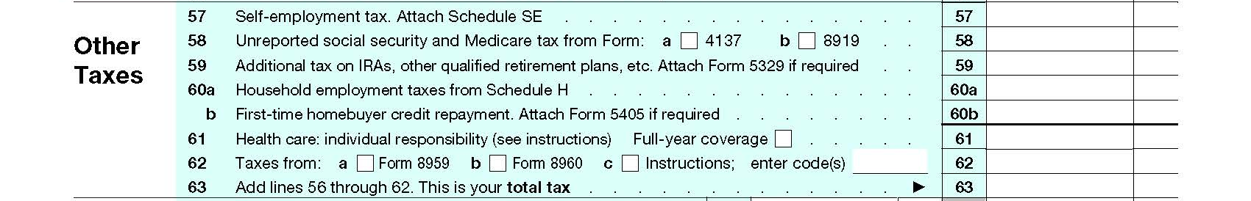
2017 INDIVIDUAL INCOME TAX WORKSHOP
Affordable Care Act (ACA) Requires Health Care Coverage
For 2017, The Affordable Care Act (Obama Care) did require that there must be Qualifying Health Care Coverage (Medical Insurance) for yourself, your spouse (if filing jointly), and anyone you can or do claim as a dependent for every month of 2017.
If Health Care Coverage was for all of 2017, then simply check the box for “Full-year Coverage” on Federal Form 1040EZ, line 11, 1040A (Short Form) line 38 or the Federal 1040 Line 61.
Tip: For 2017, ObamaCare suggests Presidential Executive Order 13765 allows that if you didn’t have coverage, going silent, not checking a box and leaving it blank on the Health Care Line is an option and the IRS will accept your return.
Don’t attest to coverage unless you had it. JohnGoldhamer.com
https://obamacarefacts.com/2017/04/18/going-silent-on-line-61-is-an-option-just-dont-attest-to-coverage-you-didnt-have/

Slide 28
2017 INDIVIDUAL INCOME TAX WORKSHOP
Affordable Care Act (ACA) (Obama Care)
Official Shared Responsibility Payment or
Individual Mandate Fee
(Official Tax Penalty for not having Health Care Coverage)
For 2017, the payment stayed the same as 2016. The “Official” payment or fee is $695 per adult and $347.50 per child (up to $2,085 for a family), or it’s 2.5% of your household income above the tax return filing threshold for your filing status – whichever is greater. For each full month in which a family member went without coverage or an exemption the Tax Penalty is 1/12 of the total fee.
For 2018, the fee is non existent because the mandate was repealed by the Tax Cuts and Jobs Act (2017 Trump Tax Act).
http://obamacarefacts.com/obamacare-individual-mandate

Slide 29
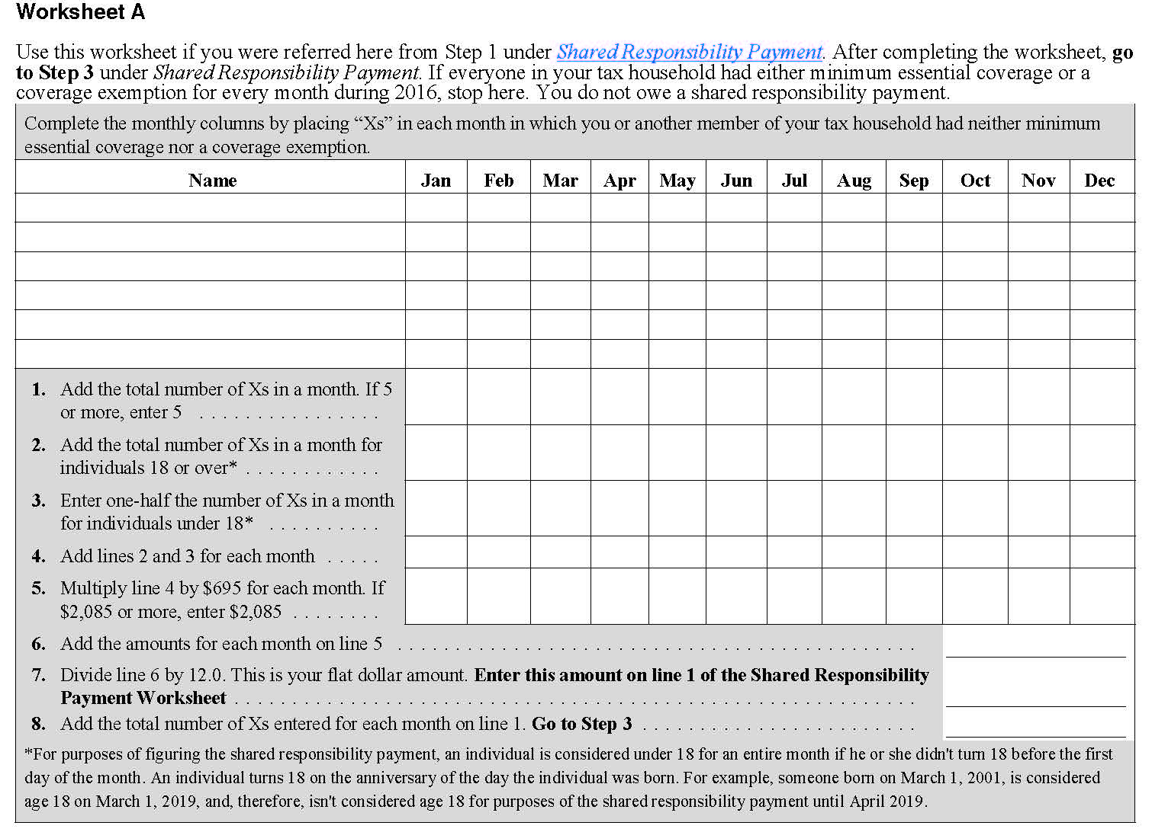
2017 INDIVIDUAL INCOME TAX WORKSHOP
Affordable Care Act (ACA) (Obama Care)
Official Shared Responsibility Payment Worksheet A.
(Penalty for not having Health Care Coverage)
https://www.irs.gov/pub/irs-pdf/i8965.pdf (Page 18)

Slide 30
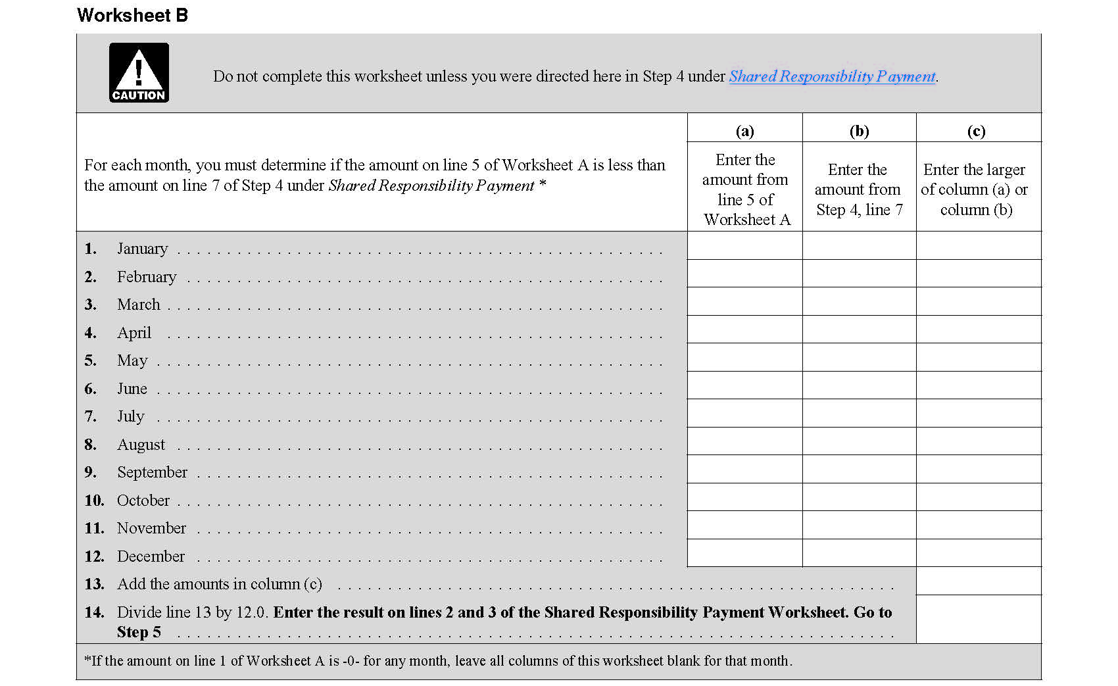
2017 INDIVIDUAL INCOME TAX WORKSHOP
Affordable Care Act (ACA) (Obama Care)
Official Shared Responsibility Payment Worksheet B.
https://www.irs.gov/pub/irs-pdf/i8965.pdf (Page 19)

Slide 31
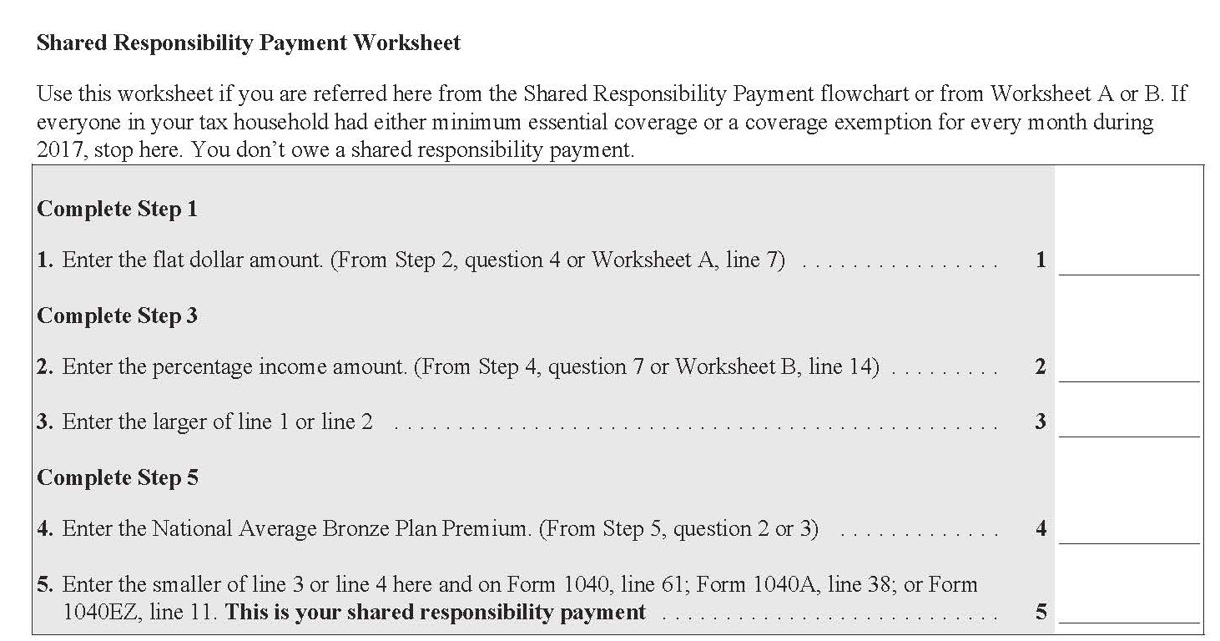
2017 INDIVIDUAL INCOME TAX WORKSHOP
Affordable Care Act (ACA) (Obama Care)
Official Shared Responsibility Payment Enter on 1040EZ, 1040A, 1040
https://www.irs.gov/pub/irs-pdf/i8965.pdf (Page 17)

Slide 32
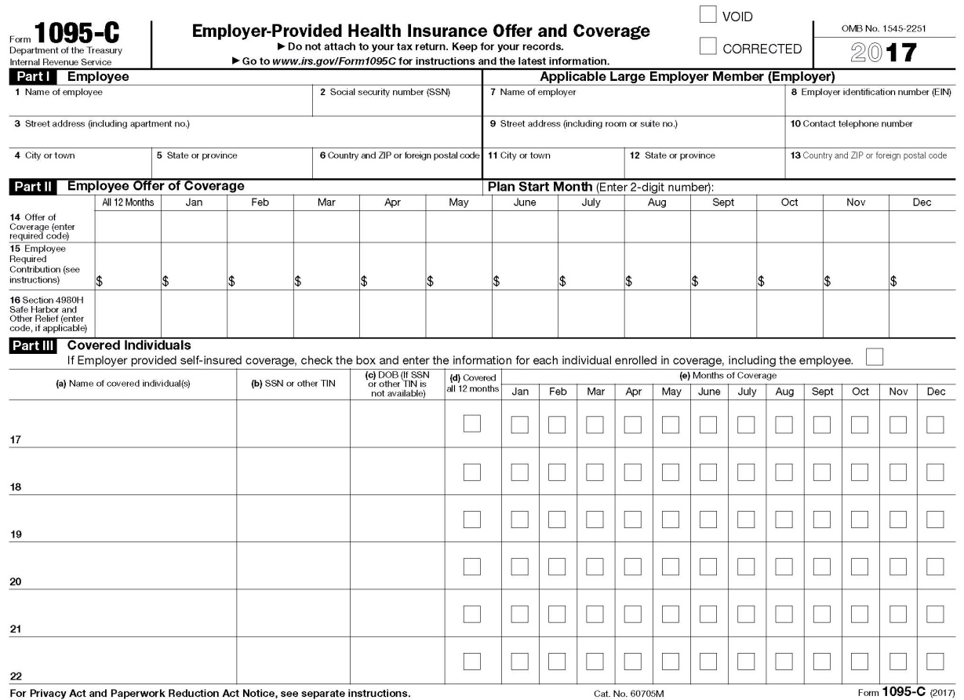
2017 INDIVIDUAL INCOME TAX WORKSHOP
1095-C, EMPLOYER-PROVIDED HEALTH INSURANCE OFFER AND COVERAGE
The Affordable Care Act (Obama Care) requires that Applicable Large Employers (ALE), which generally employs 50 or more full-time employees (an average of 30 hours per week) must furnish Form 1095-C, Employer-Provided Health Insurance Offer and Coverage, listing the cost and months the employee and dependents had Medical Coverage to each of its employees for their records by January 31 of the following year with a copy filed with the IRS

Slide 33
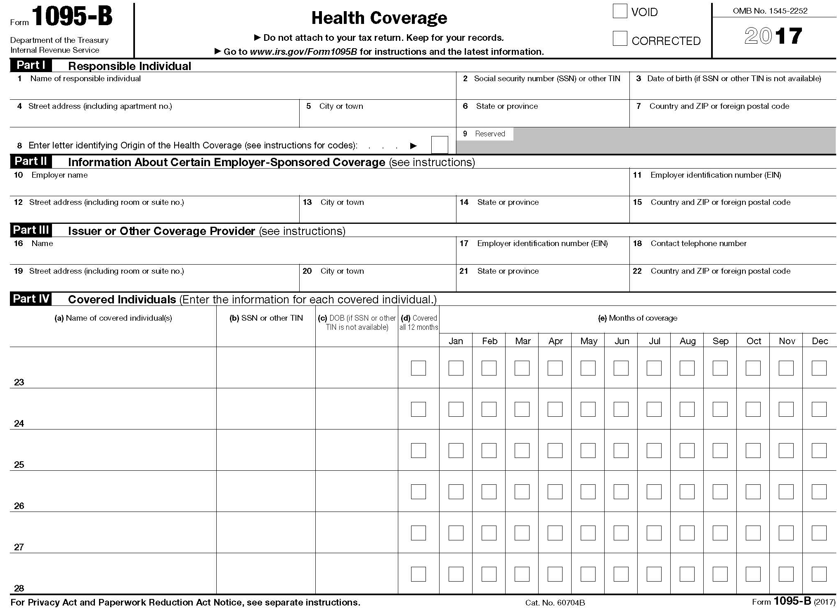
2017 INDIVIDUAL INCOME TAX WORKSHOP
1095-B, HEALTH COVERAGE
The Affordable Care Act (Obama Care) requires “Health Insurance Providers” and "Self-insured Companies,” where a company itself pays its employees' medical bills, rather than an insurance company, must file with the IRS Form 1095-B listing the cost and months the Employee / Insured and Dependents had Medical Coverage.

Slide 34
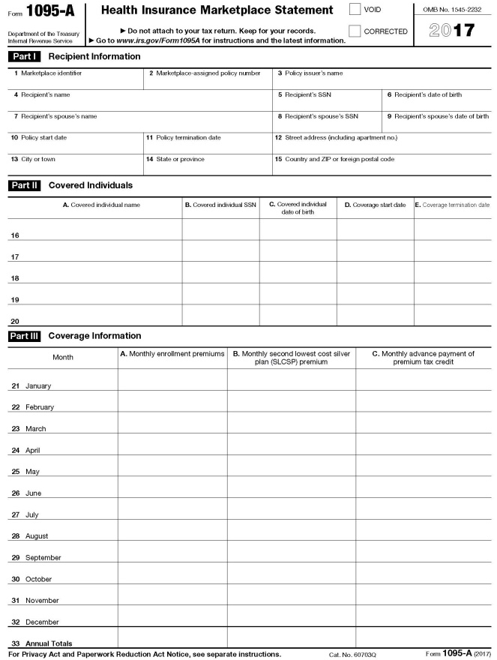
2017 INDIVIDUAL INCOME TAX WORKSHOP
1095-A, Health Insurance Marketplace Statement
The Affordable Care Act (Obama Care) requires that if health insurance was purchased through a Health Care Exchange or Marketplace, Form 1095-A must be completed by the Insurance Provider listing the cost and months the Insured and Dependents had Medical Coverage and issued to the Insured for their records by January 31 of the following year with a copy filed with the IRS. Form 1095-A also provides information needed to complete Form 8962, Premium Tax Credit (PTC), which must be filed with your tax return if any amount other than zero is in Part III, Column C.

Slide 35
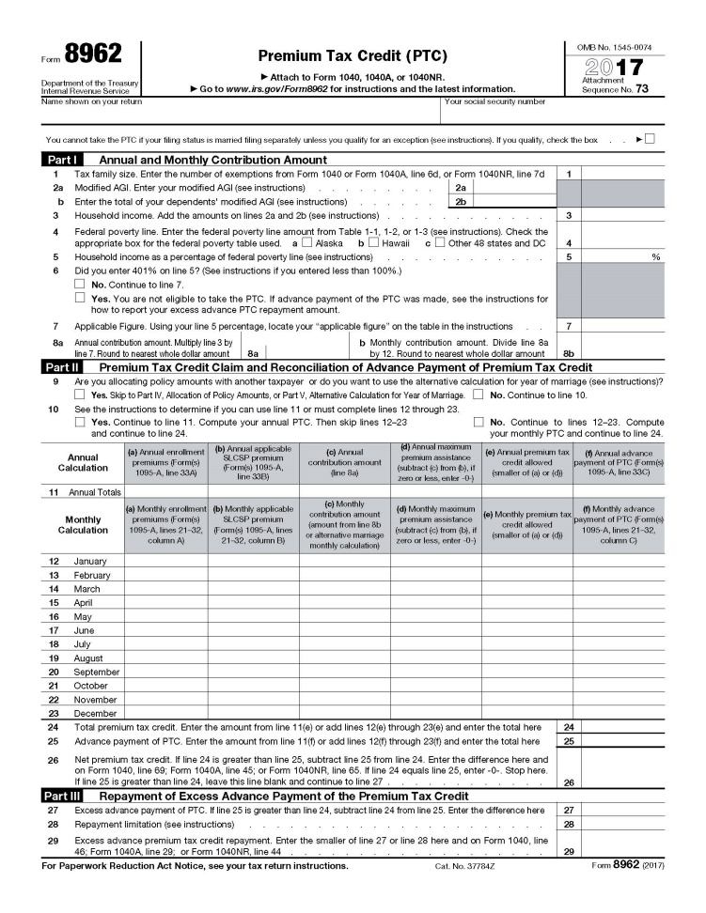
2017 INDIVIDUAL INCOME TAX WORKSHOP
8962, Premium Tax Credit (PTC)
https://www.irs.gov/pub/irs-pdf/f8962.pdf
If you or a member of your family are enrolled in health insurance coverage for 2017 through a Health Insurance Marketplace, use Form 8962 to figure the amount of your Premium Tax Credit (PTC) and reconcile it with Advance Payment of the premium Tax Credit (APTC) and attach 8962 to your tax return.

Slide 36
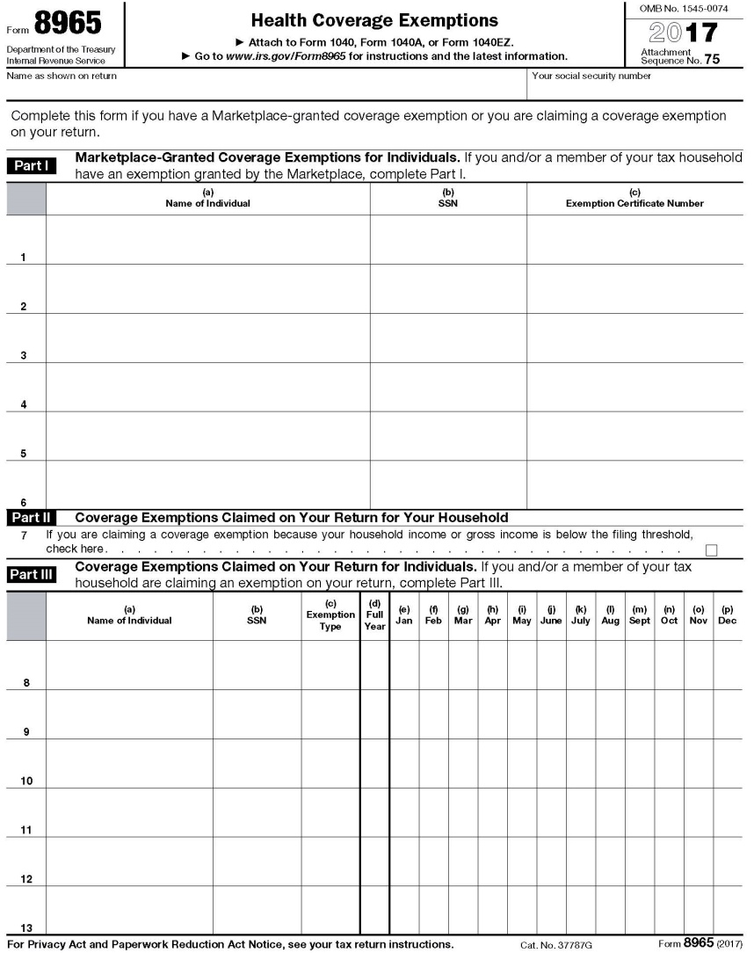
2017 INDIVIDUAL INCOME TAX WORKSHOP
8965, Health Coverage Exemptions
(Attach to Form 1040, Form 1040A, or Form 1040EZ)
To claim an exemption, enter the Code in Part III, Column (c), and identify the months the exemption applies. For Short Coverage Gap of less than 3 consecutive months, enter “B.”

Slide 37
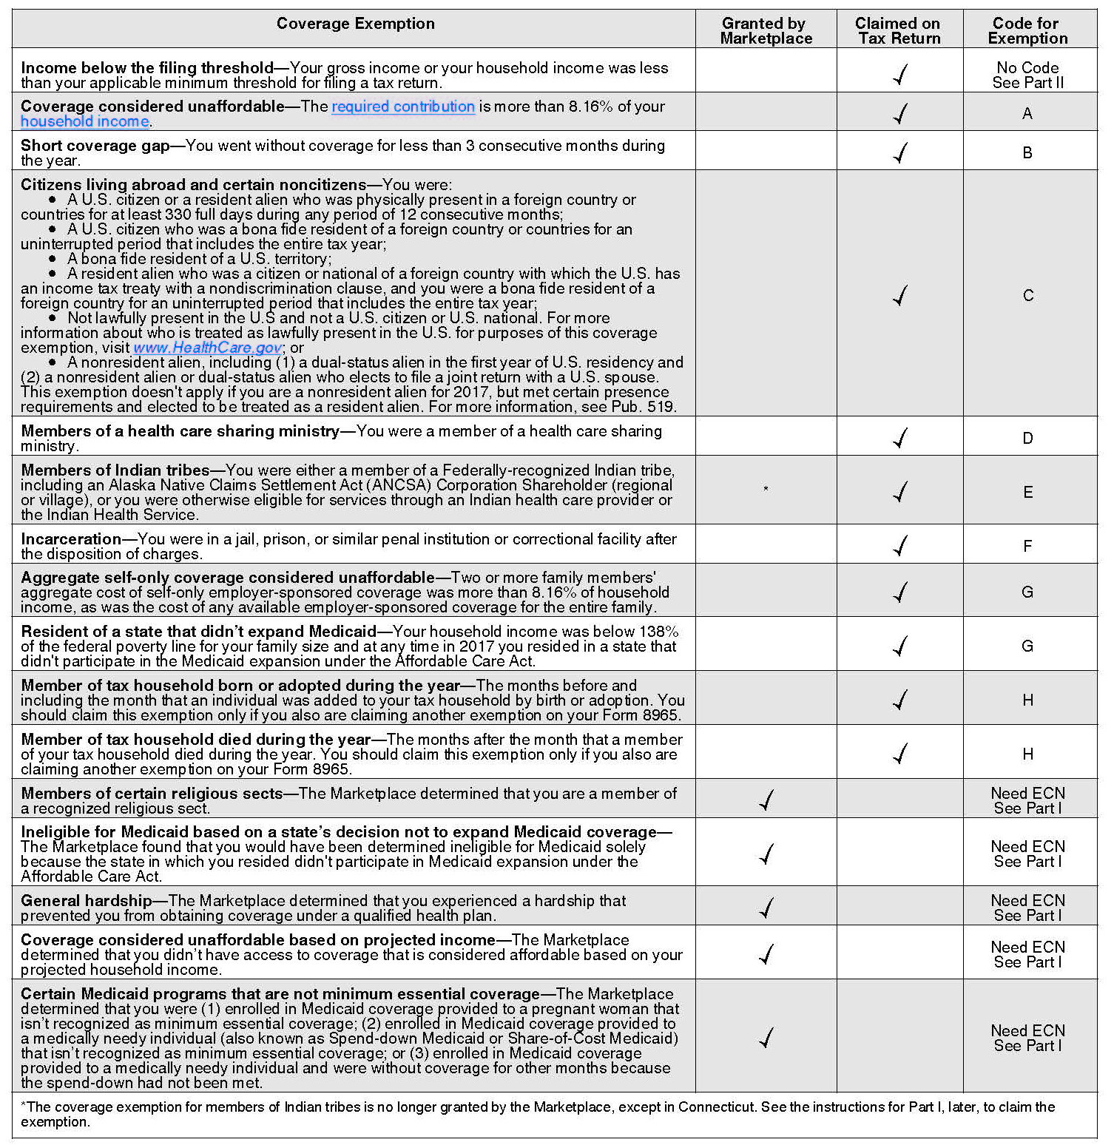
2017 INDIVIDUAL INCOME TAX WORKSHOP
Types of Coverage Exemptions (16) and Codes
https://www.irs.gov/pub/irs-pdf/i8965.pdf (Page 3)
This chart shows the [16] Coverage Exemptions and code for 2017, including information where each can be obtained and the code used on Form 8965 when you claim the exemption. If your coverage exemption was granted by the Marketplace, enter the Exemption Certificate Number (ECN) provided by the Marketplace.

Slide 38
2017 INDIVIDUAL INCOME TAX WORKSHOP
IMPORTANT DATES FOR 2017 AFFORDABLE CARE ACT ENROLLMENT
https://www.healthcare.gov/quick-guide/dates-and-deadlines
If you don’t have health insurance through a job, Medicare, Medicaid, the Children’s Health Insurance Program (CHIP), or another source that provides qualifying coverage, the Health Insurance Marketplace can provide you with coverage.
For 2018, the Open Enrollment Period was reduced to run from November 1, 2017 to December 15, 2017.
If you did not enroll in a health insurance plan for 2018 you may qualify for a Special Enrollment Period.
Current Dates, Unless Congress Changes the Laws:
November 1, 2017: Open Enrollment started — first day to enroll, re-enroll, or change a 2018 insurance plan through the Health Insurance Marketplace.
December 15, 2017: Last day to enroll in or change plans for coverage to start January 1, 2018.
January 1, 2018: 2018 coverage starts for those who enrolled or changed plans by December 15.
January 29, 2018 to April 17, 2018: IRS Tax Season for filing 2017 Individual Income Tax Return, unless extension is filed, then due October 15, 2018.

Slide 39
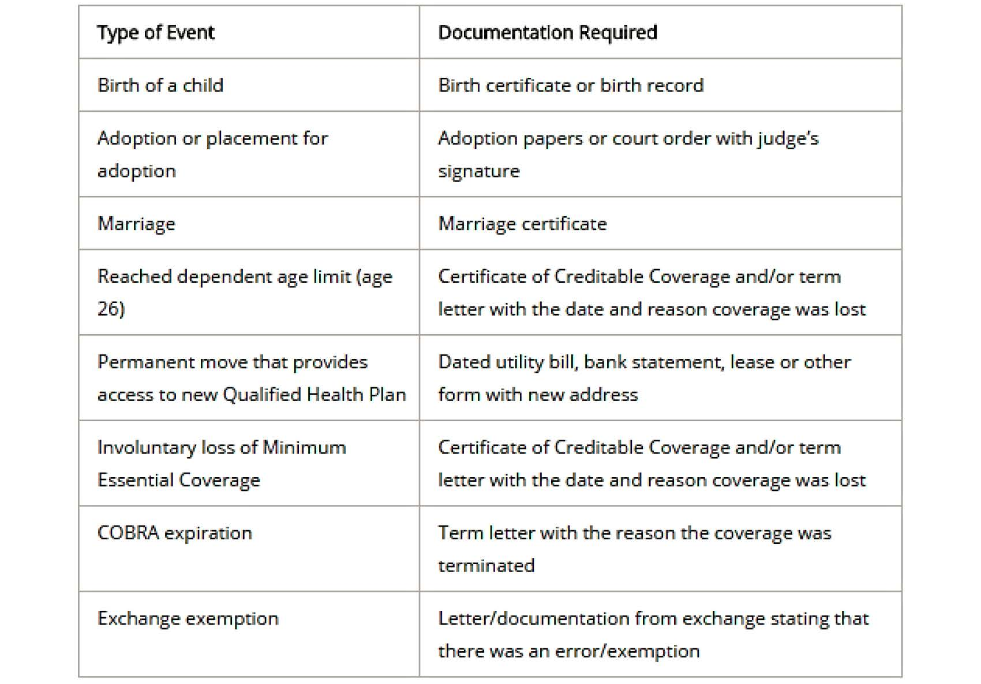
2017 INDIVIDUAL INCOME TAX WORKSHOP
SPECIAL ENROLLMENT PERIOD (SEP)
Special Enrollment Period is a time outside the yearly Open Enrollment Period when you can sign up for health insurance. You qualify for a Special Enrollment Period if you’ve had certain Life Events, including losing health coverage, moving, getting married, having a baby, or adopting a child. https://www.healthcare.gov/glossary/special-enrollment-period
Generally, Special Enrollment Periods apply to all health insurance plans through a Job, Medicare, Medicaid, the Children’s Health Insurance Program (CHIP), or another source that provides qualifying coverage, but paying too much for health care does not qualify for the enrollment.
The following are Life Events or Qualifying Events that would trigger a Special Enrollment Period, and the documentation needed for each:
https://www.healthcare.gov/coverage-outside-open-enrollment/special-enrollment-period

Slide 40
2017 INDIVIDUAL INCOME TAX WORKSHOP
CAPITAL GAINS AND LOSSES
If you already have “Taxable Capital Gains” from selling stock or investment real estate, see if you have some unrealized “Capital losses” in other assets that you can sell before year-end to offset those gains and reduce your tax liability.
“You can deduct up to $3,000 in “Capital Losses each year,” and if there are more losses, you can carry them forward” to the next year.
Suggestions:
If you’re thinking of selling stock, consider postponing the gain until after January to avoid the tax in the current year.
The experts say first make the right decision from an Economic or Investment standpoint then Taxes.

Slide 41
2017 INDIVIDUAL INCOME TAX WORKSHOP
FLEXIBLE SPENDING ACCOUNT (FSA) - DEFINITION
A Flexible Spending Account allows an employee to set aside a portion of earnings to pay for qualified expenses as established in the cafeteria plan, most commonly for medical expenses, but often for dependent care or other expenses. Money deducted from an employee's pay into an FSA is not subject to payroll taxes, resulting in substantial payroll tax savings.
Under the Affordable Care Act, a plan may permit an employee to carry over up to $500 into the following year without losing the funds.
https://en.wikipedia.org/wiki/Flexible_spending_account
A Flexible Spending Account (FSA) is simply a savings account offered by an employer to help employees put away “Tax-free money” for “Qualified Medical Expenses.”
Generally, by paying medical expenses with “Pre-Tax money” or “Tax-free money,” then if your Tax rate is 25% you are saving 25%; just like getting a discount! Deductions are easy, they are taken out of your paycheck by your employer.

Slide 42
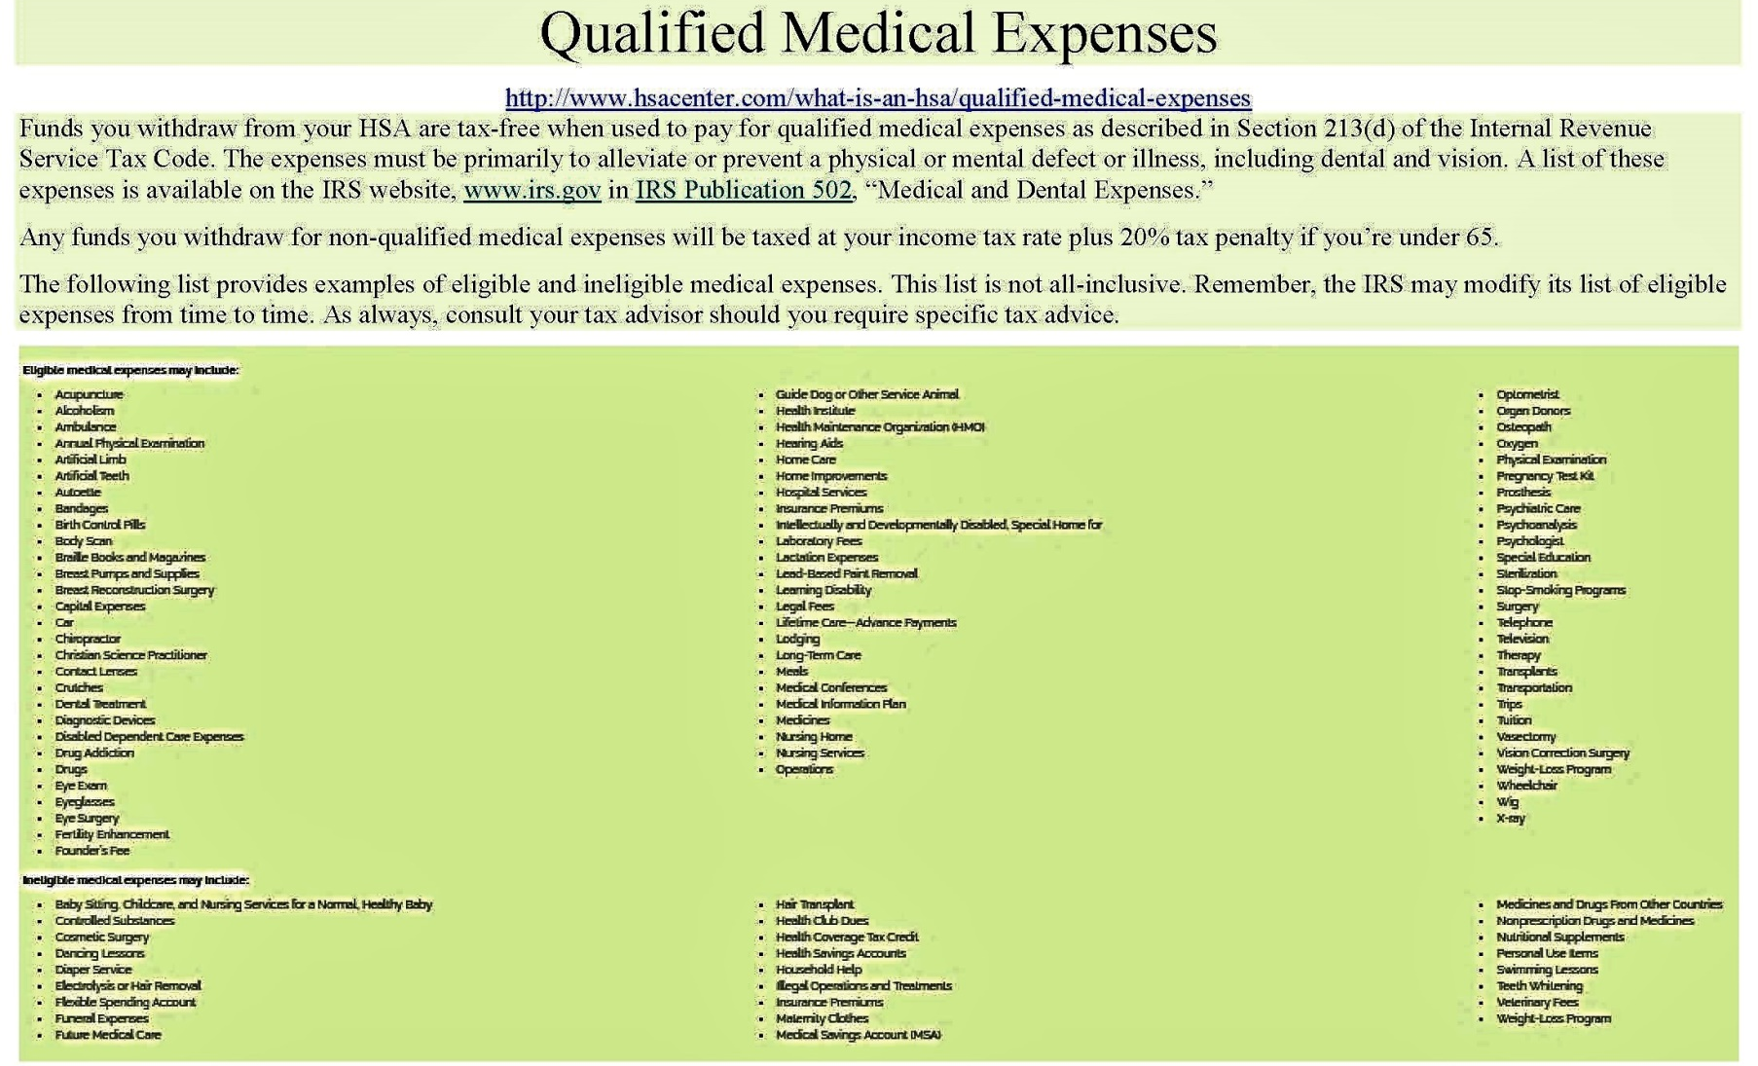
2017 INDIVIDUAL INCOME TAX WORKSHOP
FLEXIBLE SPENDING ACCOUNT (FSA) - QUALIFIED MEDICAL EXPENSES
The IRS is very strict what are considered “Qualified Medical Expenses.” http://www.hsacenter.com/what-is-an-hsa/qualified-medical-expenses

Slide 43
2017 INDIVIDUAL INCOME TAX WORKSHOP
FLEXIBLE SPENDING ACCOUNT (FSA) PLANS
Use It or Lose It Policy
Generally, some Flexible Spending Account Plans (FSA) still have a “Use It or Lose It Policy.” This means that amounts in the account at the end of the plan year cannot be carried over to the next year. If your plan follows this rule, you should make sure to use all of your funds by the end of the plan year, which generally is the end of the calendar year.
As part of the Affordable Care Act, the IRS has changed the rules so that Flexible Spending Account Plans may permit an employee to carry over up to $500 into the following year without losing the funds, but it is not required.
Suggestions:
Because of some FSA plans have the “Use It or Lose It Policy, ” if you do not spend everything in your account, legally the company is not responsible to pay you the balance. Before the end of the year, spend your FSA on Qualified Medical Expenses to maximize your tax savings.
Flexible Spending Accounts allows “Pre-funding,” which means you can spend the money in the account before it’s actually deposited. If you left a company where your Flexible Spending Account paid all the Medical Expenses during the year, but your Payroll Deductions were less, then you are not responsible to pay the company the difference. Although, the company may take it out of your final paycheck.

Slide 44
2017 INDIVIDUAL INCOME TAX WORKSHOP
WHY ARE UNEMPLOYMENT BENEFIT PAYMENTS TAXABLE?
Similar to Medical Insurance Benefits, Unemployment Benefits are just another “Employee Benefit.”
When you file for Unemployment Benefits, the state pays you from a State Trust Fund, which has State Unemployment Taxes plus Federal Unemployment Taxes; both paid by organizations.
Generally, most insurance proceeds or payments are not taxable. Although unemployment is an insurance paid by employers, to protect salaries, starting with the Tax Reform Act of 1986, unemployment insurance benefits became taxable as a “Substitute for Wages.”
According to The Tax Foundation, of the 41 states that tax wage income, 5 states completely exempt unemployment benefits from tax (California, New Jersey, Oregon, Pennsylvania, and Virginia). Two states (Indiana and Wisconsin) partially exempt a fixed dollar amount of unemployment benefits from state income tax but tax the rest, following federal practice from 1982 to 1986. The remaining states fully tax unemployment benefits.
After the end of the year, the Unemployment Benefits Beneficiary should receive Federal Form 1099-G, Certain Government Payments listing the Unemployment Compensation, Federal Income Tax Withheld, and any State Income Tax Withheld. Generally, Severance and Vacation Pay will be allocated to the employees last week at the organization and should be included in the W-2 issued by that organization.

Slide 45
2017 INDIVIDUAL INCOME TAX WORKSHOP
UNEMPLOYMENT BENEFITS FOR 501(C)(3) (NON-PROFIT) EMPLOYEES
An organization that is exempt from income tax under Section 501(c)(3) (Non-profit) of the Internal Revenue Code is also exempt from Federal Unemployment Taxes (FUTA).
https://www.irs.gov/charities-non-profits/exempt-organizations-what-are-employment-taxes
The Federal Unemployment Tax Act, Section 3309 enables 501(c)(3) (Non-profit) organizations to opt out of the tax system and to reimburse the state for unemployment claims the state has paid out to the non-profits' former employees.
http://www.501ctrust.org/unemployment-tax-exemption-for-501c3s-explained
In some states, non-profit reimbursing claims is voluntary.
VA Code Ann §60.2-213 (B)(1) only exempts organizations operating primarily for religious purposes from reimbursing claims to the state. Generally, since these groups are not required to reimburse the state, then their employees are not eligible for Unemployment.
https://law.lis.virginia.gov/vacode/title60.2/chapter2/section60.2-213

Slide 46
2017 INDIVIDUAL INCOME TAX WORKSHOP
401(k) FINANCIAL QUESTIONS
Question:
When I left my company, did the company stop matching funds paid into my 401(k)?
Answer:
Yes, generally you are not eligible to receive additional Company Matching Contributions in a 401(k) plan 30 days after the Separation Date, but what was paid is yours and remains in the account.
Generally, you are also not eligible to Contribute additional amounts to the 401(k) plan 30 days after the Separation Date.
Question:
Since I left my company, will my 401(k) investment fees be higher?
Answer:
No, all plans must charge each investor the same fees for the same investments.
Question:
If I leave my 401(k) with the company, will it still earn investment income?
Answer:
Yes, if you leave your 401(k) with the company, it will still earn investment income.

Slide 47
2017 INDIVIDUAL INCOME TAX WORKSHOP
CONCLUSION
“The hardest thing in the world to understand is the income tax.”
Albert Einstein, Physicist
https://www.irs.gov/uac/Tax-Quotes
Please let me know if you have any questions.
John B. Goldhamer
John.Goldhamer@gmail.com
www.LinkedIn.com/in/JohnGoldhamer
www.JohnGoldhamer.com
I can Hammer out any Tax Problem!

