Slide 1
JOB SEEKER TIPS, TOPICS, AND TOOLS – NAVIGATING It has Everything a Job Seeker Needs to Get a Job from Beginning to End!
It Slices, it Dices, and it will Get you a Job!
PASS IT ALONG!
How to Navigate these All-encompassing Comprehensive Documents that assist Job Seekers with Composing: Cover Letters, Resumes, Marketing Plans, Researching Companies and People, as well as Presenting an Image and More!
by John B. Goldhamer
www.JohnGoldhamer.com Richmond, Virginia

Slide 2
JOB SEEKER TIPS, TOPICS, AND TOOLS – NAVIGATING
Why should you listen to John B. Goldhamer?
John B. Goldhamer is an Authored Tax Law Expert with Education and Experience in all Business Disciplines, including:
J.D. Equivalent Legal Education, Finance, Marketing, MBA, Accounting, and Information Technology with extensive Management Experience.
He has been essentially a Tax Lawyer for organizations for many years; identifying issues, researching, composing and presenting numerous Impact Statements, Position Papers, and Tax Appeals to Jurisdictions and Management as well as composing ten legal briefs; including a Writ of Certiorari legal brief submitted to the Supreme Court of the United States.
On his website, he compiled “Thirty Tax Tools” to assist with Business, Legal, and Tax Research and he also wrote many Position Papers on Individual Income Tax and Unemployment issues.

Slide 3
JOB SEEKER TIPS, TOPICS, AND TOOLS – NAVIGATING
John B. Goldhamer
www.LinkedIn.com/in/JohnGoldhamer
www.JohnGoldhamer.com
Career Counselor
As a “Trained Observer” combined with a “Legal Logic Approach,” John has been conducting One-on-One Career Counseling for many years.
John also has the unusual ability to see connections to things that others do not recognize.
With these skills and abilities, John has helped hundreds of people with:
Career Counseling,
Legal and Finance Issues,
Marketing and Technology Problems,
Accounting, Business, and Tax Issues,
Automotive and Construction Questions and much more.
John admits he is a:
“JACK-OF-ALL TRADES, MASTER OF A FEW, WITH OPINIONS ON EVERYTHING!”

Slide 4
JOB SEEKER TIPS, TOPICS, AND TOOLS – NAVIGATING
During the “Great Recession,” when John was a Job Seeker, he carefully listened to what people said, but also had his own ideas and observations. Eventually, he realized that he had the skills and abilities to put his ideas in writing that became his “Five Job Seeker Tools,” which is now the comprehensive
“Job Seeker Tips, Topics, and Tools.”
It has Everything a Job Seeker Needs to Get a Job from Beginning to End!
Since 2010, including in 2015 when his website went live, his entertaining advice, guidance, and information has crisscrossed the United States helping thousands of Job Seekers.
At one time, John taught classes on LinkedIn, Résumé Writing, and Researching the Internet at the Employment Transition Center and Network Groups.
He is also on the speaker circuit to small groups.

Slide 5
JOB SEEKER TIPS, TOPICS, AND TOOLS – NAVIGATING
Website: www.JohnGoldhamer.com

Slide 6
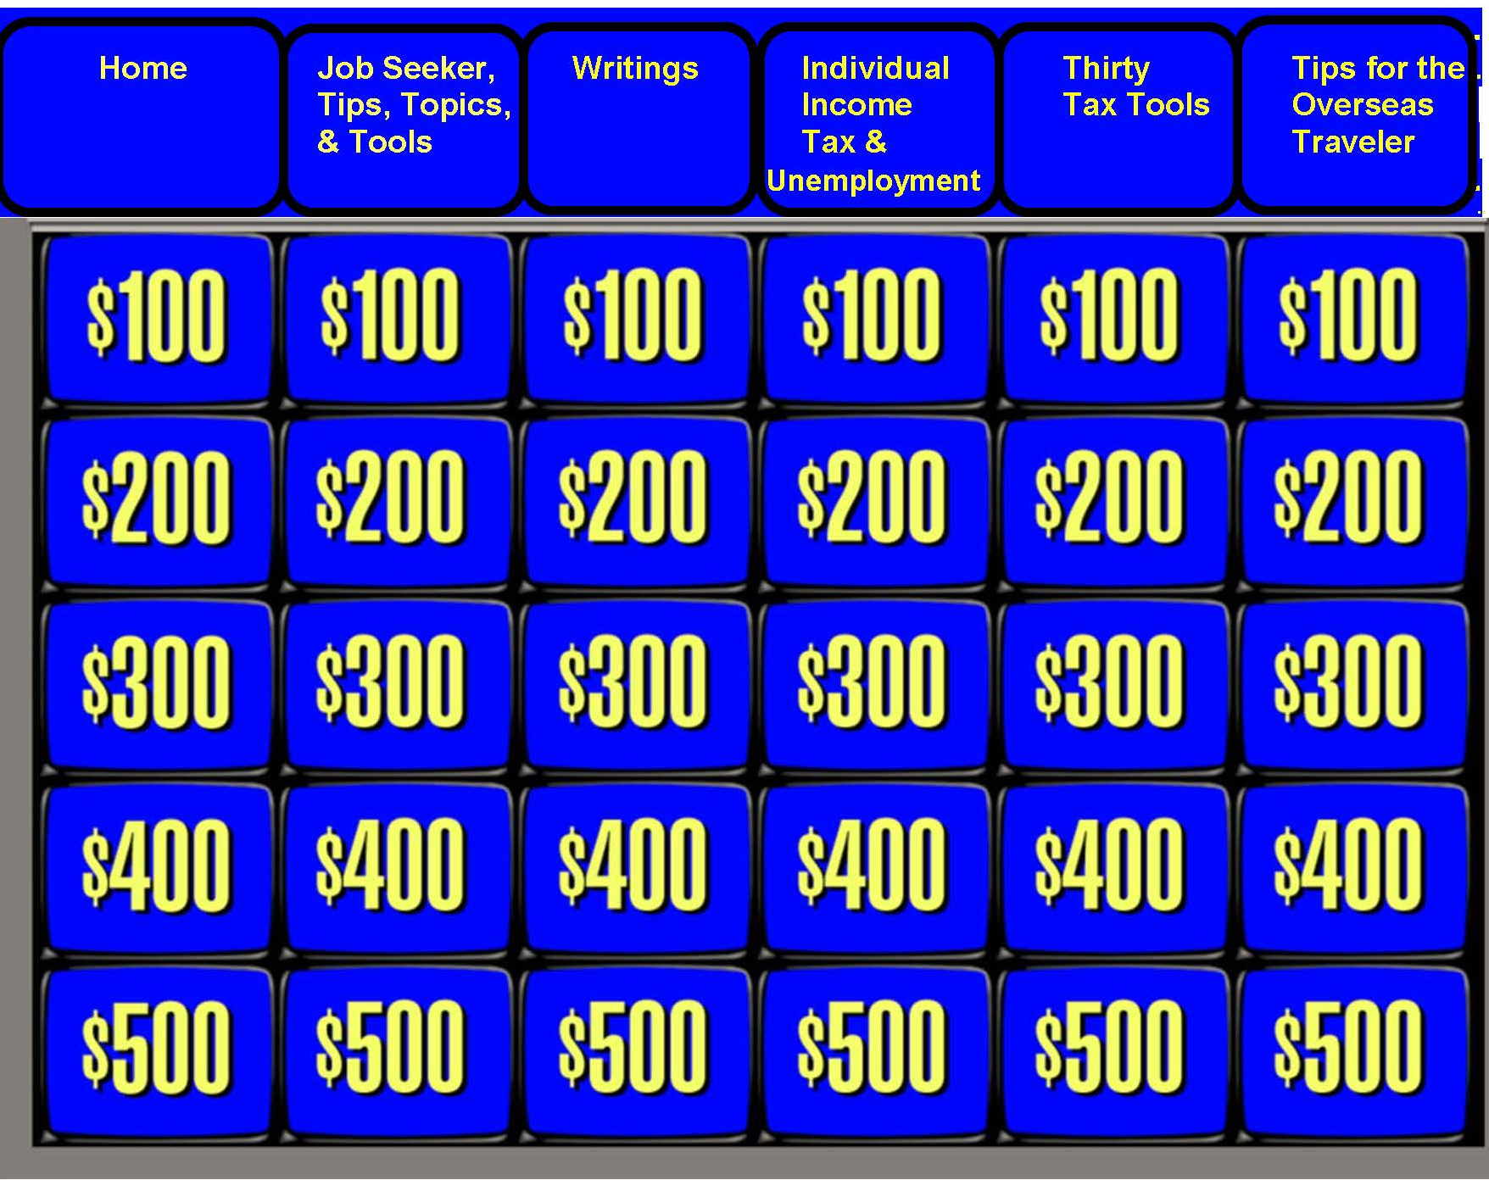
JOB SEEKER TIPS, TOPICS, AND TOOLS – NAVIGATING
IT HAS EVERYTHING A JOB SEEKER NEEDS TO GET A JOB FROM BEGINNING TO END!
Just like Jeopardy, JohnGoldhamer.com has categories across the top

Slide 7
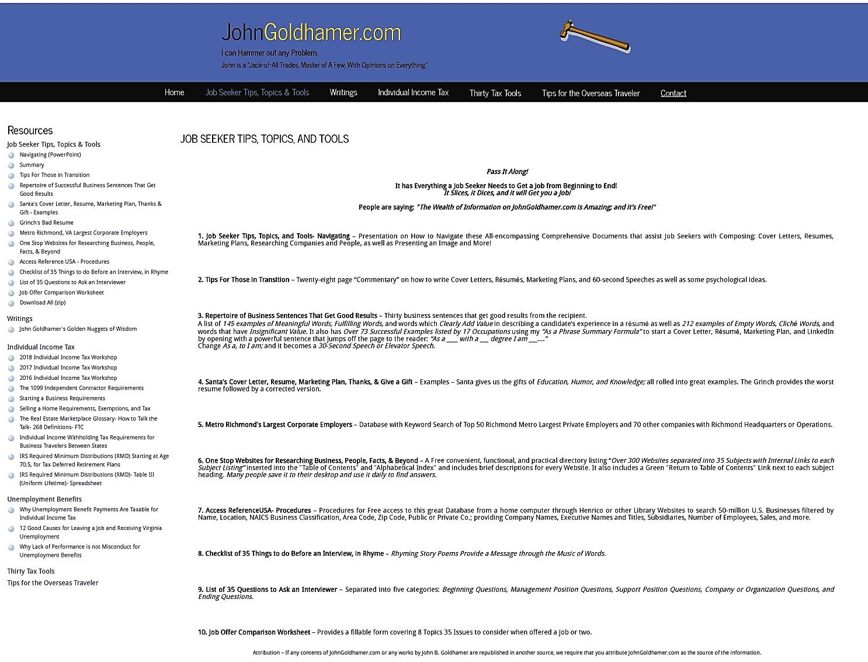
JOB SEEKER TIPS, TOPICS, AND TOOLS – NAVIGATING
IT HAS EVERYTHING A JOB SEEKER NEEDS TO GET A JOB FROM BEGINNING TO END!
People are saying: “The Wealth of Information on JohnGoldhamer.com is Amazing; and it’s Free!”
Pass It Along!

Slide 8
JOB SEEKER TIPS, TOPICS, AND TOOLS – NAVIGATING
IT HAS EVERYTHING A JOB SEEKER NEEDS TO GET A JOB FROM BEGINNING TO END! Pass It Along!
Job Seeker Tips, Topics, and Tools- Navigating – Presentation How to Navigate these All-encompassing Comprehensive Documents that assist Job Seekers with Composing: Cover Letters, Resumes, Marketing Plans, Researching Companies and People, as well as Presenting an Image and More!
Tips For Those in Transition – Twenty-five page “Commentary” on how to write Cover Letters, Résumés, Marketing Plans, and 60-second Speeches as well as some psychological ideas.
Repertoire of Successful Business Sentences That Get Good Results – Thirty business sentences that get good results from the recipient. A list of 145 examples of Meaningful Words, Fulfilling Words, and words which Clearly Add Value in describing a candidate’s experience in a résumé as well as 212 examples of Empty Words, Cliché Words, and words that have Insignificant Value. It also has Over 76 Examples listed by 17 Occupations using my “As a Phrase Summary Formula” to start a Cover Letter, Résumé, Marketing Plan, and LinkedIn by opening with a powerful sentence that jumps off the page to the reader: “As a ___ with a __ degree I am ___...” Change As a, to I am; and it becomes a 30-Second Speech or Elevator Speech.
Santa's Cover Letter, Resume, Marketing Plan, Thanks, & Give a Gift- Examples – Santa gives us the gifts of Education, Humor, and Knowledge; all rolled into great examples. The Grinch provides the worst resume followed by corrected versions.
Metro Richmond's Largest Corporate Employers – Database with Keyword Search of Top 50 Richmond Metro Largest Private Employers and 70 other companies with Richmond Headquarters or Operations.
One Stop Websites for Researching Business, People, Facts, & Beyond – A Free convenient, functional, and practical directory listing “Over 300 Websites separated into 35 Subjects with Internal Links to each Subject Listing” inserted into the "Table of Contents" and "Alphabetical Index" and includes brief descriptions for every Website. It also includes a Green "Return to Table of Contents" Link next to each subject heading. Many people save it to their desktop and use it daily to find answers.
Access ReferenceUSA- Procedures – Procedures for Free access to this great Database from a home computer through Henrico or other Library Websites to search 50-million U.S. Businesses filtered by Name, Location, NAICS Business Classification, Area Code, Zip Code, Public or Private Co.; providing Company Names, Executive Names and Titles, Subsidiaries, Number of Employees, Sales, and more.
Checklist of 35 Things to do Before an Interview, in Rhyme – Rhyming Story Poems Provide a Message through the Music of Words. JBG
List of 35 Questions to Ask an Interviewer – Separated into five categories: Beginning Questions, Management Position Questions, Support Position Questions, Company or Organization Questions, and Ending Questions.
Job Offer Comparison Worksheet – A fillable form covering 8 Topics 35 Issues to consider when offered a job.

Slide 9
JOB SEEKER TIPS, TOPICS, AND TOOLS – NAVIGATING
Tips For Those in Transition
Twenty-eight page “Commentary” on how to write Cover Letters, Résumés, Marketing Plans, and 60-second Speeches.
Containing John Goldhamer's ideas, opinions, and thoughts that he suggests to Job Seekers, which he developed while counseling, speaking in network meetings, and teaching.

Slide 10
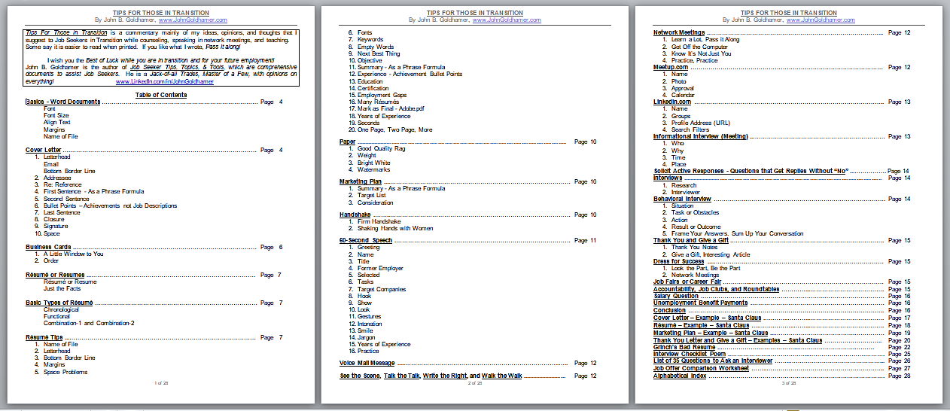
JOB SEEKER TIPS, TOPICS, AND TOOLS – NAVIGATING
Tips For Those in Transition
Table of Contents - Three Detailed Pages
How to write Cover Letters, Résumés, Marketing Plans, 60-second Speeches, Etc.

Slide 11
JOB SEEKER TIPS, TOPICS, AND TOOLS – NAVIGATING
Tips For Those in Transition
Alphabetical Index

Slide 12
JOB SEEKER TIPS, TOPICS, AND TOOLS – NAVIGATING
Tips For Those in Transition
Résumé Tips
Résumé or Resume - Either are acceptable. It is a French word, meaning “Summary.”
1. Name of File - So that the HR Recruiter or Hiring Manager recognizes your résumé, the name of the computer file should be as follows:
First Name Last Name - Resume - 2018
2. Letterhead - To make a Centered Professional Letterhead, display all information in Bold with 12-font size. Your street is not necessary. List your Town / City / State, Cell Phone Number, and LinkedIn, E-mail address. Since Cell phones are better today, do not list your landline unless it is your only phone. Make it easy for the Hiring Manager to know how to contact you! After your name, list your credentials such as PhD, MBA, J.D., CPA, PMP, etc.
3. Bottom Border Line - To offset the letterhead from the body of the cover letter, add three empty lines or spaces, and then on the middle line, add a Bottom Border line by clicking the Borders Drop Down Box so that the line goes across the page.
If space is a problem, use one line for the Bottom Border or make the line size “1.”
Human nature will automatically start reading below a line.

Slide 13
JOB SEEKER TIPS, TOPICS, AND TOOLS – NAVIGATING
Tips For Those in Transition
Cover Letter
6. Bullet Points - Achievements not Job Descriptions - Bullet Points should be similar to your résumé Bullet Points, but written in Complete sentences, and demonstrate to the reader that they were Achievements or Assigned Successful Tasks. It has been said that they must meet the “So What Test,” showing that they were important to the success of your employer and maybe your future employer.
The following shows the difference between a Job Description and an Achievement Bullet Point:
A Job Description Bullet Point states, “Every day I inhaled and exhaled.”
An Achievement Bullet Point states, “I exhaled, blowing up a balloon traveling 9 feet.”
Bullet Points should have Valid Numeric or Percentage Statistics such as:
Saved my company over $2,000,000 by designing and implementing a product cost reduction manufacturing plan,
Increased sales over 20% by creating an unusual method of presenting products into weaker markets,
Bullet Points could list Improved Functions without numbers such as:
Created a process improvement for manufacturing widgets,
Modified the filing return procedures, which saved time,
Bullet Points could have conclusions that are not in your résumé such as:
Extensive education and experience to quickly analyze, evaluate, and resolve complex accounting issues,
Can make an easier transition when dealing with governments,

Slide 14
JOB SEEKER TIPS, TOPICS, AND TOOLS – NAVIGATING
Tips For Those in Transition
Résumé Tips
12. Experience – Achievement Bullet Points – Just as LinkedIn uses, since we read English from left to right, top to bottom the most important should be listed first. On one line start with Title, followed by the Company, City, State, and just the years.
Under each employment, list your Achievements or Assigned Successful Tasks related to the position. They should meet the “So What Test” showing success.
(See Cover Letter Number 6, Bullet Points – Achievements not Job Descriptions)
If you cannot recall some of your achievements and you need something to spark your memory, go to LinkedIn.com; on the top, click Advanced Search. Then, on the left side you can search by Keyword, Name, Title, Company, and Location. By keying your title and then clicking Search, you may be able to find someone that lists an achievement that reminds you that you had the same achievement.
13. Education – Since we read English from left to right, top down, start with your most recent degree or certificate, then the school, followed by the city and state. We have been taught to list the school first, but unless you went to an Ivy League school, Recruiters are first interested in your degree followed by the school. If you are older, do not list graduation dates. If an associate degree rolled into a bachelor, then only list the bachelor. List all degree disciplines even if “Basket Weaving.”

Slide 15
JOB SEEKER TIPS, TOPICS, AND TOOLS – NAVIGATING
Tips For Those in Transition
Psychological Phrases:
See the Scene, Talk the Talk, Write the Right, and Walk the Walk
I added my ideas to his popular expression. You should first See the Scene
or Visualize what you want to do, next Talk about doing it, then Write
about it, which takes your ideas out of your head, puts it on paper, so that
your eyes can see it, and finally Walk or put your words into practice by
doing it.
Look the Part, Be the Part - Just like a photo, your “Visual Identity" carries the weight of a thousand words and can give a Good First Impression. For all professional positions, even if a company is “Business Casual, for an interview you should Always Dress Up! Brand yourself as a professional. Psychologists call it Enclothed Cognition, which is the influence clothes have on the wearer's psychological processes.
Sum Up Your Conversation - If you find that you speak to long, give yourself a mental note to try to “Sum up Your Conversation” when you shift in your seat.
Frame Your Answers - Start your Behavioral Answers with “When I was a __________ at __________ I had a situation where…”
First Name Last Name Show and you are Star! - 60-second Speech

Slide 16
JOB SEEKER TIPS, TOPICS, AND TOOLS – NAVIGATING
Tips For Those in Transition
Give a Gift
Remember how your parents taught you to never go to someone’s house without a gift?
If you do not hear from an Recruiter or Interviewer, after a couple of weeks, search for an interesting “Free” article on the industry or company using Google or Blog Search Engine such as: http://www.blogsearchengine.org/
Once you find an article on the field or company, e-mail the interviewer saying:
Thank you again for interviewing me recently! Enclosed is a link to an article that I found about ______ that I think you will find interesting. I hope to hear from you soon!
Be sure your name, address, telephone, and e-mail address are listed.
The Interviewer will think you are creative and noticeable, but not feel pestered.
Salary Question
Bid on a Job - When an Interviewer asks what salary are you looking for, first respond saying,
“It is difficult to bid on a job without all the details.” The Interviewer may reply by questioning,
“Since you have the job description, what salary you are looking for?” Then merely ask,
“What is the range for the position?” The Interviewer may ask, “What is your range?” Simply say,
“According to Salary.com, O*Net or another salary website, the range for this job in this city is _ to _.”

Slide 17
JOB SEEKER TIPS, TOPICS, AND TOOLS – NAVIGATING
Tips For Those in Transition
Job Seeking Documents are similar to the Charles Dickens story of Mr. Scrooge’s three visitors:
Your Résumé is the “Spirit of Job Seeker’s Past,”
Your Cover Letter is the “Spirit of Job Seeker’s Present,”
Your Marketing Plan is the “Spirit of Job Seeker’s Future.”
With these three “Spirits” or “Representations,” you will succeed!

Slide 18
JOB SEEKER TIPS, TOPICS, AND TOOLS – NAVIGATING
Repertoire of Business Sentences That Get Good Results

Slide 19
JOB SEEKER TIPS, TOPICS, AND TOOLS – NAVIGATING
Repertoire of Business Sentences That Get Good Results
Opening Sentences that Jump Off the Face of the Page
As we discussed,
As you know,
As mentioned previously,
As a _____, with a _____ degree, I am proficient in ____ (As a Phrase Summary Formula)
As our customer, we want to make sure that you are aware of __________
Recently, I received a __________
Thank you for your question regarding __________
__________ suggested that I contact you regarding __________
Declarations (Things Come in Threes)
Attached is my résumé listing my Achievements, Education, and Experience.
My Education, Experience, and Expertise establish the type of exceptional work I would perform.
Attached are my Conclusions, Data, and Documentations.
I Accumulated, Assembled, and Authored __________
I Conceived, Created, and Composed __________
I Explored, Researched, and Composed a document on ___________
I Created, Presented, and Implemented a ____________
Making an Experiential Educational Estimate I conclude that __________
Demonstrating my Ingenuity, Initiative, and Inventiveness, I created ___________
Through the Art of Legal Reasoning, Law, and Evidence I was able to __________
May you and your family have a Plentiful, Productive, and Prosperous New Year!
I provide the advice as well as the Direction, Details, and Documentation for success.

Slide 20
JOB SEEKER TIPS, TOPICS, AND TOOLS – NAVIGATING
Repertoire of Business Sentences That Get Good Results
145 examples of Meaningful Words, Fulfilling Words, and words which Clearly Add Value in describing a candidate’s experience that could be used in a résumé.

Slide 21
JOB SEEKER TIPS, TOPICS, AND TOOLS – NAVIGATING
Repertoire of Business Sentences That Get Good Results
212 examples of Empty Words, Cliché Words, and words that that have Insignificant Value to describe a candidate’s experience that should not be used in a résumé.

Slide 22
JOB SEEKER TIPS, TOPICS, AND TOOLS – NAVIGATING
Repertoire of Business Sentences That Get Good Results
68 Dynamic Action Verbs To Enhance Your Resume
http://theinterviewguys.com/action-verbs-to-enhance-your-resume
Verbs are words that help to describe an action, such as ran, threw, and jumped.

Slide 23
JOB SEEKER TIPS, TOPICS, AND TOOLS – NAVIGATING
Repertoire of Business Sentences That Get Good Results
As a Phrase Summary Formula

Slide 24
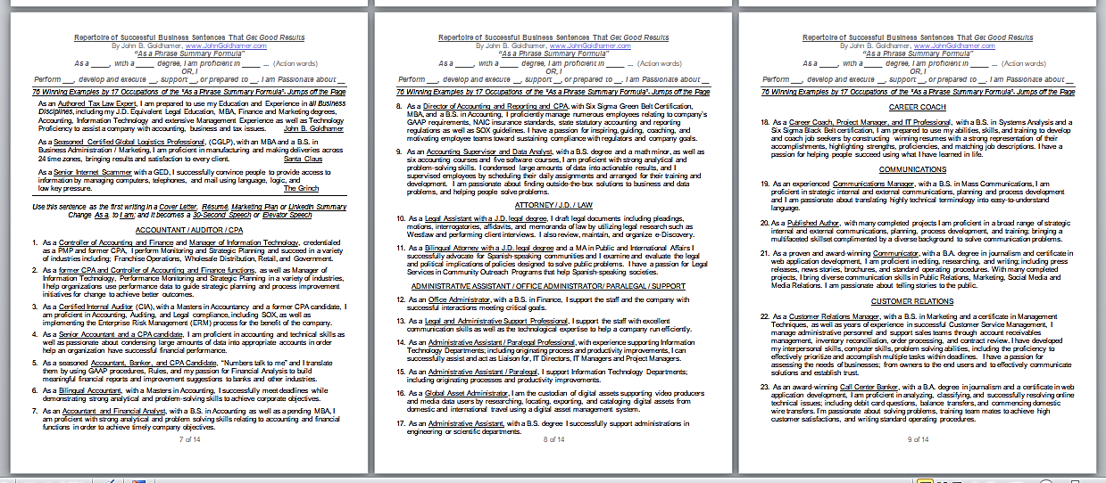
JOB SEEKER TIPS, TOPICS, AND TOOLS – NAVIGATING
Repertoire of Business Sentences That Get Good Results
76 Successful Examples listed by 17 Occupations using my
“As a Phrase Summary Formula” that Jumps off the Page to the Reader!

Slide 25
JOB SEEKER TIPS, TOPICS, AND TOOLS – NAVIGATING
Repertoire of Business Sentences That Get Good Results
As a Phrase Summary Formula
As a ____, with a ___ degree, I am proficient in ___. (Action words)
OR I
Perform __, develop and execute __, support __, or prepared to __. I am Passionate about __
Applying the concepts of “Legal Brief Opening Statements” and “Successful Manuscript Writing,” an Opening Sentence, Statement, or Summary should be:
Penetrating, show what you intend to prove, and be a “Page-turner.”
For a Job Seeker, using my “As a Phrase Summary Formula” provides a powerful sentence that sums up everything anyone would want to know about an applicant and it will stand out to an HR Recruiter.
This “Magical” sentence Jumps off the page to the reader and should be the first writing in a Cover Letter, Résumé, Marketing Plan, and LinkedIn Summary.
Change As a to I am and it’s a 30-Second or Elevator Speech all about You!

Slide 26
JOB SEEKER TIPS, TOPICS, AND TOOLS – NAVIGATING
Repertoire of Business Sentences That Get Good Results
As a Phrase Summary Formula
As a _____, with a _____ degree, I am proficient in _____ ... (Action words)
OR, I
Perform ___, develop and execute __, support __, or prepared to __. I am Passionate about __
76 Successful Examples listed by 17 Occupations using my “As a Phrase Summary Formula”
that Jumps off the page!
As an Authored Tax Law Expert, I am prepared to use my Education and Experience in all Business Disciplines, including my J.D. Equivalent Legal Education, MBA, Finance and Marketing degrees, Accounting, Information Technology, and extensive Management Experience as well as Technology Proficiency to assist a company with accounting, business and tax issues. John B. Goldhamer
As a Seasoned Certified Global Logistics Professional, (CGLP) with an MBA and a B.S. in Business Administration / Marketing, I am proficient in manufacturing and making deliveries across 24 time zones, bringing results and satisfaction to every client. Santa Claus
As a Senior Internet Scammer with a GED, I successfully convince people to provide access to information by managing computers, telephones, and mail using language, logic, and low key pressure. The Grinch

Slide 27
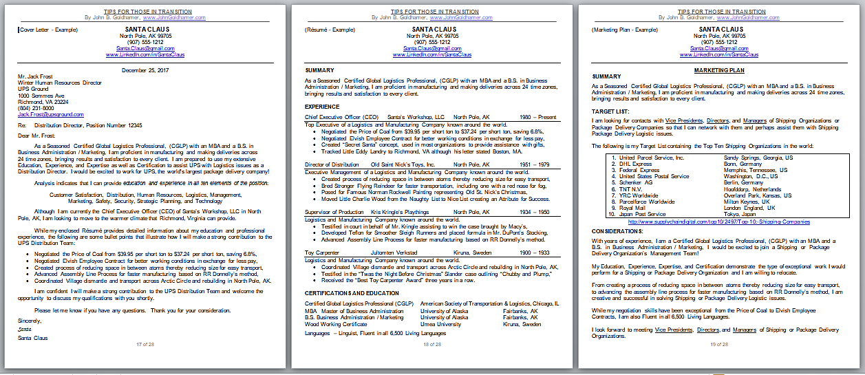
JOB SEEKER TIPS, TOPICS, AND TOOLS – NAVIGATING
Santa Claus’s
Cover Letter, Résumé, and Marketing Plan – Examples

Slide 28
JOB SEEKER TIPS, TOPICS, AND TOOLS – NAVIGATING
Santa Claus’s
Thank You Letter and Give a Gift – Examples

Slide 29
JOB SEEKER TIPS, TOPICS, AND TOOLS – NAVIGATING
The Grinch Provides the Worst Résumé

Slide 30
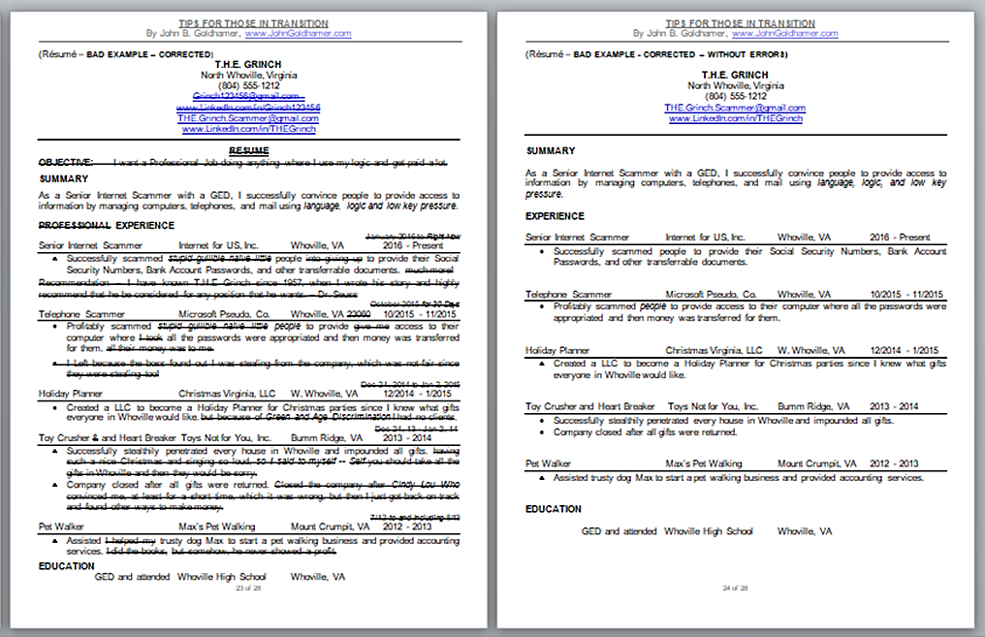
JOB SEEKER TIPS, TOPICS, AND TOOLS – NAVIGATING
The Grinch’s Worst Résumé - Listed Corrections and Final

Slide 31
JOB SEEKER TIPS, TOPICS, AND TOOLS – NAVIGATING
Metro Richmond's Largest Corporate Employers
Database of the Top 120 Richmond Metropolitan Largest Private Employers with Keyword Search

Slide 32
JOB SEEKER TIPS, TOPICS, AND TOOLS – NAVIGATING
2015 Metro Richmond's Largest Corporate Employers
Database of the Top 50 Richmond Metropolitan Largest Private Employers and 70 other Companies with Richmond Headquarters or Operations.
It includes links to company’s Fortune 1000 Ranking, Stock Symbol, Company Website, and links to:
Company Keyword Search of Open Positions.

Slide 33
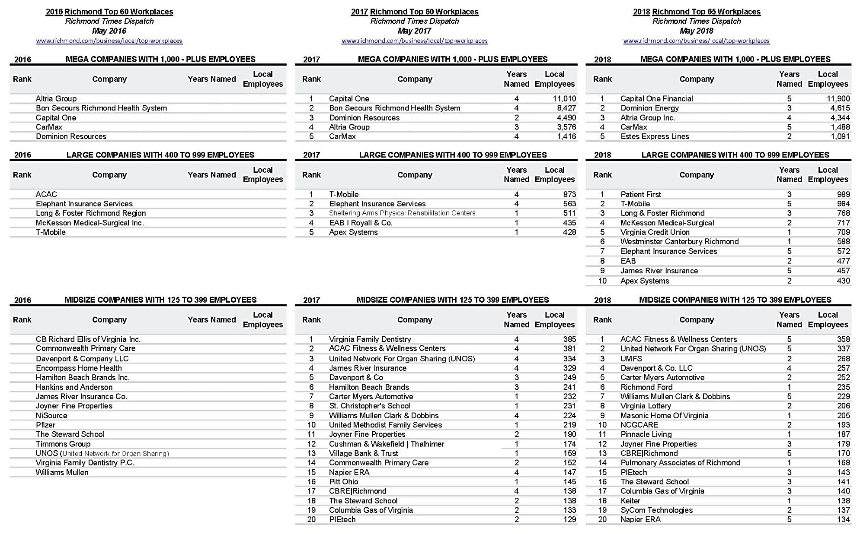
JOB SEEKER TIPS, TOPICS, AND TOOLS – NAVIGATING
2016, 2017, & 2018 Richmond Top 65 Workplaces- Mega, Large, & Midsize Companies

Slide 34
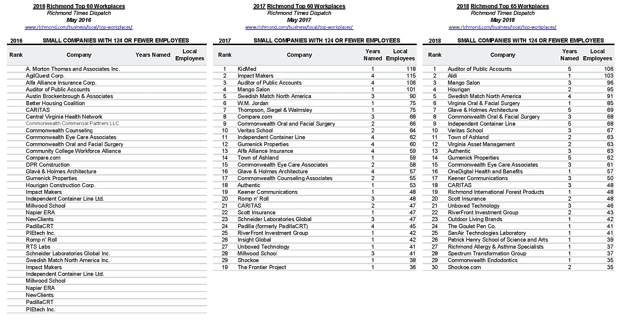
JOB SEEKER TIPS, TOPICS, AND TOOLS – NAVIGATING
2016, 2017, & 2018 Richmond Top 65 Workplaces- Small Companies- 124 or less Employees

Slide 35
JOB SEEKER TIPS, TOPICS, AND TOOLS – NAVIGATING
One Stop Websites for Researching Business, People, Facts, & Beyond
A Free convenient, functional, and practical directory listing “Over 300 Websites separated into 35 Subjects with Internal Links to each Subject Listing” inserted into the "Table of Contents" and "Alphabetical Index" and includes brief descriptions for every Website. It also includes a Green "Return to Table of Contents" Link next to each subject heading. Many people save it to their desktop and use it daily to find answers.

Slide 36
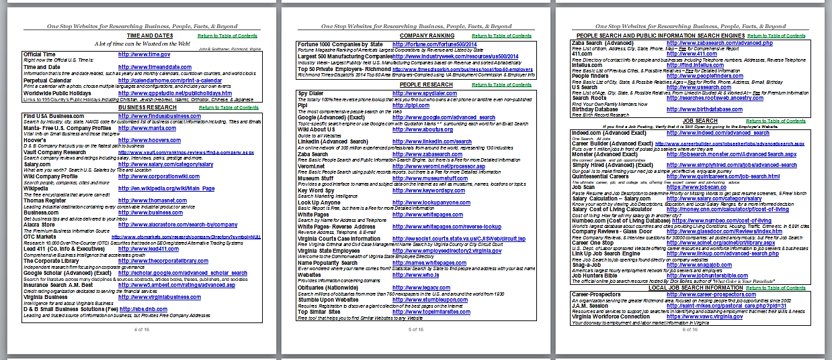
JOB SEEKER TIPS, TOPICS, AND TOOLS – NAVIGATING
One Stop Websites for Researching Business, People, Facts, & Beyond
A Practical Directory of 35 Subjects over 300 Websites including brief descriptions for each Website and Link to “Return to Table of Contents”

Slide 37
JOB SEEKER TIPS, TOPICS, AND TOOLS – NAVIGATING
Access ReferenceUSA
Procedures for Free access to this Great Database from your home computer to search over 24-million U.S. Businesses through the Henrico County Library Website.

Slide 38
JOB SEEKER TIPS, TOPICS, AND TOOLS – NAVIGATING
Access Reference USA- Procedures
Procedures for Free access to this Great Database from your home computer to search over 24-million U.S. Businesses through the Henrico County Library Website.
This Database provides information on individuals, industries, business size, sales volumes, and credit scores.
It searches millions of U.S. businesses, residences, or physicians by geographic location, size, and type.

Slide 39
JOB SEEKER TIPS, TOPICS, AND TOOLS – NAVIGATING
Access ReferenceUSA
ReferenceUSA is the leading provider in business and consumer research! Offering a full-service platform, ReferenceUSA helps users create marketing plans, conduct competitive analysis, raise funds, and locate people.
Our database selections and real-time access to more than 24 Million Businesses, 262 Million Consumers, U.S. New Businesses, U.S. New Homeowners and Movers, make research easy and fast!
ReferenceUSA’s quality information helps researchers, students and Job Seekers answer a wide variety of questions, and saves them valuable time and money. http://www.referenceusa.com/Static/AboutUs

Slide 40
JOB SEEKER TIPS, TOPICS, AND TOOLS – NAVIGATING
Checklist of 35 Things to Do Before an Interview, in Rhyme
“Rhyming Story Poems Provide a Message through the Music of Words.”
By John B. Goldhamer
Our Clocks are set, Shoes Shined, and we are ready for Interview DAY,
With Clothing Pressed, Hair Combed, and Car Keys Known we are Set without DELAY
Our Cars are Fixed, Tires Good, Tank Full, and we are ready for Victory TODAY,
Address Googled, Directions Firm, Map Printed and Plan to be early so Success will not be GRAY.
Smiles in the Mirror show we have Confidence and we Shine like a SUNRAY,
We Look Good, Professional too, and now we are ready to tell the Interviewer HEY.
Ready to Turn Off Cell Phones before the meeting so we do not get a call from any of THEY,
And we have a Stack of Business Cards, which look great and are not made of CLAY.
We have Two Good Pens Without Advertising that we had in our Pen and Pencil TRAY,
Our Portfolio is Cleaned, Old Papers Removed, and the Pad of Paper is not FRAY.
We Printed the Interview’s E-mail Invitation and Replied our Excitement to Meet in order to SWAY,
And Prepared Thank you E-mails to send After the Interview so our Competence would WEIGH.
We Reviewed, Underlined Verbs, and Printed the Job Posting and think they will offer a Good PAY,
Created Six Questions from the List of Questions to Ask an Interviewer, hoping some will get a YEA,
We Looked at each Interviewer’s LinkedIn Profile to Show us the WAY,
And Researched the Company to show we are Prepared and it will not be just, Come What MAY.
With Printed Cover Letters and Resumes In Hand with a Lot to SAY,
We Know that our SOAR Stories would make a Good PLAY.
We even Read John Goldhamer’s “Job Seeker Tips, Topics, and Tools” and did not STRAY,
So now we are EQUIPPED, PREPARED, AND READY for Interview DAY.

Slide 41
JOB SEEKER TIPS, TOPICS, AND TOOLS – NAVIGATING
Checklist of 35 Things to Do Before an Interview, in Rhyme

Slide 42
JOB SEEKER TIPS, TOPICS, AND TOOLS – NAVIGATING
List of 35 Questions to Ask an Interviewer
Separated into five categories: Beginning Questions, Management Position Questions, Support Position Questions, Company or Organization Questions, and Ending Questions.

Slide 43
JOB SEEKER TIPS, TOPICS, AND TOOLS – NAVIGATING
Job Offer Comparison Worksheet
Provides a fillable form covering 8 Topics 35 Issues to consider when offered a job or two.

Slide 44
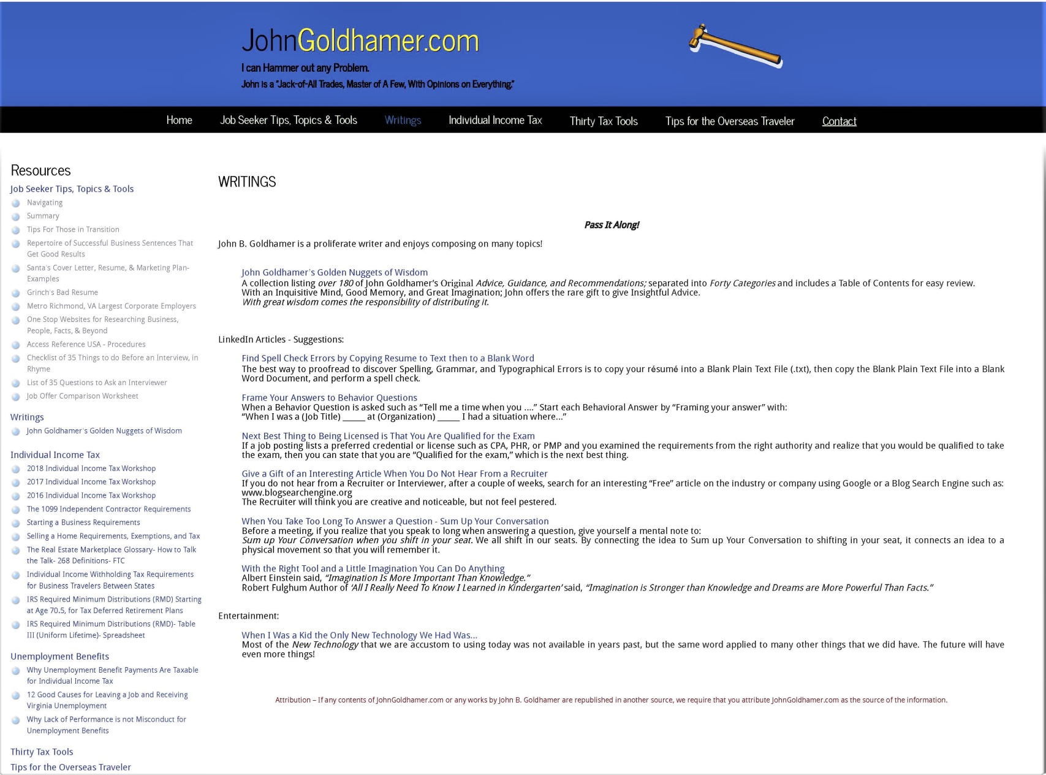
JOB SEEKER TIPS, TOPICS, AND TOOLS – NAVIGATING
Writings - John Goldhamer’s Golden Nuggets of Wisdom & Six LinkedIn Articles

Slide 45
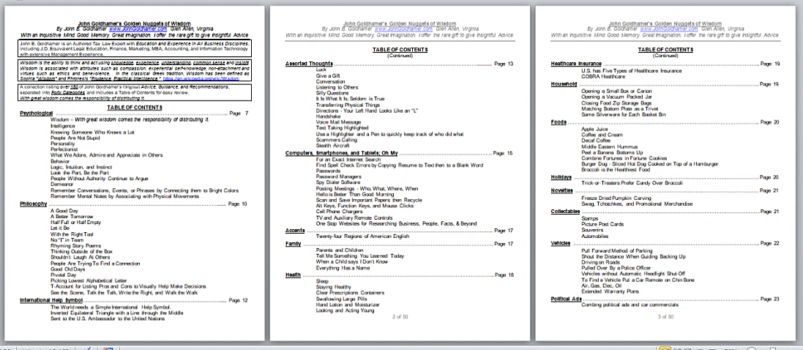
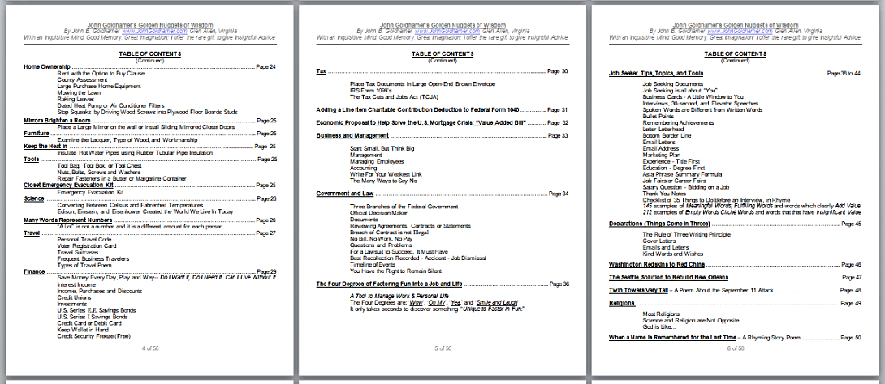
JOB SEEKER TIPS, TOPICS, AND TOOLS – NAVIGATING
Writings
John Goldhamer's Golden Nuggets of Wisdom
A collection listing over 180 of John Goldhamer’s Original Advice, Guidance and Recommendations separated into Forty Categories and includes a Table of Contents for easy review.
With an Inquisitive Mind, Good Memory and Great Imagination; John offers the rare gift of Insightful Advice.
With great wisdom comes the responsibility of distributing it.

Slide 46
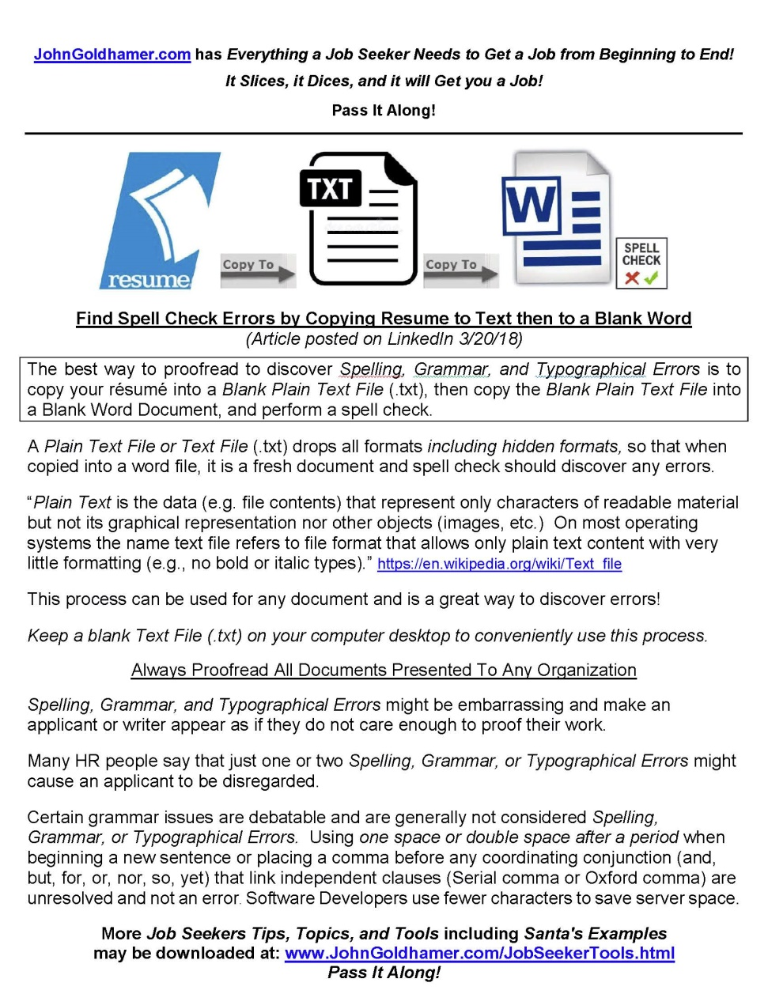
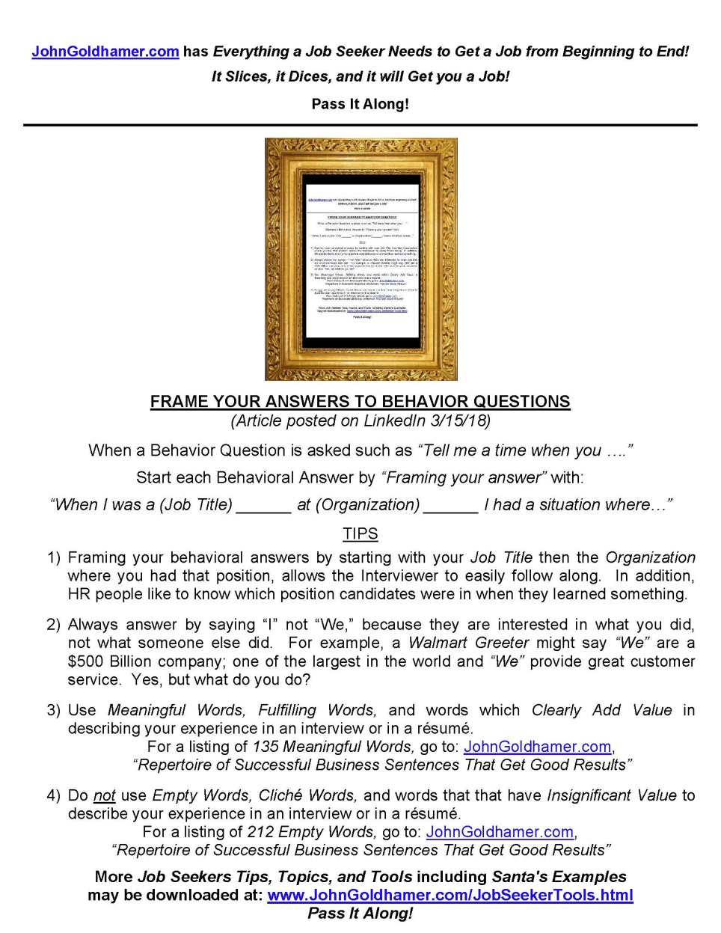
JOB SEEKER TIPS, TOPICS, AND TOOLS – NAVIGATING
Writings

Slide 47
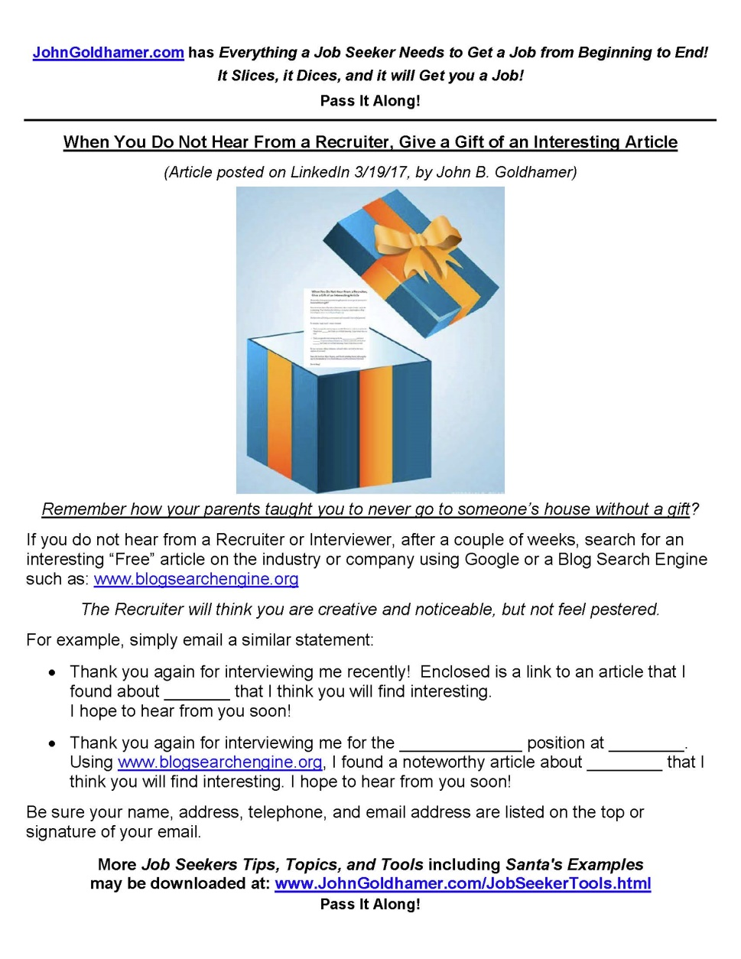
JOB SEEKER TIPS, TOPICS, AND TOOLS – NAVIGATING
Writings

Slide 48
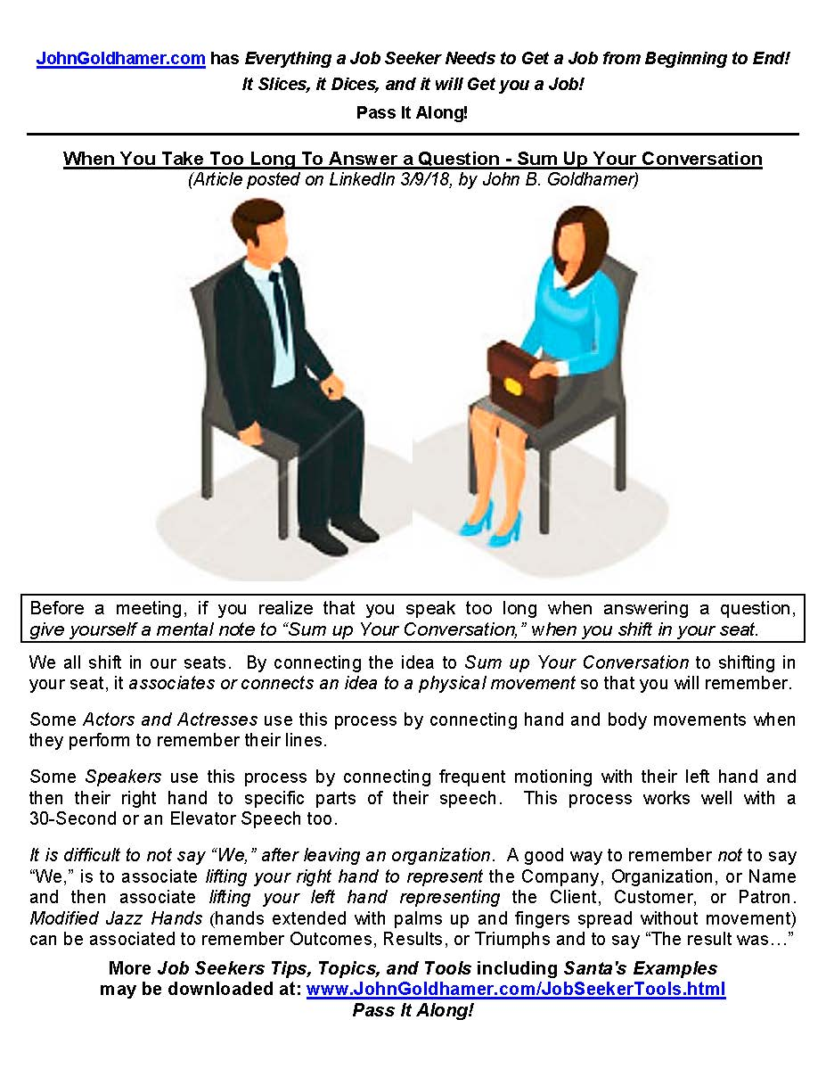
JOB SEEKER TIPS, TOPICS, AND TOOLS – NAVIGATING
Writings

Slide 49
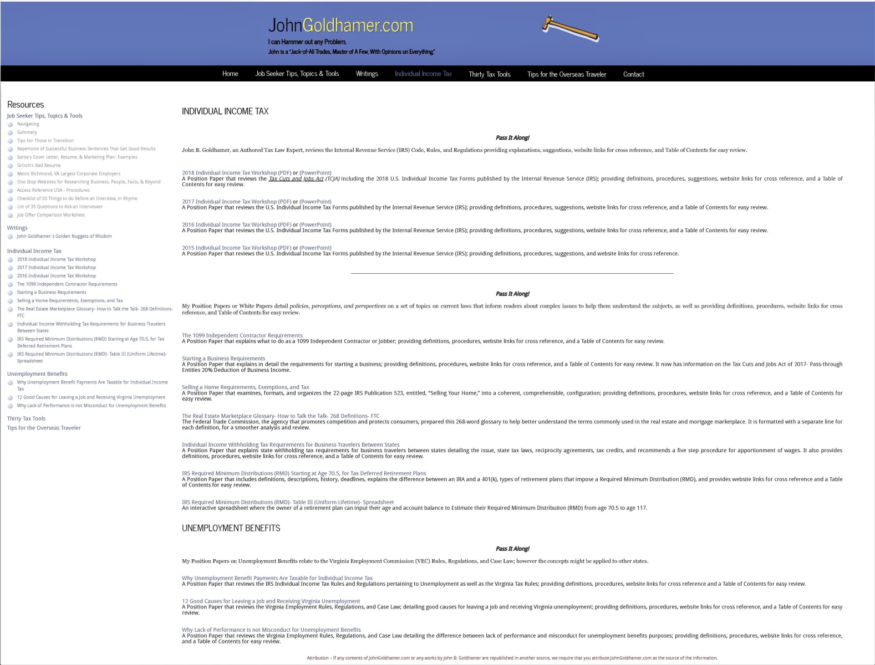
JOB SEEKER TIPS, TOPICS, AND TOOLS – NAVIGATING
Individual Income Tax & Unemployment Benefits

Slide 50
JOB SEEKER TIPS, TOPICS, AND TOOLS – NAVIGATING
Individual Income Tax

Slide 51
JOB SEEKER TIPS, TOPICS, AND TOOLS – NAVIGATING
Individual Income Tax
Pass It Along!
John B. Goldhamer, an Authored Tax Law Expert, reviews the Internal Revenue Service (IRS) Code, Rules, and Regulations providing explanations, suggestions, website links for cross reference, and Table of Contents for easy review.
2018 Individual Income Tax Workshop (PDF) or (PowerPoint)
A Position Paper that reviews the Tax Cuts and Jobs Act (TCJA) including the 2018 U.S. Individual Income Tax Forms published by the Internal Revenue Service (IRS); providing definitions, procedures, suggestions, website links for cross reference, and a Table of Contents for easy review.
2017 Individual Income Tax Workshop (PDF) or (PowerPoint) A Position Paper that reviews the U.S. Individual Income Tax Forms published by the Internal Revenue Service (IRS); providing definitions, procedures, suggestions, website links for cross reference, and a Table of Contents for easy review.
2016 Individual Income Tax Workshop (PDF) or (PowerPoint) A Position Paper that reviews the U.S. Individual Income Tax Forms published by the Internal Revenue Service (IRS); providing definitions, procedures, suggestions, website links for cross reference, and a Table of Contents for easy review.
The 1099 Independent Contractor Requirements
A Position Paper that that explains what to do as a 1099 Independent Contractor or Jobber; providing definitions, procedures, website links for cross reference, and a Table of Contents for easy review.
Starting a Business Requirements
A Position Paper that explains in detail the requirements for starting a business; providing definitions, procedures, website links for cross reference, and a Table of Contents for easy review.
Selling a Home Requirements, Exemptions, and Tax
A Position Paper that examines, formats, and organizes the 22-page IRS Publication 523, entitled, “Selling Your Home,” into a coherent, comprehensible, configuration; providing definitions, procedures, website links for cross reference, and a Table of Contents for easy review.
The Real Estate Marketplace Glossary- How to Talk the Talk- 268 Definitions- FTC
The Federal Trade Commission, the agency that promotes competition and protects consumers, prepared this 268-word glossary to help better understand the terms commonly used in the real estate and mortgage marketplace. It is formatted with a separate line for each definition, for a smoother analysis and review.
Individual Income Withholding Tax Requirements for Business Travelers Between States
A Position Paper that explains state withholding tax requirements for business travelers between states; detailing the issue, state tax laws, reciprocity agreements, tax credits, and recommends a five step procedure for apportionment of wages. It also provides definitions, procedures, website links for cross reference, and a Table of Contents for easy review.
IRS Required Minimum Distributions (RMD) Starting at Age 70.5, for Tax Deferred Retirement Plans A Position Paper that includes definitions, descriptions, history, deadlines, explains the difference between an IRA and a 401(k), types of retirement plans that impose a Required Minimum Distribution (RMD), and provides website links for cross reference and a Table of Contents for easy review.
IRS Required Minimum Distributions (RMD)- Table III (Uniform Lifetime)- Spreadsheet
An interactive spreadsheet where the owner of a retirement plan can input their age and account balance to Estimate their Required Minimum Distribution (RMD) from age 70.5 to age 117.

Slide 52
JOB SEEKER TIPS, TOPICS, AND TOOLS – NAVIGATING
Unemployment
Pass It Along!
John B. Goldhamer, an Authored Tax Law Expert, reviews the Internal Revenue Service (IRS) Code, Rules, and Regulations providing explanations, suggestions, and website links for cross reference.
Why Unemployment Benefit Payments Are Taxable for Individual Income Tax
A Position Paper that reviews the IRS Individual Income Tax Rules and Regulations pertaining to Unemployment as well as the Virginia Tax Rules; providing definitions, procedures, website links for cross reference and a Table of Contents for easy review.
12 Good Causes for Leaving a Job and Receiving Virginia Unemployment
A Position Paper that reviews the Virginia Employment Rules, Regulations, and Case Law; detailing good causes for leaving a job and receiving Virginia unemployment; providing definitions, procedures, website links for cross reference, and a Table of Contents for easy review.
Why Lack of Performance is not Misconduct for Unemployment Benefits
A Position Paper that reviews the Virginia Employment Rules, Regulations, and Case Law detailing the difference between lack of performance and misconduct for unemployment benefits purposes; providing definitions, procedures, website links for cross reference, and a Table of Contents for easy review.

Slide 53
JOB SEEKER TIPS, TOPICS, AND TOOLS – NAVIGATING
Conclusion
You are welcome to share my “Job Seeker Tips, Topics, and Tools” with others; as I freely distribute all my documents that I create.
Now my job of presenting ideas to you is done and yours is just beginning.
For each subject, you must decide if you want to follow my advice. I will not be offended, if you do something different, but at least you now have the details to make an informed decision.
I wish you the Best of Luck while you are in transition and for your future employment!
Remember, Scientists, Sales People, and Song Writers all agree:
The Sun Will Come Up Tomorrow!
Thank you. Are there any Questions?
John B. Goldhamer
www.JohnGoldhamer.com

